Slide 1
基础编程练习1——循环与判断(2)

Slide 2
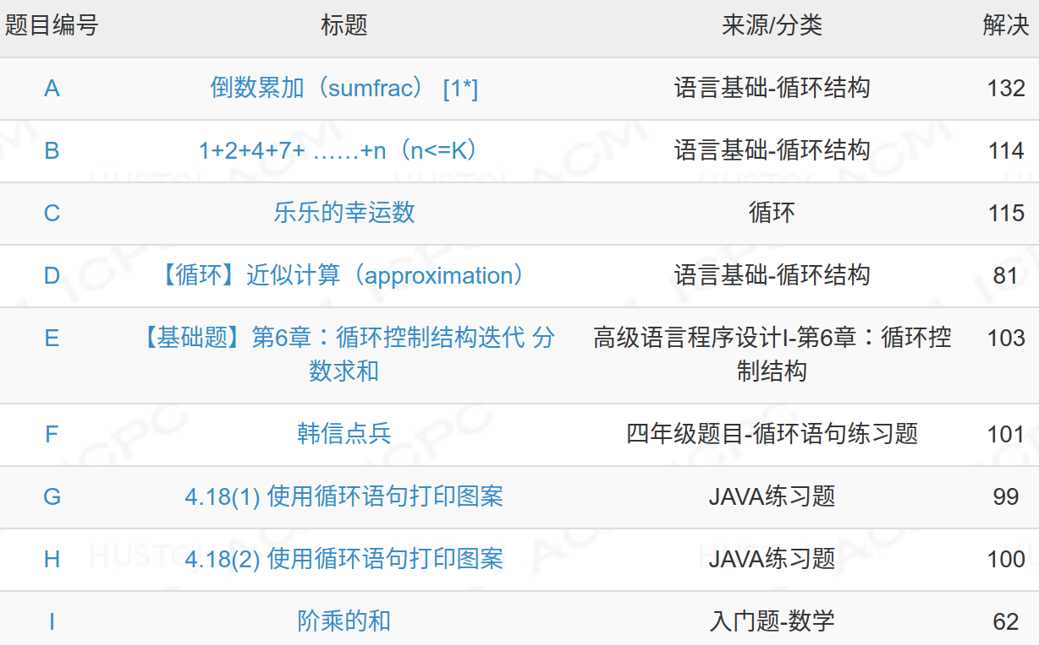

Slide 3

for循环+条件（if语句）
A.输入n,计算S=1-1/2+1/3-1/4+1/5-1/6+…… 1/n的值
n = int(input()) sum1 = 0 for i in range(1,n+1): if i % 2 != 0: sum1 += 1./i else: sum1 -= 1./i print(sum1)
sum1 = 0 for i in range(1,101): if i % 2 != 0: sum1 += 1./i else: sum1 -= 1./i print(sum1)

Slide 4
while循环
B. S=1+2+4+7+11……n
(n<=k)
求1+2+3+…+100和
k = int(input()) sum1 = 0 n = 1 i = 1 while n<= k: sum1 += n n += i i += 1 print(sum1)
k = int(input()) sum1 = 0 n = 1 i = 1 while n<= k: sum1 += n n += i i += 1 print(sum1)
sum1 = 0
i = 0
while i<101: i = i +1
sum1 += i

Slide 5
for循环+判断条件（if语句）
C: 乐乐的幸运数:6或8的倍数
求1~100之间，能被5整除，但不能被3整除的数
for i in range(1,101): if i % 5 ==0 and i % 3 != 0: print(i)
m,n = map(int,input().split()) count= 0 for i in range(m,n+1): if i % 6 == 0 or i % 8 == 0: count+= 1 print(count)

Slide 6
D: 依据π/4 = 1 - 1/3 + 1/5 - 1/7 +……计算π的值，
直到最后一项小于10⁻⁷
sum1 = 0 n = 1 i = 1 while 1/n >= 10 ** -7: if i % 2 != 0: sum1 += 1/n else: sum1 -= 1 / n n += 2 i += 1 print(round(4*sum1,6))
sum1 = 0 n = 1 while n <= 100: if n % 2 != 0: sum1 += 1/n else: sum1 -= 1 / n n += 1 print(sum1)

Slide 7

for循环
E: 求和 2/1+3/2+5/3+8/5+…
n = int(input()) sum1 = 0 a = 1 b = 2 for i in range(1,n+1): sum1 += b/a b = b + a a = b - a print(round(sum1,2))
sum1 = 0 for i in range(1,101): sum1 += 1./i print(sum1)
a, b = b, a + b

Slide 8
F: 韩信点兵:3,5,7的倍数类
《射雕英雄传》中，黄蓉见瑛姑时，出过一道题：今有物不知其数，三三数之剩二，五五数之剩三，七七数之剩二，问几何？
for i in range(1,101): if i % 3 == 2 and i % 5 == 3 and i % 7 == 2: print(i)
break
m,n,t = map(int,input().split()) for i in range(1,101): if i % 3 == m and i % 5 == n and i % 7 == t: print(i) break

Slide 9
双重循环
G. 上三角形状的图案
1 1 2 1 2 3 1 2 3 4 1 2 3 4 5 1 2 3 4 5 6
for i in range(1,10): for j in range(1, i + 1): print("{}".format(j), end= ' ') print()

Slide 10
双重循环
H. 正倒三角形状
6 5 4 3 2 1 5 4 3 2 1 4 3 2 1 3 2 1 2 1 1
for i in range(10, 0,-1): for j in range(i,0,-1): print("{}".format(j), end= ' ') print()

Slide 11
双重循环
打印乘法口诀表
for i in range(1,10):
for j in range(1,i+1):
print("{}*{}={}".format(i,j,i*j),end= ' ')
print()
1*1=1
2*1=2 2*2=4
3*1=3 3*2=6 3*3=9
4*1=4 4*2=8 4*3=12 4*4=16
5*1=5 5*2=10 5*3=15 5*4=20 5*5=25
6*1=6 6*2=12 6*3=18 6*4=24 6*5=30 6*6=36
7*1=7 7*2=14 7*3=21 7*4=28 7*5=35 7*6=42 7*7=49
8*1=8 8*2=16 8*3=24 8*4=32 8*5=40 8*6=48 8*7=56 8*8=64
9*1=9 9*2=18 9*3=27 9*4=36 9*5=45 9*6=54 9*7=63 9*8=72 9*9=81

Slide 12
I: 阶乘的和，如：9=1！+2！+3！
lst = [1, 1, 2, 6, 24, 120, 720, 5040, 40320, 362880] while True: n = int(input()) if (n < 0): break for i in range(9, -1, -1): if (n >= lst[i]): n -= lst[i] if (n == 0): print("YES") else: print("NO")
lst = [1] for i in range(1,10): tem = lst[i-1] * i lst.append(tem) print(lst)

Slide 13
The End

