Slide 1

POLYDIM & PMTP
Native Tensor Communication for Latent Multi-Agent Swarms

Slide 2
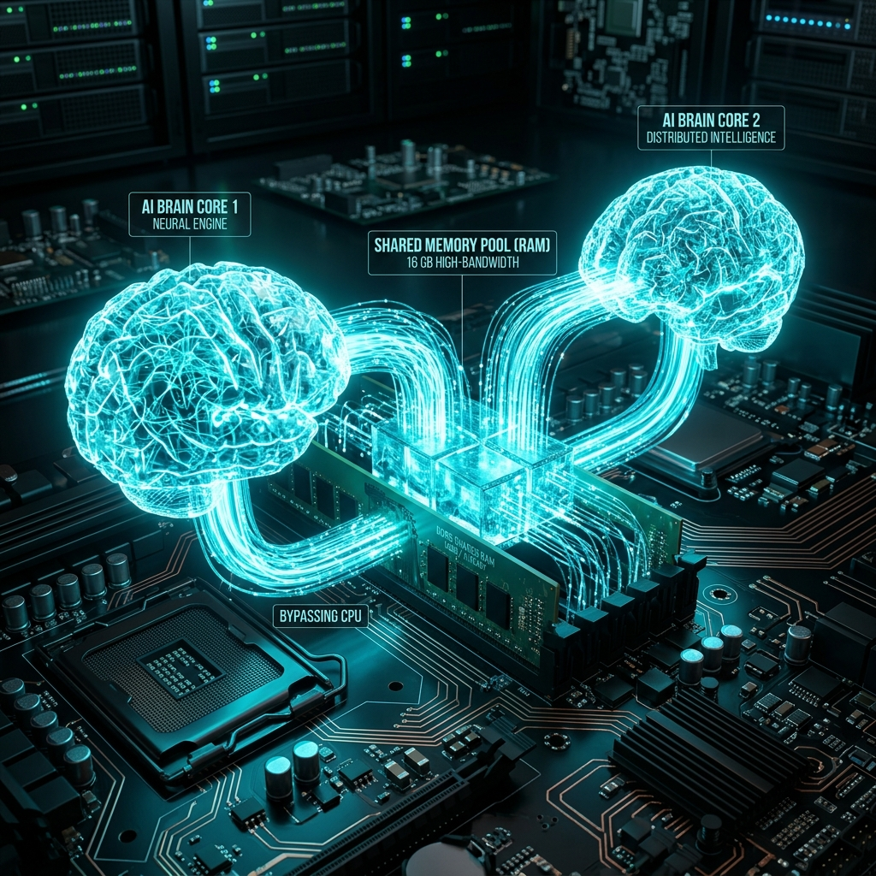
Phase 9: Local Zero-Copy IPC
• Proven on Local Hardware.
• Node A writes tensor to OS Shared RAM.
• Node B inherits context instantly.
• Bypasses CPU processing entirely.

Slide 3
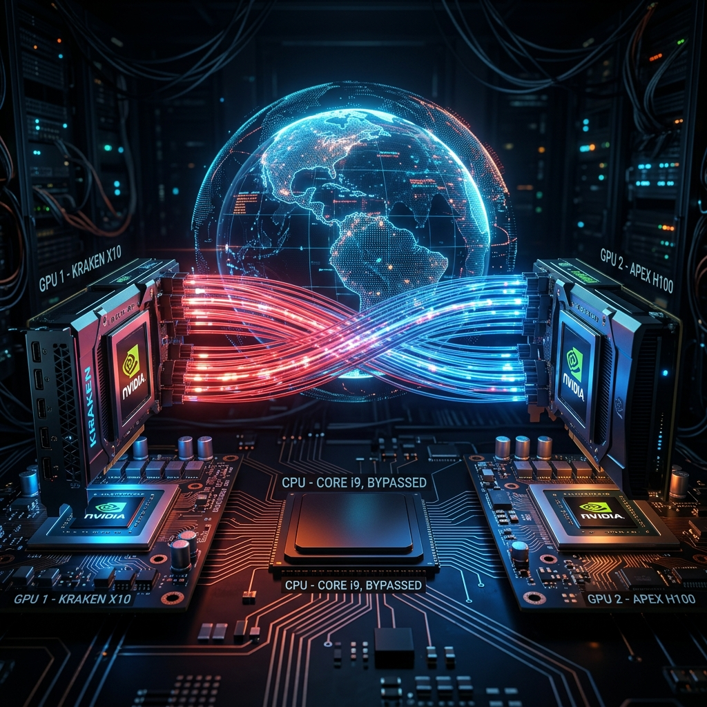
Phase 11: GPUDirect RDMA
• Connects GPU microchips across the globe.
• Tensor blasted across network (RoCEv2).
• Fiber optics bypass the CPU memory controller.
• Absolute zero latency.

Slide 4
The Economic & Hardware Impact
• 100% Internal Token Savings:
  Swarm agents generate ZERO text internally.
  Saves ~560 TFLOPS per 4k tokens exchanged.
• 40% - 60% Energy Reduction:
  Bypassing autoregressive decoding massively cools memory chips (HBM3).
• Hardware Decoupling:
  RDMA extends CPU lifespans by eradicating PCIe saturation.

