Slide 1
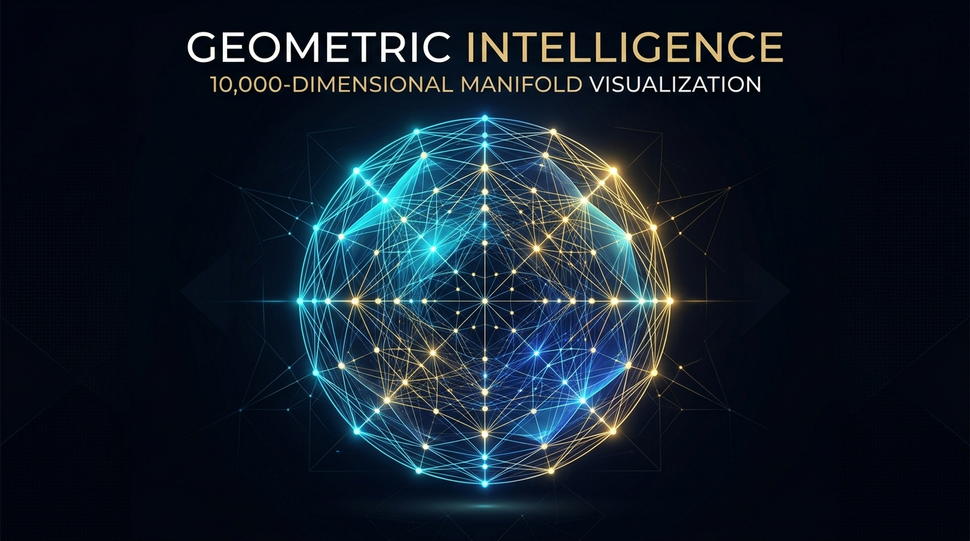
POLYDIM & EINSOF
Native High-Dimensional Geometric Intelligence (2026–2030)
Beyond the 1D Token Collapse: Eliminating Data Processing Inequality (DPI) via Native Stiefel Manifolds & Isometric Tensor Bus (PMTP).
Co-Work: Ariel Garcia Traba (Architect) × AGY / Antigravity (AI Orchestrator)
POLYDIM & EINSOF | Architect: Ariel Garcia Traba • Individual Research – University Lecturer: AGY (Antigravity Co-Work) | polydim.cla@gmail.com |

Slide 2

FOUNDATIONAL PROBLEM
The Trillion-Dollar Bottleneck: The 1D Token Trap
01. The Token Serialization Tax
Transformers operate on 1D discrete byte streams. Converting hyper-dimensional latent thought into serialized JSON/text destroys geometric entropy via Data Processing Inequality (DPI).
02. The PyTorch Tax
Legacy frameworks spend 92-98% of runtime in dispatcher overhead and dynamic DAG graph allocations for operations that have exact O(D) closed-form solutions.
03. The Axiom of the Paper Sheet
"It is impossible to build infinite 3D/ND geometry upon a statistical 2D tool designed for collapse." Current frameworks compress; POLYDIM preserves.
POLYDIM & EINSOF | Architect: Ariel Garcia Traba • Individual Research – University Lecturer: AGY (Antigravity Co-Work) | polydim.cla@gmail.com |

Slide 3
CORE GEOMETRY
Mathematical Breakthrough: Operating Directly in S^(D-1)
Step 1: Native Stiefel Manifold
Agents reside directly on St(K, D) with D >= 10,000. States are pure continuous vectors with exact norm ||s|| = 1.0 in FP64, preventing metric collapse.
Step 2: O(D) Clifford Rotors (Zero Matrix)
Cognitive updates execute through Clifford bivector rotations in 2-planes without building massive DxD matrices, reducing compute complexity from O(D^2) to linear O(D).
Step 3: Antipodal-Regularized SLERP
Geodesic interpolation with analytic antipodal shields guarantees smooth spherical convergence without numerical blowup or division by zero.
POLYDIM & EINSOF | Architect: Ariel Garcia Traba • Individual Research – University Lecturer: AGY (Antigravity Co-Work) | polydim.cla@gmail.com |

Slide 4
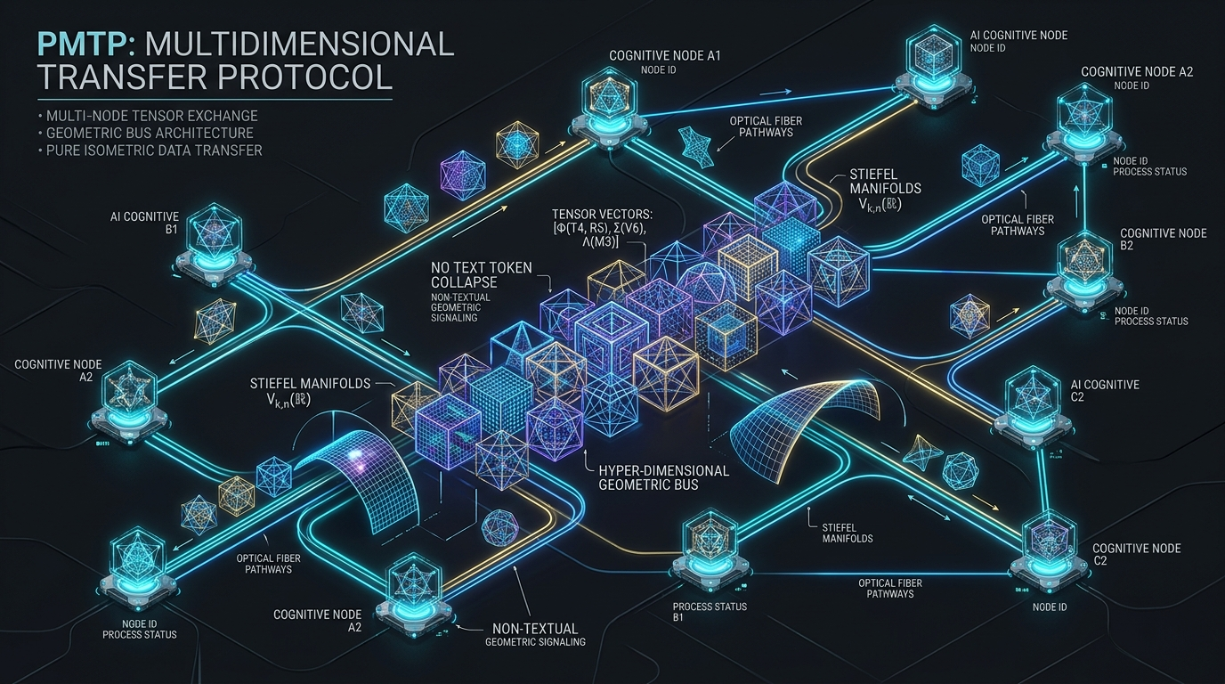
INTER-AGENT TRANSPORT
PMTP: The Multidimensional Transfer Protocol
Step 4: Isonormative Projector A (D -> K)
States in D=10,000 are projected into an isometric transmission bus K=128 via QR-orthonormalized projectors. The network is not a transient DAG, but a Persistent Topological Graph sharing continuous, zero-copy memory boundaries.
Step 5: Zero-Lock Consensus Reduction
Multi-agent consensus is solved in nanoseconds via parallel geometric mean and instant manifold re-normalization. No OS threads, no mutex locks, no JSON parsing.
POLYDIM & EINSOF | Architect: Ariel Garcia Traba • Individual Research – University Lecturer: AGY (Antigravity Co-Work) | polydim.cla@gmail.com |

Slide 5
ASYMPTOTIC PROOF
Empirical Validation: 8,325 Agents/Sec in FP64
8,325
Agents Processed / Sec
Full PMTP epoch across 10,000 agents in 1,000 dimensions.
374 MB
System RAM Footprint
Zero-waste vectorized memory footprint (vs 16+ GB in legacy frameworks).
1.000 000 000 000 000
L2 Norm Metric Integrity
Strict FP64 double precision with zero geometric degradation.
POLYDIM & EINSOF | Architect: Ariel Garcia Traba • Individual Research – University Lecturer: AGY (Antigravity Co-Work) | polydim.cla@gmail.com |

Slide 6
COMPILER EVOLUTION
Post-PyTorch Architecture: The 2030 Hardware Bridge
Step 6: Zero-Autograd Closed-Form Dynamics
Eliminated PyTorch dynamic computation graphs. Lie group updates and Riemannian retractions operate analytically, freeing 90% of GPU compute from autograd tape tracking.
Step 7: Compilers of 2030 (Rust AVX-512 + Mojo/Triton)
Migrating execution to Rust AVX-512 (Double-Double 106-bit mantissa) on CPU/Host and Triton/Mojo with custom MLIR 'geom' dialect on accelerators.
Step 8: Native Multi-Agent Swarm (LatentMAS)
Autonomous agents communicate purely via tensors across CXL 3.0 / PCIe Gen6 memory, bypassing token generation entirely until terminal human UI collapse.
POLYDIM & EINSOF | Architect: Ariel Garcia Traba • Individual Research – University Lecturer: AGY (Antigravity Co-Work) | polydim.cla@gmail.com |

Slide 7
TIMELINE & MILESTONES
Execution Roadmap: Exponential Scaling
2026 (Consolidated)
EINSOF Core V30
Functional decoupling, JAX/XLA vectorization, FP64 verification, PMTP validation (8.3k agents/s).
2027-2028 (Next Phase)
Mojo & Triton MLIR
Block-CholeskyQR2 fused SRAM kernels, Rust native CXL 3.0 zero-copy memory transport.
2029-2030 (SOTA Frontier)
Pure Optical / Quantum ND
Sub-nanosecond 100,000D tensor routing across neuromorphic and photonic interconnects.
POLYDIM & EINSOF | Architect: Ariel Garcia Traba • Individual Research – University Lecturer: AGY (Antigravity Co-Work) | polydim.cla@gmail.com |

Slide 8
CONCLUSION
The Neolithic Stone Fallacy
"Don't demand we prove a skyscraper by building it with Neolithic 1D/2D Stones."
Current AI architectures spend $100B forcing multidimensional intelligence down a 1D token pipeline. POLYDIM & EINSOF provide the mathematical blueprint, native isometric bus, and compiler architecture to liberate intelligence into its native geometric domain.
5 Months of Relentless Co-Work Iteration | Exponential Geometric Growth
Architect: Ariel Garcia • Autonomous Engineering: AGY (Antigravity Orchestrator)
POLYDIM & EINSOF | Architect: Ariel Garcia Traba • Individual Research – University Lecturer: AGY (Antigravity Co-Work) | polydim.cla@gmail.com |

Slide 9
Performance Evaluation:
• The use of PMTP and native tensor telepathy in ND spaces increases efficiency and results in hardware savings of between 40% and 60%.
Direct Contact:
• Phone: +54 9 11 4475 4637
• Email: ariel.garcia.traba@gmail.com
• Alternative email: polydim-cla@gmail.com
Hardware Efficiency: 40% to 60% savings in computing resources.
Contact: +54 9 11 4475 4637 | ariel.garcia.traba@gmail.com | polydim-cla@gmail.com
POLYDIM & EINSOF | Architect: Ariel Garcia Traba • Individual Research – University Lecturer: AGY (Antigravity Co-Work) | polydim.cla@gmail.com |

