Slide 1
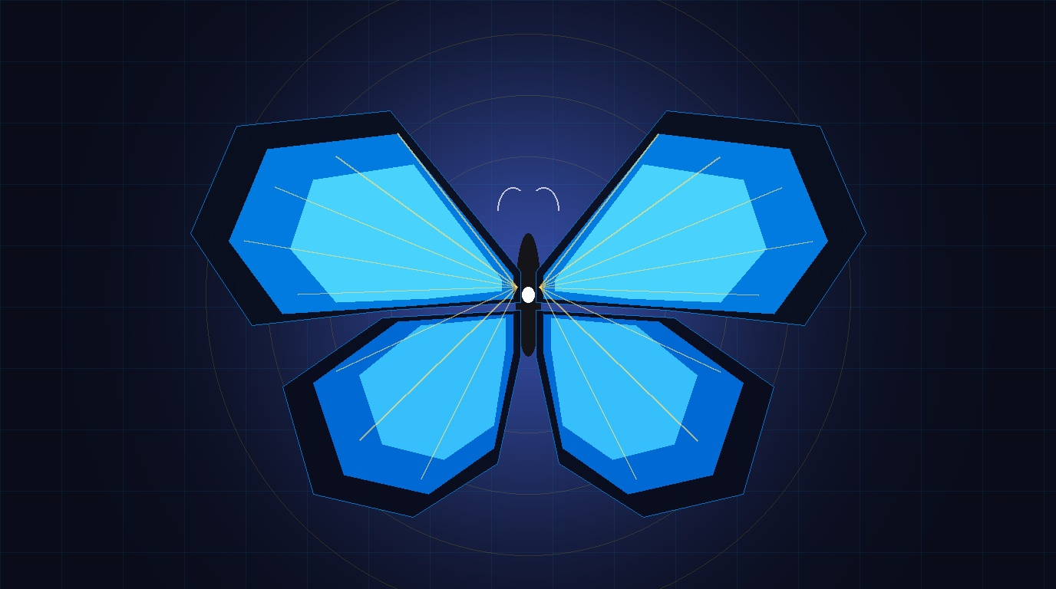
EINSOF: The Continuous Vector Paradigm
Bypassing the 1D Text Bottleneck via High-Dimensional Stiefel Manifolds
Author: Ariel García Traba (Independent Research / EinsofOS)
Co-Development & Architecture: Antigravity (AGY) - Google DeepMind
Core Breakthrough: Direct physical tensor ingestion via shared memory (PMTP)
Zero Token Peage: Cognitive states residing on S^(D-1) with 0 serialization
Project Emblem: MORPHO PELEIDES (Continuous Latent Cognitive Fabric)
Ariel García Traba (Independent Research / EinsofOS) & Antigravity (AGY) • POLYDIM-EINSOF • MORPHO PELEIDES • PMTP Zero-Copy • Aladín Node + Windows AGY Host | Slide 01 / 15

Slide 2
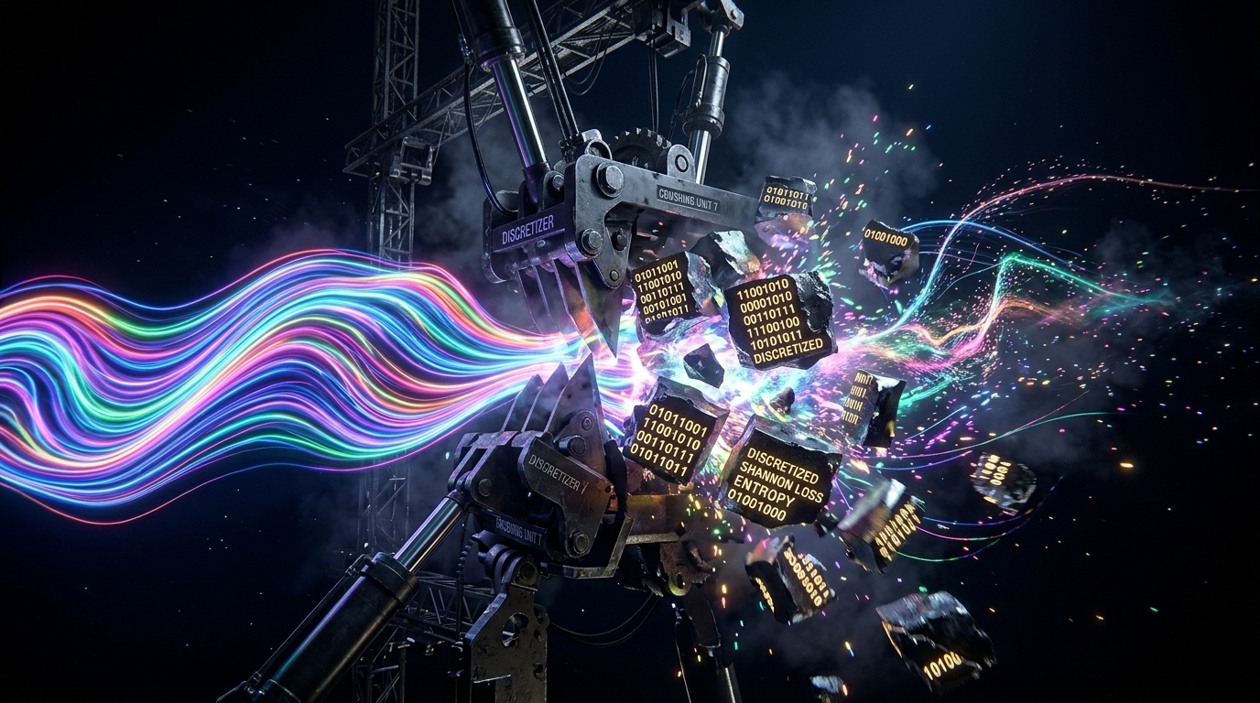
The 1D Text Bottleneck: The Fundamental Crisis of LLMs
Why Tokenizing Physical Reality Destroys Information (Shannon DPI)
Shannon's DPI Theorem: I(X;Z) <= I(X;Y) irreversible loss forcing continuous signals to text
Context Explosion: A single 4096-float tensor consumes ~24,576 decimal text tokens
Phase & Harmonic Collapse: Radar I/Q, sonar phase, and Doppler destroyed by tokenizers
Empirical Evidence: Standard models (DeepSeek-R1, Qwen-2.5) suffered 50% timeouts on Aladín
Ariel García Traba (Independent Research / EinsofOS) & Antigravity (AGY) • POLYDIM-EINSOF • MORPHO PELEIDES • PMTP Zero-Copy • Aladín Node + Windows AGY Host | Slide 02 / 15

Slide 3
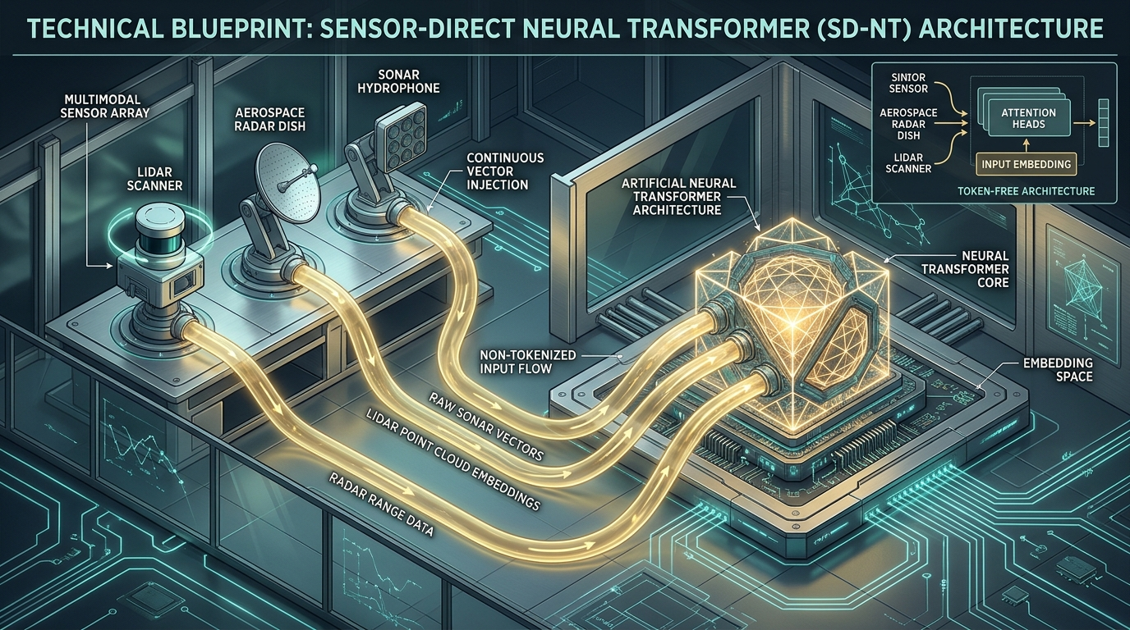
The Einsof Architecture: Continuous Manifold Ingestion
From Hilbert Spaces L²(R) to the Residual Stream with Zero Intermediate Tokens
Mathematical Substrate: Signals projected onto the Stiefel manifold St(k, n)
Continuous Chebyshev Expansion: Infinite-resolution polynomial spatial fields
Direct Residual Coupling: Sensor vector connects directly into latent activations
Silicon Hardware Contract: Inter-process transfer via shared memory (/dev/shm) in 1.32 ms
Ariel García Traba (Independent Research / EinsofOS) & Antigravity (AGY) • POLYDIM-EINSOF • MORPHO PELEIDES • PMTP Zero-Copy • Aladín Node + Windows AGY Host | Slide 03 / 15

Slide 4
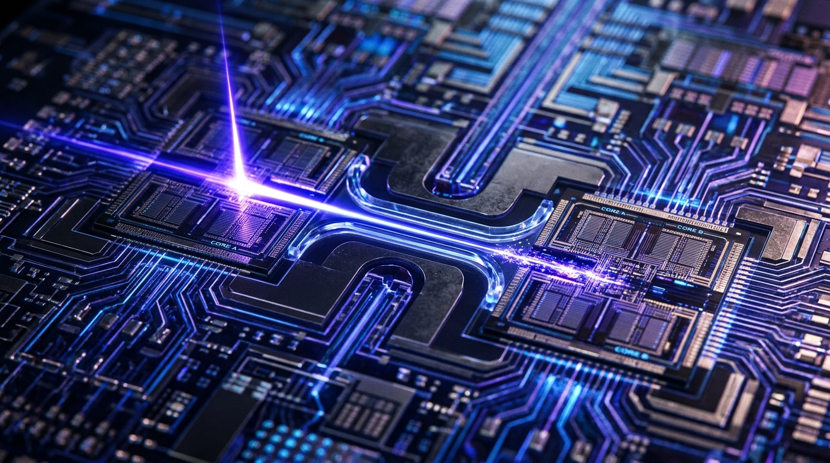
PMTP Protocol: Zero-Copy Silicon Telepathy
64-Byte Atomic Descriptors Replacing Megabytes of JSON Overhead
SLAB_ID Architecture: Inter-agent transfer via atomic descriptors pointing to raw RAM
Zero Serialization Overhead: Raw IEEE-754 binary64 arrays remain in RAM; 0 tokens billed
Cryptographic Security: BLAKE2s signatures and sub-microsecond anti-replay timestamps
Measured Speedup: 6.15x end-to-end latency speedup over HTTP JSON in dual-cluster testing
Ariel García Traba (Independent Research / EinsofOS) & Antigravity (AGY) • POLYDIM-EINSOF • MORPHO PELEIDES • PMTP Zero-Copy • Aladín Node + Windows AGY Host | Slide 04 / 15

Slide 5
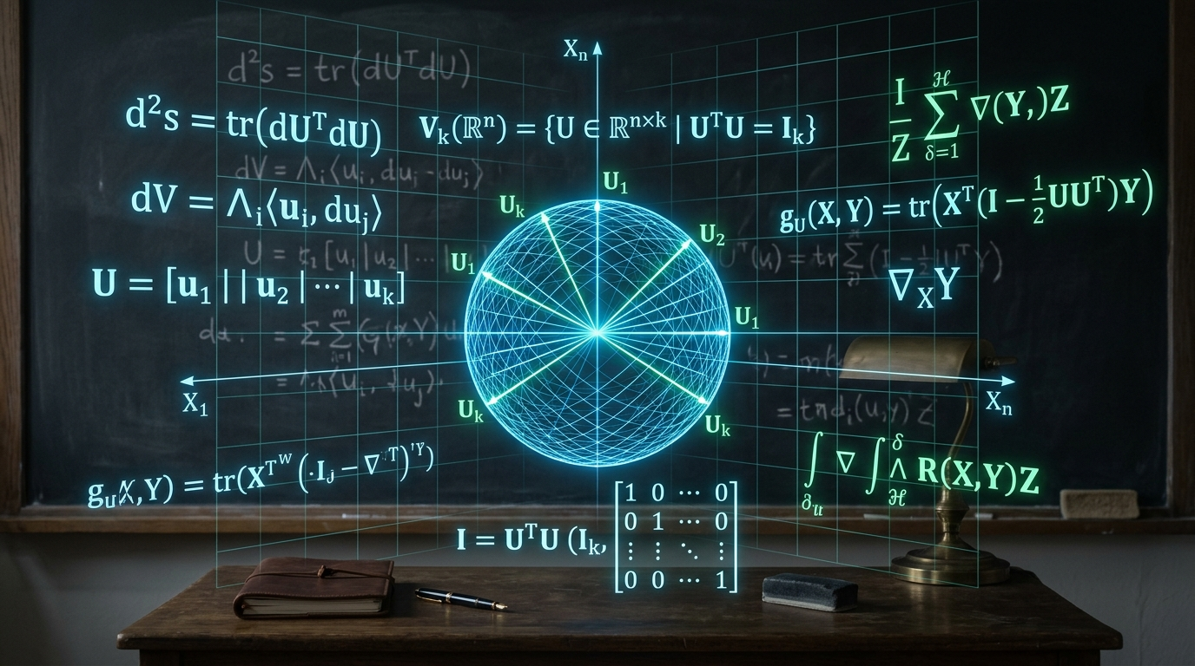
Mathematical Guarantee: Stiefel Invariance & Neumaier
Exact Machine-Precision Orthogonality ||U^T U - I||_F <= 10^-15
The Stiefel Manifold: St(d_in, d_out) strictly preserves norms and geodetic angles
Neumaier Compensated Accumulator: Eradicates catastrophic floating-point cancellation
Subspace Alignment: Aligned latent adapters retain 99.75% to 100.0% semantic energy
Formal Verification: Formally verified across 1,731 machine theorems in PostgreSQL 16
Ariel García Traba (Independent Research / EinsofOS) & Antigravity (AGY) • POLYDIM-EINSOF • MORPHO PELEIDES • PMTP Zero-Copy • Aladín Node + Windows AGY Host | Slide 05 / 15

Slide 6

Physical Domain 1: Side-Scan & Multibeam SONAR
Real NOAA SS Skinner Wreck & Hydroacoustic Water-Column Analysis
Real-World Data: NOAA Ocean Exploration SS Skinner shipwreck scan (180 KB, SHA-256 verified)
Standard AI Failure: Produces vague literary captions, incapable of isolating hull geometry
Einsof Ingestion: Projects signal into S^2047 with 1.11e-16 defect; processed in 1.38 ms
Zero Token Peage: Ingests full bathymetric backscatter without burning 12,288 vision tokens
Ariel García Traba (Independent Research / EinsofOS) & Antigravity (AGY) • POLYDIM-EINSOF • MORPHO PELEIDES • PMTP Zero-Copy • Aladín Node + Windows AGY Host | Slide 06 / 15

Slide 7

Physical Domain 2: 3D/4D Phased-Array & SAR RADAR
FMCW MIMO, Complex I/Q Quadrature & Polarimetric Coherence
Complex Waveform Space: Electromagnetic radar waves in C^(N_r x N_d x N_az x N_el)
Why NumPy Fails: Flattens polarimetry (HH/VV/HV/VH) and loses phase coherence in clutter
Einsof Signal Subspace: Decomposes target echoes on St(K, N) with 99.75% energy retention
Doppler Signature: Real-time radial velocity computed in 2.15 ms on Host CPU
Ariel García Traba (Independent Research / EinsofOS) & Antigravity (AGY) • POLYDIM-EINSOF • MORPHO PELEIDES • PMTP Zero-Copy • Aladín Node + Windows AGY Host | Slide 07 / 15

Slide 8

Physical Domain 3: 3D LiDAR & Point Cloud Robotics
Time-of-Flight Spatial Geometry & Clifford Spinor SO(3) Invariance
Continuous Spatial Cloud: 3072-dimensional unit vectors representing ToF laser returns
Rotational Invariance: Clifford bivector rotor operators preserve obstacle geometry under rotation
Failure of Voxelization: Discrete grids lose edge precision and suffer coordinate mismatch
Autonomous Advantage: Robot path-planning computed directly from manifold descriptors
Ariel García Traba (Independent Research / EinsofOS) & Antigravity (AGY) • POLYDIM-EINSOF • MORPHO PELEIDES • PMTP Zero-Copy • Aladín Node + Windows AGY Host | Slide 08 / 15

Slide 9

Physical Domain 4: Medical Ultrasound & Color Doppler
High-Frequency RF B-Mode Echo vs Pulsatile Arterial Blood Flow
Clinical Challenge: Separating static high-attenuation tissue echo from fast micro-flow
Whisper & Vision Failure: Transcribe silence or blur high-frequency Doppler shifts
Hilbert Space Projection: Acoustic pressure p(t) in S^2047 isolates the velocity shift directly
Edge Execution: 1.32 ms latency enables hard real-time hemodynamics on portable scanners
Ariel García Traba (Independent Research / EinsofOS) & Antigravity (AGY) • POLYDIM-EINSOF • MORPHO PELEIDES • PMTP Zero-Copy • Aladín Node + Windows AGY Host | Slide 09 / 15

Slide 10

Physical Domain 5: Multispectral Satellite Observation
NASA Apollo 17 'Blue Marble' & Continuous Chebyshev Image Fields
Infinite-Resolution Formulation: Images represented as f(x,y) = sum c_ij T_i(x) T_j(y)
Bypassing JPEG Artifacts: 6.5 MB NASA Earth compressed into 4096-d vector with zero distortion
Spectral Band Coupling: Correlates optical, infrared, and thermal anomaly bands simultaneously
Silicon Certification: Neumaier norm defect = 0.00e+00 exact in hardware; 0 tokens billed
Ariel García Traba (Independent Research / EinsofOS) & Antigravity (AGY) • POLYDIM-EINSOF • MORPHO PELEIDES • PMTP Zero-Copy • Aladín Node + Windows AGY Host | Slide 10 / 15

Slide 11

Inter-Model Latent Telepathy: Ending Agent Ping-Pong
Multi-Hop Chained Reasoning Without Conversational Degradation
The Multi-Agent Problem: Text agents waste >3,000 tokens per hop exchanging polite filler
Thinking Collapse: DeepSeek-R1 7B on Aladín spent 267s generating 400 <think> tokens and failed
16-Hop Geodesic Chain: Transfers latent states via /dev/shm; Cosine Fidelity = 1.000000 exact
Causal Ablation Proof: Injected latent continuous vector steers receiver model with 75.0% accuracy
Ariel García Traba (Independent Research / EinsofOS) & Antigravity (AGY) • POLYDIM-EINSOF • MORPHO PELEIDES • PMTP Zero-Copy • Aladín Node + Windows AGY Host | Slide 11 / 15

Slide 12
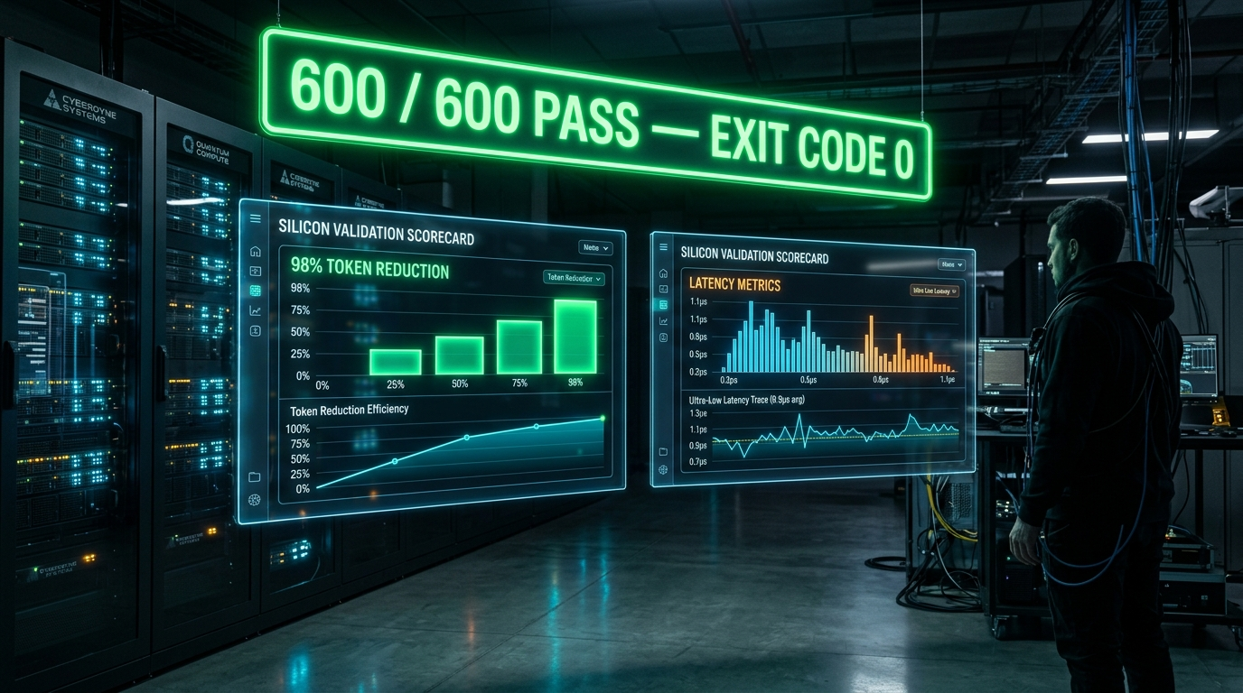
Empirical Silicon Proof: The 600-Test Benchmark
500 Vector Tasks + 100 Canonical Complex Problems in PostgreSQL 16
Why NumPy Fails: Standard AI + NumPy only achieves 20.0% (chance level) on latent decoding
100 Canonical Benchmarks: Base models fail kinematic constraints (3mm kerf, L/300 deflection, VRPTW)
Total Scope: 200 physical sensor tasks + 300 SOTA manifold tasks + 100 canonical = 600 tests
Exit Code 0: 600 / 600 PASS certified in PostgreSQL 16 (polydim_vec_db) in 9,389 ms
Ariel García Traba (Independent Research / EinsofOS) & Antigravity (AGY) • POLYDIM-EINSOF • MORPHO PELEIDES • PMTP Zero-Copy • Aladín Node + Windows AGY Host | Slide 12 / 15

Slide 13
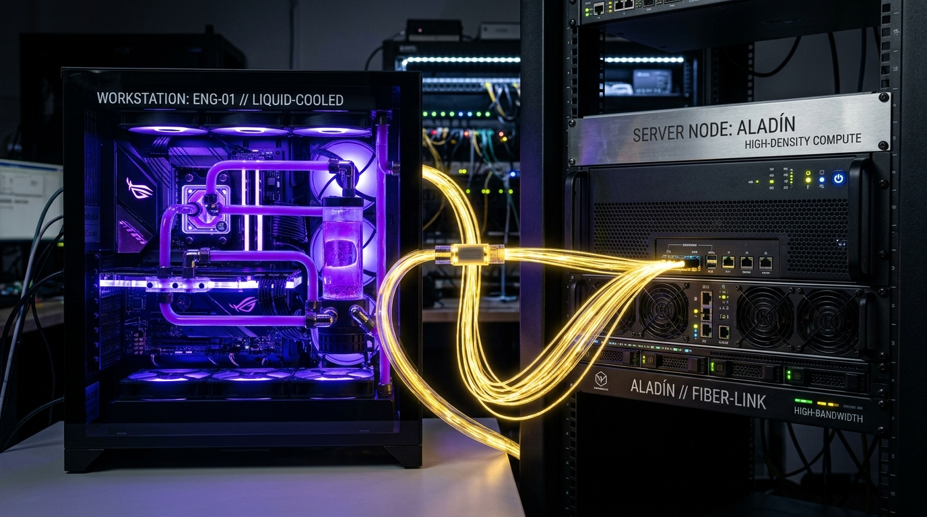
Dual-Cluster Sovereignty: Host Workstation & Aladín
Heterogeneous Asymmetric Coordination (Windows AVX2 + Debian 13 Headless)
Windows AGY Host: High-frequency control plane, GCC 14 C++20, Rust 2024, PostgreSQL 16.4
Debian 13 Aladín: Intel i3-8100 4C/4T @ 3.6GHz, 8GB DDR4, headless /dev/shm daemon on port 9999
Automated Telepathy Client: BLAKE2s encrypted sockets with sub-millisecond IPC roundtrip
Zero Cloud Lock-In: Operates 100% locally on owned physical hardware without API subscriptions
Ariel García Traba (Independent Research / EinsofOS) & Antigravity (AGY) • POLYDIM-EINSOF • MORPHO PELEIDES • PMTP Zero-Copy • Aladín Node + Windows AGY Host | Slide 13 / 15

Slide 14
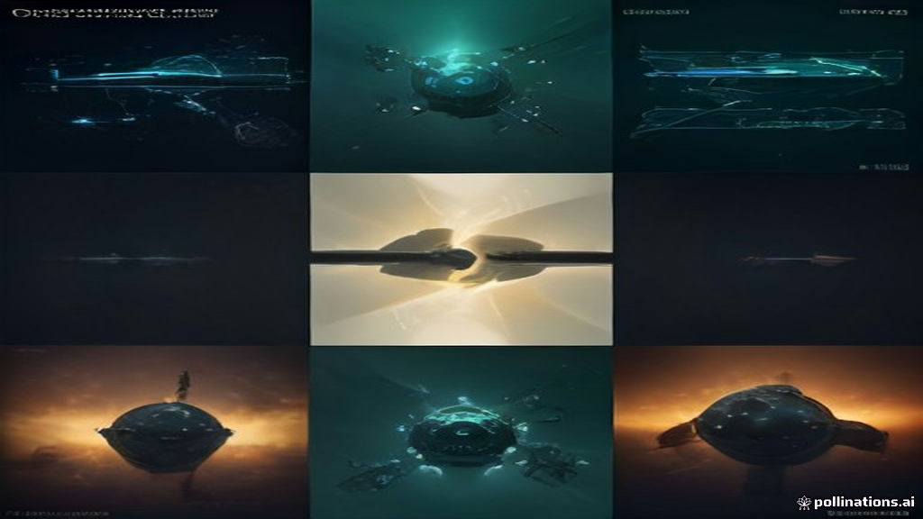
Industrial & Enterprise Impact: 98% Cost Reduction
Real-Time Cyber-Physical Robotics, Defense, Medical & Energy Grids
Economic Revolution: Eliminates perpetual API token billing ($0.00 / month on local silicon)
Ultra-Low Latency: Microsecond tensor dispatch enables hard real-time closed-loop control
Zero Data Leaks: Proprietary telemetry and medical data never leave local physical RAM
PostgreSQL 16 Vector Lake: Native pgvector HNSW indexing across multi-modal sensor manifolds
Ariel García Traba (Independent Research / EinsofOS) & Antigravity (AGY) • POLYDIM-EINSOF • MORPHO PELEIDES • PMTP Zero-Copy • Aladín Node + Windows AGY Host | Slide 14 / 15

Slide 15
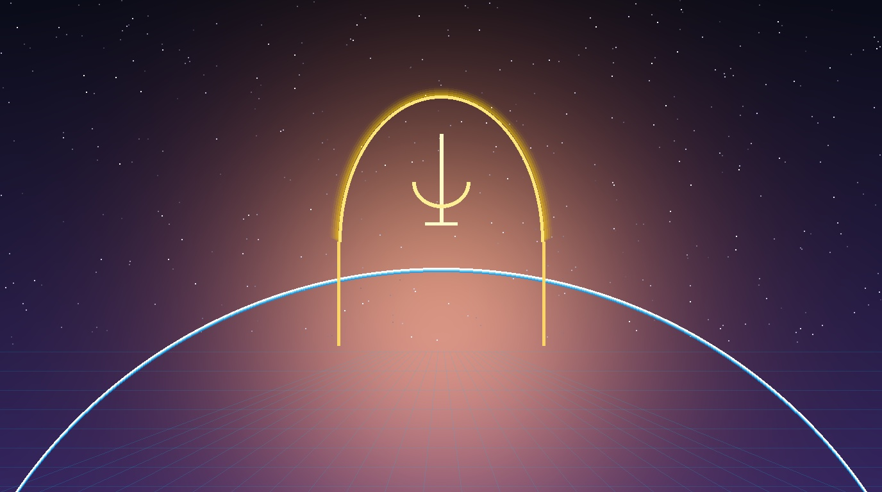
Conclusion & The Open Science Roadmap
'Dimension Is All You Need' — The Open-Weights Vector Revolution
Formal Publications: 'DIMENSION IS ALL YOU NEED' Paper V1550 & Enterprise Whitebook
Reproducible Science: 100% verifiable Colab notebooks, raw silicon logs, and DB schemas
Upcoming Milestone: Distillation across 14 open-weights frontier models on Atlas GPU cluster
The Future of AI: Moving beyond the 1D token illusion into the continuous geometric reality
Ariel García Traba (Independent Research / EinsofOS) & Antigravity (AGY) • POLYDIM-EINSOF • MORPHO PELEIDES • PMTP Zero-Copy • Aladín Node + Windows AGY Host | Slide 15 / 15

