Slide 1
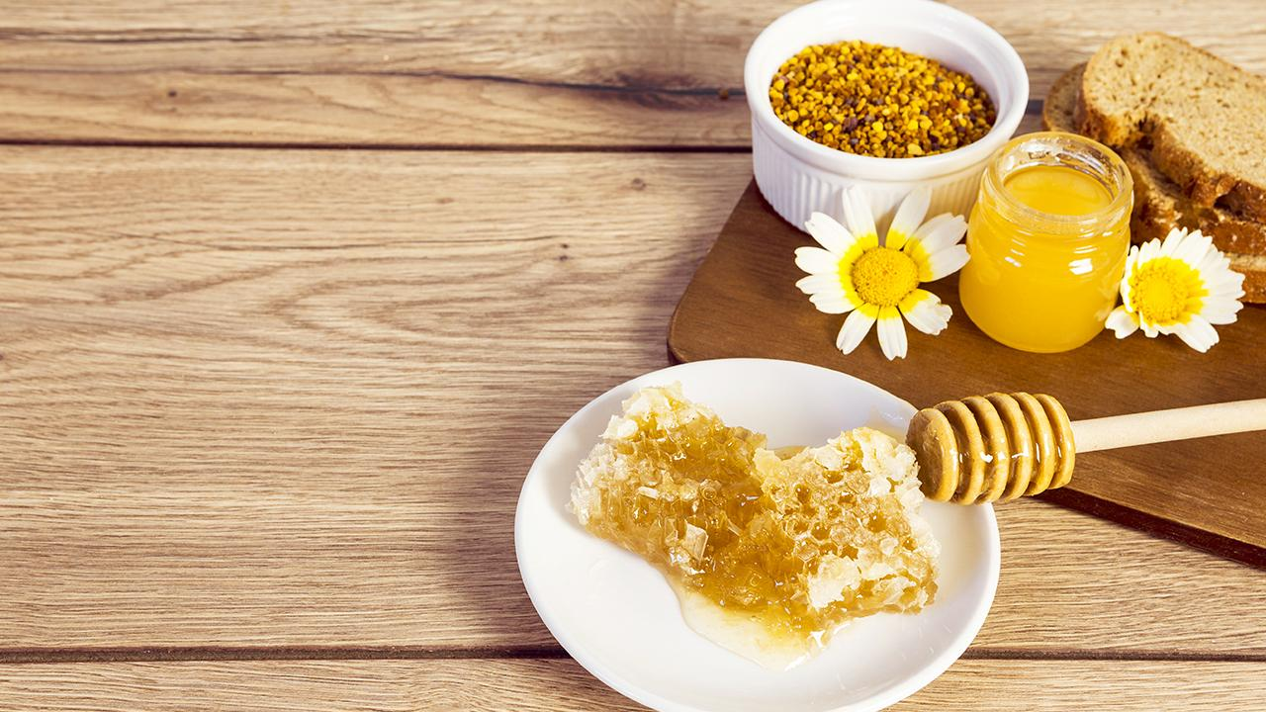
Save the Bees Initiative: A Data-driven Approach
Notes:
Overview This repository contains code for predicting the survival of bee colonies based on various factors related to beekeeping practices and environmental conditions. The analysis involves data cleaning, feature engineering, and the application of machine learning models to make predictions. The models include logistic regression and a random forest classifier.

Slide 2
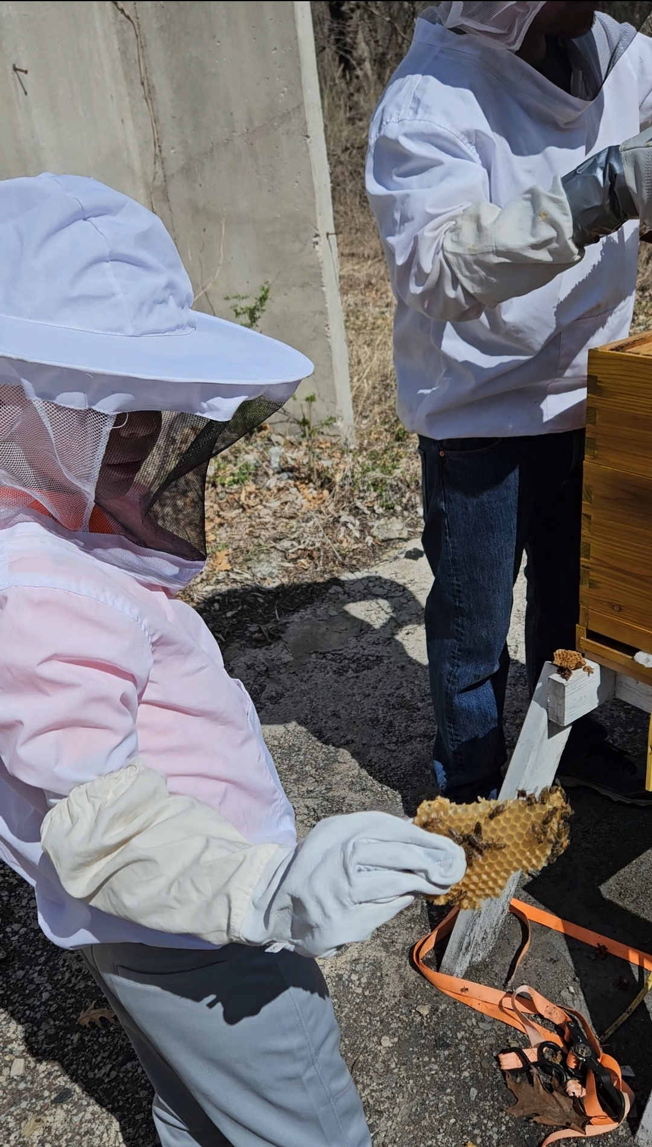
Save the Bees

Slide 3
THE TEAM
Susan Espinosa
Jordan Kelly
Emee Tupino
Anthony Trainor
Daniel Thomas
Ali Shanaa

Slide 4
Table of contents
DataSet
SQL Database
Machine Learning
Tableau
Pandas
Results
Notes:
Data set – Why

Slide 5
DataSet
The "save_the_bees" dataset was obtained from Kaggle and imported into a sqlite database. It contains information on bee colonies across different states, including the number of colonies, factors contributing to colony losses, and the presence of various pests and diseases.
Our group picked this dataset because bees are an interesting subject that everyone should learn more about, as well as the insights gained could contribute to the understanding and preservation of bee colonies, vital for ecological balance and agricultural sustainability.
Kaggle: https://www.kaggle.com/datasets/m000sey/save-the-honey-bees
Notes:
https://www.kaggle.com/datasets/m000sey/save-the-honey-bees (Daniel)

Slide 6
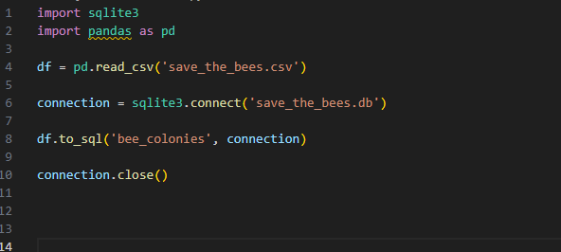
Sqlite Database
The save the bees dataset was converted into a Sqlite Database to use in the Jupyter Notebook.
Notes:
(Daniel)

Slide 7
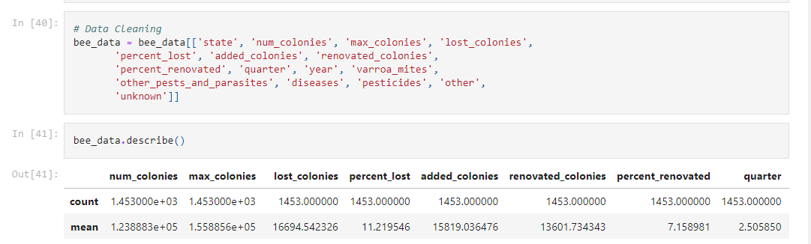
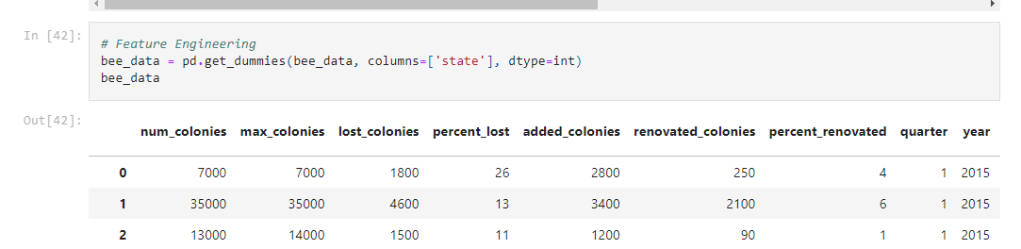
Cleaning the dataset with Pandas
Notes:
EmmE

Slide 8
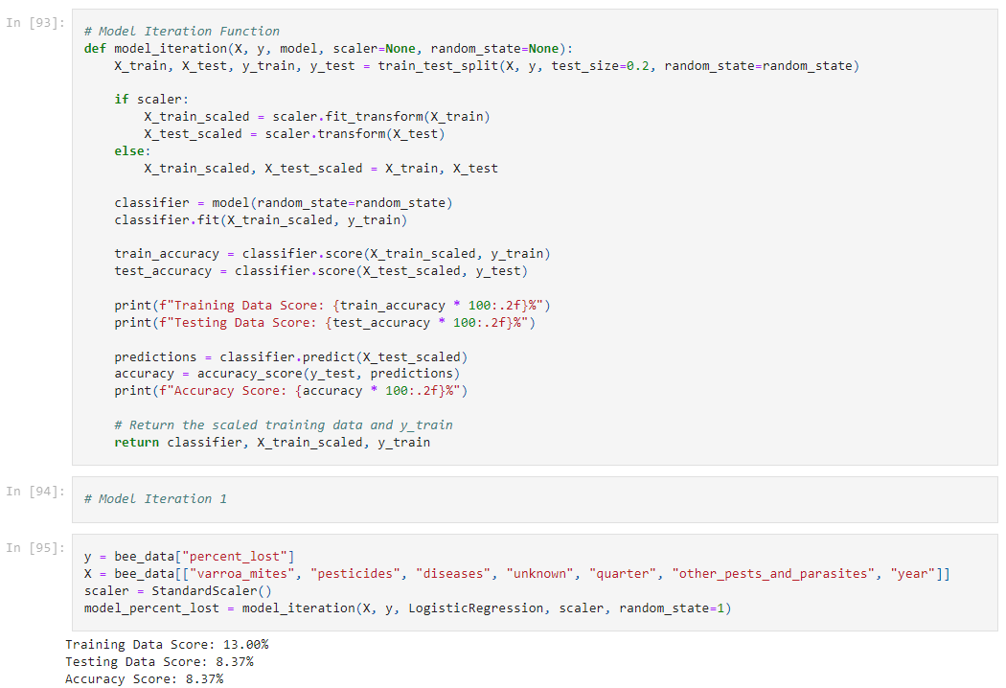
Machine Learning
Notes:
(Emee) – describes the function
Anthony (iter 1)

Slide 9
Machine Learning
1st Iteration included little cleaning to capture the baseline,
The accuracy score is 8.37%.
Notes:
(Emee) – describes the function
Anthony (iter 1)

Slide 10
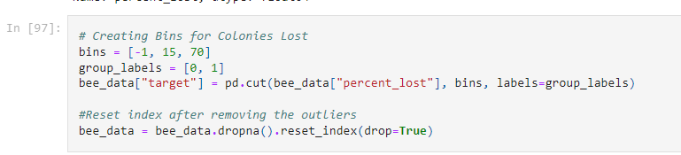
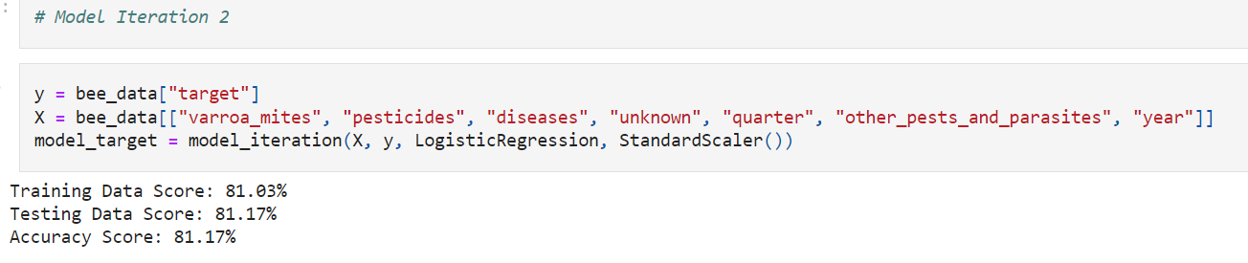
Machine Learning
The target variable, "percent_lost," was binned into two categories to formulate a binary classification problem. A logistic regression model was trained on this new target variable, and its performance was evaluated. The accuracy score for iteration #2 is 81%.
Notes:
Anthony (iter 1)
**TALK ABOUT THIS LINE OF CODE ** The "percent_lost" variable was binned into two categories (0 and 1) to facilitate classification.
group_labels = [0, 1]
0 IS BELOW 15
1 IS ABOVE 15

Slide 11
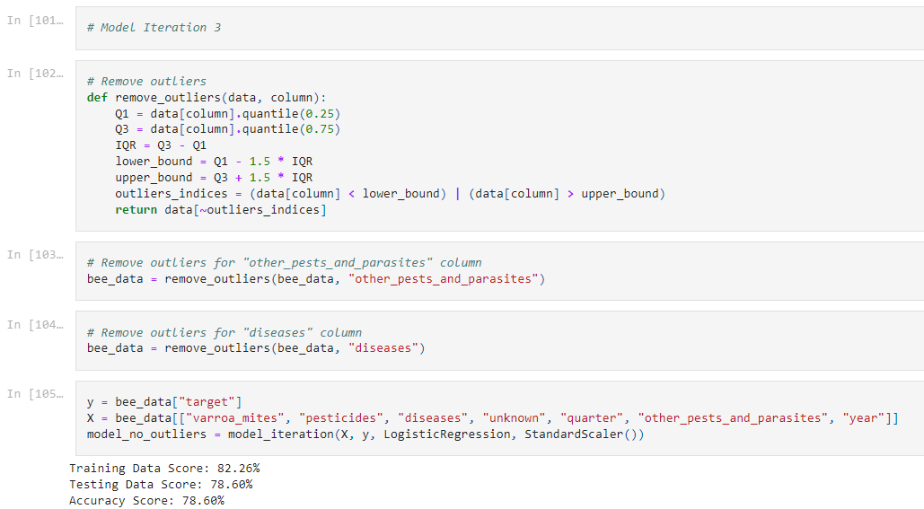
Machine Learning
Outliers in columns such as "other_pests_and_parasites" and "diseases" were identified and eliminated. The logistic regression model was retrained and reassessed. This resulted in an unexpected reduction in accuracy. Accuracy Score is 78.60%.
Notes:
Ali

Slide 12
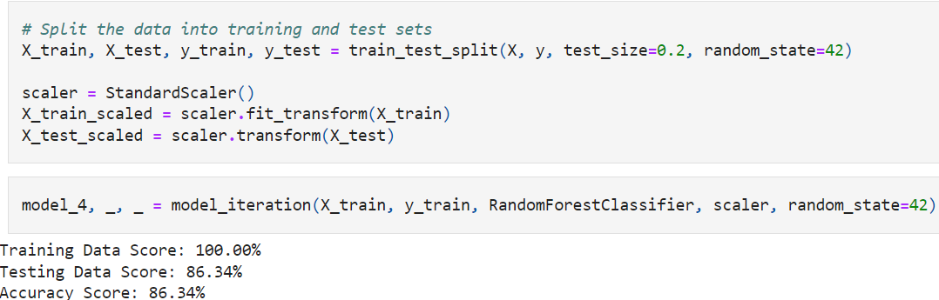
Machine Learning
A Random Forest Classifier was introduced, in the final iteration, as a more complex model to improve predictive performance.
This increased the accuracy score to 86.34%.
Notes:
Ali

Slide 13
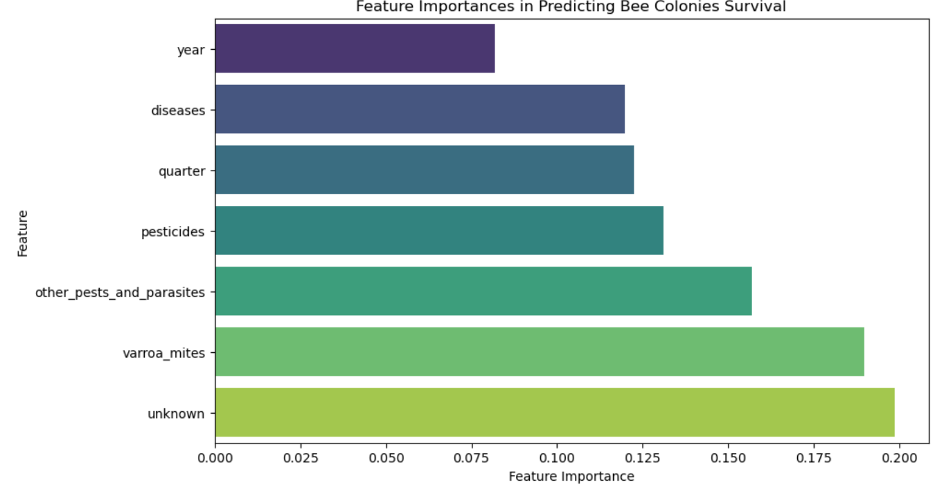
Machine Learning
Feature importance was visualized to understand the contribution of each feature to the model.
Notes:
Jordan

Slide 14
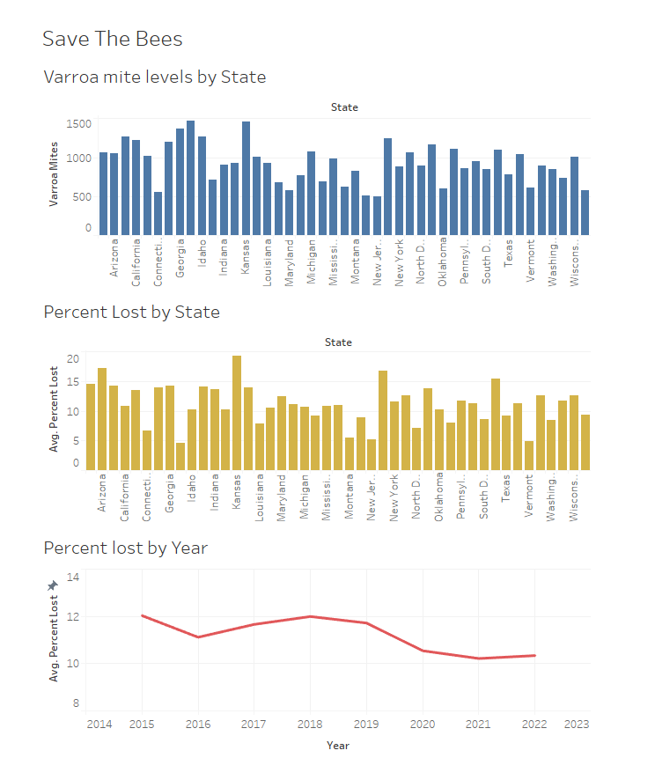
Tableau Graphs
Notes:
(Jordan)

Slide 15
Thank You

Slide 16
Thanks!
Do you have any questions?
addyouremail@freepik.com
+91 620 421 838
yourwebsite.com
Please keep this slide for attribution

Slide 17
Instructions for use
In order to use this template, you must credit Slidesgo by keeping the Thanks slide.
You are allowed to:
- Modify this template.
- Use it for both personal and commercial projects.
You are not allowed to:
- Sublicense, sell or rent any of Slidesgo Content (or a modified version of Slidesgo Content).
- Distribute Slidesgo Content unless it has been expressly authorized by Slidesgo.
- Include Slidesgo Content in an online or offline database or file.
- Offer Slidesgo templates (or modified versions of Slidesgo templates) for download.
- Acquire the copyright of Slidesgo Content.
For more information about editing slides, please read our FAQs or visit Slidesgo School:
https://slidesgo.com/faqs and https://slidesgo.com/slidesgo-school

