Slide 1
Spin Qubit Control using NV Centres in Diamond
Asier Galicia (5139481)
Nicholas Zutt (5005523)
Delft University of Technology

Slide 2

Outline
NV Centres and Carbons intro
Simulation with lindblad
Protection with spin echo
...

Slide 3
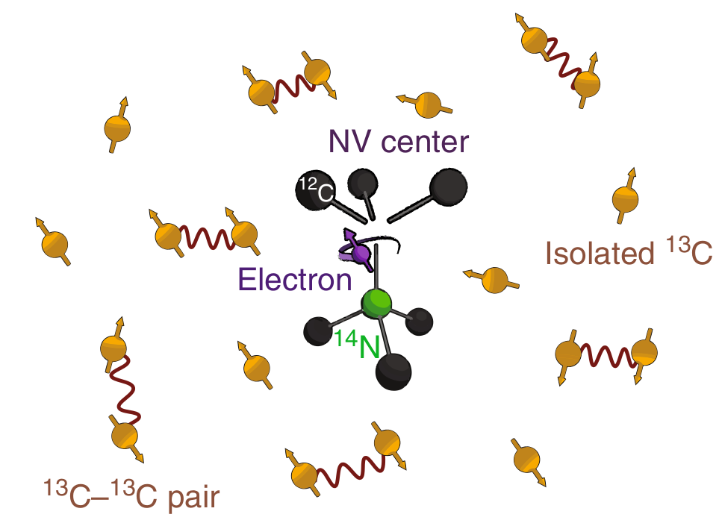
Nitrogen-Vacancy Centres
Outline what NV centres are
Storing quantum states in Carbon
Control with lasers
Decoherence through dephasing noise
NV = nodes, carbon = storage qubits, need long decoherence time -> quantum network

Slide 4
Lindblad simulation
Present lindblad equation
Integration method – runge kutta
Explain the collapse operator part to simulate noise

Slide 5
Present testing of Lindblad
Normal oscillation
Checking that everything works correctly

Slide 6
Spin Echo and Damped
Spin echo figure
Damped oscillation of projection plot from lindblad_solver
Protect NV centre coherence by implementing repeated spin echo protocol

Slide 7
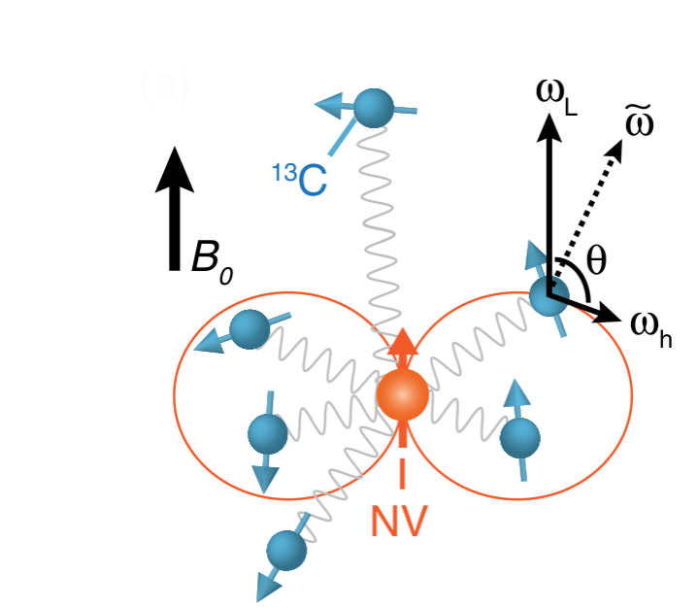
Dyn Decoupling
Explain what decoupling is
Previous error model insufficient, need to model dephasing as random bumps in precession frequency

Slide 8
New correlated error model
Plot of dw
Explain why DD will help protect
Cite Hanson paper

Slide 9
Protecting NV with decoupling
Show DD results for NV and compare to experimental plot

Slide 10
NV-Carbon Interaction
Explain interaction as conditional rotation about two different axes based on NV state
Show Hamiltonian for above

Slide 11
Explain dips in experimental plot of NV centre decoupling
Start in Iden for carbon and + for electron, dips manifest as interaction between them
Show decoupling plot without error model which coincides with theoretical prediction == great simulation! Good job 100%

Slide 12
Using NV-Carbon interaction to implement rotation of Carbons
Controlled rotation plot – choose tau corresponding with resonance, implement the right number of dynamical decoupling sequences
Show that this performs high fidelity pi rotations

Slide 13
DD on Carbon
Talk about how this differs from NV DD
Increased protection

Slide 14
Conclusion
NV centres can make your life complete. Just love them
Thank you for your attention

