Slide 1
Spin Qubit Control using NV Centres in Diamond
Asier Galicia (5139481)
Nicholas Zutt (5005523)
Delft University of Technology

Slide 2


Outline
NV Centres – defect centres in diamond which, along with surrounding , constitute promising platforms for effective qubits
Lindblad equation – simulating the system dynamics from the Hamiltonian with a convenient way of adding noise through collapse operators
Dynamical decoupling – implementing π-rotations at carefully chosen resonant frequencies can both drive Carbon atoms and protect NV and Carbons
Controlled rotation – possibility to implement π-rotations on Carbon atoms conditional on the NV centre spin state
Dephasing protection – even imperfect application of repeated π-rotations can extend the dephasing time of Carbon atoms

Slide 3
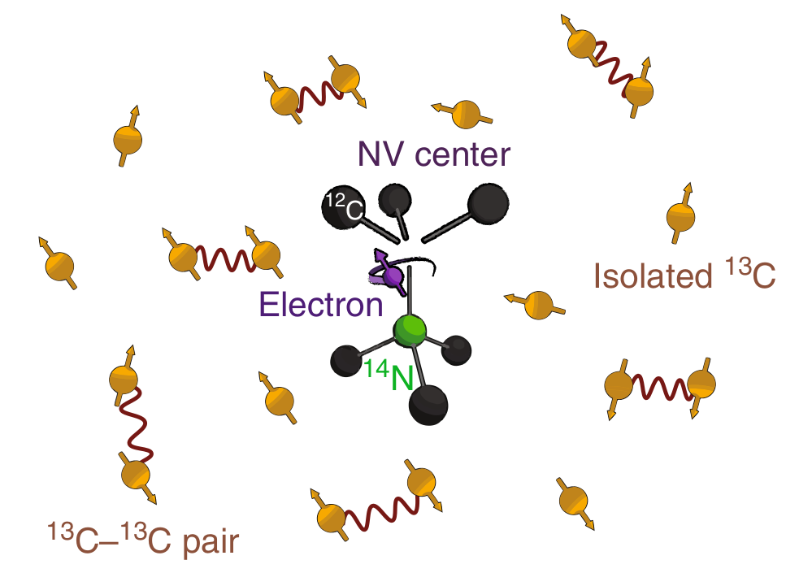
Nitrogen-Vacancy Centres
NV centres are spin-1 defects in the crystal structure of diamond
The spin states are controllable using lasers
Surrounding Carbon-13 atoms (spin-1/2) act as storage qubits
Main Challenge – mitigating decoherence through dephasing noise due to fluctuations in surround Carbon-13 spin bath¹
¹ van der Sar, T., Wang, Z., Blok, M. et al. Decoherence-protected quantum gates for a hybrid solid-state spin register. Nature 484, 82–86 (2012). https://doi.org/10.1038/nature10900

Slide 4
Lindblad simulation
Present lindblad equation
Integration method – runge kutta
Explain the collapse operator part to simulate noise

Slide 5
Present testing of Lindblad
Normal oscillation
Checking that everything works correctly

Slide 6
Spin Echo and Damped
Spin echo figure
Damped oscillation of projection plot from lindblad_solver
Protect NV centre coherence by implementing repeated spin echo protocol

Slide 7
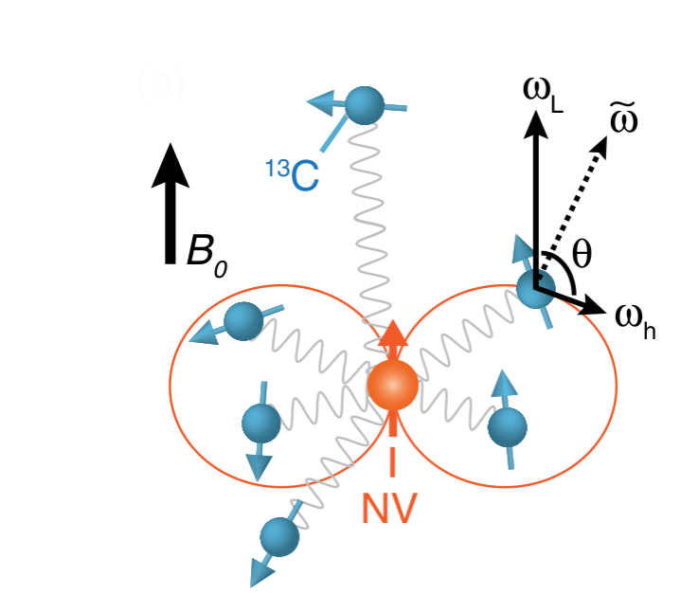
Dyn Decoupling
Explain what decoupling is
Previous error model insufficient, need to model dephasing as random bumps in precession frequency

Slide 8
New correlated error model
Plot of dw
Explain why DD will help protect
Cite Hanson paper

Slide 9
Protecting NV with decoupling
Show DD results for NV and compare to experimental plot

Slide 10
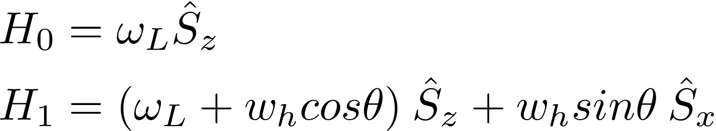

NV-Carbon Interaction
Angle of precession of in presence of Bext is dependent on NV spin state
Each has a uniquely shifted precession axis depending on the geometry within the diamond
Raises possibility of individual control of different atoms

Slide 11
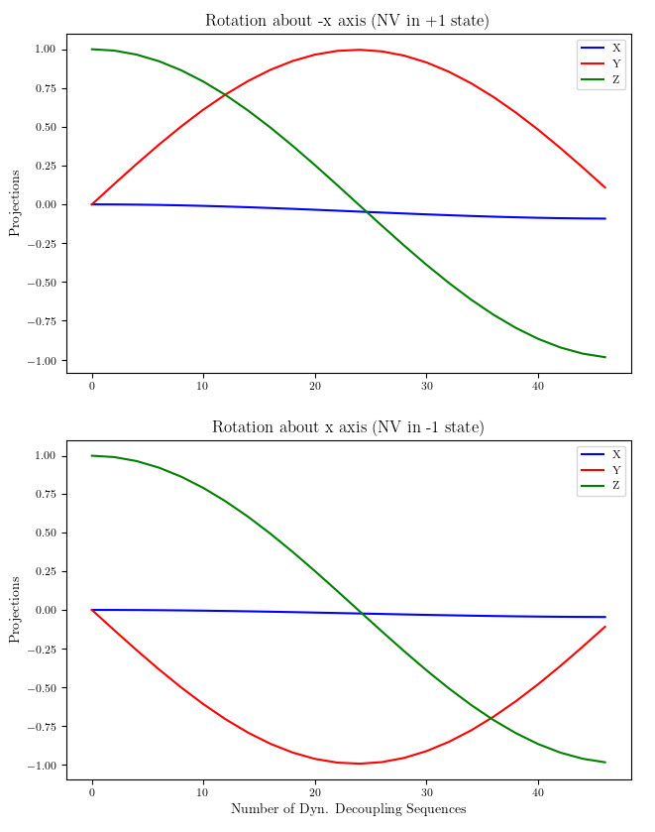
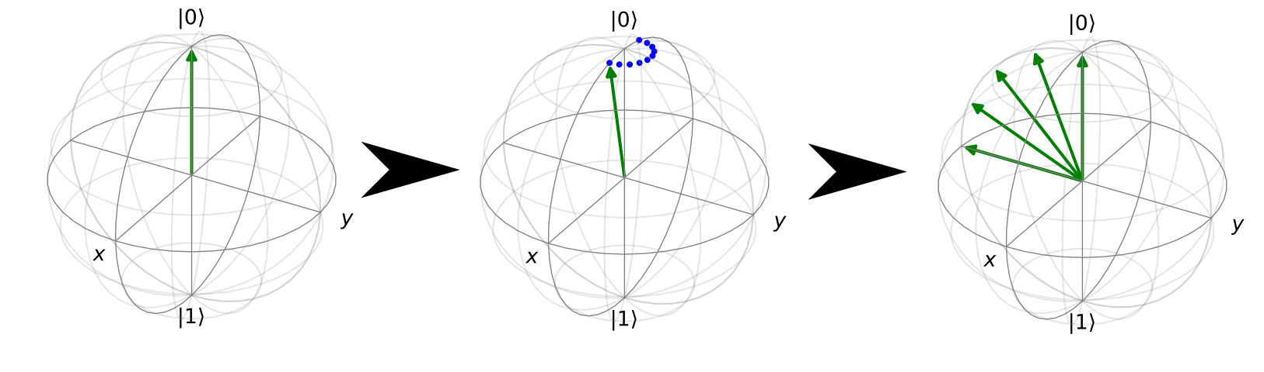
Controlled Rotation of Carbons
By flipping the spin state of the NV centre at the resonant precession frequency for a , we can implement coherent rotations
Direction of rotation is conditional on initial spin of the NV
Even with just ~40 sequences, capable of performing π-rotation with over 99% fidelity

Slide 12
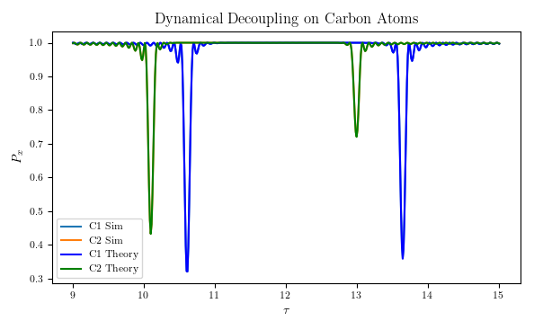


Dynamical Decoupling and Entanglement Generation
Initialize NV in and the in the mixed state
Due to conditional interaction between NV and Carbon only at special resonant frequencies, entanglement appears as small peaks
Simulation coincides perfectly with the theoretical prediction²
Average difference between simulation and theoretical values: 2 x 10⁻⁴
² Taminiau, T. H. et al. “Detection and Control of Individual Nuclear Spins Using a Weakly Coupled Electron Spin.” Physical Review Letters 109.13 (2012) https://doi.org/10.1103/PhysRevLett.109.137602

Slide 13
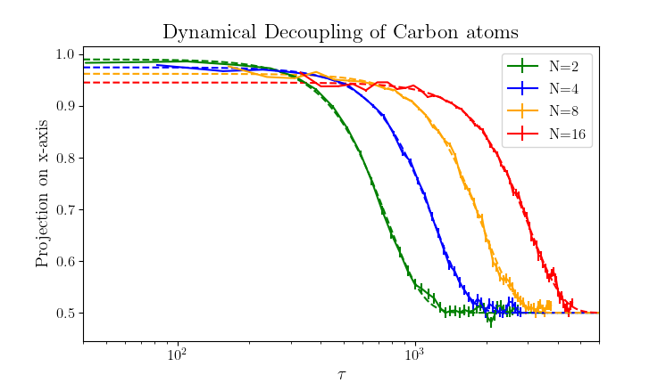

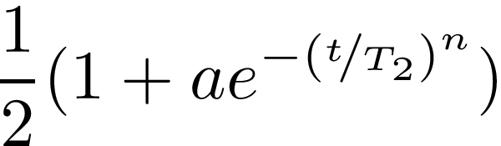
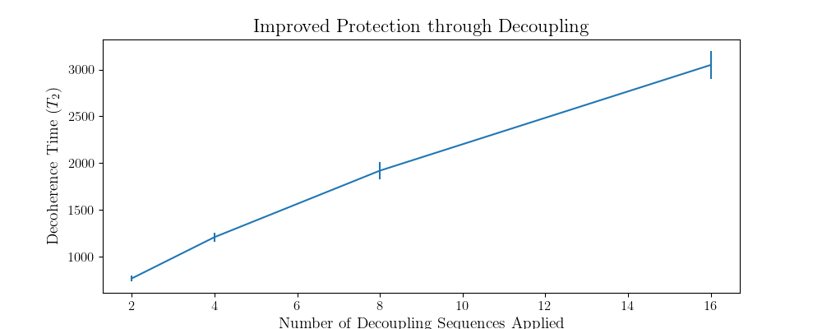
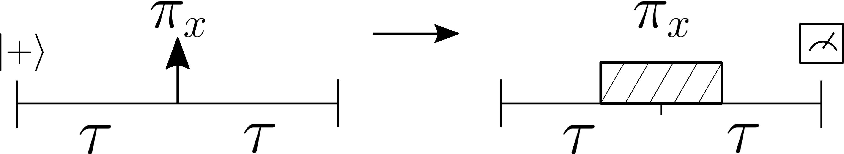
Dynamical Decoupling on Carbon
To protect the from de-phasing noise, we can implement the spin-echo protocol similar to that on the NV
Main Difference - cannot implement π-rotations directly, must be mediated by NV centre, and thus they take much longer
Nonetheless, more rotations lead to better protection (higher fidelity for longer time)

Slide 14
Conclusion
NV Centres enjoy naturally long T1 relaxation times thanks to stability of spin states
The ability to extend T2 makes very stable memory qubits possible
NV Centres are leading candidates for nodes in a future quantum network (entanglement distillation is possible³)
Recent work focusing on encoding quantum states into Carbon pairs (exploiting their decoherence protected subspaces) may extend T2 further still⁴
³ Kalb, N. et al. “Entanglement Distillation Between Solid-State Quantum Network Nodes.” Science 356.6341 (2017): 928–932. https://www.doi.org/10.1126/science.aan0070
4 Reiserer, Andreas et al. “Robust Quantum-Network Memory Using Decoherence-Protected Subspaces of Nuclear Spins.” Physical Review X 6.2 (2016). https://doi.org/10.1103/PhysRevX.6.021040

