Slide 1
Spin Qubit Control using NV Centres in Diamond
Asier Galicia (5139481)
Nicholas Zutt (5005523)
Delft University of Technology

Slide 2

Outline
NV Centres and Carbons intro
Simulation with lindblad
Protection with spin echo
...

Slide 3
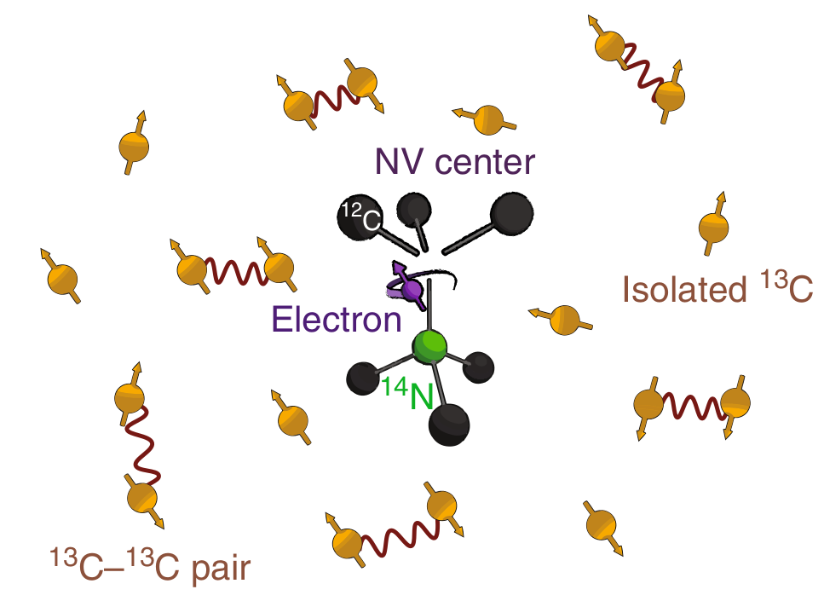
Nitrogen-Vacancy Centres
Outline what NV centres are
Storing quantum states in Carbon
Control with lasers
Decoherence through dephasing noise
NV = nodes, carbon = storage qubits, need long decoherence time -> quantum network

Slide 4
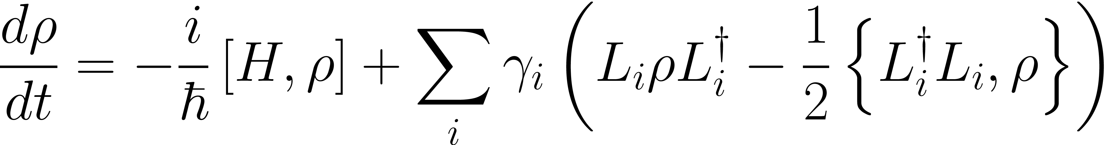


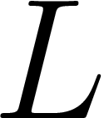
Lindblad simulation
Density matrix.
Hamiltonian.
Collapse operators (efective action of the enviroment on the system).

Slide 5
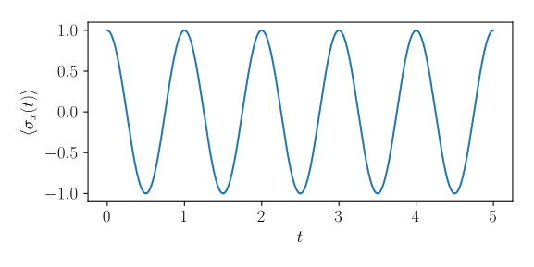
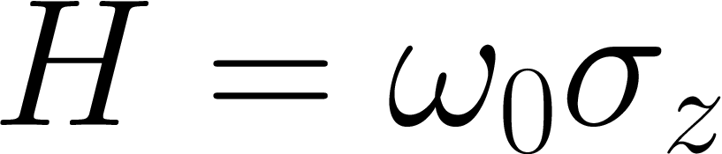
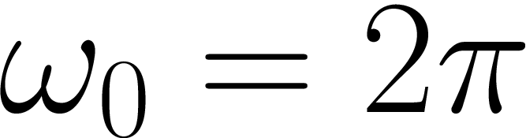
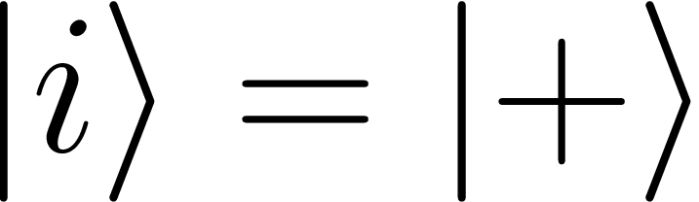
Lindblad Simulation
Numerical simulations performed with Runge-Kutta 4.
Example:

Slide 6
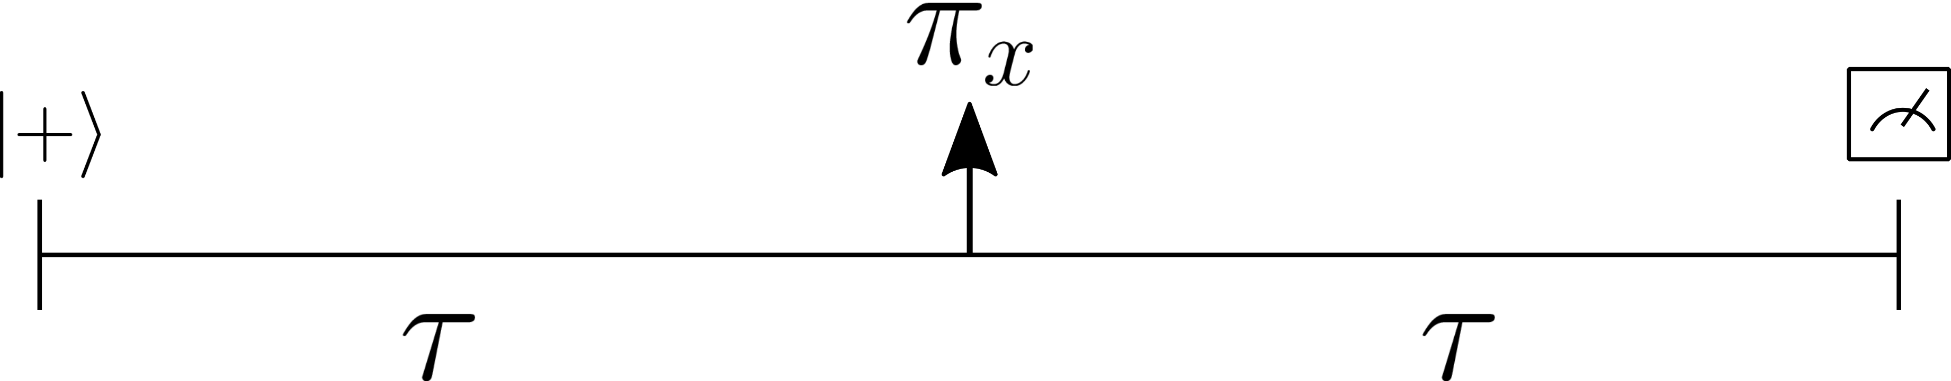
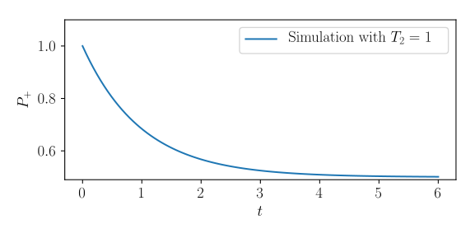
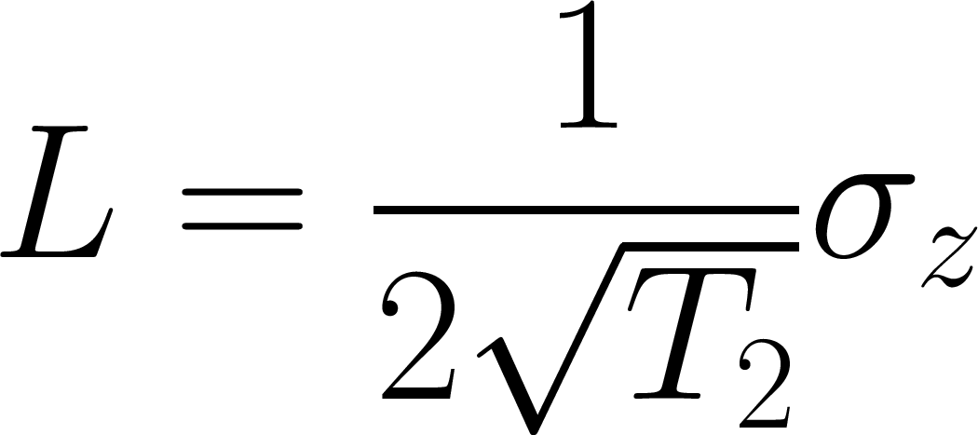
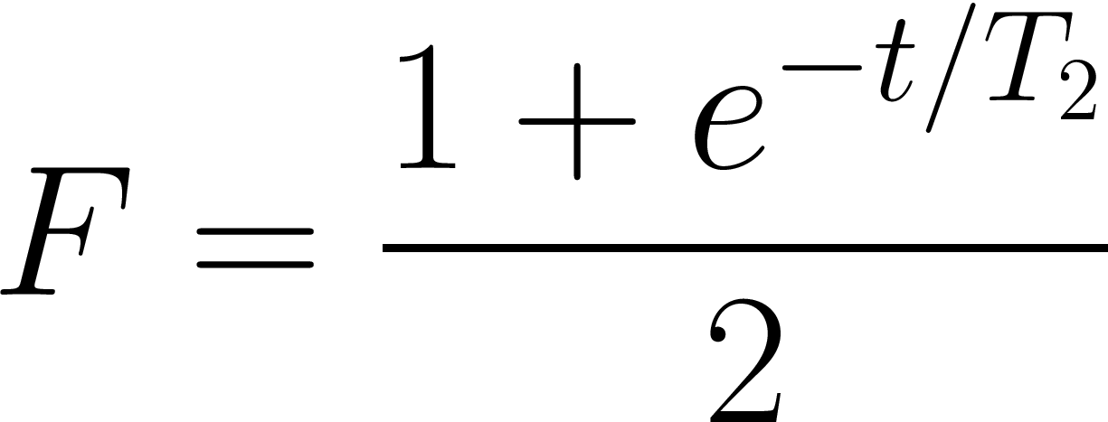
Spin Echo and Damped
Dephasing introduced with colapse operators:

Slide 7
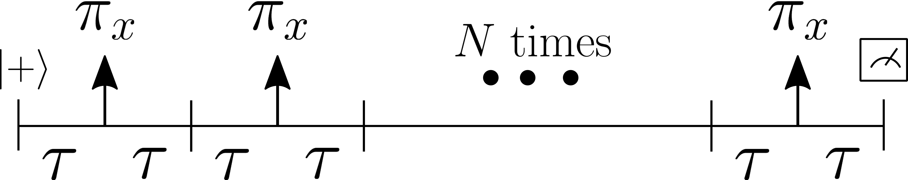
Dyn Decoupling
With previous model same T2 as before. We need better error model.

Slide 8
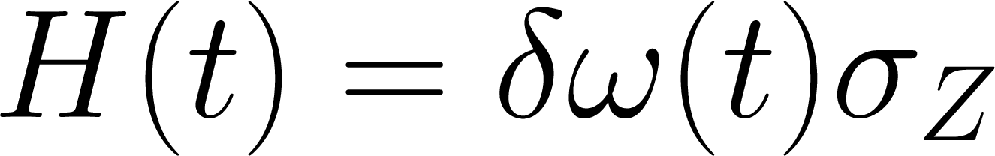
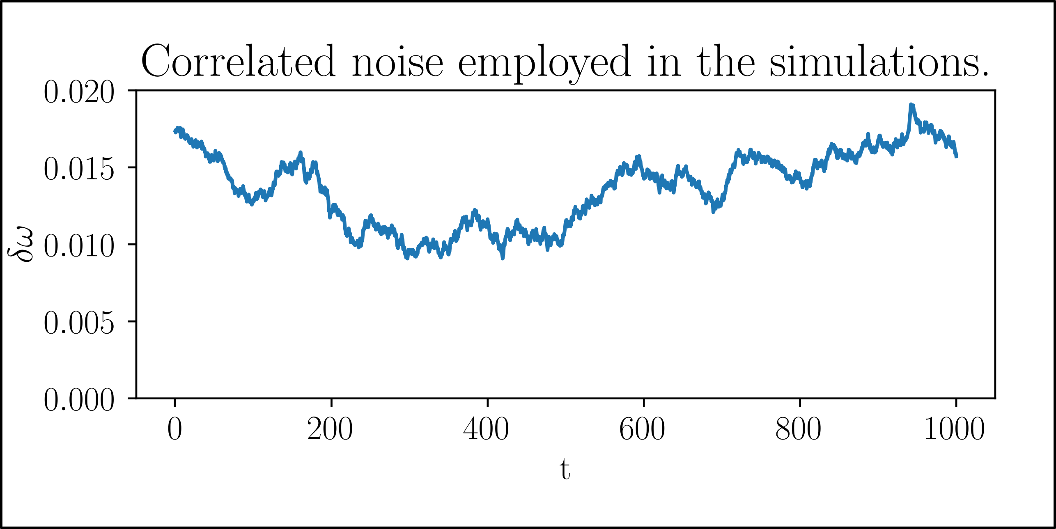
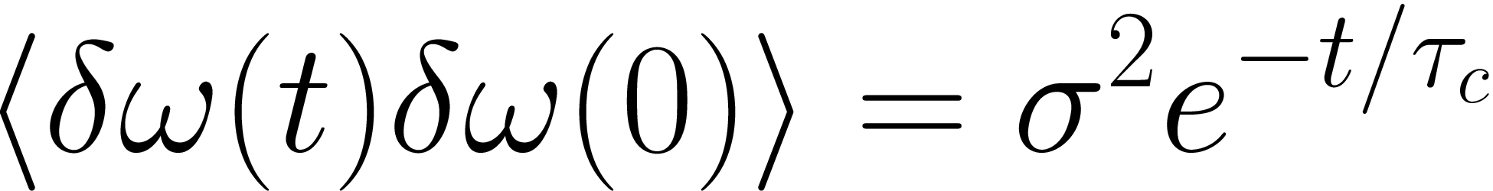
Dyn Decoupling
Autocorrelated normal noise,
In what follows, we employ 960 parallel simulations and average the required quantities.

Slide 9
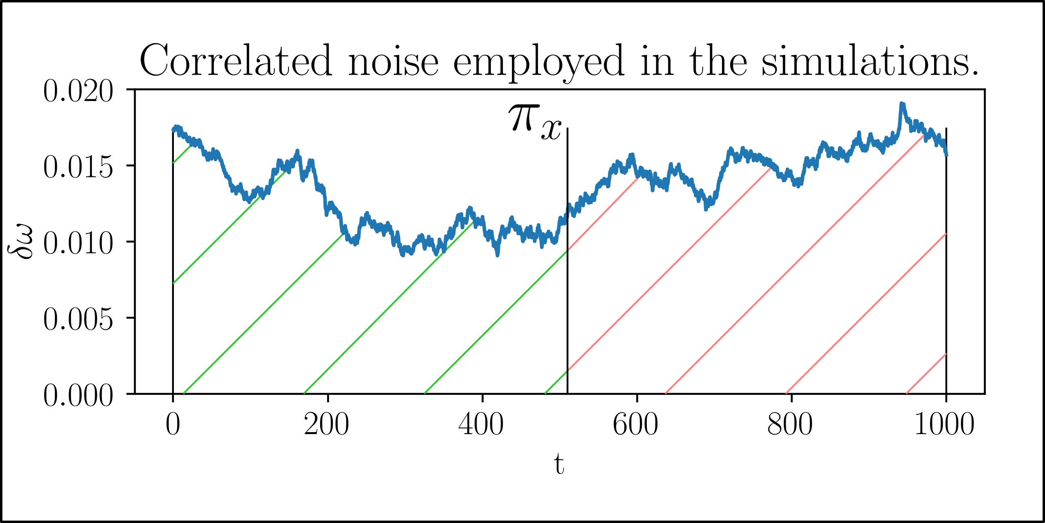
Dyn Decoupling

Slide 10
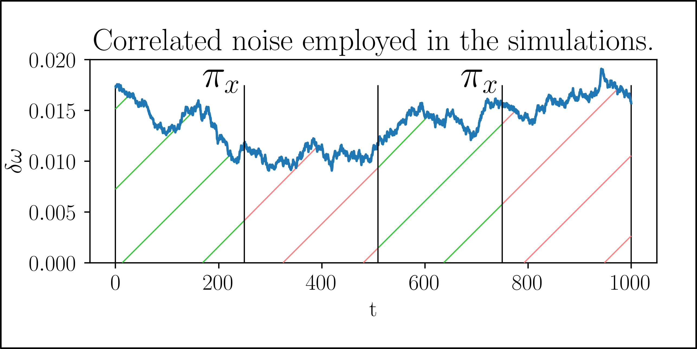
Dyn Decoupling

Slide 11
Dyn Decoupling
Plot of NV center being protected
Plot of experimental results for comparison.

Slide 12
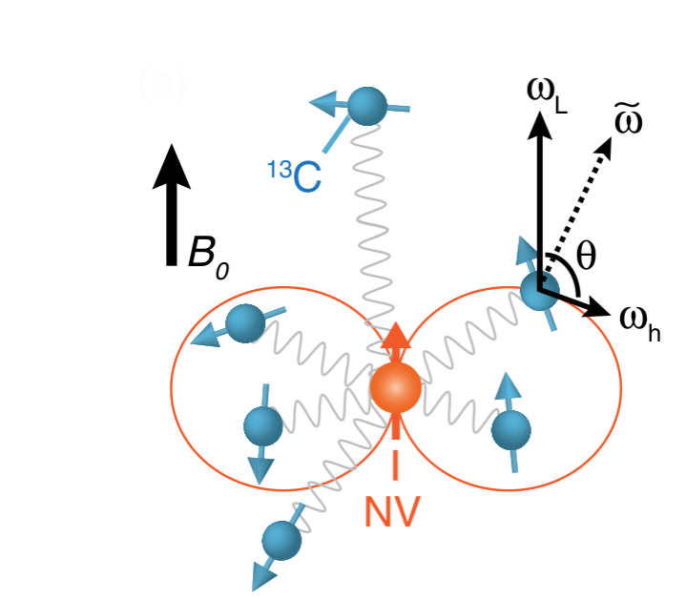
NV-Carbon Interaction
Explain interaction as conditional rotation about two different axes based on NV state
Show Hamiltonian for above

Slide 13
Explain dips in experimental plot of NV centre decoupling
Start in Iden for carbon and + for electron, dips manifest as interaction between them
Show decoupling plot without error model which coincides with theoretical prediction == great simulation! Good job 100%

Slide 14
Using NV-Carbon interaction to implement rotation of Carbons
Controlled rotation plot – choose tau corresponding with resonance, implement the right number of dynamical decoupling sequences
Show that this performs high fidelity pi rotations

Slide 15
DD on Carbon
Talk about how this differs from NV DD
Increased protection

Slide 16
Conclusion
NV centres can make your life complete. Just love them
Thank you for your attention

