Slide 1

Spin Qubit Control using NV Centres in Diamond
Asier Galicia (5139481)
Nicholas Zutt (5005523)
Delft University of Technology

Slide 2


Outline
NV Centres – defect centres in diamond which, along with surrounding , constitute promising platforms for effective qubits
Model and simulation – implemented an error model to simulate decoherence
Dynamical decoupling – with perfect and imperfect π-rotations to extend decoherence time for spin qubits

Slide 3
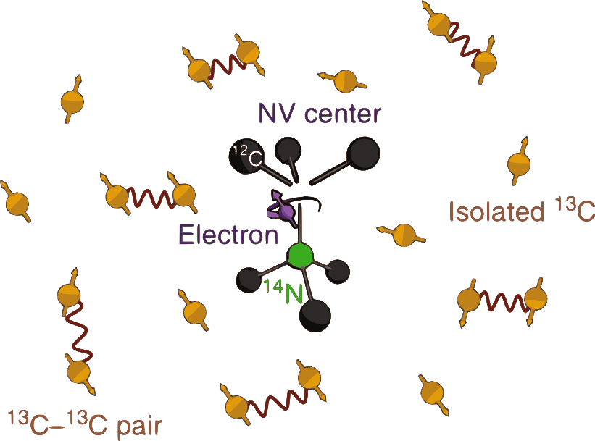

Nitrogen-Vacancy Centres
NV centres are spin-1 defects in the crystal structure of diamond, effective 2-level system
bath protects spin of NV
Surrounding atoms (spin-1/2) can be used as storage qubits
Main Challenge – mitigating decoherence through dephasing noise due to magnetic fluctuations from surrounding spin bath¹
2
¹ van der Sar, T., Wang, Z., Blok, M. et al. Decoherence-protected quantum gates for a hybrid solid-state spin register. Nature 484, 82–86 (2012). https://doi.org/10.1038/nature10900
² Abobeih, M.H., Cramer, J., Bakker, M.A. et al. One-second coherence for a single electron spin coupled to a multi-qubit nuclear-spin environment. Nat Commun 9, 2552 (2018). https://doi.org/10.1038/s41467-018-04916-z

Slide 4
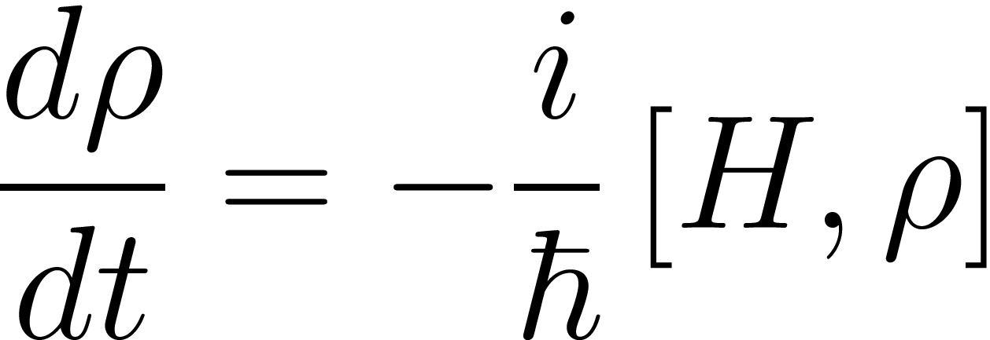
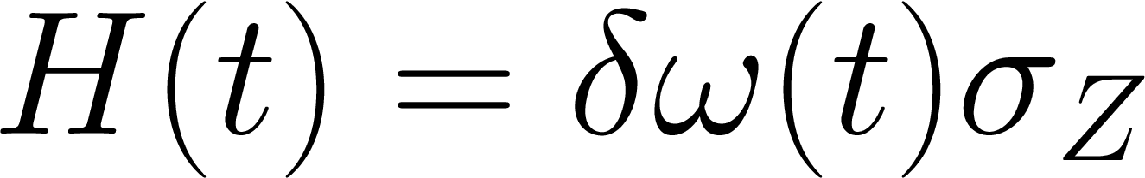

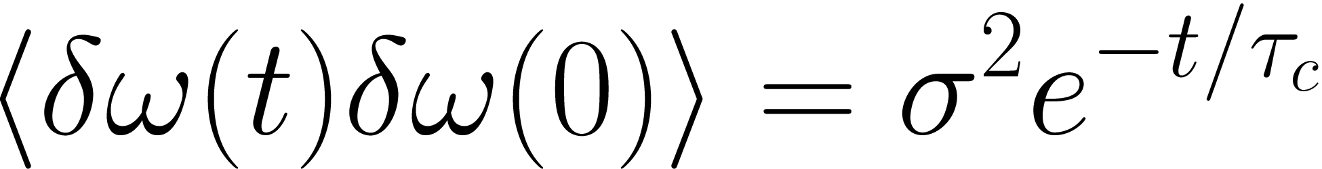

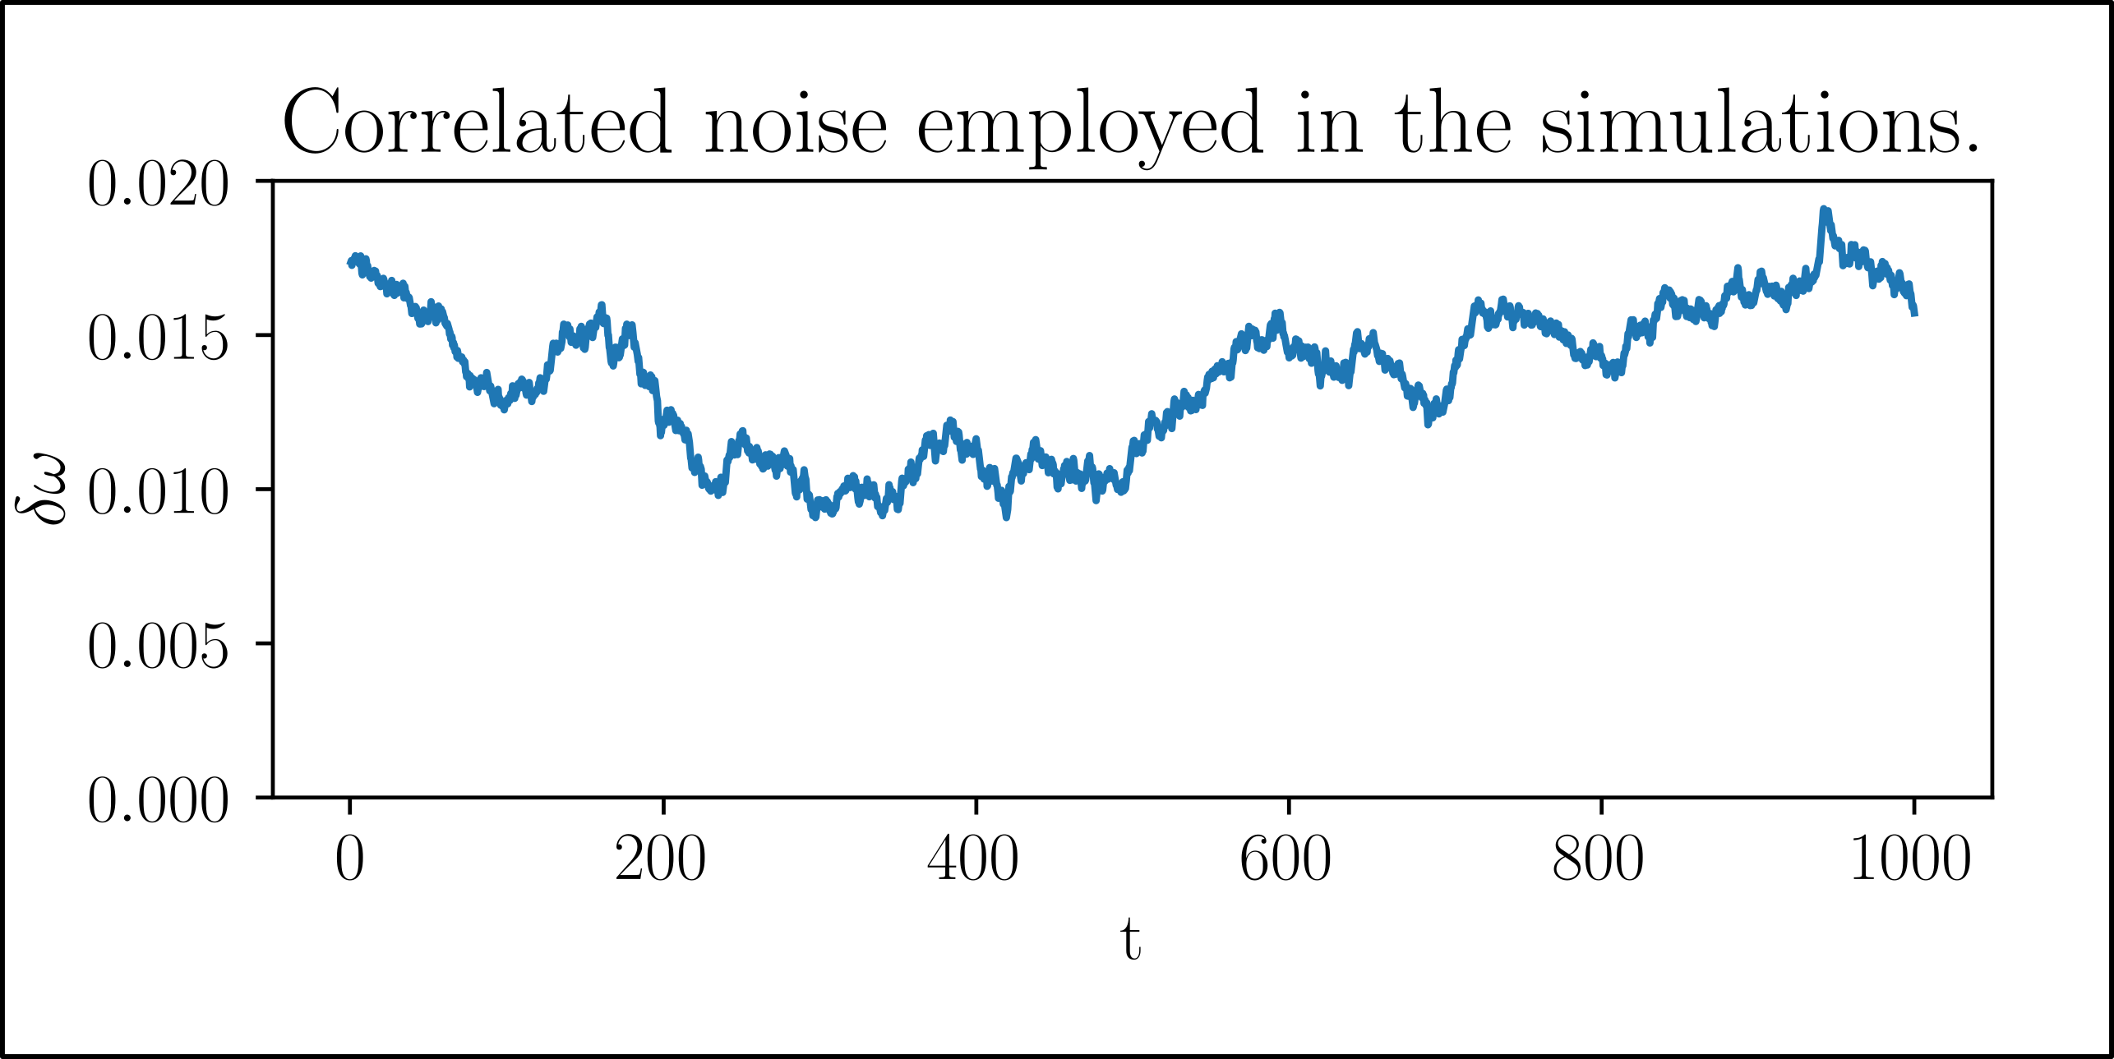
System Simulation
Evolution of state:
Error model:
Autocorrelated normal noise (average final values 960 times),
Density matrix.
Hamiltonian.
Numerical simulations performed
with Runge-Kutta 4.
Here cite paper

Slide 6
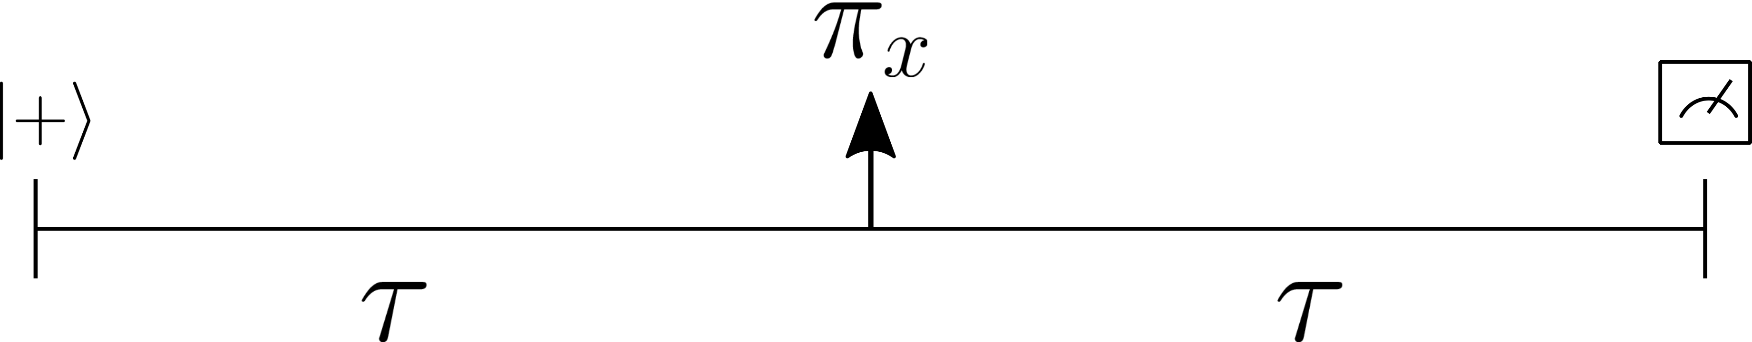
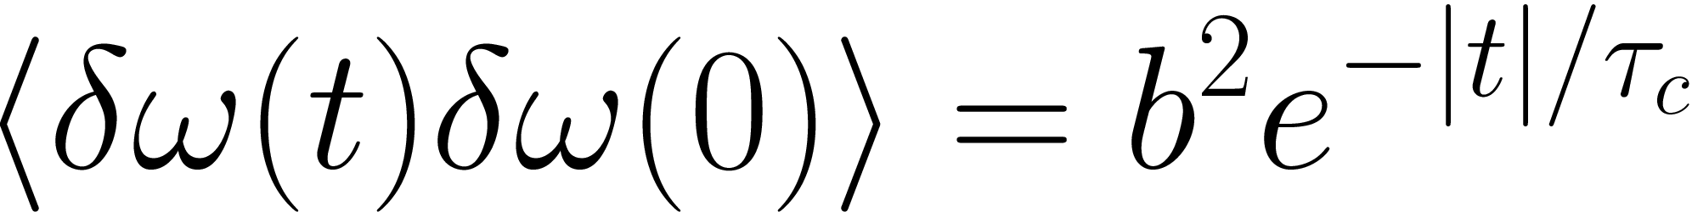
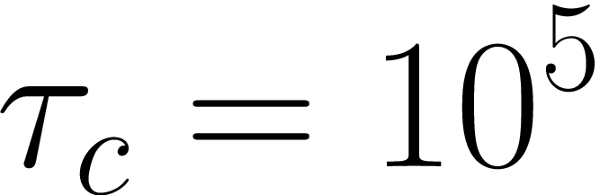
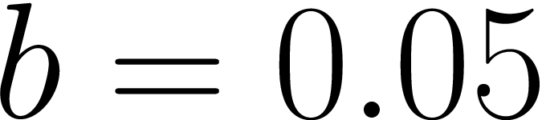
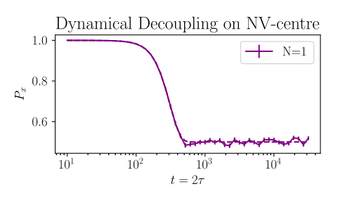
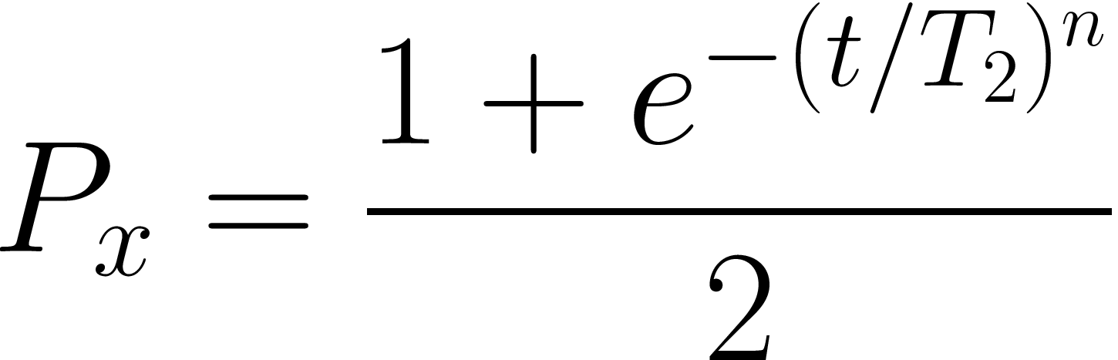
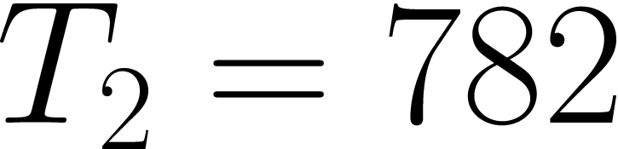
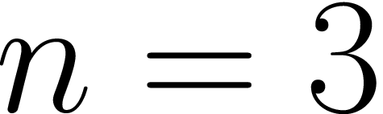
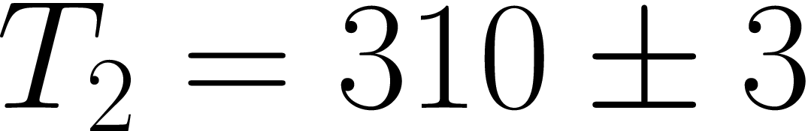
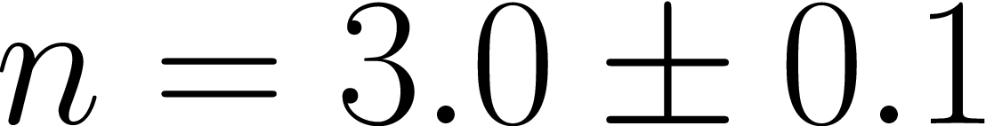
Spin echo
Simulation parameters:
Fit function:
Analytical results:
Simulation results:

Slide 7
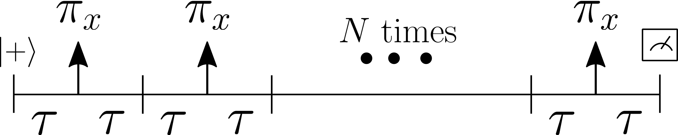
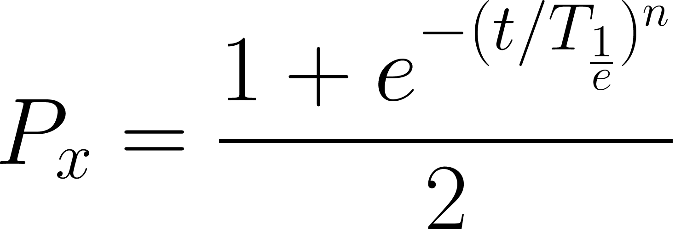
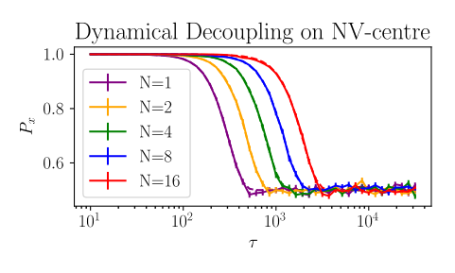
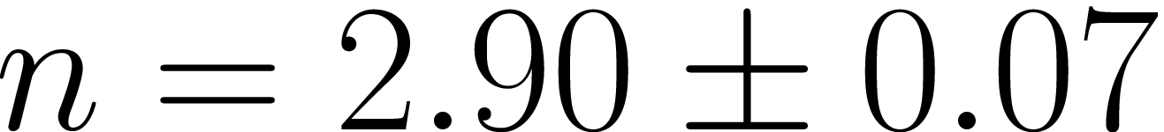
Dynamical Decoupling
Same simulation parameters:
Same fit function:
Expected analytically:
Worse case
obtained:

Slide 8
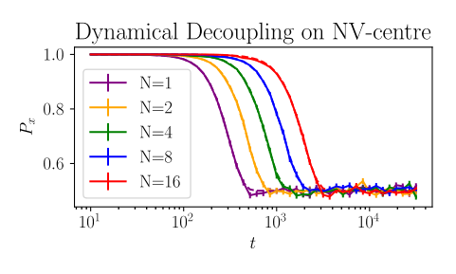
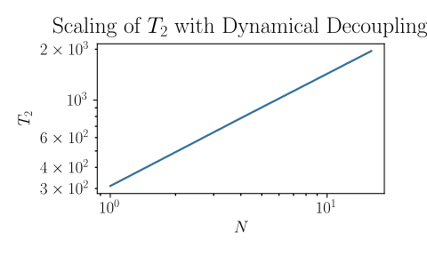
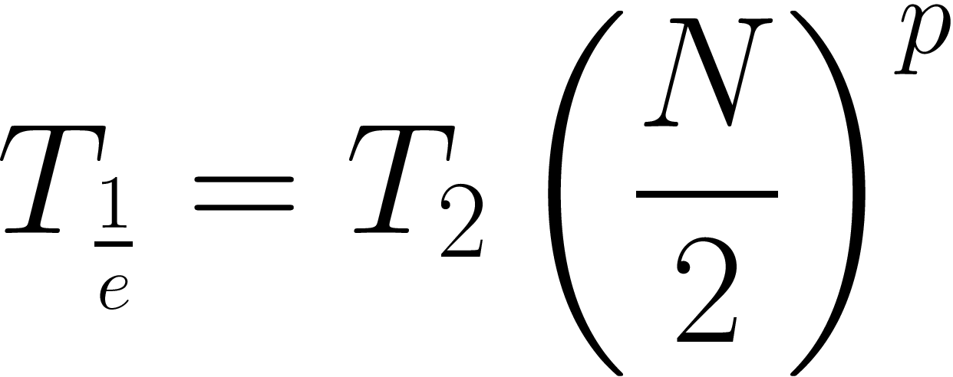
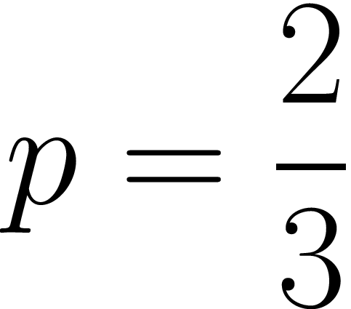
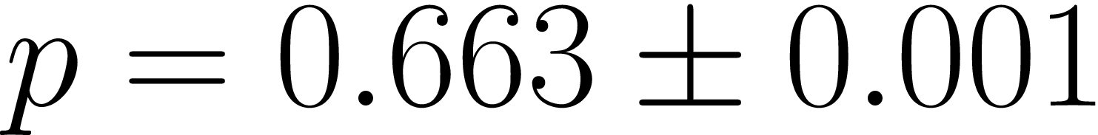
Dynamical Decoupling
Analytical result:
Simulation:

Slide 9
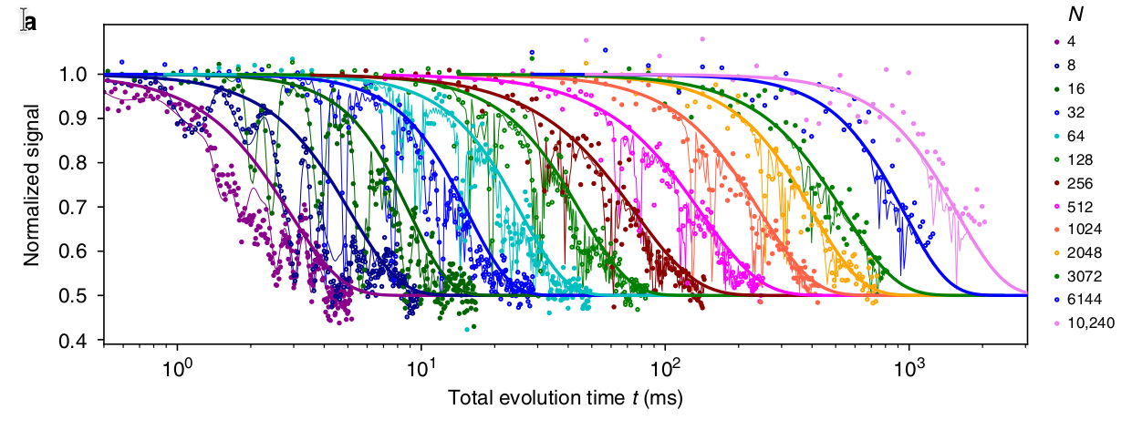
Dyn Decoupling
Here is a point about life
† Abobeih, M.H., Cramer, J., Bakker, M.A. et al. One-second coherence for a single electron spin coupled to a multi-qubit nuclear-spin environment. Nat Commun 9, 2552 (2018). https://doi.org/10.1038/s41467-018-04916-z

Slide 10
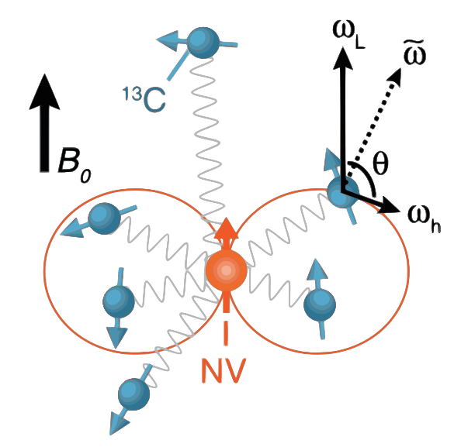
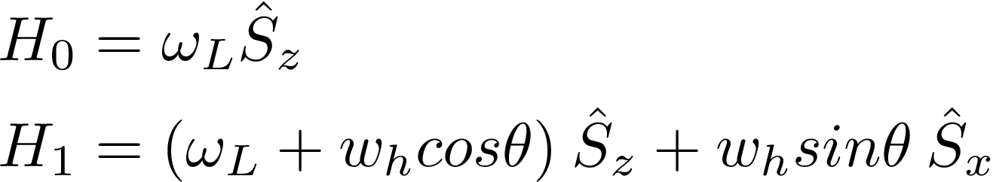

NV-Carbon Interaction
Hamiltonian of the atoms is dependent on the NV centre spin state
Raises possibility of individual control because each has its own resonance with the NV centre

Slide 11
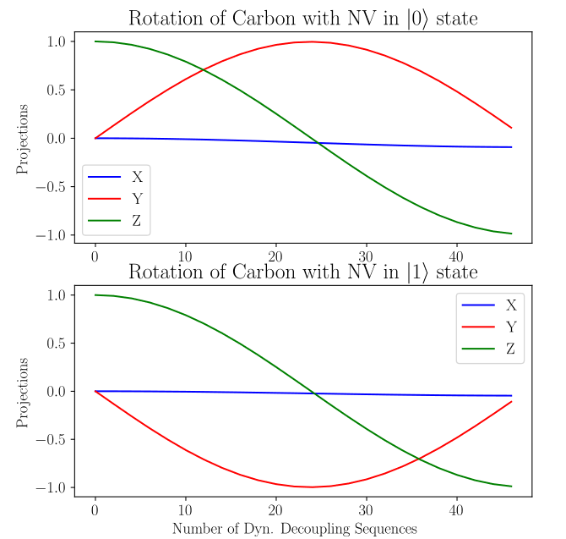
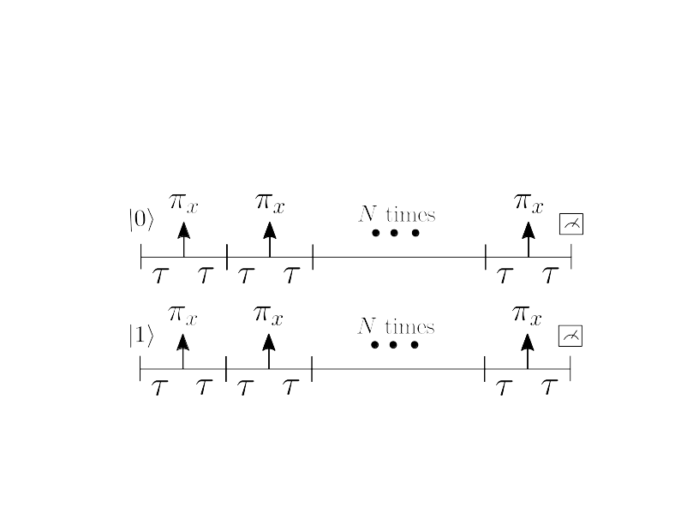
Controlled Rotation of Carbons
By flipping the spin state of the NV centre at the resonant precession frequency for a , we can implement coherent rotations
Direction of rotation is conditional on initial spin of the NV
Even with just ~40 sequences, capable of performing π-rotation with over 99% fidelity

Slide 12


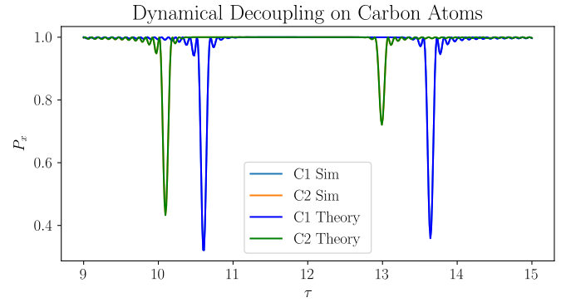
Dynamical Decoupling and Entanglement Generation
Initialize NV in and the in the mixed state
Due to conditional interaction between NV and Carbon only at special resonant frequencies, entanglement appears as small
peaks
Simulation coincides perfectly with the theoretical prediction*
* Taminiau, T. H. et al. “Detection and Control of Individual Nuclear Spins Using a Weakly Coupled Electron Spin.” Physical Review Letters 109.13 (2012) https://doi.org/10.1103/PhysRevLett.109.137602

Slide 13
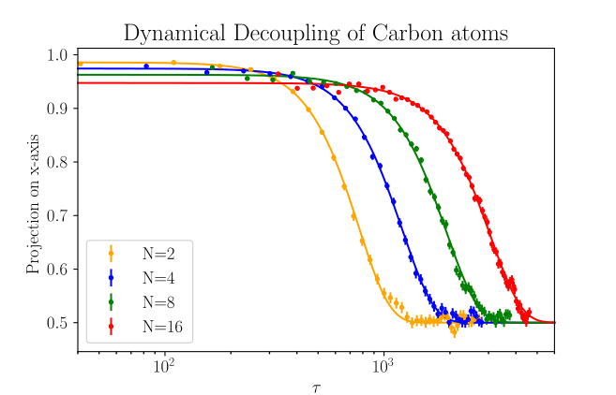

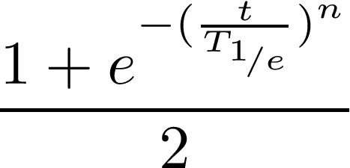
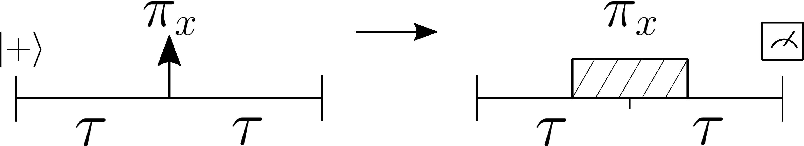
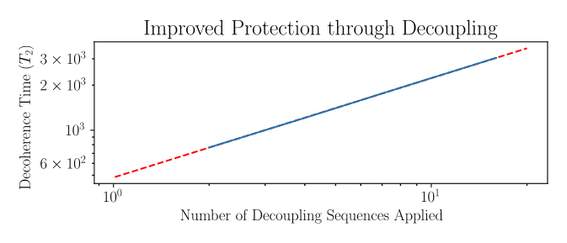
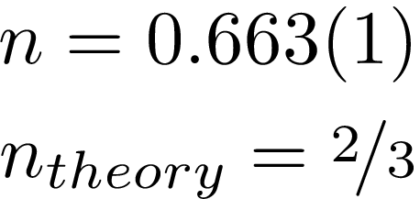
Dynamical Decoupling on Carbon
To protect the from dephasing noise, we can implement the spin-echo protocol similar to that on the NV
Main Difference - cannot implement π-rotations directly, must be mediated by NV centre, and thus they take much longer
More rotations lead to better protection (higher fidelity for longer time)
†
† Abobeih, M.H., Cramer, J., Bakker, M.A. et al. One-second coherence for a single electron spin coupled to a multi-qubit nuclear-spin environment. Nat Commun 9, 2552 (2018). https://doi.org/10.1038/s41467-018-04916-z

Slide 14
Conclusion
Decoherence can be mitigated by to some extent using dynamical decoupling sequences, addressing a key challenge in the use of NV centres as nodes for quantum computing
Our model qualitatively describes the system’s evolution under decoupling sequences, obtaining the values for several parameters correctly
Due to the way the simulation scales with time, simulating for high N values was not feasible. Performance could be improved by implementing time evolution directly rather than using the Lindblad equation
Future Outlook – probing the effect of different types of decoupling sequences on the spin qubits, as done in recent papers†
† Wang, Zhi-Hui et al. “Comparison of Dynamical Decoupling Protocols for a Nitrogen-Vacancy Center in Diamond.” Physical Review B 85.15 (2012): https://doi.org/10.1103/PhysRevB.85.155204

Slide 15
Thank you!
Questions?

Slide 16
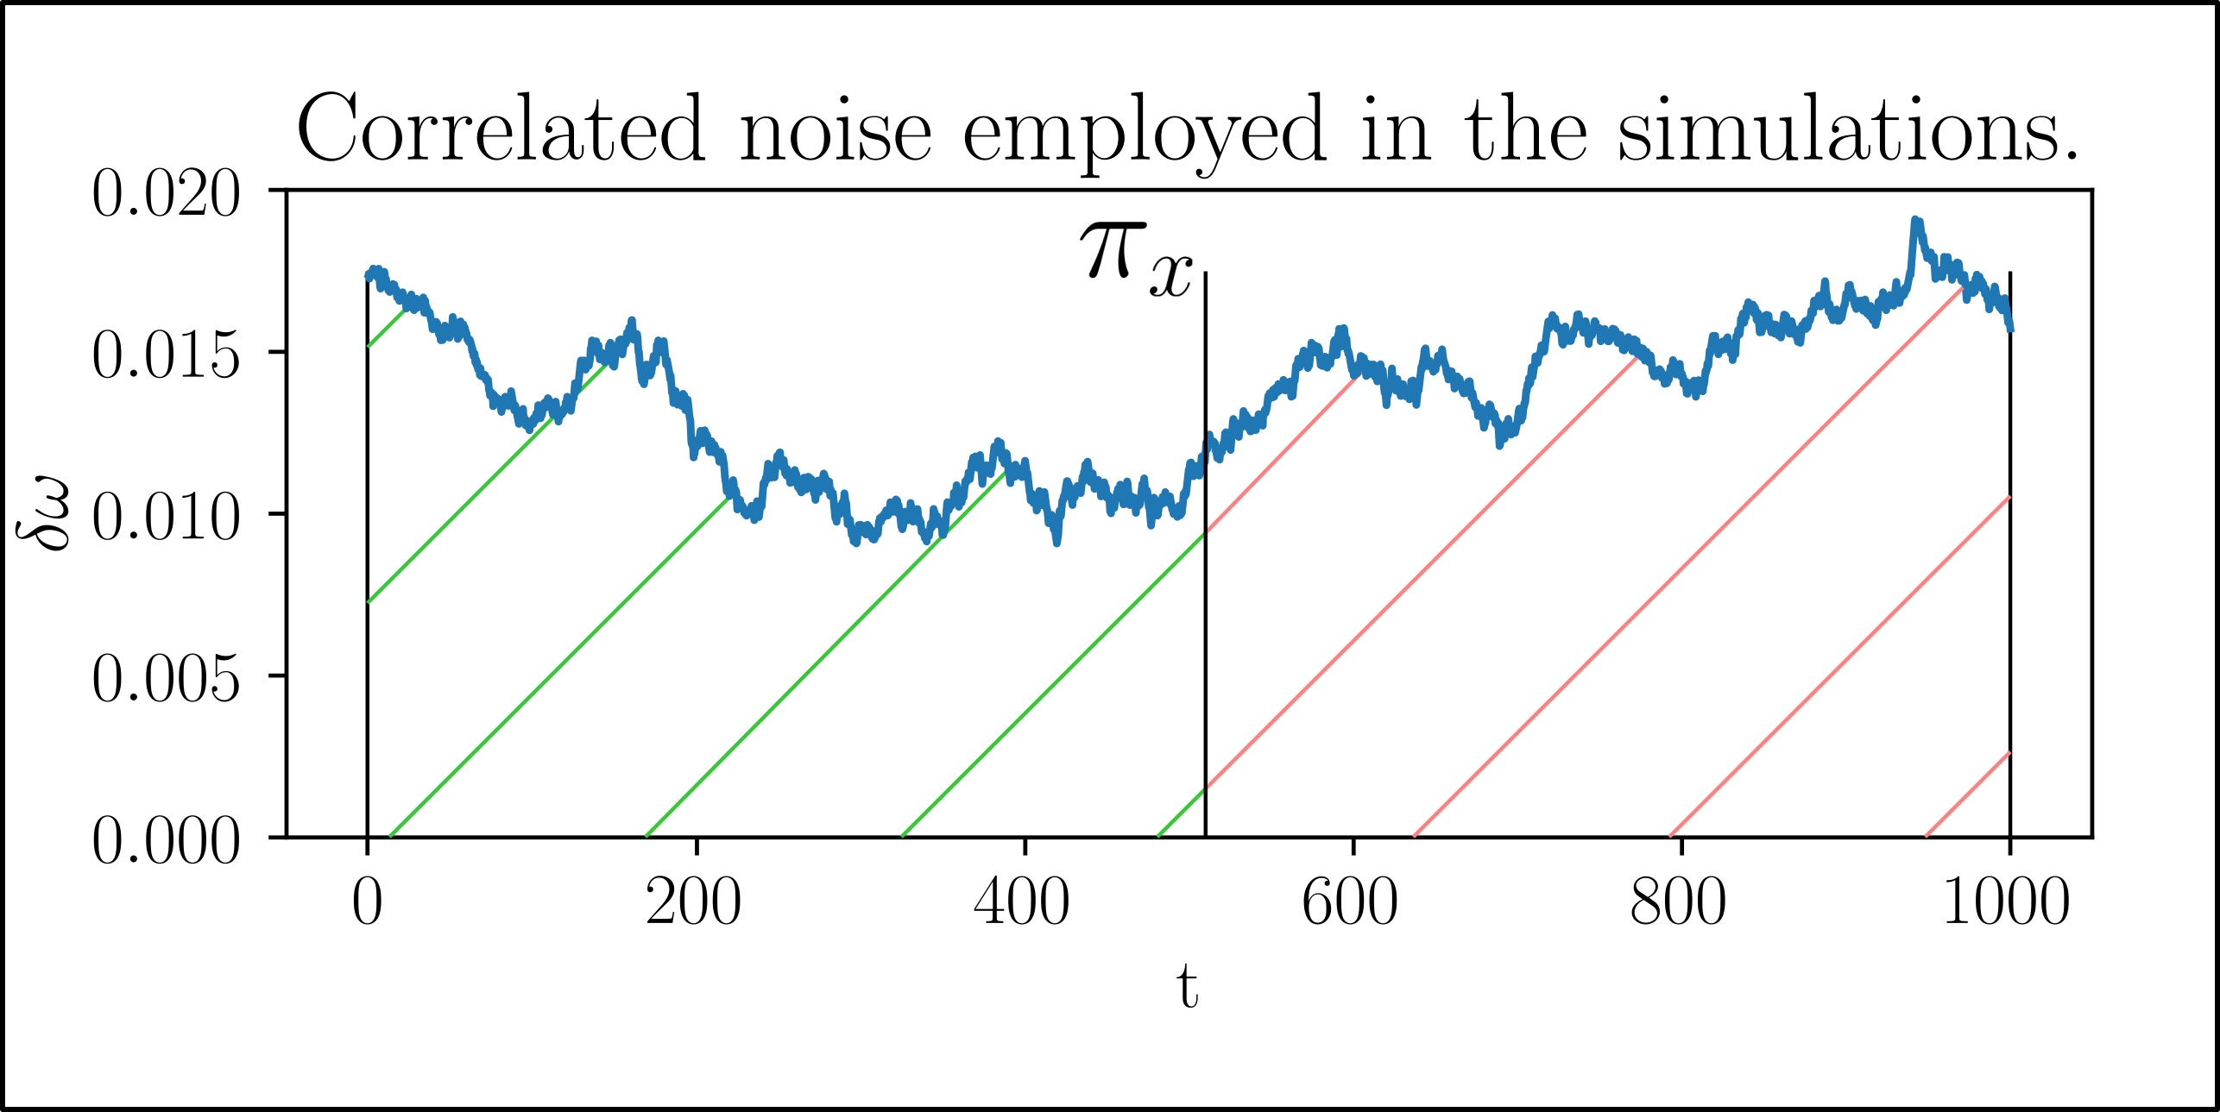
Dyn Decoupling

Slide 17
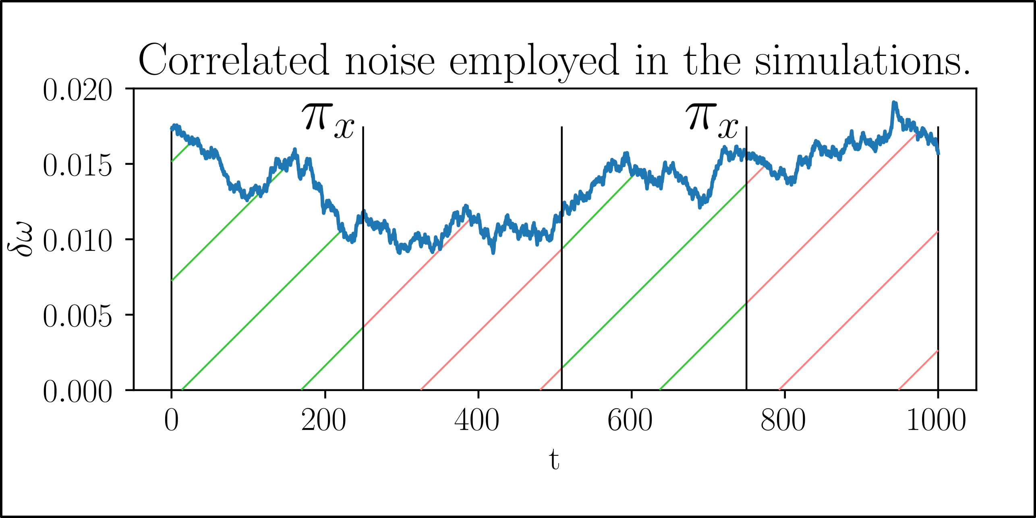
Dyn Decoupling

