Slide 1
qutip-tensorflow
Asier Galicia Martínez

Slide 2
A little bit of background
QuTiP 5 - a new dispatching system. It includes by default two Data layers:
- CSR matrices for large systems.
- Dense matrices for small or dense systems.

Slide 3
Motivation for qutip-tensorflow
Dense and CSR operate in a CPU. Is it possible to leverage the computational power of a GPU?
How extensible/robust is the new dispatching system.
There are other nice features that tensoflow can provide:
Autodifferentiation.

Slide 4
Operating with a GPU - Matrix addition

Slide 5
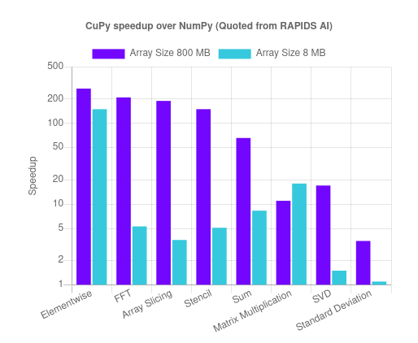
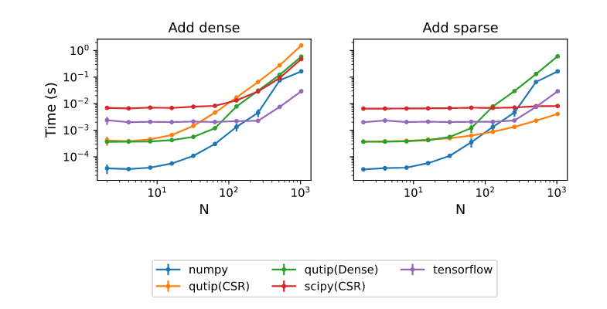
Operating with a GPU - Matrix multiplication
More important as scales O(N^3)
Above image taken from CuPy. Benchmarks with similar results:

Slide 6
Autodifferentiation.

Slide 7
Results
We successfully implemented a new data layer, `TfTensor` that allows:
GPU operations when one is available.
Autodifferentiation.

