Slide 1
High-performance code in Browser & NodeJS
Andrey Ganyushkin

Slide 2
#notforenterprisedevelopers
Это не для энтерпрайз
Это не точно
Все уже изменилось
Горячее сырым не бывает
Вам это не нужно

Slide 3
Performance

Slide 4
For what?
Игры
Интерполяция графиков
Библиотеки
Machine Learning
Переиспользовать С++ библиотеки

Slide 5
JS Data Types
Number
String
Boolean
Null
Undefined
Objects
Array (object)
RegExp (object/function)
Function
Symbol
Map
Set
WeakMap
WeakSet
Int8Array
Uint8Array
Uint8ClampedArray
Int16Array
Uint16Array
Int32Array
Uint32Array
Float32Array
Float64Array

Slide 6
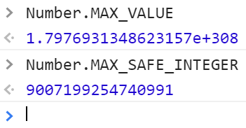

JS Data Types
IEEE754
NaN
NaN !== NaN it is true
∞+(- ∞)
0 × ∞
0/0, ∞/∞
sqrt(x), где x<0
NaN check
isNaN(x)
x !== x
Infinity
3 / 0 -> Infinity
3 / -0 -> -Infinity
Infinity === -Infinity it is false

Slide 7
JS Data Types
Factorial: 70!
example: https://habrahabr.ru/post/327544/
Мы можем посчитать 70!
# factorial(70)
> 1.1978571669969892e+100
Проблема?

Slide 8

JS Data Types
Factorial: 70!
example: https://habrahabr.ru/post/327544/
Мы можем посчитать 70!
# factorial(70)
> 1.1978571669969892e+100
Int ---> Float ? WTF?

Slide 9
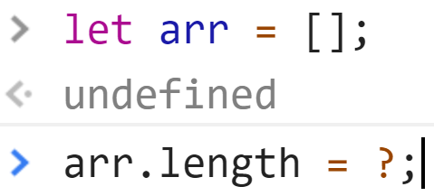
JS Data Types

Slide 10
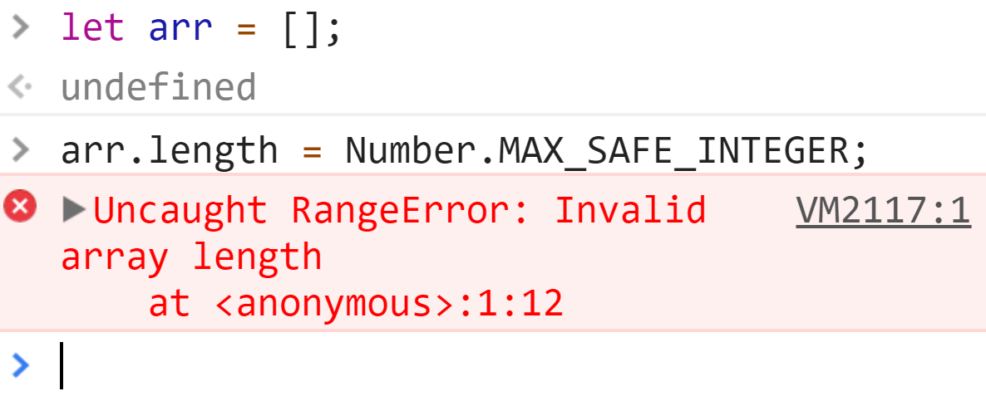
JS Data Types

Slide 11
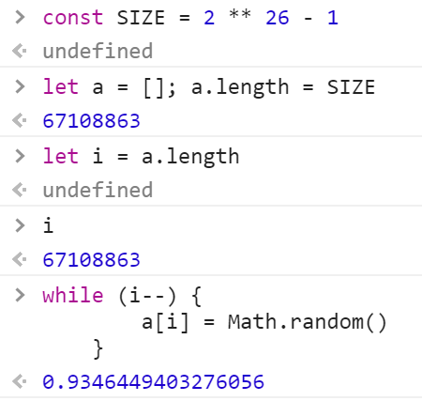
JS Data Types

Slide 12
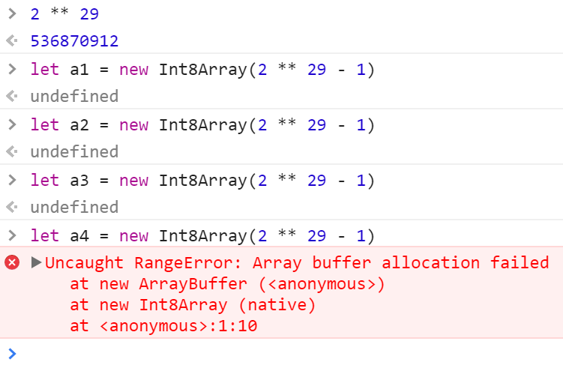
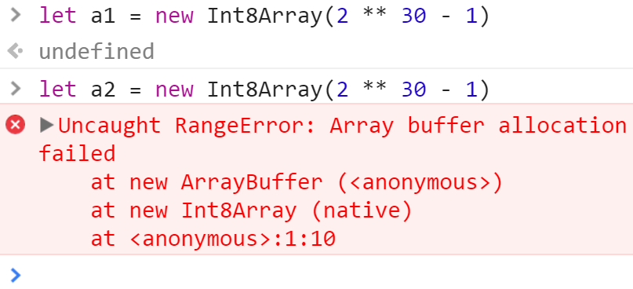
JS Data Types
ECMAScript 6 does not specify any mechanism of memory allocation.
Engines are free to implement what they want. I'd expect them to be allocated on the heap as it is the default for all objects, but they might as well go on the stack frame for optimisation purposes or in a dedicated "heap" segment with special garbage collection semantics.
Browser: 1 gb or 512mb + 512mb + 512mb
Node: host memory limit

Slide 13
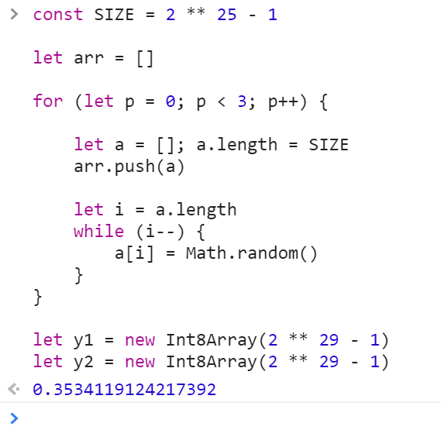
JS Data Types
Max chrome memory allocation. ~1.8GB was allocated
repo: chrome_max_array_size_limit.js
window.performance.memory
jsHeapSizeLimit:1136000000
totalJSHeapSize:15200000
usedJSHeapSize:11900000

Slide 14
JS/V8 Features & Optimizations
optimization compiler and data types
deoptimizations
performance optimizations instability
Hidden classes
Polymorphism
V8 versions, let optimization example,
Chrome vs Edge
C++ style
Flow

Slide 15
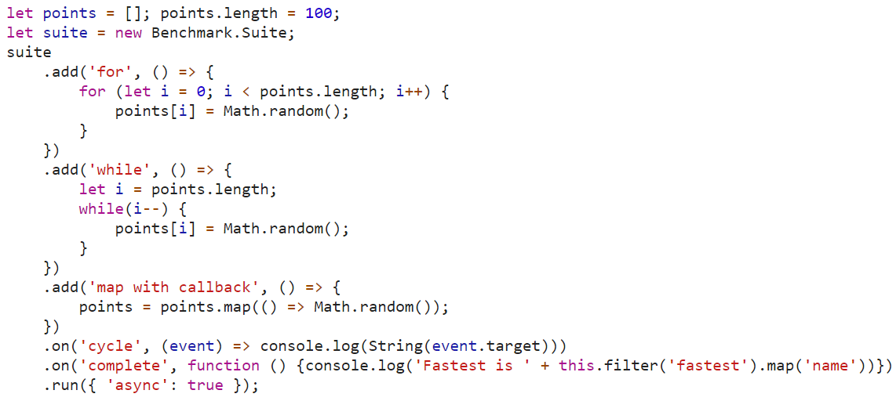
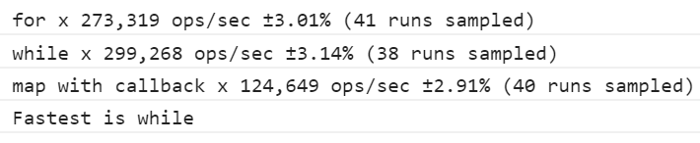
Benchmark JS

Slide 16
IRHydra^2 & Chrome DevTools
node --trace-hydrogen \
--trace-phase=Z \
--trace-deopt \
--code-comments \
--hydrogen-track-positions \
--redirect-code-traces \
--redirect-code-traces-to=code.asm \
--trace_hydrogen_file=code.cfg \
--print-opt-code \
try1.js
-> code.asm
-> code.cfg
IRHydra2 is deprecated. Supporting various V8 related features in IRHydra was always a race against the clock. V8 5.9 has switched to a new execution pipeline (TurboFan+Ignition) and modernizing IRHydra to properly work with it would be too much of a time investment for me, given that I don't need to dig into JavaScript performance anymore.

Slide 17
Natives Syntax
v8 --allow-natives-syntax RuntimeFunctions
%NeverOptimizeFunction(myFunctionName);
function myFunctionName() { … }
https://gist.github.com/totherik/3a4432f26eea1224ceeb
RuntimeFunctions > 330

Slide 18
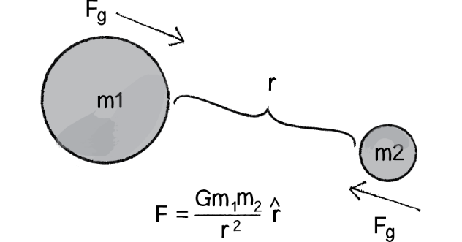
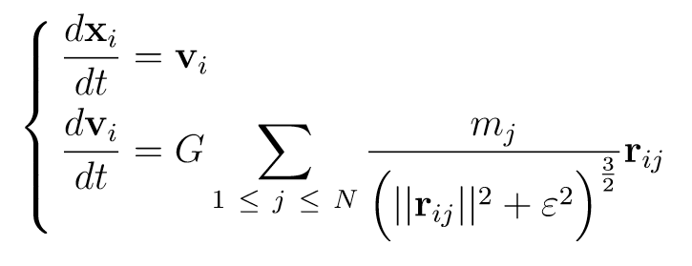
Gravity math model
Метод Рунге — Кутты четвёртого порядка

Slide 19
Gravity math model
Нормальная математика
Достаточно простая задача
Не имеет аналитического решения для n > 2*
Требует синхронизации данных каждую итерацию
Хорошо параллелится
Красивый результат!

Slide 20


Gravity math model

Slide 21
let optimization in v8 vs edge
PS> nvm use 8.4.0
Now using node v8.4.0 (64-bit)
PS> node -e 'console.log(process.versions.v8);'
6.0.286.52
PS> node .\try1.js
computeStep 2 x 0.69 ops/sec ±0.62% (6 runs sampled)
Fastest is computeStep 2
PS> nvm use 8.1.4
Now using node v8.1.4 (64-bit)
PS> node -e 'console.log(process.versions.v8);'
5.8.283.41
PS> node .\try1.js
computeStep 2 x 0.18 ops/sec ±0.90% (5 runs sampled)
Fastest is computeStep 2
repo: 20_nodejs_benchmarkjs

Slide 22
Что делать если не помогло?
?
?
?
?

Slide 23
Что делать если не помогло?
Писать на JS как на C++
Потоки CPU
Потоки GPU
Не писать на JS

Slide 24
C++ style

Slide 25
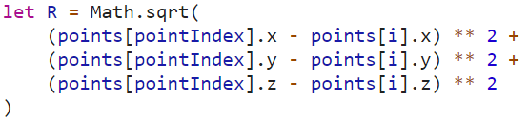
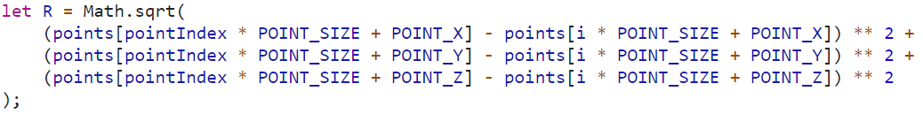
C++ style

Slide 26
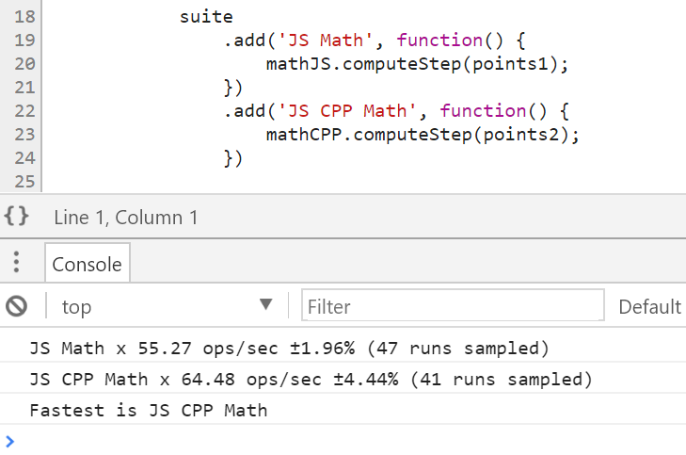
C++ style

Slide 27
WebWorkers

Slide 28
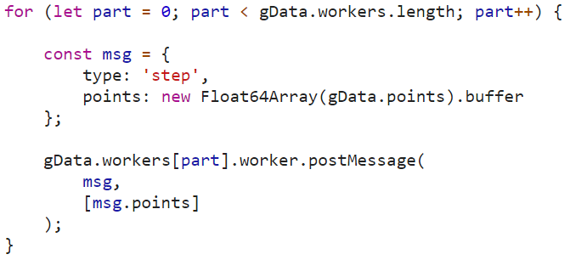
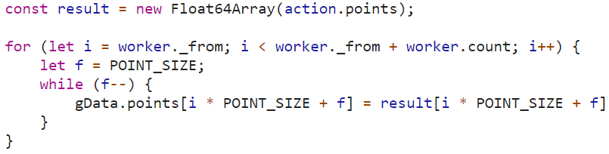
WebWorkers
Почему трансфер владения?

Slide 29
WebWorkers
Работает!
~ в n – 1 раз быстрее, где n – количество воркеров
repo: 40_browser_math_webworkers

Slide 30
GPU
turbo.js
gpu.js

Slide 31

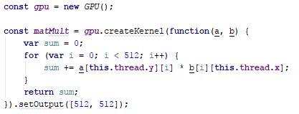
gpu.js
Matrix Multiplication
Create the GPU accelerated function from a kernel function that computes a single element in the 512 x 512 matrix (2D array). The kernel function is run in a parallel manner in the GPU resulting in very fast computations! (...sometimes)

Slide 32
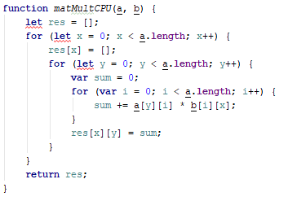
gpu.js

Slide 33
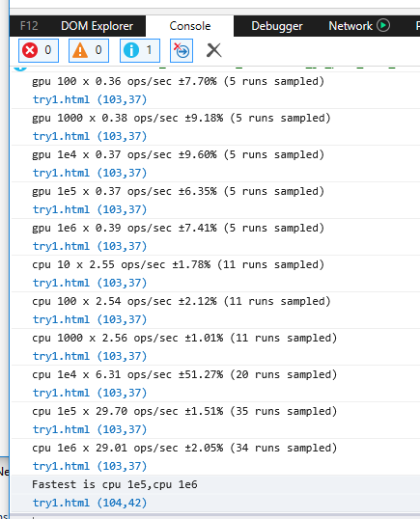
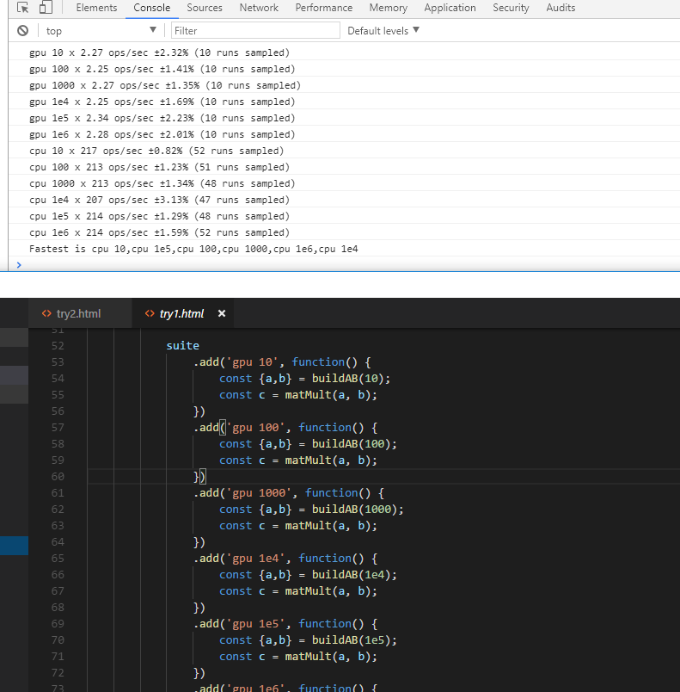
gpu.js

Slide 34
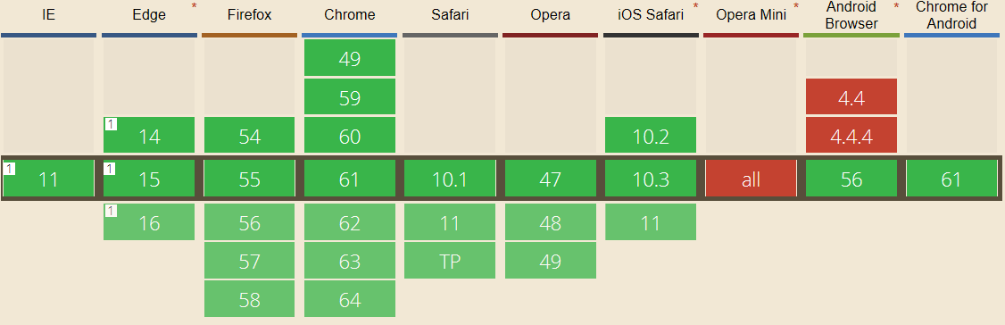
gpu.js

Slide 35
Asm.js

Slide 36
Asm.js
http://asmjs.org/spec/latest/
This specification defines asm.js, a strict subset of JavaScript that can be used as a low-level, efficient target language for compilers. This sublanguage effectively describes a sandboxed virtual machine for memory-unsafe languages like C or C++. A combination of static and dynamic validation allows JavaScript engines to employ an ahead-of-time (AOT) optimizing compilation strategy for valid asm.js code.

Slide 37
let x = inputValue let y = inputValue
x: int ?
y: float ?

Slide 38
let x = inputValue | 0 let y = +inputValue
почему ?

Slide 39
let heap = new ArrayBuffer(0x10000);
access: values[pointer>>3]

Slide 40
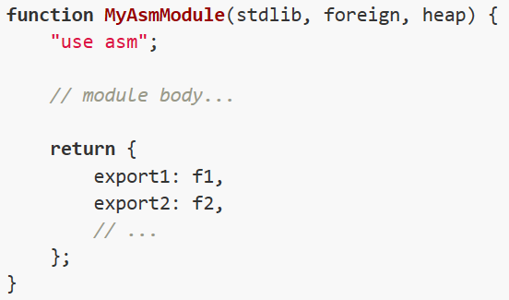
Asm.js

Slide 41
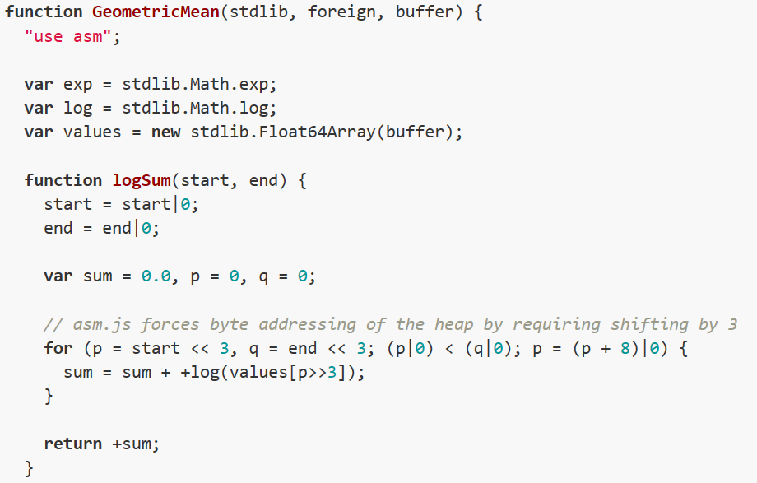
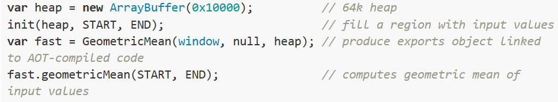
Asm.js

Slide 42
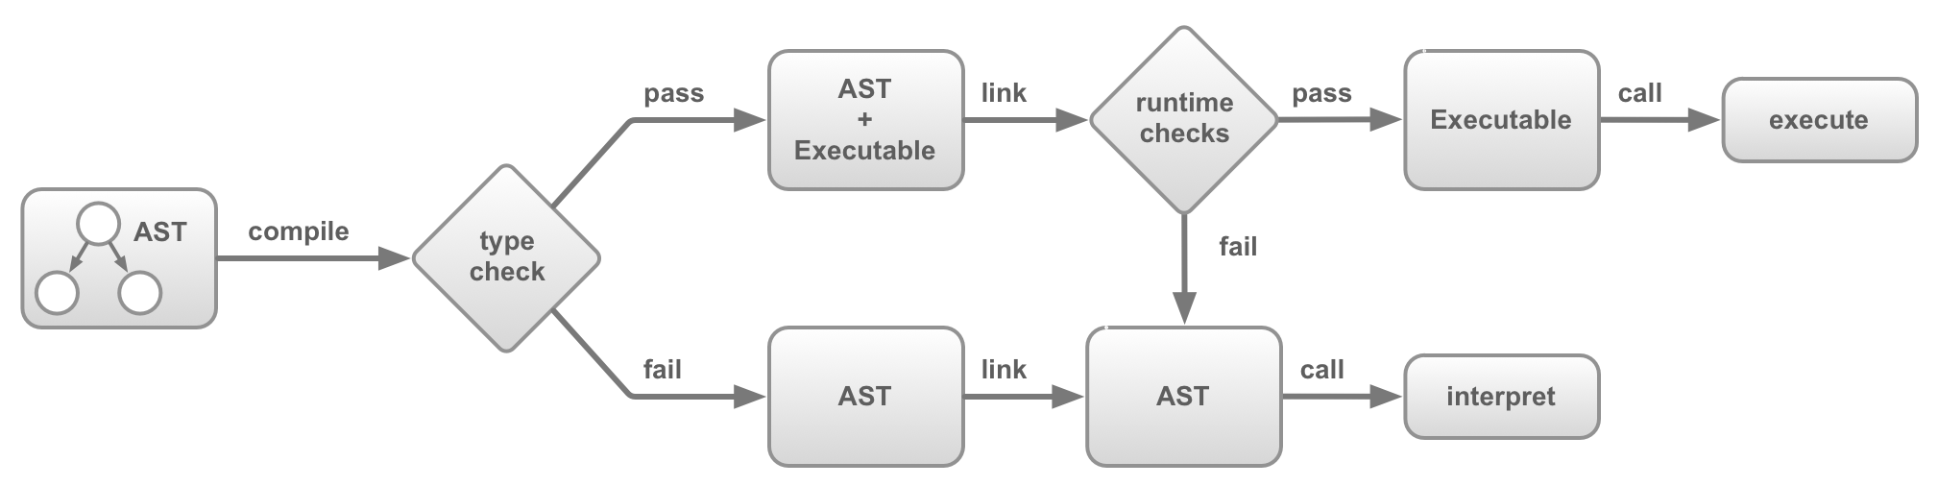
Asm.js

Slide 43
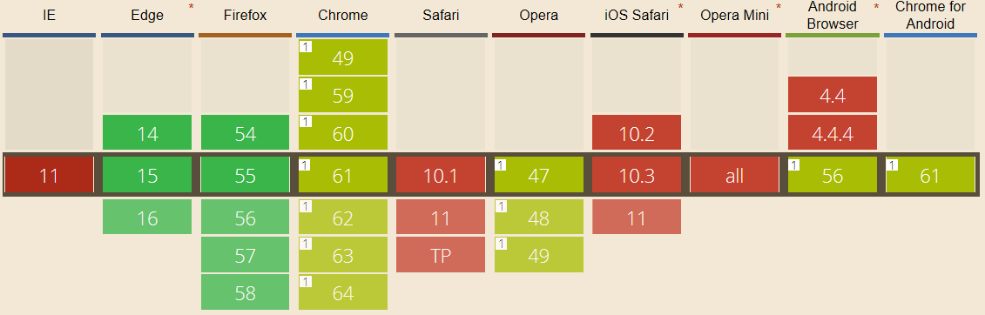
Asm.js
Performance of asm.js code in pass flow ~ fail flow
Performance of asm.js code < origin js code
Примера нет ☹

Slide 44
WebAssembly

Slide 45
WebAssembly Minimum Viable Product
The distributable, loadable and executable unit of code in WebAssembly is called a module.
The behavior of WebAssembly code in a module is specified in terms of instructions for a structured stack machine.
The WebAssembly binary format, which is designed to be natively decoded by WebAssembly implementations, is specified as a binary encoding of a module’s structure and code.
The WebAssembly text format, which is designed to be read and written when using tools (e.g., assemblers, debuggers, profilers), is specified as a textual projection of a module’s structure and code.
WebAssembly is designed to be implemented both by web browsers and completely different execution environments.

Slide 46
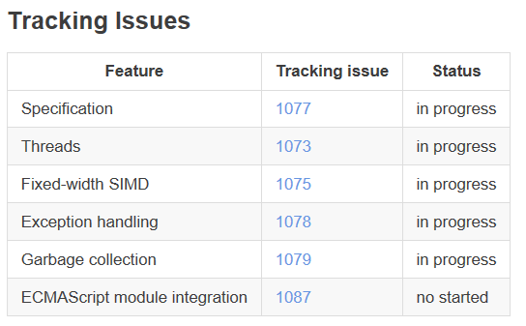
WebAssembly Features to add after the MVP

Slide 47
WebAssembly High-Level Goals
Define a portable, size- and load-time-efficient binary format…
Specify and implement incrementally
Design to execute within and integrate well with the existing Web platform
Design to support non-browser embeddings as well
Make a great platform

Slide 48
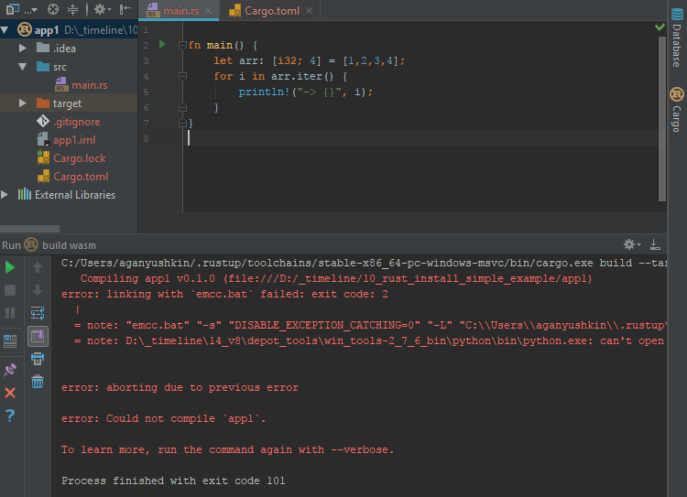

Slide 49
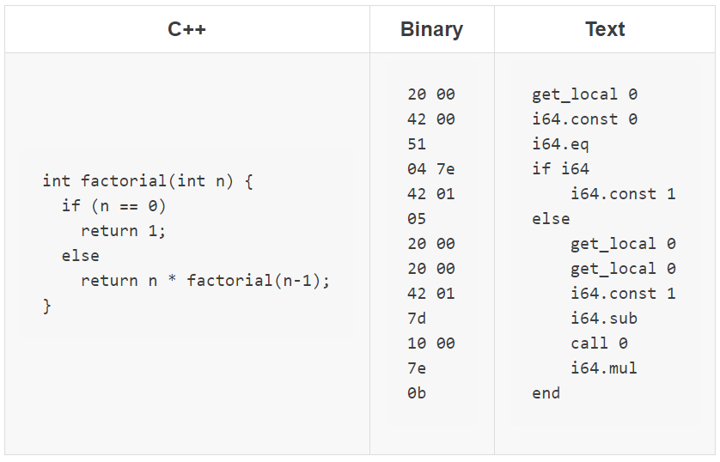
WebAssembly

Slide 50
WebAssembly
Q: Как использовать?
A: Никак.

Slide 51
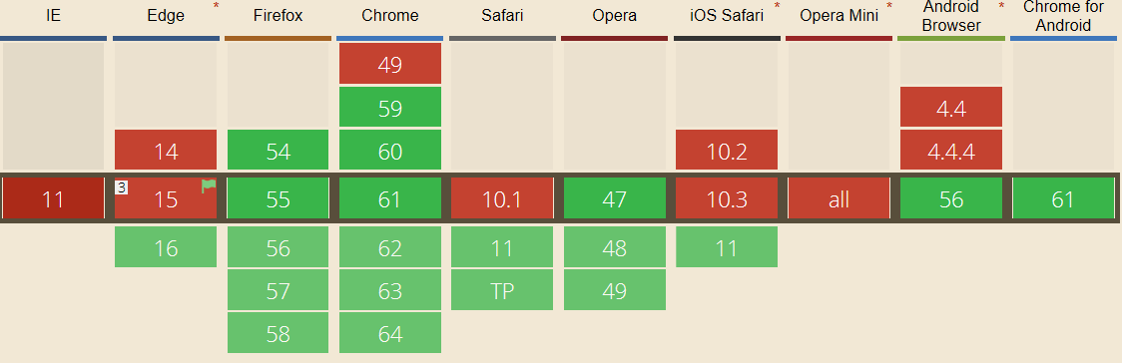
WebAssembly

Slide 52
Rust & C++
AssemblyScript
binaryen
vs_buildtools
emscripten
rustc --target=wasm32-unknown-emscripten hello.rs -o hello.html
repo: 60_rust_asm_wasm_install_simple_example

Slide 53
NodeJS
Addons
WebAssembly
foreign function interface (FFI)

Slide 54
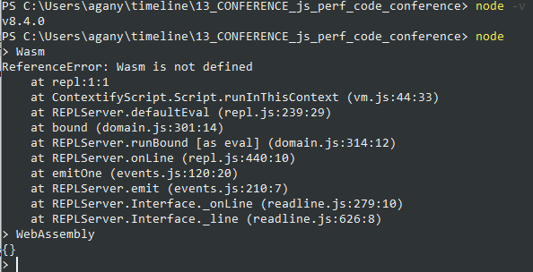
NodeJS WebAssembly
https://gist.github.com/kanaka/3c9caf38bc4da2ecec38f41ba24b77df
http://thecodebarbarian.com/getting-started-with-webassembly-in-node.js.html
https://www.reddit.com/r/javascript/comments/5lcgus/will_future_versions_of_nodejs_support/
https://stackoverflow.com/questions/42852594/compile-hello-world-to-wasm-and-run-in-node

Slide 55
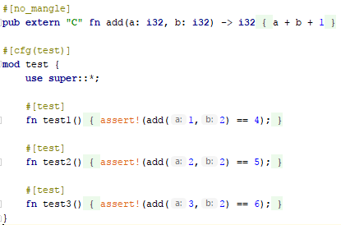
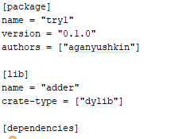
NodeJS FFI

Slide 56
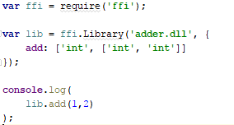
NodeJS FFI

Slide 57
JS Math Libraries
algebra.js
LALOLib
linear-algebra
Algebrite
odex-js
Des-js
graphlib
graphjs
jsgraph
random-js
synaptic
brain
mind
Sushi
Math.js
ConvNetJS
graph.js
big.js
Numeric Javascript
Bignumber.js
javascript-biginteger
decimal.js
Numeral-js
numbers.js
strint
victorjs
Sylvester
Algebra
MathLib.js

Slide 58
Вывод
Browser
JS
C++JS
Workers
GPU
Asm.js
WebAssembly
NodeJS
Addon
WebAssembly
FFI

Slide 59
Вывод
Browser
JS
C++JS
Workers
GPU
Asm.js
WebAssembly
NodeJS
Addon
WebAssembly
FFI

Slide 60

Присоединяйтесь
https://github.com/AGanyushkin/teraflops
Java
C++
Rust

Slide 61
Спасибо!

