Slide 1
Vending Machine in VHDL

Slide 2
Vending machine ini memiliki isi 6 minuman dan 5 makanan dan menerima uang Rp 5.000, Rp 10.000, serta Rp 20.000 (maksimal uang yang ada dalam mesin Rp 20.000)

Slide 3
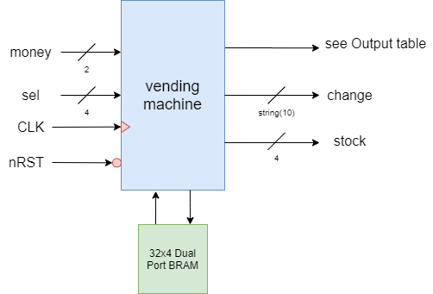
Schematics
Output Table
Drink | Price | Sel code
Water | 5 | 0001
Tea | 5 | 0010
Milk | 5 | 0011
Green tea | 10 | 0100
Coffee | 10 | 0101
Soda | 10 | 0110
Food | Price | Sel code
Candy | 5 | 0111
Chocolate Bar | 5 | 1000
Gum | 5 | 1001
Cookies | 10 | 1010
Chips | 15 | 1011

Slide 4
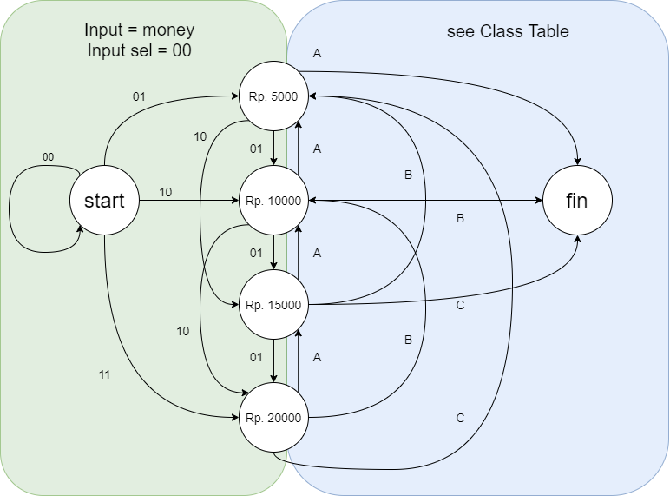
State Diagram
Class A
Input (Sel) | Output
0001 | Water
0010 | Tea
0011 | Milk
0111 | Candy
1000 | Chocolate Bar
1001 | Gum
Class B
Input (Sel) | Output
0100 | Green Tea
0101 | Coffee
0110 | Soda
1010 | Cookies
Class C
Input (Sel) | Output
1011 | Chips

