Slide 1
Ray-Marching Based Water Rendering

Slide 2
Outline
Ray-Marching
Water Generation
Water Rendering
Result

Slide 3
Outline
Ray-Marching
Water Generation
Water Rendering
Result

Slide 4
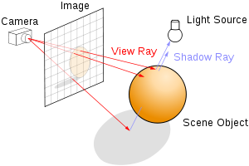
Ray-Marching
Original Ray-tracing
Mesh are already built
Interact with every triangle
Notes:
一般的ray tracing
场景已经被生成，有很多的mesh
光线需要对每个triangle进行interaction的计算

Slide 5
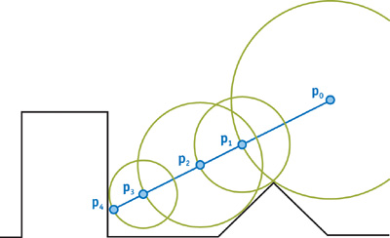
Ray-Marching
Ray-Marching
Signed Distance Function
Ray-tracing based on step
Notes:
场景是用signed distance function描述的，比如一个球体，一个正方体和当前的点的距离
得到最小的距离后，前进那一段距离

Slide 6
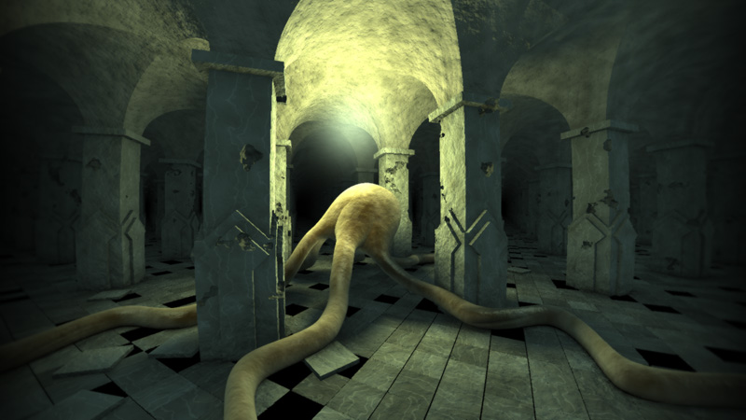
Ray-Marching
Notes:
普通的几何描述经过变形可以渲染出如下的结果

Slide 7
Outline
Ray-Marching
Water Generation
Water Rendering
Result

Slide 8
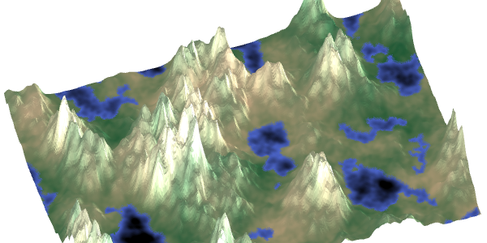
Water Generation
Ridged Multi-fractal Algorithm
Used to generate terrain
Notes:
这种算法通常用来产生下面这种地形

Slide 9
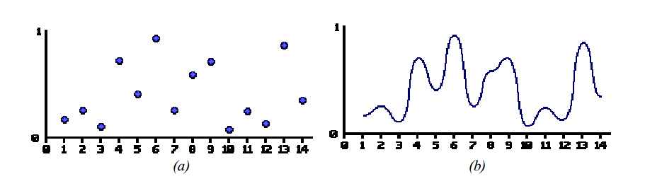
Water Generation
Fractal Algorithm
Based on Noise function
Smooth Interpolation
Notes:
用noise function来产生随机的值，然后对它进行插值
但是太过平滑

Slide 10
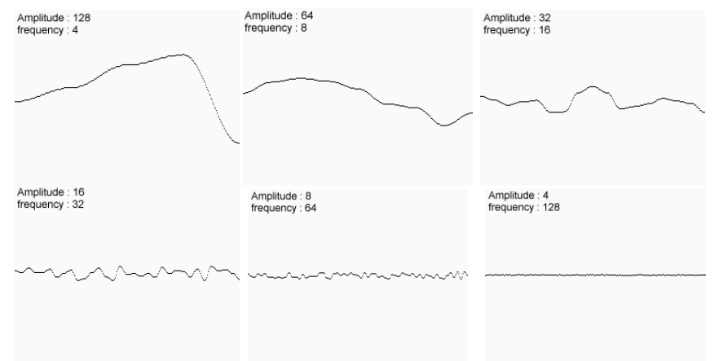
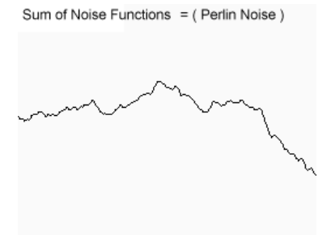
Water Generation
Fractal Algorithm
With different amplitude & frequency
Notes:
使用不同的幅度和频率来生成曲线，然后相加
得到既有整体的起伏又有细节的抖动的曲线

Slide 11
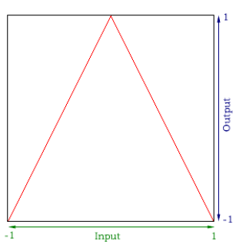
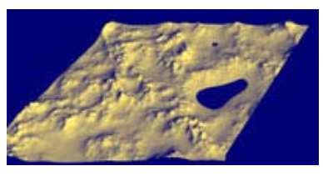
Water Generation
Multi-fractal (to make it more randomly)
Ridged (to make it
Notes:
普通的fractal还是太过规律，可以用multi fractal，在不同的位置产生不同的fractal使结果更随机
Ridged可以让低的地方更低，高的地方更高

Slide 12
Outline
Ray-Marching
Water Generation
Water Rendering
Result

Slide 13
Water Rendering
Shoot an eye ray from camera
Get the distance between water and ray
Calculate the reflection & refraction
Render the point

Slide 14
Outline
Ray-Marching
Water Generation
Water Rendering
Result

Slide 15
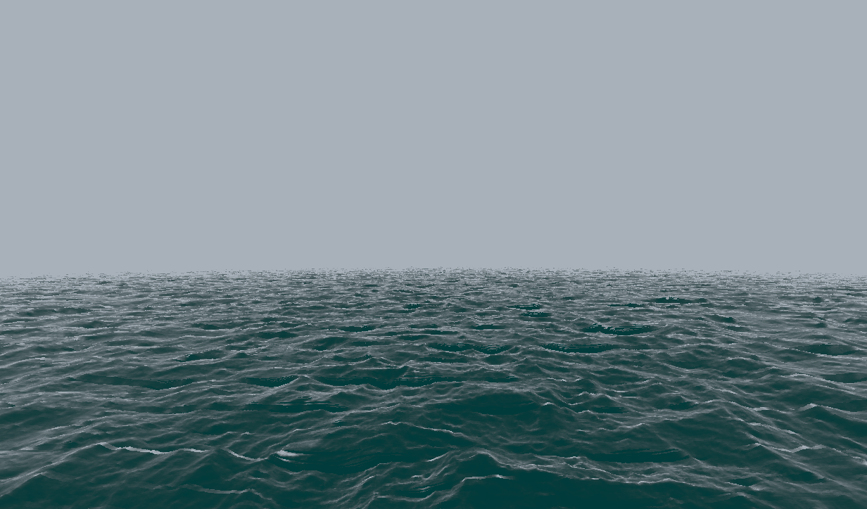
Result
Notes:
目前产生的结果
速度太慢，目测15fps不到
之后工作
VR Mode
Sky
Other interesting things

