Slide 1

Analysis and Implementation of Artificial Neural Networks in C++
Alex Gilsoul

Slide 2
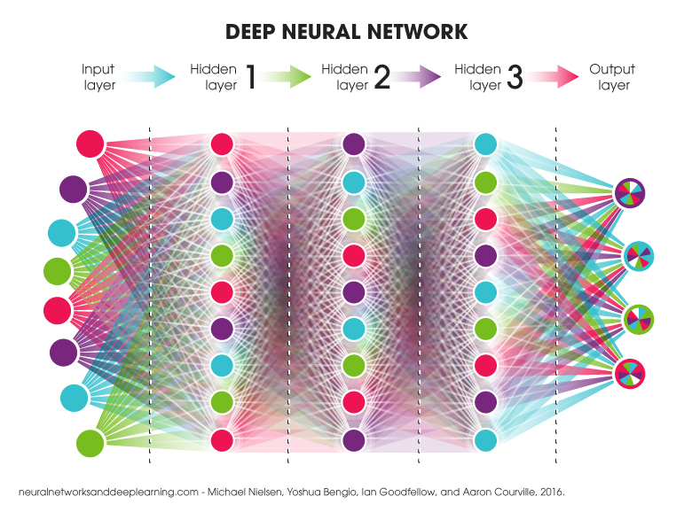
What is Machine Learning?
Machine Learning is the study of predictive computer algorithms that, using large sets of data, improve their predictive accuracy over time.
This can range from regression models that determine the line of best fit for coordinates of data to neural networks being used for speech recognition.
It is a subset of Artificial Intelligence.
An example of a basic neural network

Slide 3
How Does Machine Learning Work?
The way a machine learning algorithm works largely depends on which algorithm is being used, and what problem is being solved.
Most algorithms require the use of basic-advanced calculus for the adjustment of parameters, also called weights, but some just require basic geometry (such as taking the distance between points in higher than 3 dimensions).
A Neural Network is a type of machine learning algorithm that attempts to mimic the structure of the human brain to form connections of varying strength between neurons to make predictions.

Slide 4
Implementing Machine Learning in Code
Most existing resources and libraries for machine learning algorithms are written for the coding languages Python or R. Very few exist for C++, so that is the language I decided to code my algorithms in.
While Python and R are much easier to use, you can get a lot more specific in C++ with how data is used, and the execution speed is much quicker. Because of that, it is the one I spend the most time with and is the one I am most proficient in.

Slide 5
Classroom Foundation for Implementing Machine Learning Algorithms and Neural Networks
Programming a neural network from scratch is far from simple. It requires extensive knowledge of the coding language you’re programming in and a solid mathematical foundation to work from and build off as you research different network architectures and techniques.
Multiple classes at NUAMES have helped me build up this computer science/math foundation. I had programmed before high school, but I wasn’t formally taught until then. I have taken/am taking multiple Computer Science classes, including CS 1030, CS 1400, CS 1410, CS 2420, CS 2550, CS 2705, CS 3230, and CS 5420/6420. I am currently taking Calculus 2, with trigonometry and all the prerequisites completed as well.

Slide 6

The Math of Artificial Neural Networks
Skip

Slide 7

The Perceptron
A perceptron (also referred to as a neuron) is the basic unit of an Artificial Neural Network (ANN).
A single perceptron can perform the task of linear regression (fitting a line to a dataset).
Given a range of inputs, it multiplies each input by a weight, adds a bias, and produces a linear output. This is called the weighted sum.
For a single input (x), the equation is as follows:
$$y=mx+b, where y is the output, m is a weight, and b is the bias$$
If this looks familiar, it is because it is the equation of a line with a slope of m (the weight) and a y-intercept of b (the bias)

Slide 8

The Perceptron
If a perceptron is going to be used for multiple inputs, it is best to represent our inputs and weights as vectors. Our bias is still only a single value.
We can represent an array of n inputs as a vector $x=[\begin{matrix}x_{1} & … & x_{n}\end{matrix}]$
We can represent an array of weights as a vector$w=[\begin{matrix}w_{1} & … & w_{n}\end{matrix}]$
Notice that there are the same number of weights as inputs.
Now that we are using vectors, we can take the dot product of the two vectors to add our bias to get the weighted sum.
${y=x}_{1}∗w_{1}+…+x_{n}∗w_{n}+b$ or $y=\sum_{i=1}^{n}{{(x}_{i}∗w_{i})}+b$

Slide 9
Activation Functions
Perceptrons by themselves can only accurately represent linear data relationships, but what if our data is nonlinear (quadratic, cubic, etc.)?
For this, we need to use layers of multiple perceptrons and an activation function.
An activation function serves to transform the output of a neuron with a non-linear equation, therefore making the output non-linear.
An Artificial Neural Network (ANN) is just a collection of layers with multiple perceptrons, with activation functions applied to their outputs.
With the application of non-linear activation functions, ANN’s can approximate any function (Universal Approximation Theorem)

Slide 10

Common Activation Functions
y = output of a given neuron.
Sigmoid: $S=\frac{1}{1+e^{−y}}, range:(0,1)$
The Sigmoid function is used to classify data into two categories.
ReLu (Rectified Linear Unit): $R=\left\{\begin{aligned}y y>0 \\ 0 y≤0\end{aligned}\right., range:\left(0, ∞\right)$
ReLu is commonly used in hidden layer neurons due to the simplicity of the computations.
The Softmax activation function is used to classify data into more than two categories and is what the sigmoid function is derived from. For the sigmoid function, we have multiple output neurons, and the vector of their outputs is denoted as y, and n as the number of output neurons.
Softmax: ${S(y}_{i})= \frac{e^{y_{i}}}{\sum_{j=1}^{n}{e^{y_{j}}}}$
A benefit to using the Softmax function is that the sum of all outputs will equal 1, making it easier to compare how likely the neural network thought each category is.

Slide 11
Artificial Neural Network Structure
There is a basic structure that every ANN follows:
1 input layer
N hidden layers
1 output layer
Each layer contains neurons (perceptrons).
There can only be 1 input and 1 output layer.
The number of hidden layers depends on the complexity of the task.
For most tasks, one hidden layer is sufficient.
Every neuron in a layer is connected to every neuron in the next layer.
This means that the number of weights/connections in an ANN is equal to the size of the first layer, multiplied by the size of the next layer, which is added to the size of the next layer multiplied by the size of the layer after that, and so on.

Slide 12
Input Layer
The input layer contains one neuron for each data feature.
For example, if you want to predict a car’s price, and you know the release year of the car, the miles driven, and the MPG, you will have three neurons in the input layer.
The input layer’s only job is to feed the data to the first hidden layer.

Slide 13
Hidden Layers
There can be any number of hidden layers, but one is usually sufficient for most tasks.
There can also be any positive number of neurons (n) in a hidden layer. There is no perfect number of neurons in a hidden layer, but typically a good place to start is between the number of neurons in the input layer, and the number of neurons in the output layer.
The hidden layers transform the data through their weighted sums and activation functions for the output layer to process.

Slide 14
Output Layer
The output layer is responsible for making predictions based on the data that is passed to it from the hidden layers. As such, there can only be one output layer.
The number of neurons in the output layer depends on the task.
If you are trying to predict an exact value (regression), then the output layer must have one neuron with no activation function applied.
If you are trying to classify data into categories (classification), the number of output neurons depends on the number of categories. For two categories, the output layer can use one neuron with the sigmoid activation function. For n categories where n > 2, there are n output neurons, each with the Softmax activation function.

Slide 15
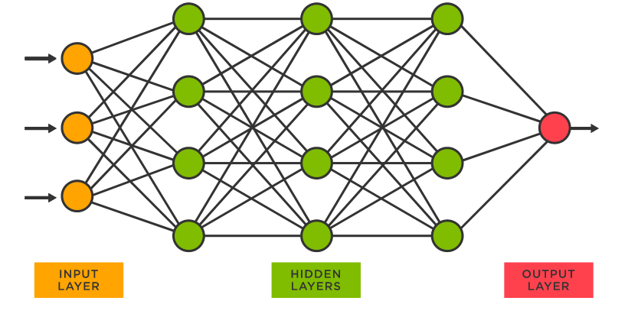
Artificial Neural Network Visualized
Skip
https://www.tibco.com/reference-center/what-is-a-neural-network

Slide 16
Forward Propagation
Forward Propagation is the process through which data is passed through a neural network to make a prediction.
The outputs of an entire layer of neurons can be represent using matrices, which will be derived by extending our vector equations for single perceptrons.
This works because matrices can be defined as rows of vectors

Slide 17

Forward Propagation
Given a layer of n neurons with the following attributes:
Input vector (output of previous layer) $x=\left[\begin{matrix}x_{1} \\ ⋮ \\ x_{N}\end{matrix}\right], size=N∗1, N=number of inputs$
Weight matrix $w=\left[\begin{matrix}w_{1,1} & ⋯ & w_{1,N} \\ ⋮ & ⋱ & ⋮ \\ w_{n,1} & ⋯ & w_{n,n}\end{matrix}\right], size=n∗N (each row contains the weights of one neuron$
Bias vector $b=\left[\begin{matrix}b_{1} \\ ⋮ \\ b_{n}\end{matrix}\right] (each row contains the bias of one neuron)$
The output can be defined as follows:
$$O=w∗x+b=\left[\begin{matrix}O_{1} \\ ⋮ \\ O_{n}\end{matrix}\right], size=n∗1, where we take the dot product of x and w, then add b$$
This output is in vector form as well, but now the number of outputs is equivalent to the number of neurons in the layer

Slide 18

Forward Propagation
Once we have our output O, we then apply our activation function to every value in the vector.
If our activation function is ReLu, the activated output is as follows:
$A\left(O\right)=A\left(\left[\begin{matrix}O_{1} \\ ⋮ \\ O_{n}\end{matrix}\right]\right)=\left[\begin{matrix}{ReLu(O}_{1}) \\ ⋮ \\ {ReLu(O}_{n})\end{matrix}\right]$
This activated output is then used as the input vector for the next layer.

Slide 19
How do we train ANNs?
Forward propagation on its own will not provide accurate predictions. Weights are randomly generated, as it would likely be impossible to generate perfect weights from the start.
Because of this, we must train the ANN. To this, though, we need a well-defined cost function.

Slide 20

Cost Functions
Cost functions are used to define the error between our network’s prediction of a data sample and the actual value of that data sample.
Common cost functions include Mean Squared Error (MSE) and Cross-Entropy Loss (CEL)
We will be using both for our network.
MSE is defined as follows:
$MSE=\frac{1}{n}\sum_{i=1}^{n}{{(A_{i}−T_{i})}^{2}}$
$$where n is the number of data samples,A_{i} is the predicted value of sample i, and{ T}_{i} is the actual value of sample i$$
CEL is defined as follows:
$CEL=−\sum_{i=1}^{n}{T_{i}∗log(A_{i})}$
$$where n is the number of data samples,A_{i} is the predicted value of sample i, and{ T}_{i} is the actual value of sample i$$
MSE is used for regression tasks where we need to predict specific values, whereas CEL is used for classification problems.

Slide 21
Cost Functions
We want to find the minimum value of the cost function, where the difference between the predicted and actual value of all samples is the smallest. Since we can’t change the actual values of the samples, we must change the predicted values. We can do this by adjusting the weights and biases of each neuron in each layer, through a process called backpropagation.
Before we get to backpropagation, rather than finding the minimum MSE for all samples, we try to minimize the squared error for each individual sample, which in turn will minimize the MSE. Doing this makes updates to the parameters of the network more frequent during training, decreasing the time it takes for the network to converge on a minimum, however this increases the number of computations required. This process is called stochastic gradient descent. There are other forms of gradient descent, such as batch gradient descent and mini-batch gradient descent.

Slide 22
Back Propagation
Back propagation is the process through which weights and biases are updated in a neural network.
It uses gradient descent to calculate the partial derivative of a weight or bias with respect to the loss function.
Once that partial derivative is calculated it is multiplied by the learning rate, a decimal value such as 0.01, which is a parameter that the designer of the network chooses. There is no optimal learning rate, but 0.01 is a common and effective choice.
After the partial derivative of the weight with respect to the cost function is multiplied by the learning rate, it is subtracted from the original value of the weight. This adjustment nudges the weight towards the minimum of the function, and slightly decreases the error for that training sample.
The samples are not all the same though, so a nudge to a weight from one sample may increase the error of another sample. Therefore, the process is repeated many times with many training samples in stochastic gradient descent, until the only adjustments being made are very small. When this happens, it means that each weight very is close to the minimum of the cost function and is fluctuating around it. Training can then stop at this point. Training further past this point may lead to overfitting, which is when the network is tuned to the training data so specifically that it becomes inaccurate for unseen data.

Slide 23
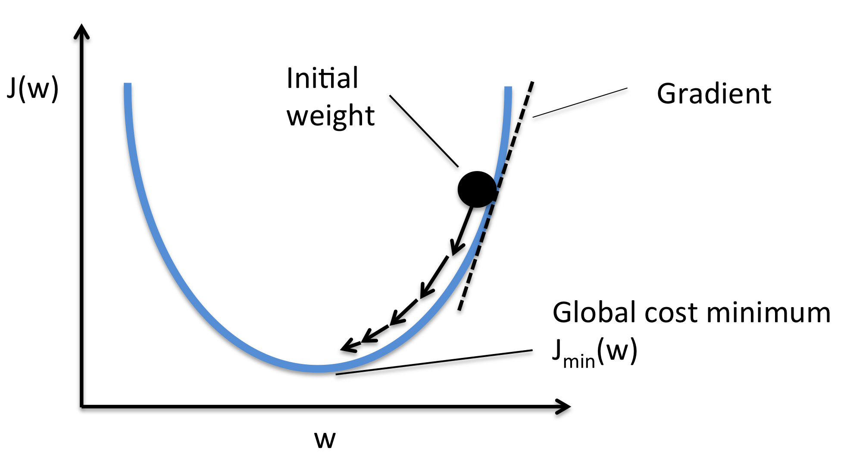
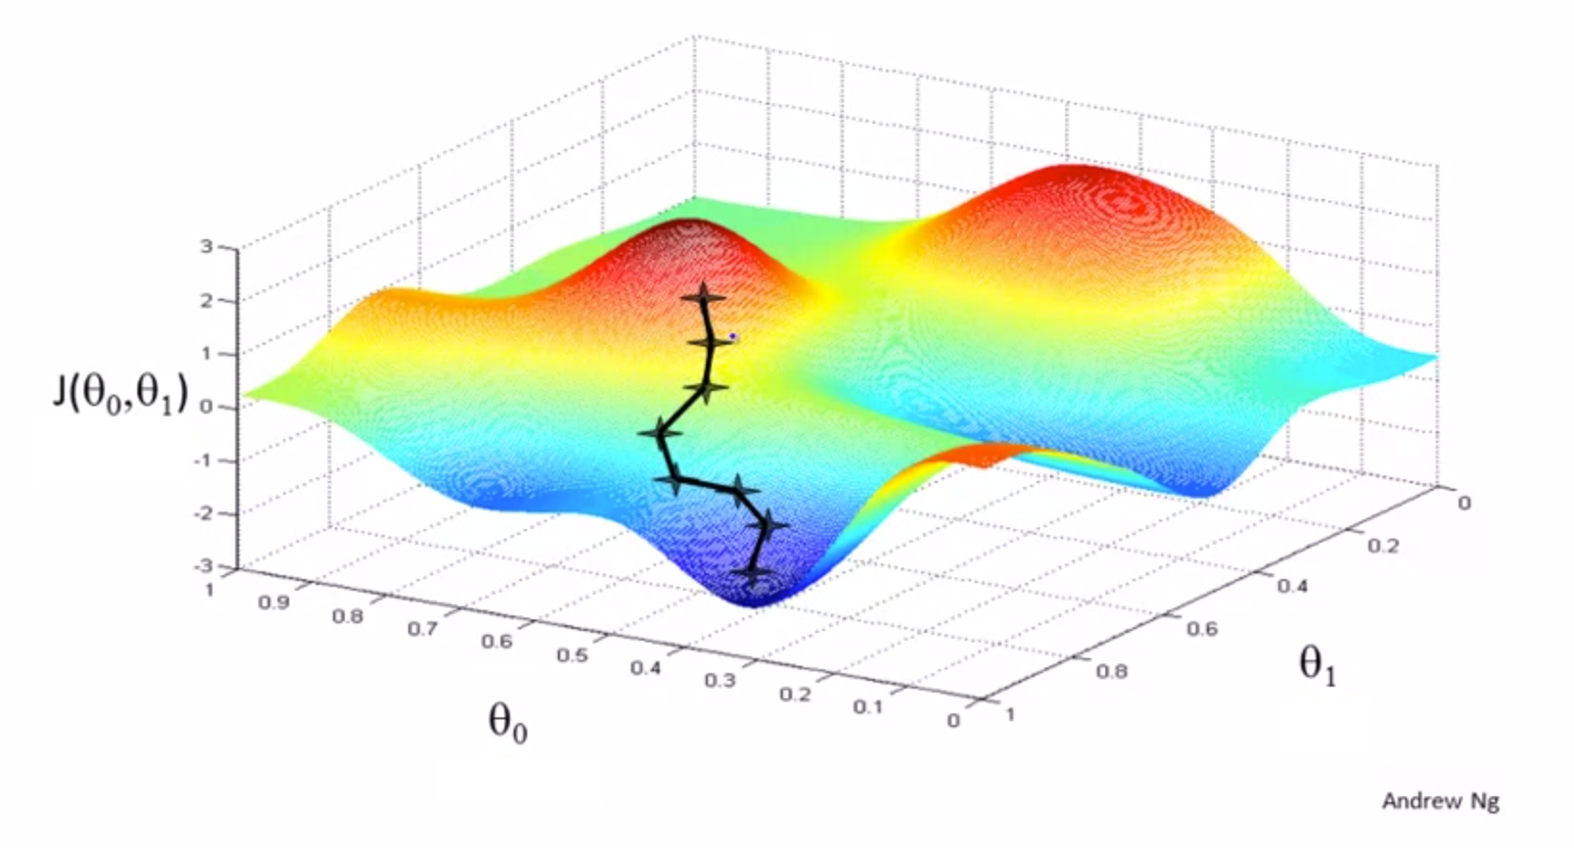
Gradient Descent Visualized
http://rasbt.github.io/mlxtend/user_guide/general_concepts/gradient-optimization/

Slide 24


How I Made an Artificial Neural Network in C++

Slide 25
Data Normalization Function
The data normalization function was one of the first functions I implemented. It does the very important job of making sure all data is on the same scale (0-1), and that from the start, no data trait is more important than another simply due different value ranges.
For example, the price of a recently built house can be in hundreds of thousands of dollars, whereas the age of that house could be in the single digits. Both factors are important, but if the data wasn’t normalized, the price would automatically play a bigger role due to the natural values of the data.

Slide 26
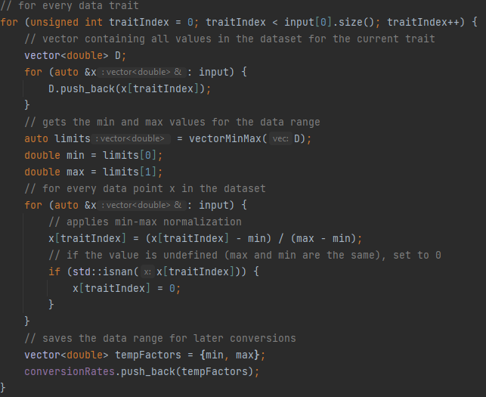

Data Normalization Function
The data normalization method I used is called min-max normalization. Given a set of data D, to normalize each element in D, we can use the following equation:
$$∀x∈D\frac{x−\min\left(D\right)}{\max\left(D\right)−\min\left(D\right)}$$
This translates to for every element x in the set D, subtract the minimum value in D from x, and then divide by the difference between the maximum and minimum values in D.

Slide 27
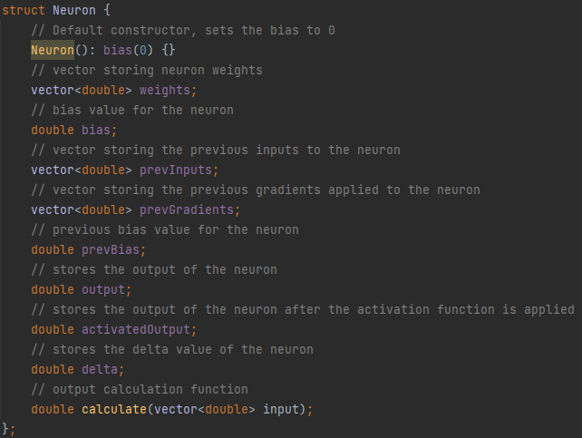
The Neuron Struct
Neurons are the foundation of neural networks, and one of the first things I define in my program. I implemented them as a struct data type, each with their own values to simplify the implementation.
Each neuron has its own weights and bias and stores its other necessary information for the gradient descent process.

Slide 28
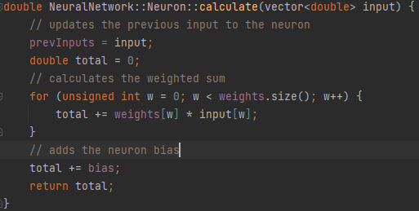
Neuron Output Calculation Function
Each neuron produces its own unique output, so as part of the neuron struct there is a “calculate” function, which produces the output for each neuron. Given a vector of inputs, it takes the weighted sum of the neuron weights and the input vector and adds a bias. This value is then returned.

Slide 29
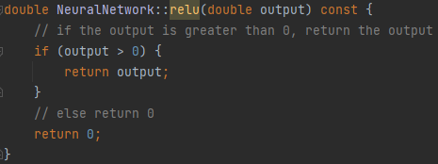
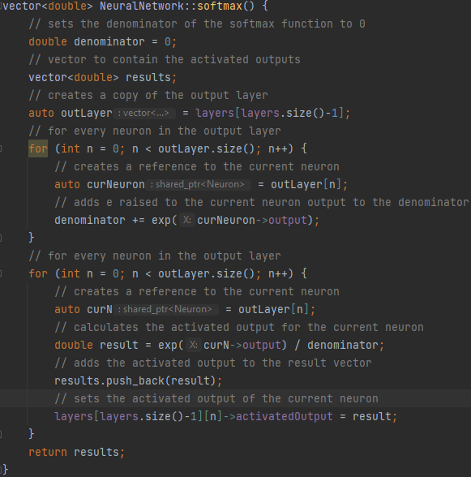
Activation Functions
The activation functions are applied directly after the output of each neuron is calculated, so naturally they were the next thing I implemented.
For every hidden layer, the ReLu activation function is used. For the output layer, if the model is being used for regression, no activation function is used and the raw output is returned, however if the model is being used for classification, the softmax activation function is used.

Slide 30
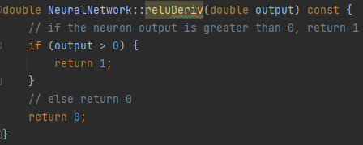
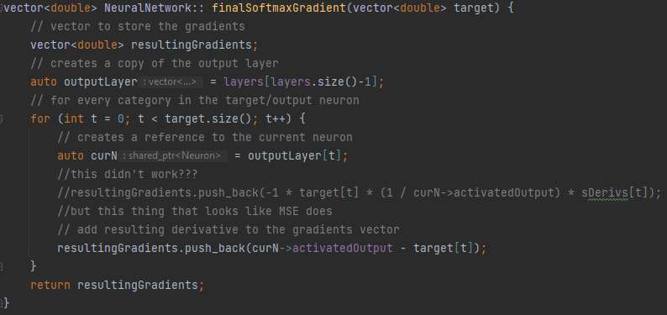

Activation Function Derivatives
For the gradient descent process to work, the partial derivatives of the weights with respect to the output must be calculated. To calculate this derivative, we must first know the derivative of the activation functions to apply the chain rule from calculus, as the outputs are processed through these functions. Having just programmed the activation functions, I then programmed the derivatives functions.
Something to note is that for the derivative of the ReLu function, since it is defined as a piecewise function, the derivative technically does not exist when $x=0$. In my implementation I have set the derivative to equal 0 when x is zero in order to avoid the problem of no value being returned
For the softmax function, deriving it proved to be pretty difficult, so I had to turn to the internet. The answer I got (and the one that works) is one that I am still trying to understand.
In addition to this, there are other functions that include the words “gradient” or “derivative” which utilize these methods. These methods are just helper methods that streamline the process of computing the derivative in the training method

Slide 31
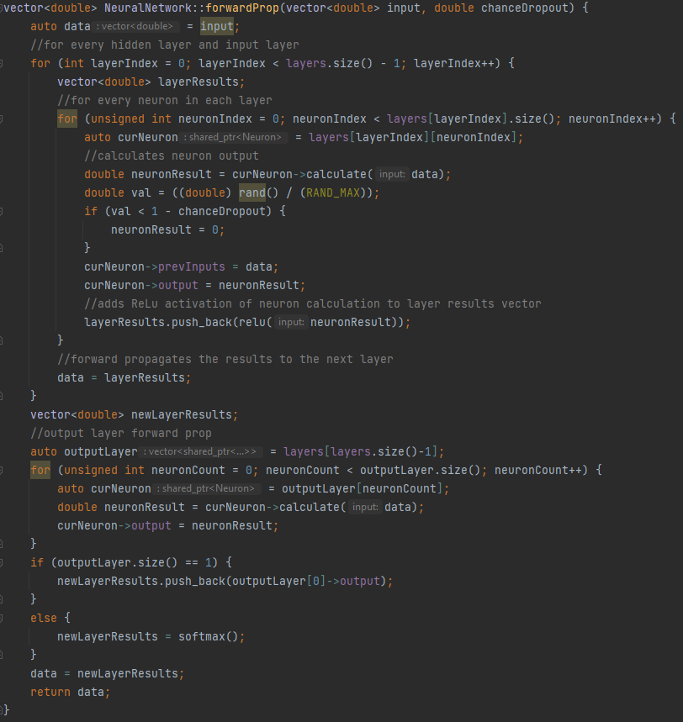
Forward Propagation Function
This function is responsible for sending data through the layers of the neural network to make a prediction. For the input layer, the data inputs are processed, and the layer output is passed to the first hidden layer. Each hidden layer uses the previous layers output as its input, processing the data and passing it forward until it reaches the output layer where the final output/prediction is made.

Slide 32
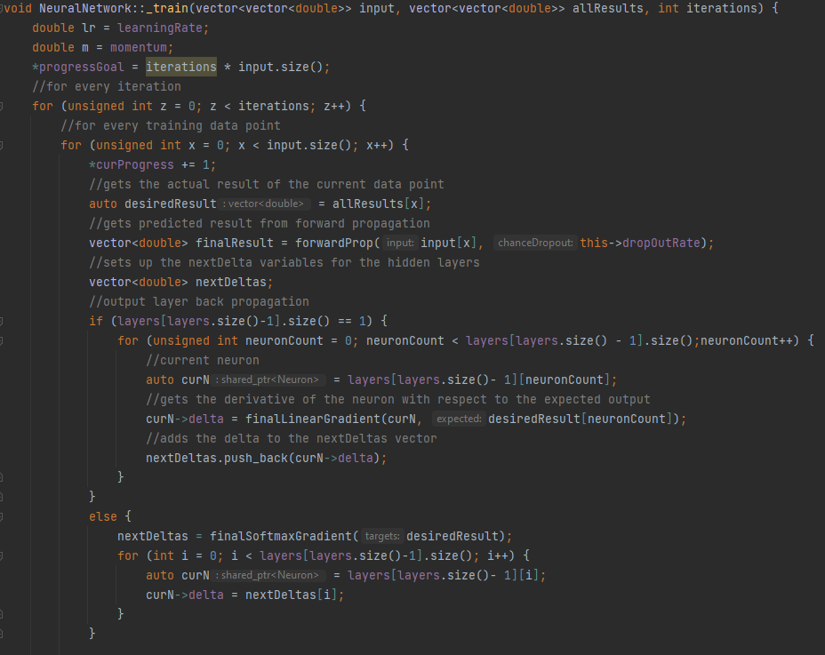
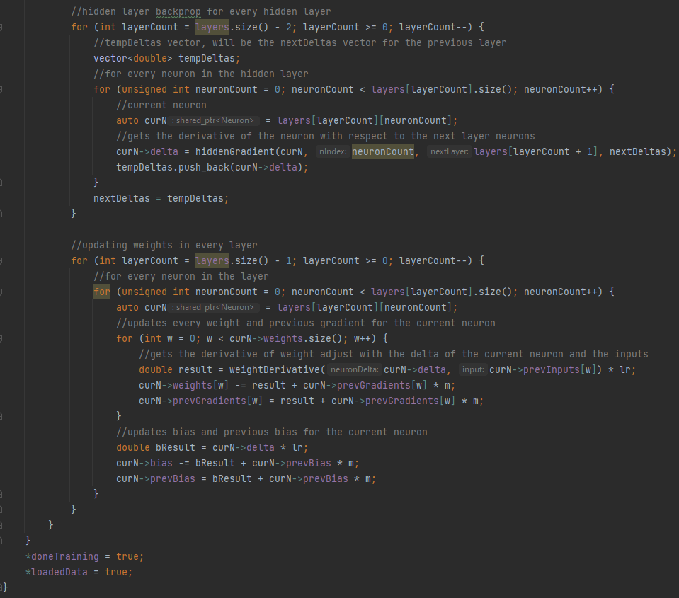
Training Method(s)
There are multiple training methods that I programmed, including variants for stochastic gradient descent and mini-batch gradient descent. The one I will display here is the stochastic training method, as all the methods are roughly the same, with just a few slight tweaks here and there. The function is hard to display here as it is quite long. It should also be noted that there are a few helper methods that have not been described, such as some of the derivative and gradient methods. These are just extensions of the previously defined derivative methods that help streamline the process of getting the partial derivatives for each weight.

Slide 33
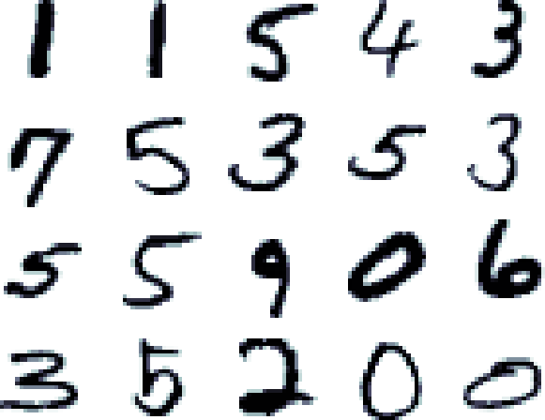
Results!
Once I was finished implementing all the previously mentioned functions, in addition to some others that made using the code easier, the network was finished for the most part. After about a month of troubleshooting in-between doing homework and during free time in class, it finally started working.
I have tested my neural network program on a variety of tasks, including both regression and classification with exceptional results. I have been testing the most on a classification dataset called the MNIST database.
The MNIST database contains tens of thousands of 28x28 images of handwritten digits 0-9 in black and white. With sufficient training time (in its current state <20 minutes is usually enough) and tuning, my program can consistently produce models that accurately determine which number the handwritten digits represent with 95% accuracy, increasing to 97% with certain model improvements.
Another dataset I have tested on quite a bit is a dataset called the Energy Efficiency Data Set from the UCI Machine Learning Repository. This dataset includes structural data on over 700 residential structures, along with their energy requirements. My program can train models that can predict these energy requirements with high accuracy, achieving R-squared values of over 0.9 (on a scale of 0-1, where 1 is a perfect match to the data).
Example MNIST digits

Slide 34
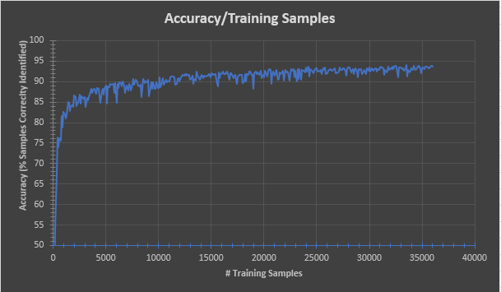
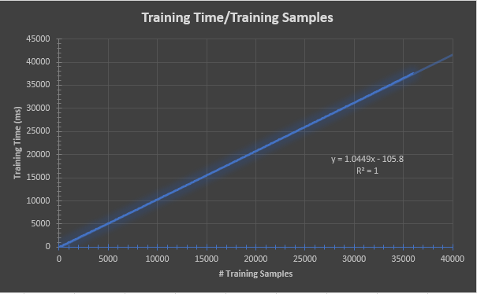
MNIST Base Model Testing Accuracy and Runtime Data
Model Specs
Learning Rate: 0.001
Neurons in 1 Hidden Layer: 32
Training Iterations: 1
Training Samples per Iteration: 36000

Slide 35
Model Improvements
Since I finished my program, I have been researching various ways to improve the accuracy and efficiency of my models. Some examples of this are shown below.
Momentum is a scalar value that is applied to weights. It is similar to the learning rate, except it is multiplied by the previous gradient for a weight and applied with the current gradient. This promotes adjusting weights in the same direction over time and makes it harder for them to slow down in these adjustments. This can lead to quicker convergence of a model and avoidance of local minima but can also lead to overshooting of the best value for a weight, and a sporadic training process. A good value for momentum is 0.9.
Dropout is a percentage relating to the number of neurons being adjusted each time a gradient is calculated. 1.0 means all neurons are trained every time, and 0.0 means no neurons are trained every time. By choosing a value such as 0.8, only 80% of the neurons in each layer are trained at a time. This helps reduce overfitting of a mode, which can reduce the accuracy when predicting the values of unseen data, due to the model fitting the training data too specifically.

Slide 36
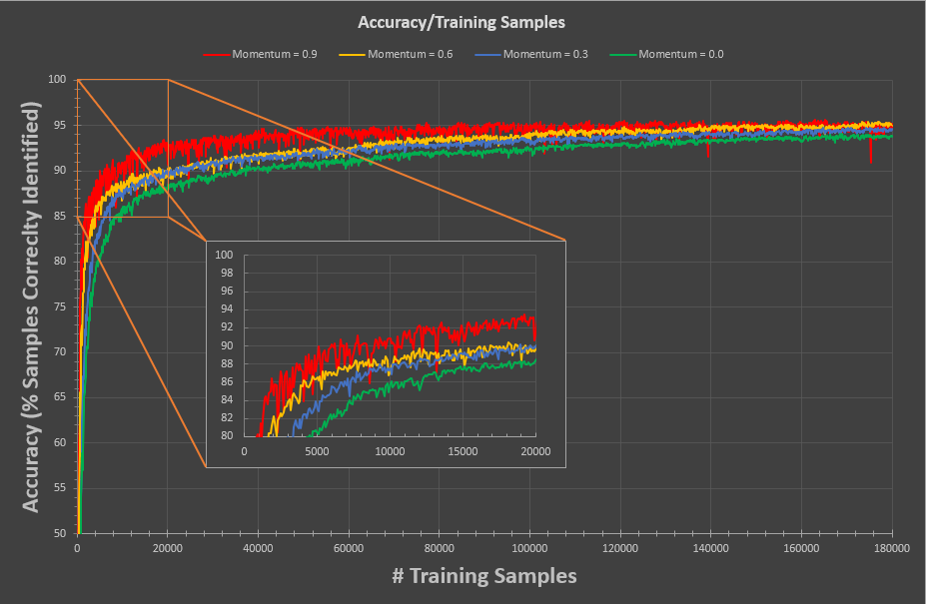
MNIST Momentum Testing Data
Model Specs
Learning Rate: 0.001
Neurons in 1 Hidden Layer: 32
Training Iterations: 5
Training Samples per Iteration: 36000

Slide 37
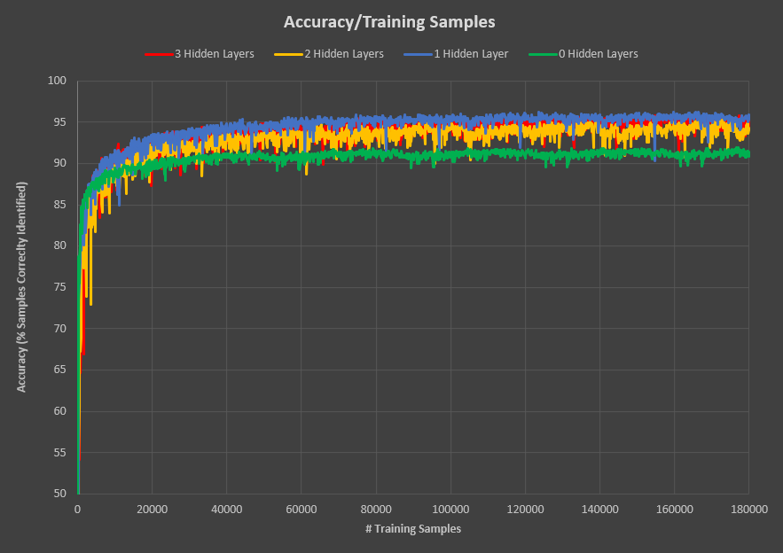
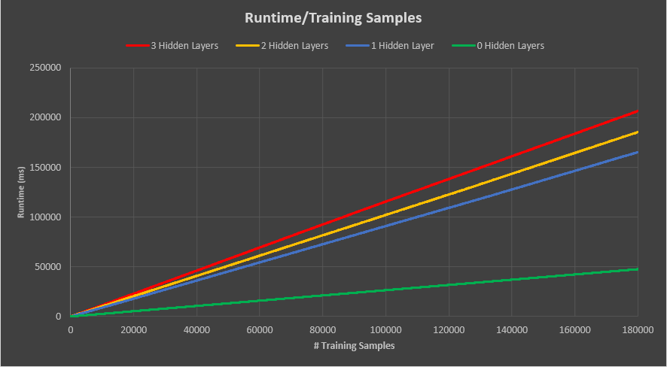
MNIST Model Complexity Testing Data
Model Specs
Learning Rate: 0.001
Neurons per Hidden Layer: 32
Training Iterations: 5
Training Samples Per Iteration: 36000

Slide 38
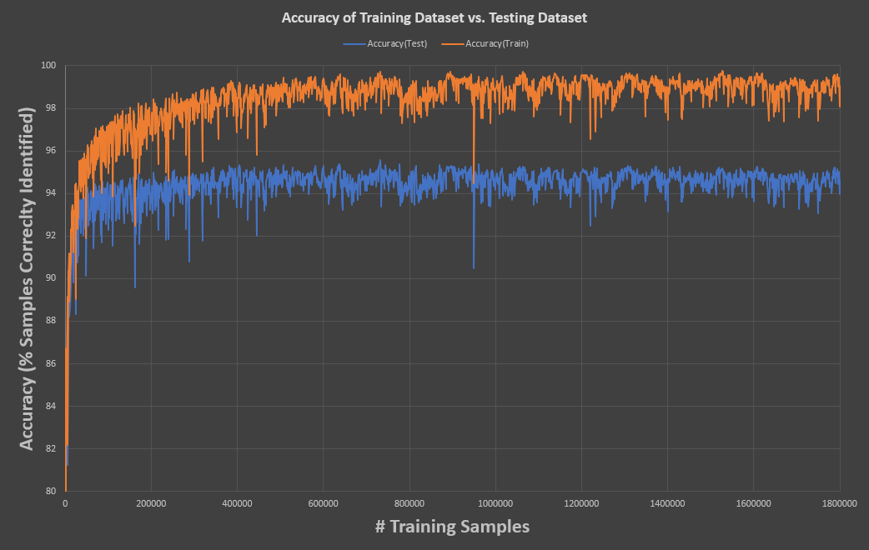
MNIST Model Overfitting
Model Specs
Learning Rate: 0.001
Neurons in 1 Hidden Layer: 32
Training Iterations: 5
Training Samples per Iteration: 36000

Slide 39
Citations and Links
Link to GitHub Repository (contains the code and data files)
https://github.com/AGilsoul/GilsoulCapstone
Resources used for learning purposes
https://www.codecademy.com/learn/machine-learning
https://towardsdatascience.com/the-maths-behind-back-propagation-cf6714736abf
Datasets:
MNIST Database
http://yann.lecun.com/exdb/mnist/
Residential Structure Energy Efficiency Dataset
https://archive.ics.uci.edu/ml/datasets/energy+efficiency

