Slide 1

Reactive Programming with NgRx
Reactive STATE MANAGEMENT for Angular
Alessandro Giorgetti www.primordialcode.com

Slide 2
What is NgRx ?
It’s a Reactive State Management library for Angular.
At its core NgRx is the Redux State Management Pattern + Angular Extensions.

Slide 3
The Redux Pattern
Enforces one way dataflow (for the state management) throught the whole application.
Promotes the use of a «Single Source of Truth» for the Application State: The Store™.
The State is Read-Only: the only way to change the state is dispatching Actions™.
Changes to the state are made by Pure Functions: The Reducers™.

Slide 4
The Redux Pattern - Illustrated
NgRx Store
View (UI)
Selector(s)
Event
Slice of State
New State
Slice of State
Store
(State)
Component
Convert Event to
State
New State
Action
Reducer(s)
Dispatch

Slide 5
NgRx, Redux and Reactive Applications
Is this «Reactive» ?
What does this has to do with RxJS ?

Slide 6
ngrx/store

Slide 7
NgRx/Store
NgRx/Store is a predictable state container for Angular Applications.
The state is «isolated and protected»: noone (but the reducers) is allowed to modify the data it holds.
The only ways to intract with the store are:
dispatch an Action (a form of «async» communication).
get a notification that something changed through selectors (a form of «async» communication).

Slide 8
NgRx/Store
Allows us to write a Reactive Application:
Programming with Asynchronous (Observable) Data Streams.
Async messaging and loose coupling.
RxJS: the Observable is the «primitive» type used in JavaScript / Angular to implement asynchronous data streams.
Mentality switch: from a pull approach to a push approach.

Slide 9
NgRx Core Principles
State: is a single, immutable data structure.
Actions: events dispatched from components and services, they describe and trigger state changes.
Reducers: pure functions (functions no side effect) that take the previous state and the next action to compute the new state. The reducers are the only way to “mutate” the state inside the Store.
Selectors: state is accessed using selector functions (pure functions) that return an observable of a slice (or a projection) of the state.

Slide 10
Redux / NgRx → CQRS applied to the UI ?
Using Redux or NgRx to write an application is much like implementing it following the CQRS guidelines and patterns in JavaScript / Angular world.
Message Driven: Commands / Events == Actions / State Change Notifications.
Read pipeline: Projections == State -> Selectors.
Write pipeline: Command → Aggregate → Event == Action → Reducer → State Action → (Side)Effects → Actions.
There's a clear separation between a read and a write pipeline, like the CQRS approach.

Slide 11
ngrx/store Setup
npm install @ngrx/store --save
Then import the StoreModule in the AppModule.
StoreModule.forRoot({...}, { initialState: {...} });

Slide 12
1) State
WARNING: the State should be considered an IMMUTABLE object, you are not allowed to mutate the value of a single property!
export interface ICounterState {
count: number;
faulty: boolean;
}
export interface IAppState {
counterState: ICounterState;
}

Slide 13
2) Provide an Initial State
export const initialCounterState: ICounterState = {
count: 0,
faulty: false
};
export const initialAppState: IAppState = {
counterState: initialCounterState
};
in the AppModule:
StoreModule.forRoot({…}, { initialState: initialAppState })
Notes:
Remove ambiguity

Slide 14
3) Define Actions
export enum CounterActionTypes {
INCREMENT = '[Counter] Increment', // best practice: add some
// namespacing
…
}
export class Increment implements Action {
readonly type = CounterActionTypes.INCREMENT;
}
export type CounterActions = Increment | Decrement | …;
Notes:
String Enum Types and Discriminated Unions to take advantage of TypeScript Type Inference

Slide 15
4) Reducers: react to actions, change the state
WARNING: do NOT mutate the state! Always return a new oject, this is the only way we guarantee immutability!
export
function counterReducer(state: ICounterState, action: CounterActions): ICounterState {
switch (action.type) {
case CounterActionTypes.INCREMENT: {
return {
...state,
count: state.count + 1
};
}
default: {
return state;
}
}
}
Notes:
A Reducer is a pure function that takes two arguments: the current state and the Action to perform, it will return a new instance of the state.
Reducers operate synchronously.

Slide 16
5) Configure the Store with Reducers
feed the StoreModule.forRoot() function with an ActionReducerMap<TState>object that provides the references to the reducers functions.
export const reducers: ActionReducerMap<IAppState> = {
counterState: counterReducer
};
StoreModule.forRoot(reducers, { initialState: initialAppState }),

Slide 17
6) Selectors: expose slices of the state as observables
In the Component: inject the store and use the select operator:
this.counter$ = store.pipe(select('counterState'));
Best Practice - use a selection function:
export const counterSelector = createSelector(
(state: IAppState) => state.counterState
);
this.counter$ = store.pipe(select(counterSelector));
Notes:
Select will return an Observable<TState>, you can use AsyncPipe to subscribe to the state changes in the UI or use any RxJS operator to process the data stream.

Slide 18
Benefits of «createSelector»
// selectors created with the 'createSelector' function have many advantages over using plain
// functions, the most important: composition and memoization.
export const counterCountSelector = createSelector(
counterSelector,
state => state.count
);
export const counterFaultySelector = createSelector(
counterSelector,
state => state.faulty
);
Notes:
Memoization is a sort of caching: selectors are pure function, so given the same inputs they return the same output.
NgRx establishes a cache so if the input do not change the result of the (previous) elaboration is immediately returned.
Only the last input will be cached.

Slide 19
7) Dispatch Actions
Inject the Store service and call the dispatch() method:
this.store.dispatch(new Increment());

Slide 20
ngrx/effects

Slide 21
NgRx/Effects: a side effect model for ngrx/store
Listen for actions dispatched to @ngrx/store.
Isolate side effects (i.e.: access to external services, business logic, etc.) from components, promoting the creation of more 'pure' components that select state and dispatch actions.
Provide new sources of actions based on external interactions such as network requests, web socket messages and time-based events.
An Effect is an Observable<Action | Action[]> that should emit non empty arrays of Actions that will (optionally) be dispatched to the Store by the library itself.

Slide 22
NgRx Effects - Illustrated
NgRx Store
Selector(s)
View (UI)
New State
Slice of State
Store
(State)
New State
Event
Slice of State
State
Component
Reducer(s)
Dispatch
Convert Event to
Action
Dispatch
cloud
Action
Effect(s)
Emit

Slide 23
ngrx/effect Setup
npm install @ngrx/effects --save
Then Import the EffectsModule in the AppModule
EffectsModule.forRoot([...list of effects...])

Slide 24
1) Define the Effect Service Class
@Injectable()
export class CounterEffects {
constructor(
private actions$: Actions<CounterActions>
) { }
}
Actions<TActions>: an observable of Action(s)

Slide 25
2) Configure the EffectsModule
export const effects = [ CounterEffects ];
In the AppModule:
EffectsModule.forRoot([...effects])

Slide 26
3) Implement the Side Effect (in the side effect class)
@Effect() fail$ = this.actions$
.pipe(
ofType(CounterActionTypes.RANDOM_FAILURE),
tap((a) => console.log(a.type)),
delay(2000), // add latency, simulate network call
map(() => {
// get a number between 1 and 10
return Math.floor(Math.random() * 10) + 1;
}),
filter(num => num < 5),
map((num) => new Fail())
);

Slide 27
Effects might not dispatch Actions
To not dispatch actions at all:
@Effect({ dispatch: false })
To not dispatch actions under some conditions:
Return / Dispatch a no-op action.
Use the RxJS filter() operator to avoid the observable proceed.

Slide 28
ngrx/effect: access external resources
@Effect()
loadHierarchy$ = this.actions$
.pipe(
ofType(ActorsActionsTypes.ACTORS_LOAD_HIERARCHY),
switchMap(action => {
return this.endpointService.GetActorsHierarchy(action.endpointName).pipe(
map(hierarchy => new ActorsHierarchyLoaded(action.endpointName, hierarchy)),
catchError(error => of(new ActorsLoadHierarcyFailed(action.endpointName, error)))
);
})
);
Notes:
There are some key concepts to pay attention to in this simple piece of cde

Slide 29
RxJS: chose the operators wisely
switchMap: runs multiple requests, the new request cancels the previous. Can be used in get requests or cancelable requests (e.g.: searches).
mergeMap: runs multiple requests in parallel and merge their results in a single stream. It does not guarantees ordering. Better suited for put, post, delete operations.
concatMap: runs the requests in order at the expense of performance. Use only when the order of operations is important.
exhaustMap: ignore all the next requests until the current one completes, then a new request can be started.
Notes:
Chose the operator based on how you want to react when multiple http requests might be active at the same time when multiple messages being dispatched: cancel previous operations, execute them in parallel and merge the results, keep ordering, wait for previous operation to complete…
How ‘in-flight’ requests are handled is up to you

Slide 30
ngrx/store-devtools

Slide 31
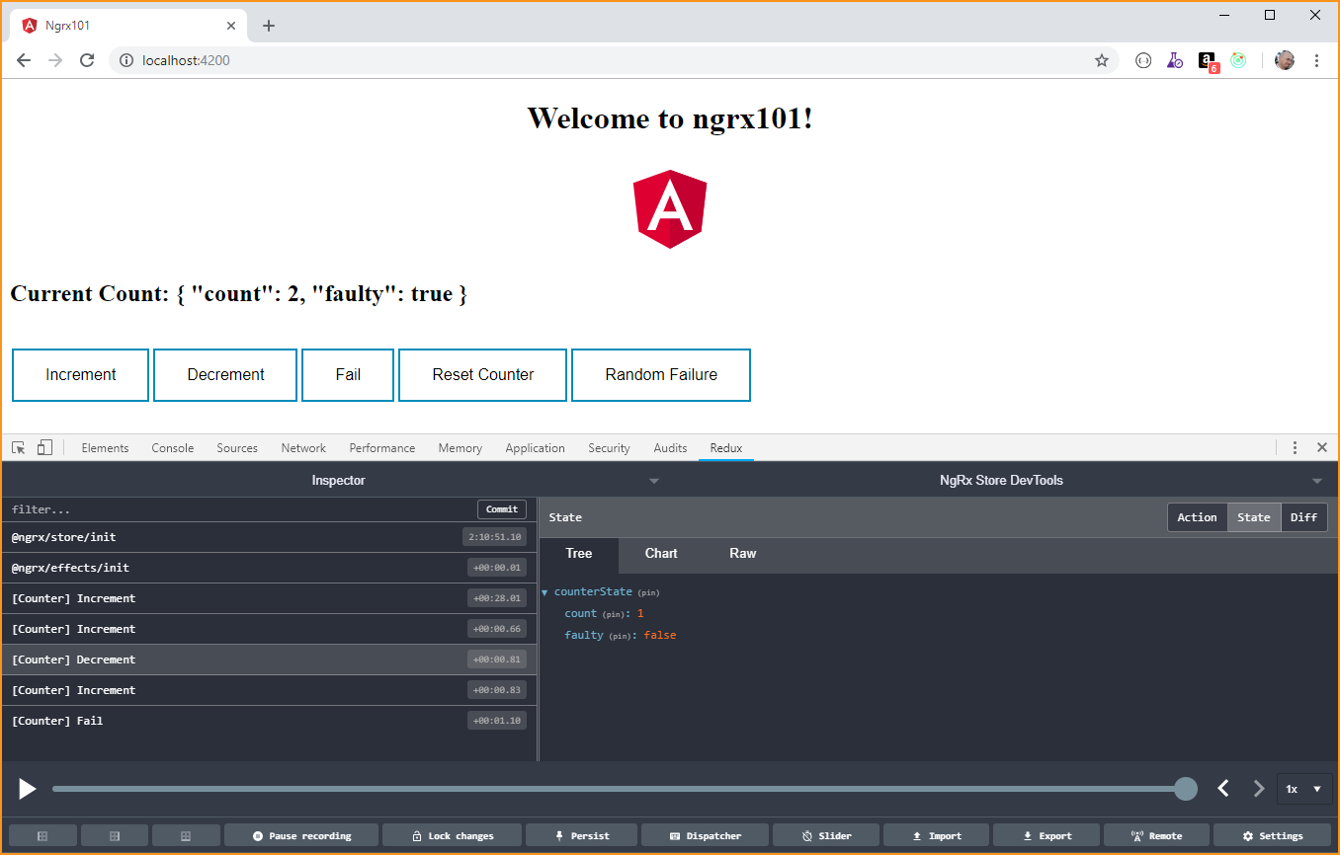
ngrx/store-devtools
Store-DevTools is an instrumentation library that enables a powerful time-travelling debugger.

Slide 32
ngrx/store-devtools Setup
npm install @ngrx/store-devtools –save
Install the Chrome / Firefox “Redux Devtools Extension” https://github.com/zalmoxisus/redux-devtools-extension/

Slide 33
Configure ngrx/store-devtools
In your AppModule imports enable the instrumentation using StoreDevtoolsModule.instrument({…}):
StoreDevtoolsModule.instrument({
maxAge: 25,
logOnly: environment.production
})
Supported instrumentation: https://ngrx.io/guide/store-devtools/config

Slide 34
there is more…
ngrx/router-store
ngrx/entity
ngrx/schematics

Slide 35
Benefits of NgRx
Centralized Immutable State
Predictability
Testablity
«Pure» Components: select state, dispatch actions
Performance: ChangeDetectionStrategy.OnPush
Powerful Debugging Toolset

Slide 36
Reference
RxJS documentation: https://rxjs-dev.firebaseapp.com/
Redux: https://redux.js.org/
NgRx: http://ngrx.io
Angular: https://angular.io/
Visual Studio Code: http://code.visualstudio.com/docs

Slide 37
Thanks All! Q. & (maybe) A. !

Slide 38

Who am I ?
Dott.ing. Alessandro Giorgetti
Facebook: https://www.facebook.com/giorgetti.alessandro
Twitter: @a_giorgetti
LinkedIn: https://it.linkedin.com/in/giorgettialessandro
E-mail: alessandro.giorgetti@live.com
Blog: www.primordialcode.com
Alessandro Giorgetti www.primordialcode.com

