Slide 1

Reactive Programming with NgRx
Reactive STATE MANAGEMENT for Angular
Alessandro Giorgetti www.primordialcode.com

Slide 2
What is NgRx ?
It’s a Reactive State Management library for Angular.
At its core NgRx is the Redux State Management Pattern + Angular Extensions.

Slide 3
The Redux Pattern
It enforces a one-way data flow for the state management throughout the entire application.
It advocates the use of a «Single Source of Truth» for the Application State: The Store™.
The State is Read-Only: the only way to modify the state is by dispatching Actions™.
Changes to the State are made by pure functions: The Reducers™.

Slide 4
The Redux Pattern - Illustrated
NgRx Store
View (UI)
Selector(s)
Event
Slice of State
New State
Slice of State
Store
(State)
Component
Convert Event to
State
New State
Action
Reducer(s)
Dispatch

Slide 5
NgRx, Redux and Reactive Applications
Is this «Reactive» ?
What does this has to do with RxJS ?

Slide 6
ngrx/store

Slide 7
NgRx/Store
NgRx/Store is a predictable state container for Angular Applications.
The state is «isolated and protected»: noone (but the reducers) is allowed to modify the data it holds.
The only ways to interact with the store are:
dispatch an Action (a form of «async» communication).
get a notification that something changed through selectors (a form of «async» communication).

Slide 8
NgRx/Store
Enables the construction of a Reactive Application:
Programming with Asynchronous (Observable) Data Streams.
Async messaging and loose coupling.
RxJS: the Observable is the «primitive» type used in JavaScript / Angular to implement asynchronous data streams.
Mentality switch: from a pull approach to a push approach.

Slide 9
NgRx Core Principles
State: is a single, immutable data structure.
Actions: events dispatched from components and services, they describe and trigger state changes.
Reducers: pure functions (functions with no side effects) that take the previous state and the next action to compute the new state. Reducers are the only way to “mutate” the state inside the Store.
Selectors: state is accessed using selector functions (pure functions) that return an observable of a slice (or a projection) of the state.
Effects: a way to interact with external services (like calling an API).

Slide 10
Redux / NgRx → CQRS applied to the UI ?
Using Redux or NgRx to write an application is much like following the CQRS guidelines and patterns in JavaScript / Angular world.
Message Driven: Commands / Events == Actions / State Change Notifications.
Read pipeline: Projections == State -> Selectors.
Write pipeline: Command → Aggregate → Event == Action → Reducer → State Action → (Side)Effects → Actions.
There's a clear separation between a read and a write pipeline, like the CQRS approach.

Slide 11
ngrx/store Setup
npm install @ngrx/store --save
Then import the StoreModule in the AppModule.
StoreModule.forRoot({...}, { initialState: {...} });

Slide 12
1) State
WARNING: the State should be considered an IMMUTABLE object, you are not allowed to mutate the value of a single property!
export interface ICounterState {
count: number;
faulty: boolean;
}
export interface IAppState {
counterState: ICounterState;
}

Slide 13
2) Provide an Initial State
export const initialCounterState: ICounterState = {
count: 0,
faulty: false
};
export const initialAppState: IAppState = {
counterState: initialCounterState
};
in the AppModule:
StoreModule.forRoot({…}, { initialState: initialAppState })
Notes:
Remove ambiguity

Slide 14
3) Define Actions (old syntax)
export enum CounterActionTypes {
INCREMENT = '[Counter] Increment', // best practice: add some
// namespacing
…
}
export class Increment implements Action {
readonly type = CounterActionTypes.INCREMENT;
}
export type CounterActions = Increment | Decrement | …;
Notes:
String Enum Types and Discriminated Unions to take advantage of TypeScript Type Inference

Slide 15
3) Define Actions
import { createAction, props } from '@ngrx/store';
export const login = createAction(
'[Login Page] Login',
props<{ username: string; password: string }>()
);
Notes:
String Enum Types and Discriminated Unions to take advantage of TypeScript Type Inference

Slide 16
4) Reducers: react to actions, change the state (old syntax)
WARNING: do NOT mutate the state! Always return a new oject, this is the only way we guarantee immutability!
export
function counterReducer(state: ICounterState, action: CounterActions): ICounterState {
switch (action.type) {
case CounterActionTypes.INCREMENT: {
return {
...state,
count: state.count + 1
};
}
default: {
return state;
}
}
}
Notes:
A Reducer is a pure function that takes two arguments: the current state and the Action to perform, it will return a new instance of the state.
Reducers operate synchronously.

Slide 17
4) Reducers: react to actions, change the state
WARNING: do NOT mutate the state! Always return a new oject, this is the only way we guarantee immutability!
export const scoreboardReducer = createReducer(
initialState,
on(ScoreboardPageActions.homeScore, state => ({ ...state, home: state.home + 1 })),
on(ScoreboardPageActions.awayScore, state => ({ ...state, away: state.away + 1 })),
on(ScoreboardPageActions.resetScore, state => ({ home: 0, away: 0 })),
on(ScoreboardPageActions.setScores, (state, { game }) => ({ home: game.home, away: game.away }))
);
Notes:
A Reducer is a pure function that takes two arguments: the current state and the Action to perform, it will return a new instance of the state.
Reducers operate synchronously.

Slide 18
5) Configure the Store with Reducers
feed the StoreModule.forRoot() function with an ActionReducerMap<TState>object that provides the references to the reducers functions.
export const reducers: ActionReducerMap<IAppState> = {
counterState: counterReducer
};
StoreModule.forRoot(reducers, { initialState: initialAppState }),

Slide 19
6) Selectors: expose slices of the state as observables
In the Component: inject the store and use the select operator:
this.counter$ = store.pipe(select('counterState'));
Best Practice - use a selection function:
export const counterSelector = createSelector(
(state: IAppState) => state.counterState
);
this.counter$ = store.pipe(select(counterSelector));
Notes:
Select will return an Observable<TState>, you can use AsyncPipe to subscribe to the state changes in the UI or use any RxJS operator to process the data stream.

Slide 20
Benefits of «createSelector»
// selectors created with the 'createSelector' function have many advantages over using plain
// functions, the most important: composition and memoization.
export const counterCountSelector = createSelector(
counterSelector,
state => state.count
);
export const counterFaultySelector = createSelector(
counterSelector,
state => state.faulty
);
Notes:
Memoization is a sort of caching: selectors are pure function, so given the same inputs they return the same output.
NgRx establishes a cache so if the input do not change the result of the (previous) elaboration is immediately returned.
Only the last input will be cached.

Slide 21
7) Dispatch Actions
Inject the Store service and call the dispatch() method:
this.store.dispatch(new Increment());

Slide 22
ngrx/effects

Slide 23
NgRx/Effects: a side effect model for ngrx/store
Listen for actions dispatched to @ngrx/store.
Isolate side effects (i.e.: access to external services, business logic, etc.), promoting the creation of more 'pure' components that select state and dispatch actions.
Provide new sources of actions based on external interactions such as network requests, web socket messages and time-based events.
An Effect is an Observable<Action | Action[]> that should (optionally) emit non empty arrays of Actions that will be dispatched to the Store itself.

Slide 24
NgRx Effects - Illustrated
NgRx Store
Selector(s)
View (UI)
New State
Slice of State
Store
(State)
New State
Event
Slice of State
State
Component
Reducer(s)
Dispatch
Convert Event to
Action
Dispatch
cloud
Action
Effect(s)
Emit

Slide 25
ngrx/effect Setup
npm install @ngrx/effects --save
Then Import the EffectsModule in the AppModule
EffectsModule.forRoot([...list of effects...])

Slide 26
1) Define the Effect Service Class
@Injectable()
export class CounterEffects {
constructor(
private actions$: Actions<CounterActions>
) { }
}
Actions<TActions>: an observable of Action(s)

Slide 27
2) Configure the EffectsModule
export const effects = [ CounterEffects ];
In the AppModule:
EffectsModule.forRoot([...effects])

Slide 28
3) Implement the Side Effect (old syntax)
@Effect() fail$ = this.actions$
.pipe(
ofType(CounterActionTypes.RANDOM_FAILURE),
tap((a) => console.log(a.type)),
delay(2000), // add latency, simulate network call
map(() => {
// get a number between 1 and 10
return Math.floor(Math.random() * 10) + 1;
}),
filter(num => num < 5),
map((num) => new Fail())
);

Slide 29
3) Implement the Side Effect
import { Injectable } from '@angular/core';
import { Actions, createEffect, ofType } from '@ngrx/effects';
import { EMPTY } from 'rxjs';
import { map, exhaustMap, catchError } from 'rxjs/operators';
import { MoviesService } from './movies.service';
@Injectable()
export class MoviesEffects {
loadMovies$ = createEffect(() => this.actions$.pipe(
ofType('[Movies Page] Load Movies'),
exhaustMap(() => this.moviesService.getAll()
.pipe(
map(movies => ({ type: '[Movies API] Movies Loaded Success', payload: movies })),
catchError(() => EMPTY)
))
)
);
constructor(
private actions$: Actions,
private moviesService: MoviesService
) {}
}

Slide 30
Effects might not dispatch Actions
To not dispatch actions at all:
@Effect({ dispatch: false })
Or
CreateEffect(… , { dispatch:false })
To not dispatch actions under some conditions:
Return / Dispatch an action with no handlers: a no-op action.
Use the RxJS filter() operator to avoid the observable proceed.

Slide 31
ngrx/effect: access external resources
@Effect()
loadHierarchy$ = this.actions$
.pipe(
ofType(ActorsActionsTypes.ACTORS_LOAD_HIERARCHY),
switchMap(action => {
return this.endpointService.GetActorsHierarchy(action.endpointName).pipe(
map(hierarchy => new ActorsHierarchyLoaded(action.endpointName, hierarchy)),
catchError(error => of(new ActorsLoadHierarcyFailed(action.endpointName, error)))
);
})
);
Notes:
There are some key concepts to pay attention to in this simple piece of cde

Slide 32
RxJS: chose the operators wisely
switchMap: runs multiple requests, the new request cancels the previous one. Can be used in get requests or cancelable requests (e.g.: searches).
mergeMap: runs multiple requests in parallel and merge their results in a single stream. It does not guarantee ordering. Better suited for put, post, delete operations.
concatMap: runs the requests in order at the expense of performance. Use only when the order of operations is important.
exhaustMap: ignore all the next requests until the current one completes, then a new request can be started.
Notes:
Chose the operator based on how you want to react when multiple http requests might be active at the same time when multiple messages being dispatched: cancel previous operations, execute them in parallel and merge the results, keep ordering, wait for previous operation to complete…
How ‘in-flight’ requests are handled is up to you

Slide 33
ngrx/store-devtools

Slide 34
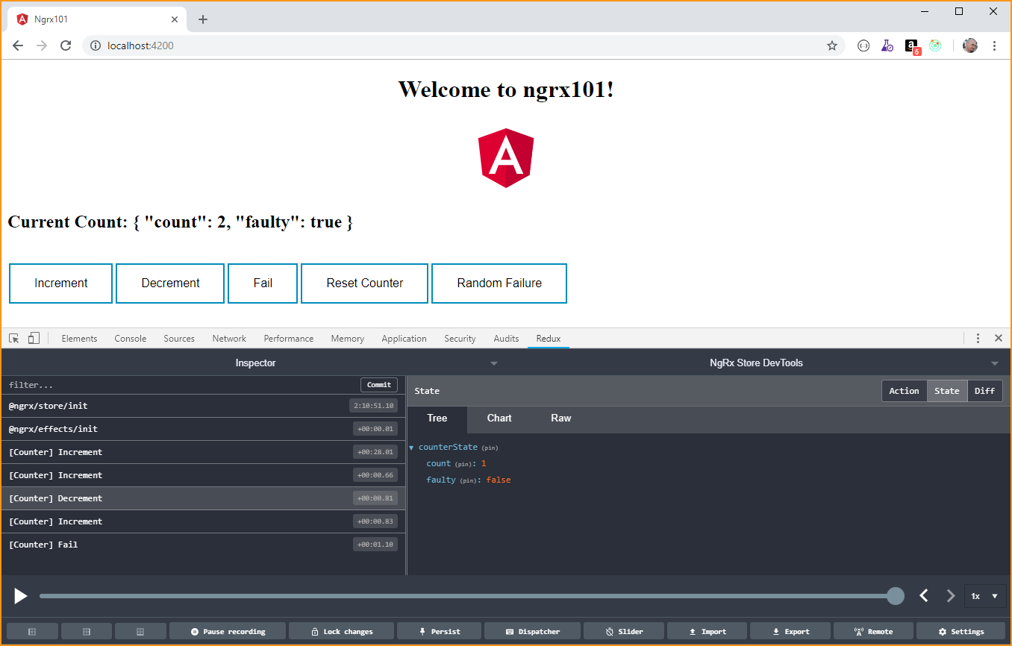
ngrx/store-devtools
Store-DevTools is an instrumentation library that enables a powerful time-travelling debugger.

Slide 35
ngrx/store-devtools Setup
npm install @ngrx/store-devtools –save
Install the Chrome / Firefox “Redux Devtools Extension” https://github.com/zalmoxisus/redux-devtools-extension/

Slide 36
Configure ngrx/store-devtools
In your AppModule imports enable the instrumentation using:
StoreDevtoolsModule.instrument({
maxAge: 25,
logOnly: environment.production
})
Supported instrumentation options: https://ngrx.io/guide/store-devtools/config

Slide 37
there is more: NGRX/ROUTER-STORE
NGRX/ENTITY
NGRX/SCHEMATICS

Slide 38
Component Store
an isolated store for a single component

Slide 39
Benefits of NgRx
Centralized Immutable State
Predictability
Testablity
«Pure» Components: select state, dispatch actions
Performance: ChangeDetectionStrategy.OnPush
Powerful Debugging Toolset

Slide 40
Reference
RxJS documentation: https://rxjs-dev.firebaseapp.com/
Redux: https://redux.js.org/
NgRx: http://ngrx.io
Angular: https://angular.io/
Visual Studio Code: http://code.visualstudio.com/docs

Slide 41
Thanks All! Q. & (maybe) A. !

Slide 42

Who am I ?
Dott.ing. Alessandro Giorgetti
Facebook: https://www.facebook.com/giorgetti.alessandro
Twitter: @a_giorgetti
LinkedIn: https://it.linkedin.com/in/giorgettialessandro
E-mail: alessandro.giorgetti@live.com
Blog: www.primordialcode.com
Alessandro Giorgetti www.primordialcode.com

