Slide 1
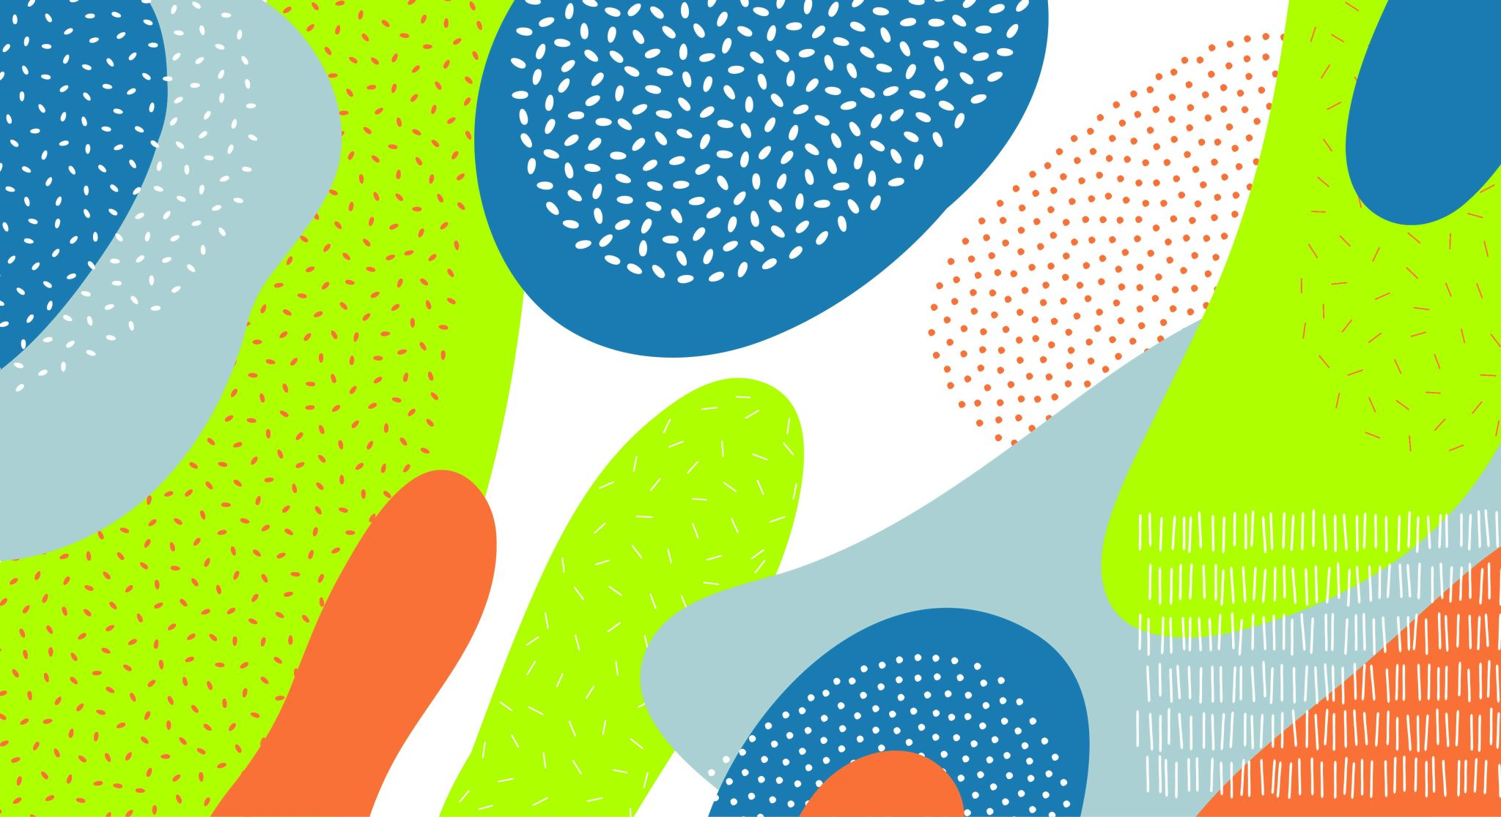
RL Based Auto Chess Implementation
Kaya Daylor
Aleksei Glebov

Slide 2

Project Description
Goal: develop an autonomous agent that can learn how to play Auto Chess using RL
Agent will learn to make strategic decisions
Unit selection
Unit positioning
Level pushing
Economy
Adapt to constantly changing game state

Slide 3
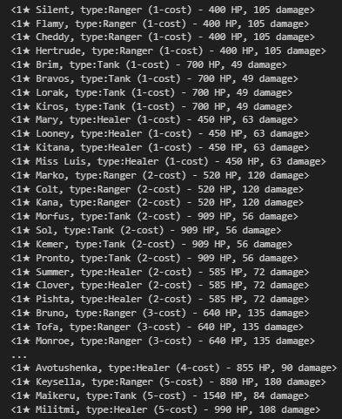
Project Motivation
Auto Chess presents unique challenges
Complex state and action space
Decision making under uncertainty
Ability to explore capabilities of RL in this context
Random elements
Opponent driven environment/dynamics
Long term planning

Slide 4
Prior Arts
"Simulating Team Fight Tactics" (Cao, 2023) - Riot Games official article addressing domain-specific challenges
"Large-scale deep learning to augment production RL workloads at Riot Games" (Anyscale, 2023) - Insights on production-level TFT reinforcement learning implementation
"TFTMuZeroAgent" GitHub repository (silverlight6, 2025) - Provides valuable environment representation approaches
"Reinforcement Learning in Chess" (Gill, 2023) - Transferable concepts from traditional chess RL applications

Slide 5
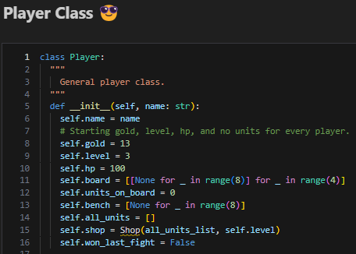
Our Approach: Auto Chess Environment
Implemented several important Python classes (Unit, Player, Shop)
Created our own custom Gym environment to replicate Auto Chess
Action space
10 discrete actions (buy, sell, move, etc.)
Observation space
(Gold, HP, units, etc.)

Slide 6
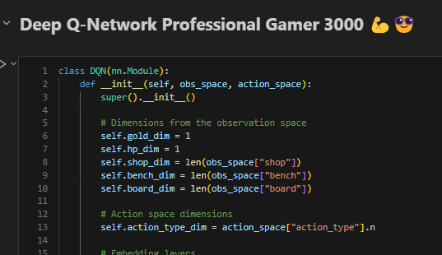
Our Approach: Deep Q-Network
Model
Embedded layers to best capture the units/environment
Final output predicts optimal action for the agent to take
Training Loop
Epsilon-greedy exploration
Finalizing our reward function

Slide 7
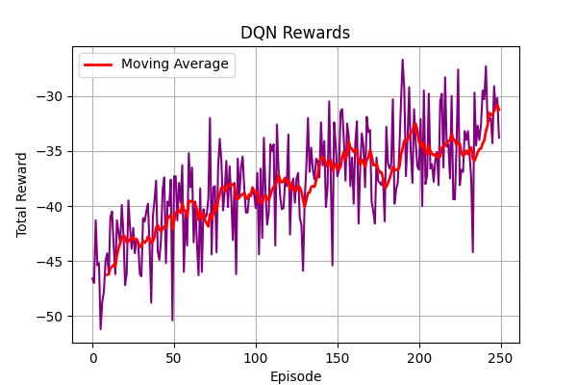
Conclusions and Future Work
Successfully built an Auto Chess environment
Constructed a DQN agent that can interact with the environment and learn the basics
Future work
Rework basic mechanics and improve the environment
Increase game complexity to fully mirror the true Auto Chess game
Add visual emulator for easier understanding

Slide 8
Thank you!

