Slide 1
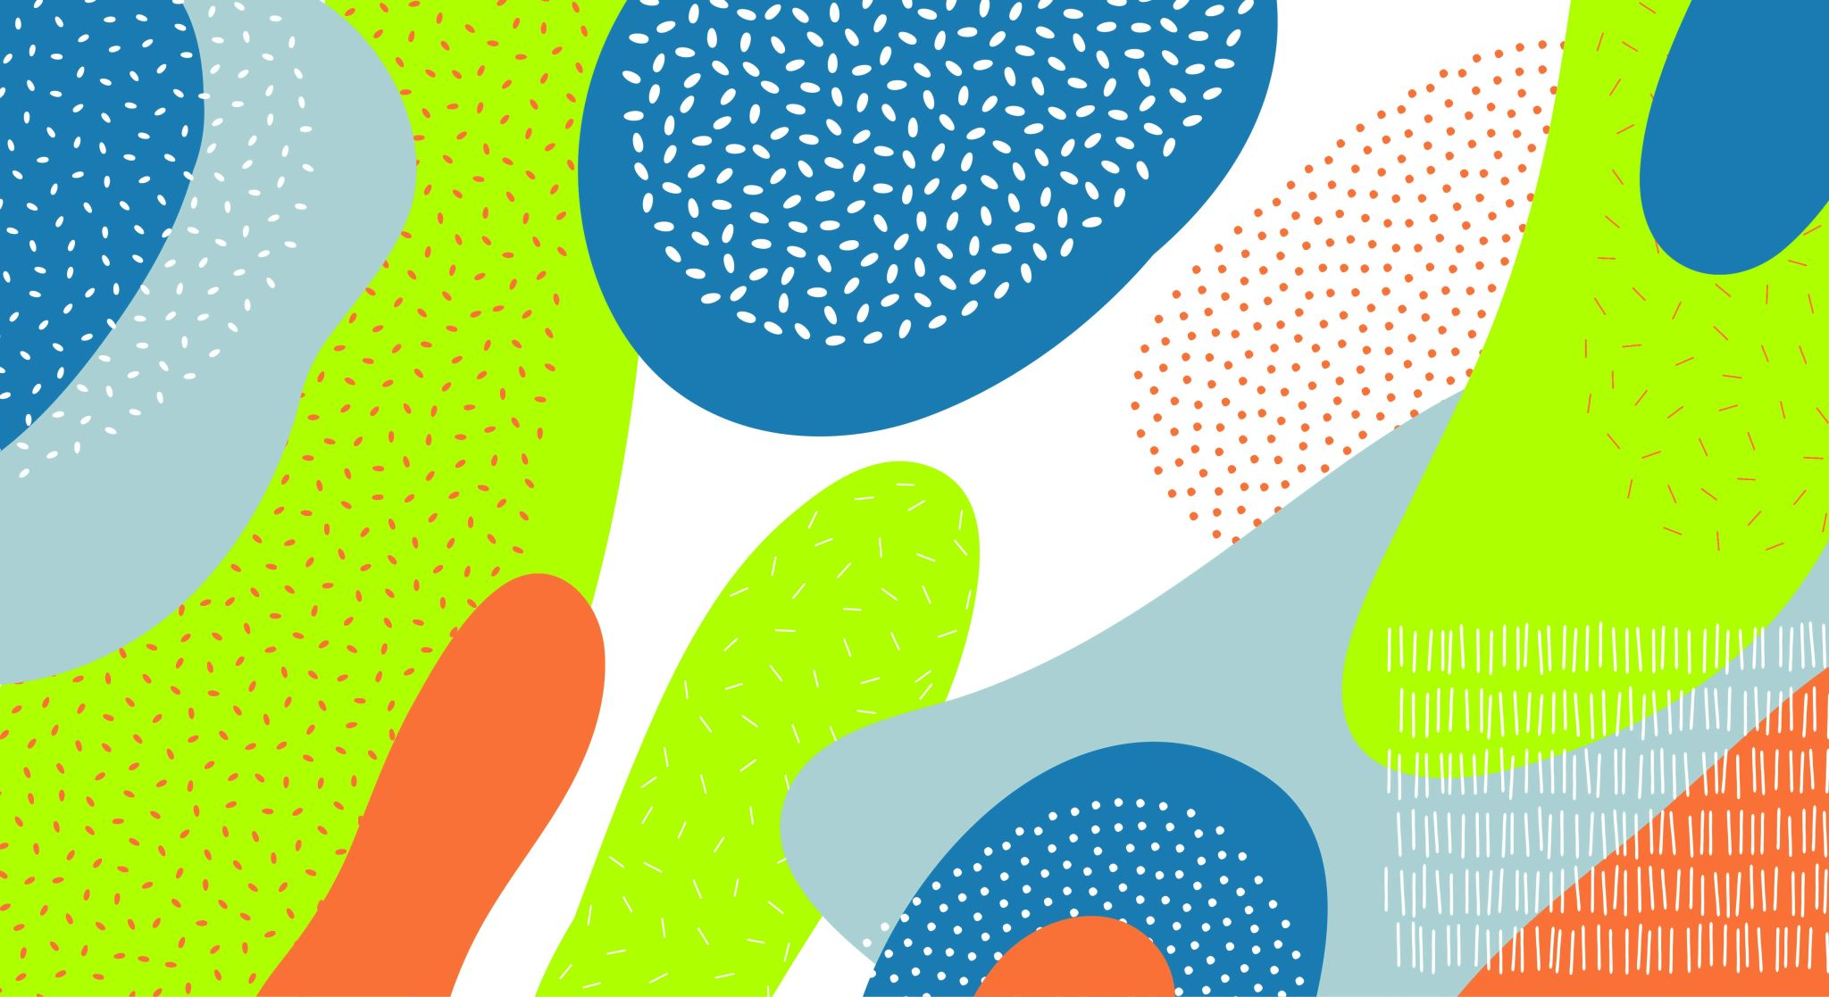
RL Based Auto Chess Implementation
Kaya Daylor
Alex Glebov

Slide 2
Project Description
Goal: develop an autonomous agent that can play Auto Chess using RL
Agent will learn to make strategic decisions
Unit selection
Item allocation
Unit positioning
Adapt to constantly changing game state

Slide 3
Project Motivation
Auto Chess presents unique challenges
Complex state and action space
Decision making under uncertainty
Ability to explore capabilities of RL in this context
Random elements
Opponent driven environment/dynamics
Long term planning

Slide 4
Prior Arts
"Simulating Team Fight Tactics" (Cao, 2023) - Riot Games official article addressing domain-specific challenges
"Large-scale deep learning to augment production RL workloads at Riot Games" (Anyscale, 2023) - Insights on production-level TFT reinforcement learning implementation
"TFTMuZeroAgent" GitHub repository (silverlight6, 2025) - Provides valuable environment representation approaches
"Reinforcement Learning in Chess" (Gill, 2023) - Transferable concepts from traditional chess RL applications

Slide 5
Solution: Auto Chess Environment
Created a custom Gym environment to replicate Auto Chess
Action space
10 discrete actions (buy, sell, move, etc.)
Observation space
(Gold, HP, units, etc.)

Slide 6
Solution: Deep Q-Network
Model
Embedded layers to best capture the units/environment
Final output predicts optimal action for the agent to take
Training Loop
Epsilon-greedy exploration
Finalizing our reward function

Slide 7
Conclusions and Future Work
Successfully built an Auto Chess environment and a DQN agent that can interact with the environment
Future work
Could add a visual emulator to visually simulate the game
Increase game complexity to fully mirror the true Auto Chess game

Slide 8
Thank you!

