Slide 1
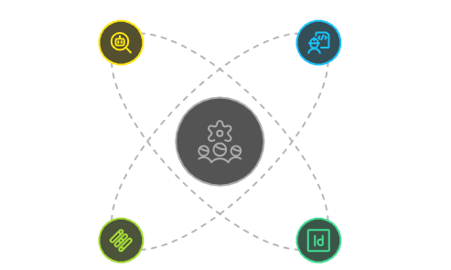
Meet The Team - MINDMESH
ANAY
KRISHANG
--> Full-Stack Web Development: Skilled
in HTML, CSS, JavaScript, React.js (Vite),
Next.js, Node.js, Express.js, MongoDB
(with Mongoose), Auth.js, and Git.
--> Machine Learning & NLP: Experienced
with core ML algorithms and basic
Natural Language Processing using spaCy.
--> Web Development: Skilled in building clean,
functional UIs with React.js and API
integration.
--> Cybersecurity: Understands secure data
handling and secure and private
browsing principles.
RIJUL
AHSAN
--> Web Developer: Experienced in
creating interactive front-end designs with
HTML, CSS, and JS.
--> ML Enthusiast: Explores practical machine
learning workflows and applies data-
driven thinking to real-world problems.
--> Applied ML & Workflow Design: Experienced in
creating lightweight AI models with efficient
data handling and decision logic.
--> Backend Orchestration: Proficient in Python and
understanding of Flask for modular automation
and agent-based workflows.

Slide 2

The Problem: Too Much, Too Easily Lost
Information Overload
Users struggle to manage 20+ tabs simultaneously, losing track of important research and context across sessions.
Context Loss
Closing a browser means losing hours of accumulated context. Manual re-searching wastes valuable time and mental energy.
Privacy Fears
Cloud-based assistants expose sensitive browsing data. Users sacrifice privacy for convenience, creating trust gaps.
Efficiency Drain
Repeated searches, fragmented workflows, and manual organization reduce productivity and increase cognitive load.

Slide 3
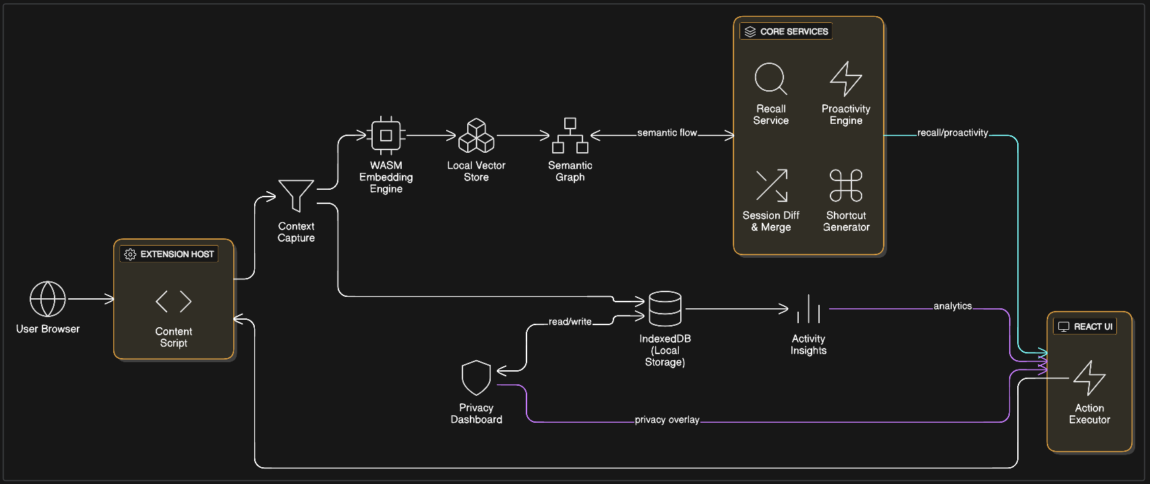
Architecture Diagram

Slide 4
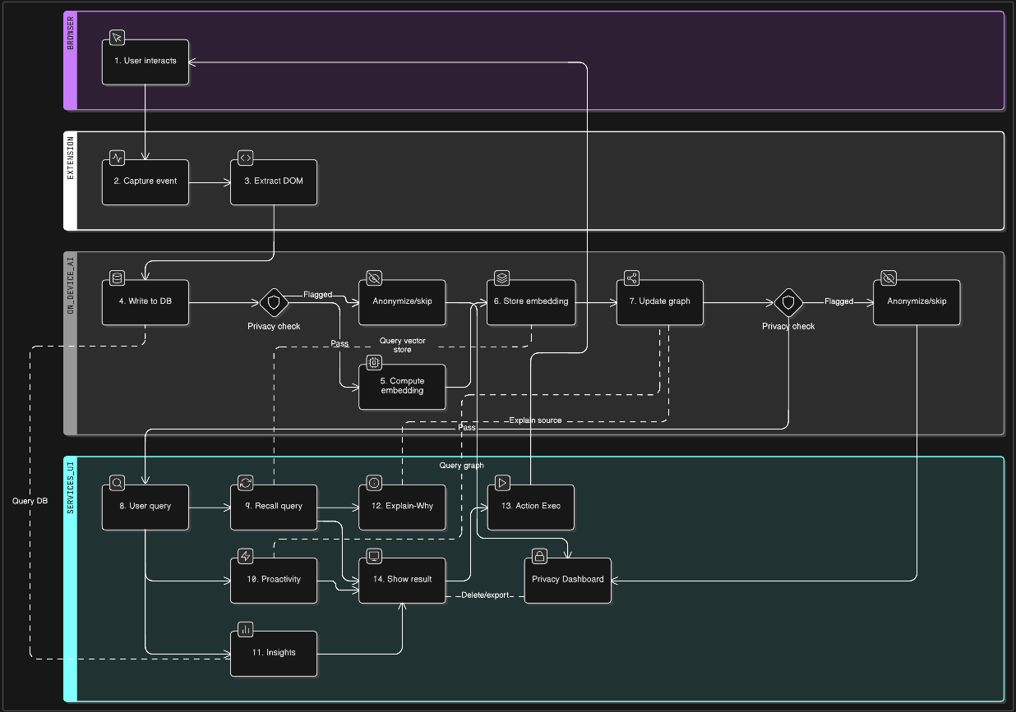
Detailed Flowchart

Slide 5
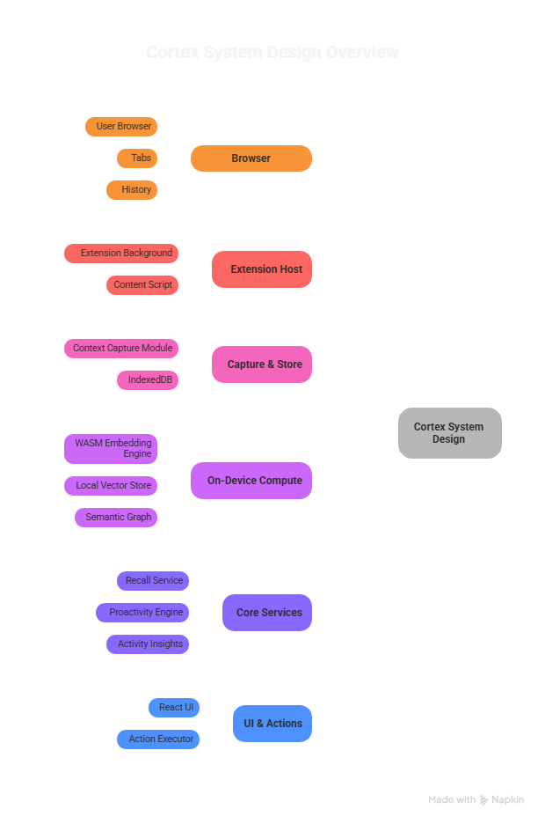
System Design (end-to-end)
Cortex is an on-device web agent that captures browser context, creates semantic embeddings with a WASM engine, stores vectors and session graphs in IndexedDB, and exposes services for recall, proactivity, analytics, and actions through a React UI. All processing stays local and permissioned by the user.
Capture: tabs, history, bookmarks, focus events
Storage: IndexedDB for sessions, embeddings, activity
Compute: WASM embeddings, local ANN (Approximate Nearest Neighbors) index, semantic graph
Services: Recall, Proactivity, Activity Insights, Session Diff, Shortcut Generator
UI & Controls: React dashboard, Explain-Why overlays, Privacy Dashboard

Slide 6
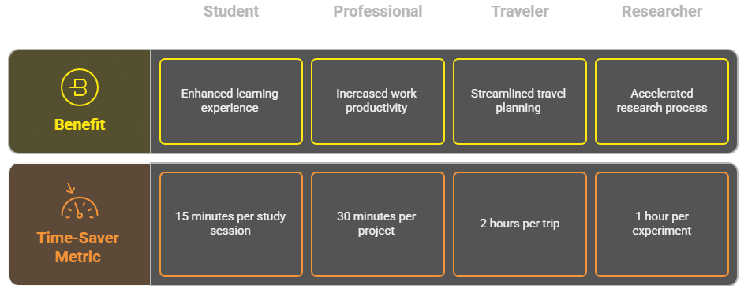
Use Cases and User Scenarios
Cortex helps students, professionals, travelers, and researchers by surfacing lost resources, organizing task-focused workspaces, retrieving last-viewed deals, and comparing research sessions, all via local, context-aware recall and actions.
Students: recall fragmented research and references quickly
Persona Comparison
Professionals: cluster tabs, autofill repetitive forms, summarize reports
Travelers: retrieve itineraries and last-seen offers with context
Researchers: compare sessions and merge new findings, spot gaps

Slide 7
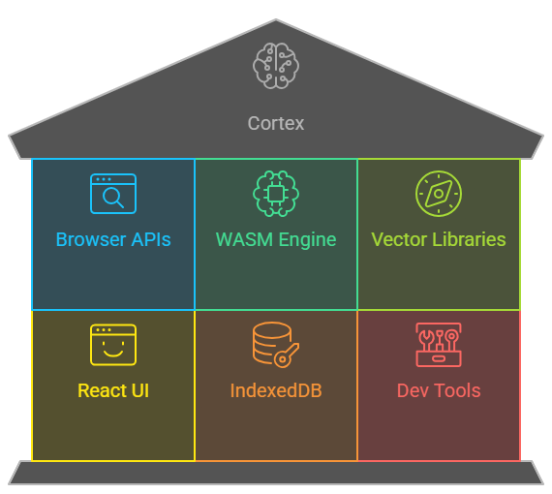
External Dependencies
Cortex uses browser WebExtension APIs, open-source WASM toolchains for embeddings, local vector index libraries, and standard frontend frameworks; all third-party components are open-source and run client-side to preserve privacy.
Category/Technology | Details
Browser APIs | tabs, history, bookmarks (Chrome/Edge/Firefox)
WASM toolchain | GPT-2 as the locally run model for WASM + browser automation
Vector/search libraries | simple ANN or brute-force JS index (HNSW alternatives)
Frontend | React, local state management, IndexedDB helpers
Dev tools | Node.js, Vite, Chrome extension tooling
Authentication | Firebase

Slide 8
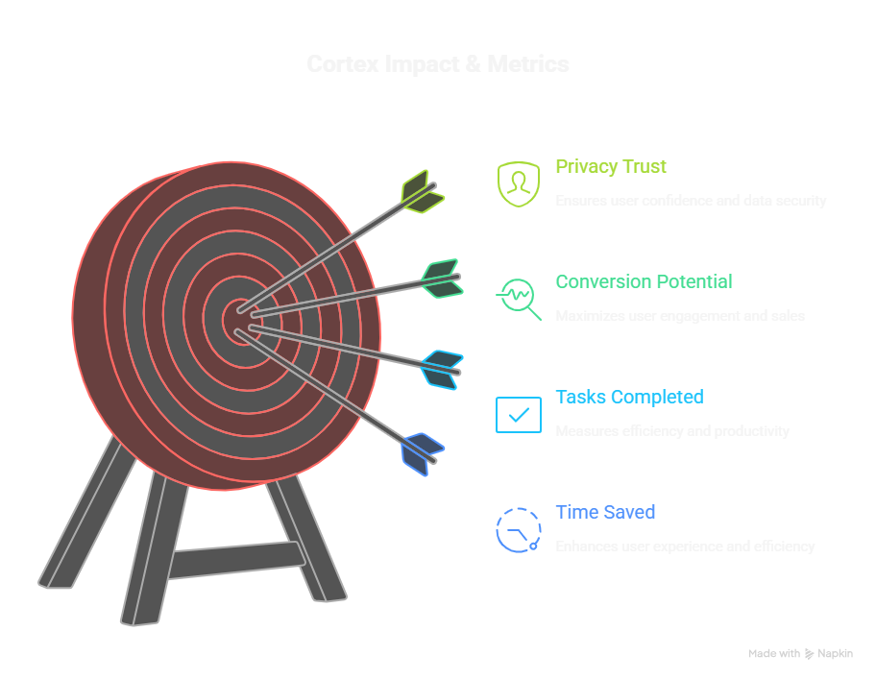
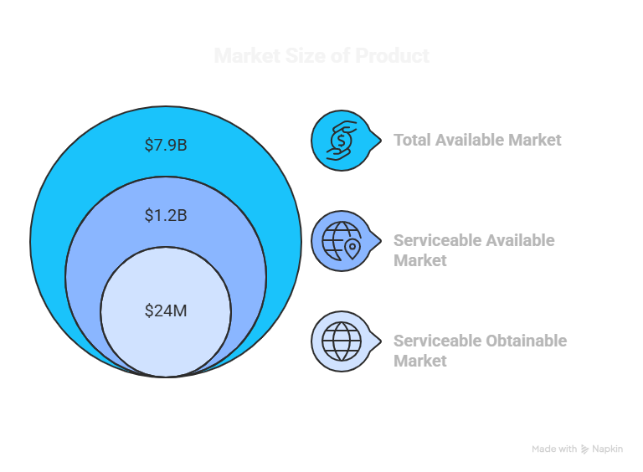
Potential Impact and Metrics
Cortex boosts productivity by reducing search time, improves user retention through personalized assistance, and enables monetization via premium workflows, while strengthening Samsung’s privacy-first market positioning.
Key metrics:
Reduce time-to-find information by up to 70%
Increase task completion rate and session efficiency by up to 80%
Premium conversion rates
Privacy-first branding, cross-device value for Samsung DeX

Slide 9
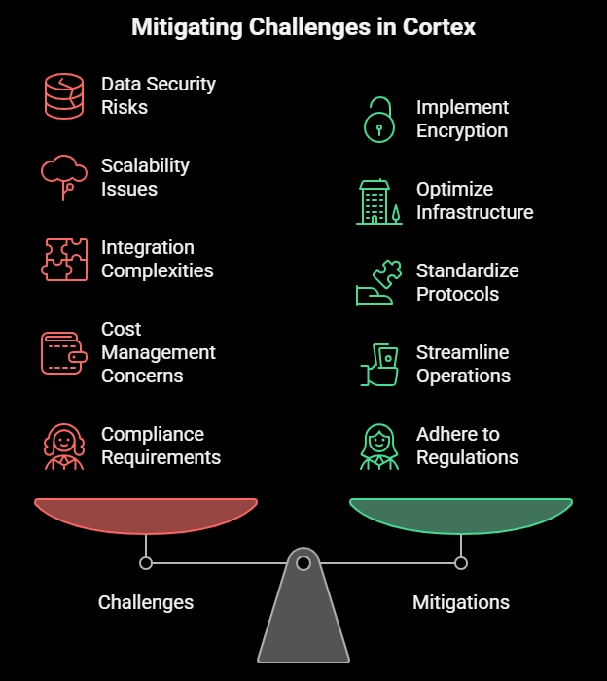
Challenges and Limitations
Key constraints include on-device compute limits, storage bloat for long histories, permissions friction, and handling dynamic or JS-heavy sites; mitigations include sampling, snippet limits, cached embeddings, and careful UX for consent.
Constraint Category | Detail/Mitigation
Compute Limits | Model precision trade-offs on-device
IndexedDB Growth | Need snippet size limits and pruning
Permissions & UX | Cross-site interactions, UX consent required
Dynamic DOM Complexity | Fallback to metadata-only capture
Cold-Start Experience | Mitigated with demo dataset and precomputed caches

Slide 10
Learnings and Insights
Building Cortex highlights that meaningful personalization is driven by context quality, not raw volume, and that explainability and clear privacy controls are essential for adoption; practical engineering requires embedding caching, background workers, and strict storage policies.
Category | Finding & Insight | Future Impact
Data Efficiency | Insight: Context Quality > Quantity. Over-indexing on all data led to noise and slowed down the agent. | We will prioritize selective capture and use an L1/L2 memory system to ensure the agent is always fast and relevant.
User Trust | Finding: Explainability is critical. Users need immediate confidence in the agent's financial suggestions. | We implemented the "Show the Why" UI early to build trust, demonstrating transparent decision-making logic.
Performance | Finding: Cold-start latency was high. Waiting for initial embedding generation breaks the user experience (UX). | Solution is viable: We preloaded the model with sample websites and categories, so it starts capturing data immediately.
Scope & Relevance | Insight: A wider memory window reduced relevance. We cannot process a 1GB chat history effectively. | Limiting the demo context window to 7-14 days ensures we deliver a consistent, high-speed MVP and proves the core mechanism works.
Business Value | Finding: Privacy UX is a competitive advantage, not an afterthought. Clear data control sells the product. | We designed a simple, visible opt-out/delete flow to establish user control and differentiate our product on the grounds of trust.

Slide 11
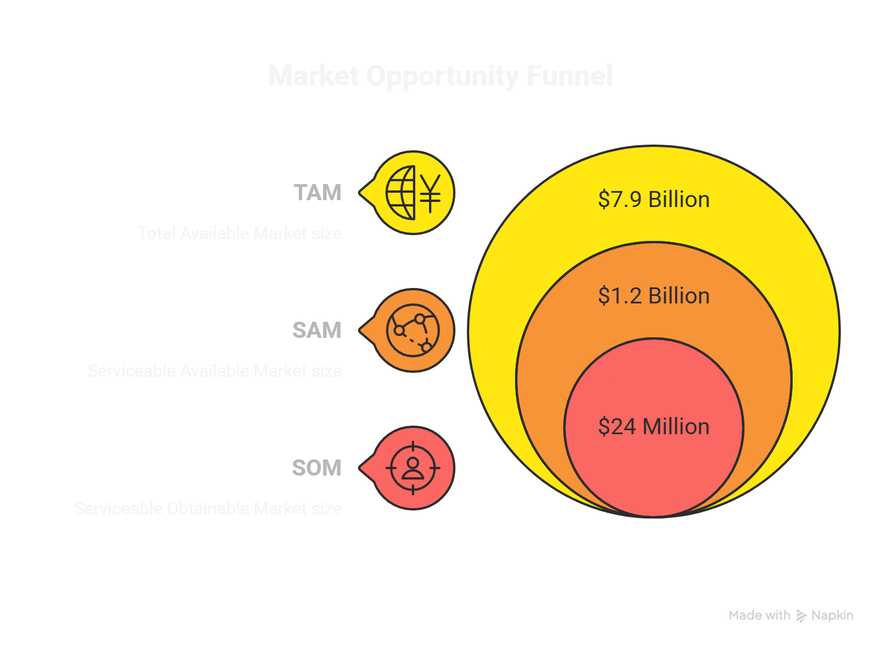
Business Feasibility
Cortex represents a convergence of market demand, technological innovation, and strategic business opportunity. Built on privacy-first principles with on-device AI processing, it addresses critical user needs while maintaining sustainable economics.
Premium Revenue Potential
Tiered monetization through advanced personalization features, enterprise licensing, and value-added services for power users.
Minimal Infrastructure Costs
On-device processing eliminates expensive cloud computing, reducing operational overhead while enhancing security and response times.
Samsung Ecosystem Integration
Strategic partnership opportunities leverage Samsung's global reach, device ecosystem, and premium brand positioning in consumer electronics.

Slide 12
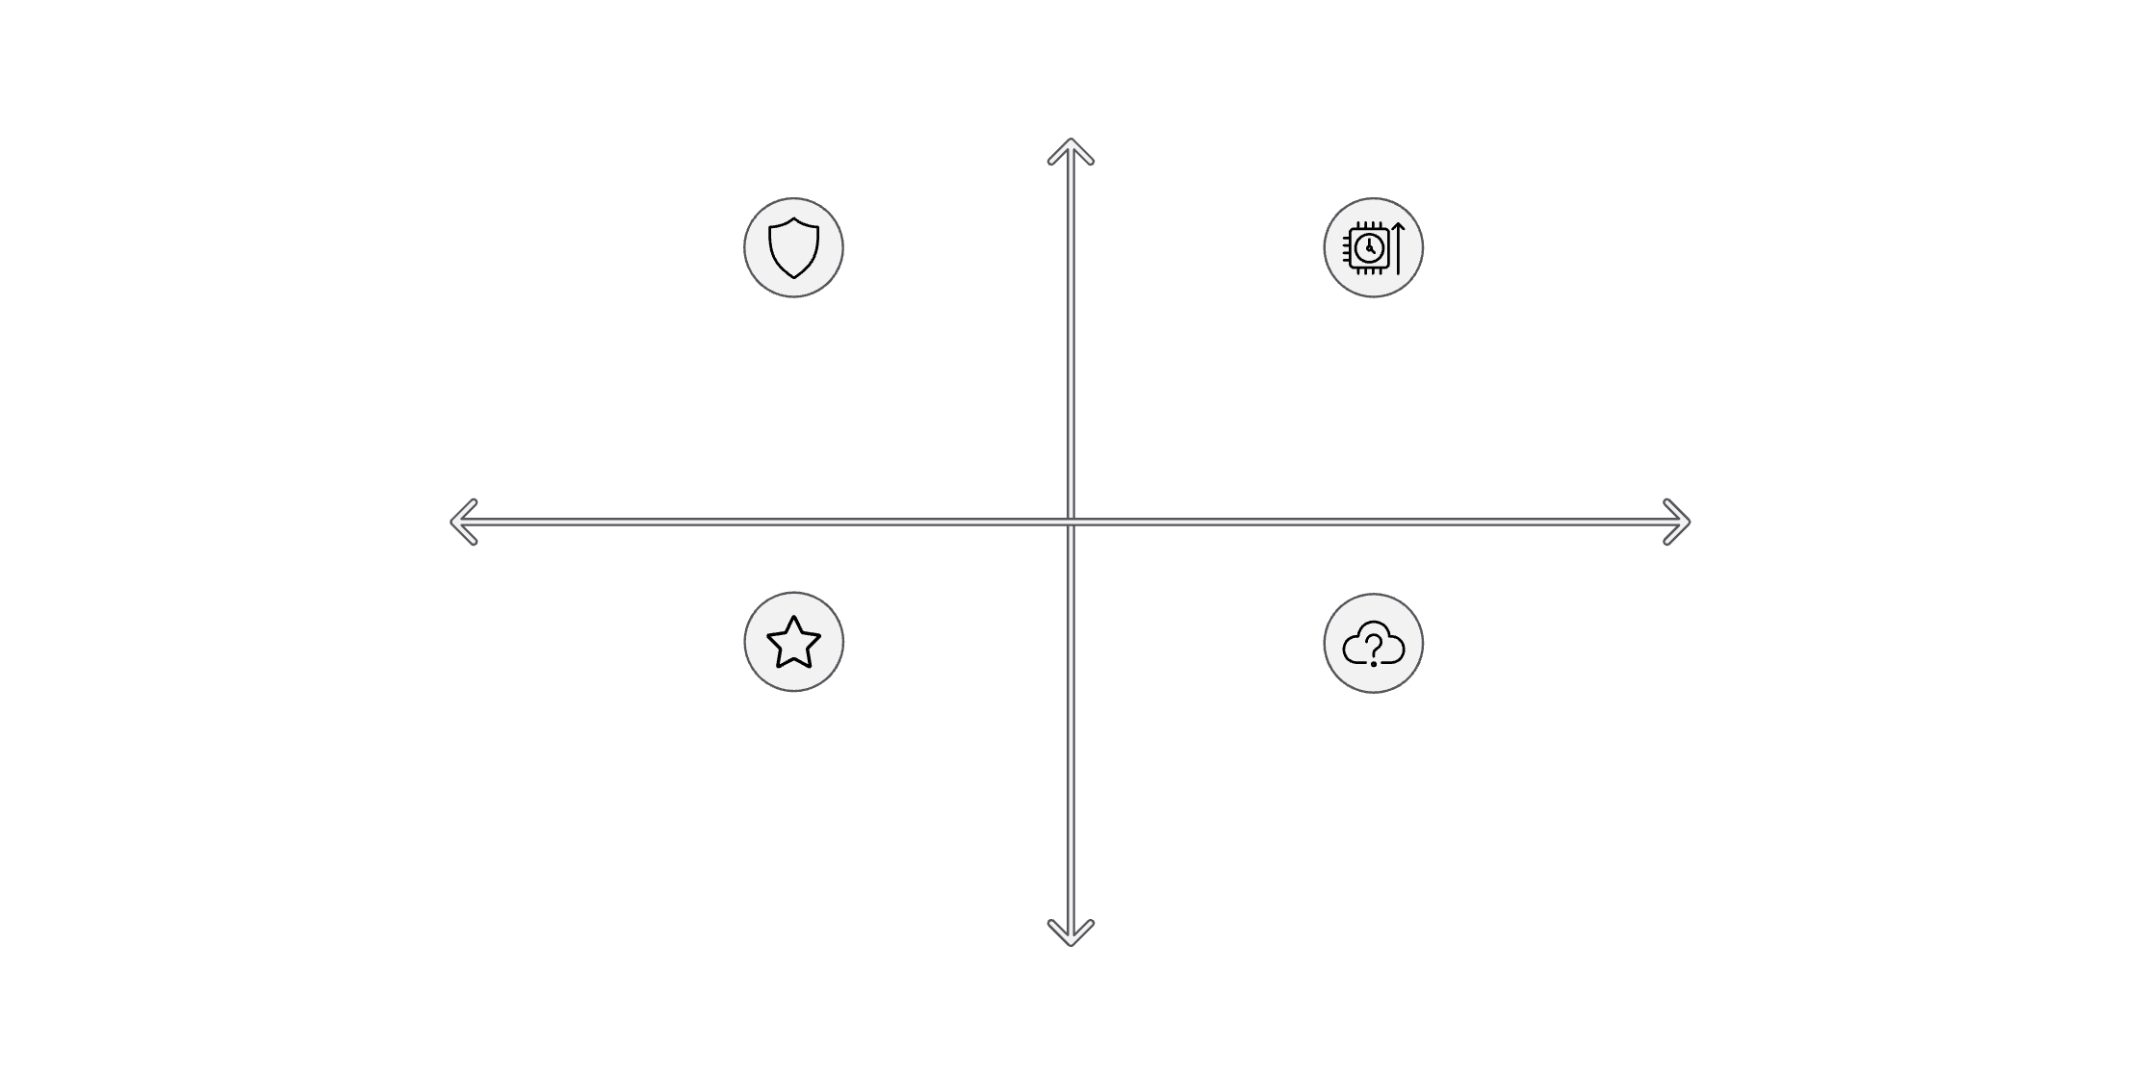
SWOT — Cortex's Strengths, Weaknesses, Opportunities, Threats
Strengths
Strengths: On-device privacy
Weaknesses: Local compute limits
Threats
Weaknesses
Opportunities: Ecosystem integration
Threats: Advancing cloud AI
Opportunities
Internal Factors
External Factors
Strengths: Unmatched privacy, intelligent semantic understanding,
proactive assistance
Opportunities: Samsung ecosystem dominance, enterprise/vertical expansion, family productivity tools
Weaknesses: Device performance constraints, initial user learning curve
Threats: Rapid cloud AI advancement, evolving regulations, competitive browser
innovation

Slide 13
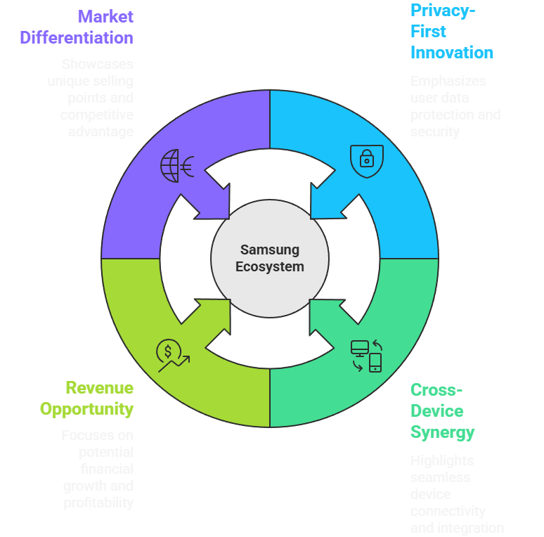
Building Value for Samsung
Privacy-First Innovation
Native AI agent for Samsung Browser and DeX would position Samsung as the leader in secure, intelligent browsing
Cross-Device Synergy
Offline sync across phones, tablets, and laptops creates seamless experiences throughout the Samsung ecosystem
Revenue Opportunity
Premium features for power users unlock monetization while maintaining free core functionality
Market Differentiation
Reinforces Samsung's commitment to secure digital innovation in an era of growing privacy concerns

