Slide 1

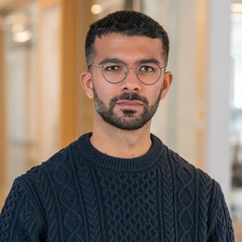
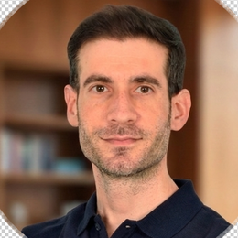
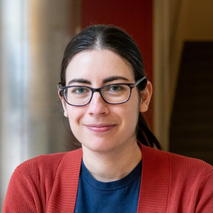
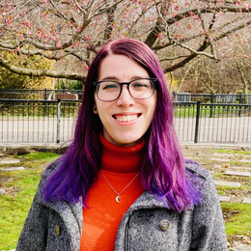

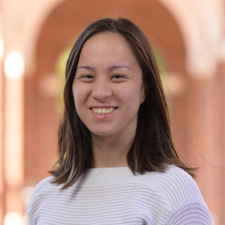

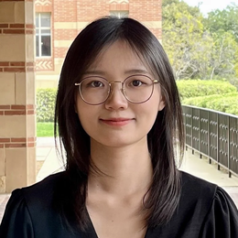

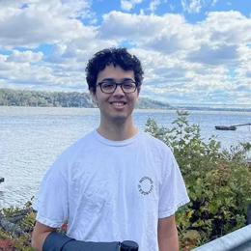

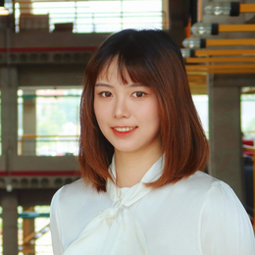
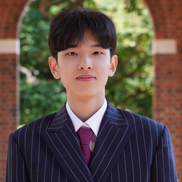
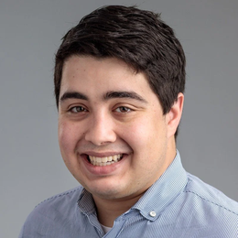


The Normativity Lab | Johns Hopkins University
Gillian Hadfield
Director
Harsh Satija
Konstantinos Mitsopoulos
Maria Ryskina
Rebekah Gelpí
Alexander Bernier
Andrea Wynn
Austen Liao
Binze Li
Iliana Maifeld-Carucci
Kuleen Sasse
Matthew Renze
Shuhui Zhu
Seokhyun Baek
Andrew Gold
Chris LaRosa
Muhamed Sulejmanagic

