Slide 1
Why the Queen's gambit is awesome
A. Gordon
Aug 2023
Notes:
My project is about chess and is called Why The Queen’s Gambit Is Awesome

Slide 2

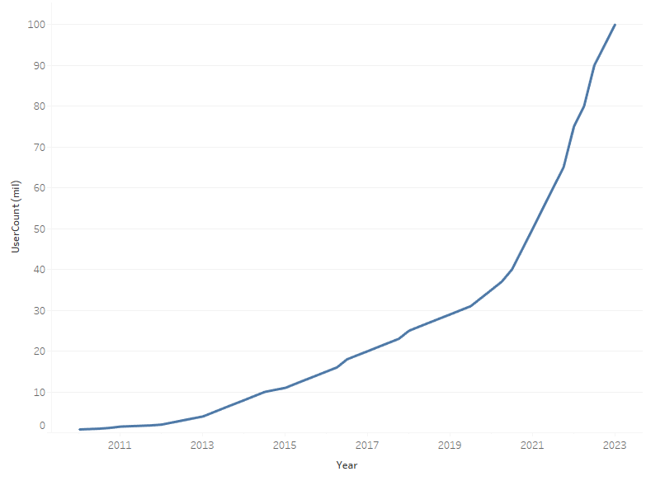
introduction
Notes:
First off, The Queen’s Gambit is an awesome TV show on Netflix, well worth watching
It’s remarkable as it inspired millions of people to take up chess as a hobby – when it came out in late 2020 (red) chess.com had 35m subscribers, now over 100m today including me (blue)

Slide 3
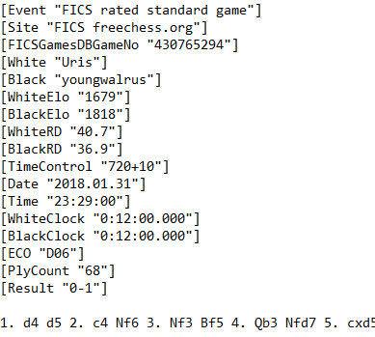
Chess data AS .pgn files
Event – time format
White / Black – player names
ELO – rating of each player
PlyCount – number of moves played
ECO – opening move sequence
Result – 1-0 White, ½-½ Draw, 0-1 Black
Movetext – sequence of moves played
Notes:
All online chess games and uploaded tournament games are saved as .pgn files
These have a standardised format and contain useful info
By playing a particular set of opening moves, the White player can coerce the Black player into responding in a predictable way. This leads to common positions appearing in lots fo games which have been catalogued and given alphanumeric codes.
ELO vs ECO is unnecessarily confusing, so I'll try to refer to them as "ratings" and "openings“
I took all games in January 2018 from Free Internet Chess Server (FICS) online database - 760,000 in total

Slide 4
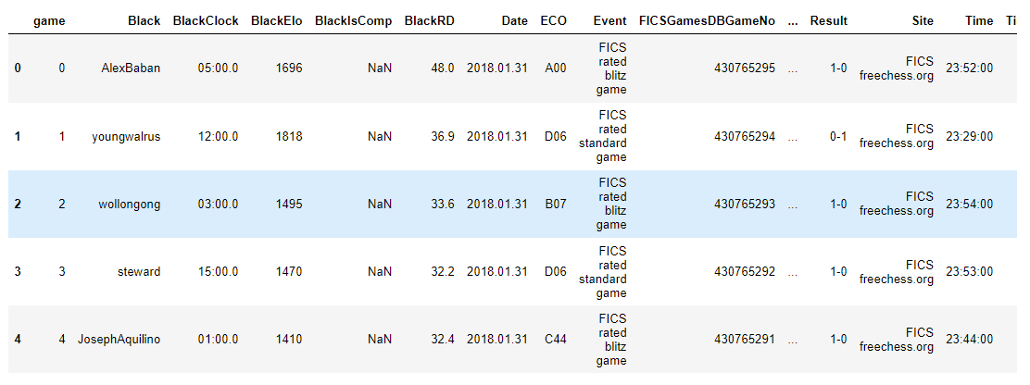
Our Best friend
Notes:
I wrote a function to convert the .pgn into our friend a Pandas Dataframe ready for analysis

Slide 5
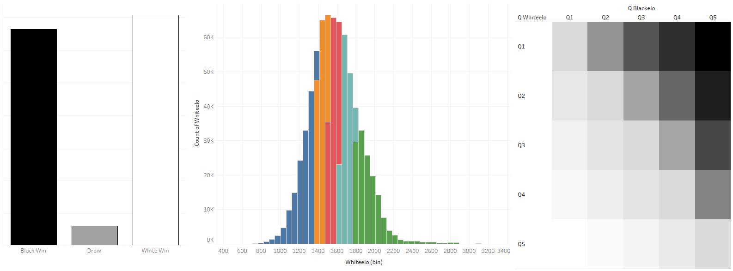
Data Wrangling 2 days in
Notes:
LEFT – White wins more than Black
This makes sense as White always starts the game so they effectively choose their preferred opening sequence and are always one move ahead of Black. Like serving in tennis, the expectation is you always win your White games, then as Black you try to hold your opponent to a draw or beat them if they slip up!
MIDDLE - There is a large spread of player ratings for the games played in my data.
I split the ratings for both White and Black into five quantiles to better understand the data.
Reference, new players start at ELO rating=1000-1200 (middle of blue) then move up or down based on performance. 2500 (end of the green tail) are Grandmasters (only around 2000 in world)
I'm at around 1400... (yellow) so a long way to go
RIGHT - It's also clear that higher quantile rated players win more often against lower players irrespective of colour played

Slide 6
Day 3: along the Dunning-Kruger Effect curve…
1) Classification models – White / Draw / Black – precision 0.63
2) Considered "matched" games for useful tips on how to improve my game
3) Tested dependence of Result on Opening Sequence (ECO) – Chi2, p was low!
---> Result depends on Opening Sequence lead by White
---> I should study up on Openings to improve my game, but which?
Notes:
I tried different classification models, and by oversampling Draws I managed to reach the heights of prediction_score = 0.63 – not great
So instead I thought how could I improve my odds of winning my games
Chess.com pairs you against similar rated opponents, so I looked at all “matched” games with players within the same rating quantile – fortunately, this was over half the dataset
I checked whether the openings had any impact on the result. Null hypothesis was that ECO was independent from Result. Chi-Squared – the p was low, the H0 had to go!
So, to improve my odds of winning as White, I should work on my chess openings.

Slide 7
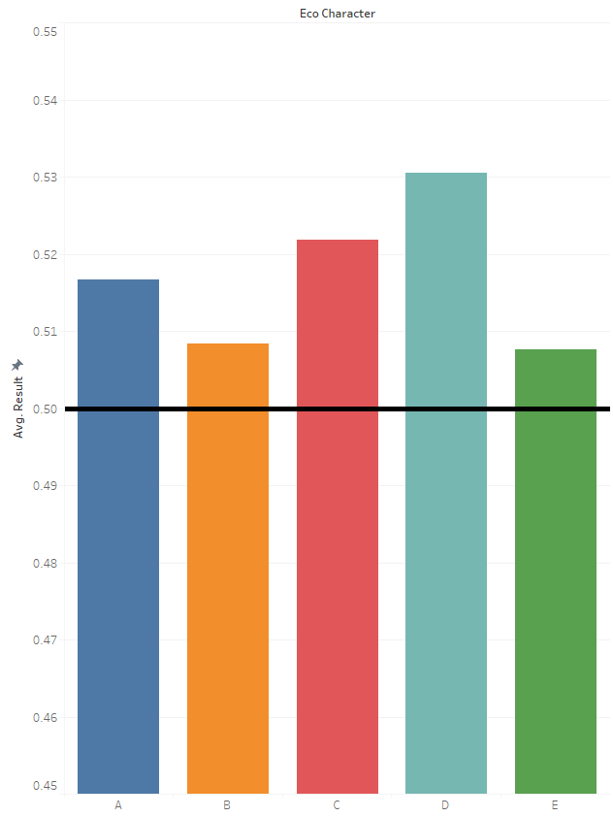
Openings Matter
Opening Moves (ECO) | Name | Average result 1 – White Win ½ – Draw 0 – Black Win
A30 | English Opening | 0.59
B90 | Sicilian, Najdor | 0.56
C21 | Centre Game | 0.56
D20 | Queen's Gambit (Accepted) | 0.58
E90 | King's Indian | 0.54
Notes:
Openings are grouped into five broad families A - E with 100 variations within each
Different opening families performed best at different ratings
Here are the most commonly played, optimised openings for each family in the “matched” games subset
At my rating, A and C families tend to work best, so I will focus my efforts on mastering the English Opening and the Centre Game

Slide 8
How I can win more often
A30 English Opening
C21 Centre Game

Slide 9
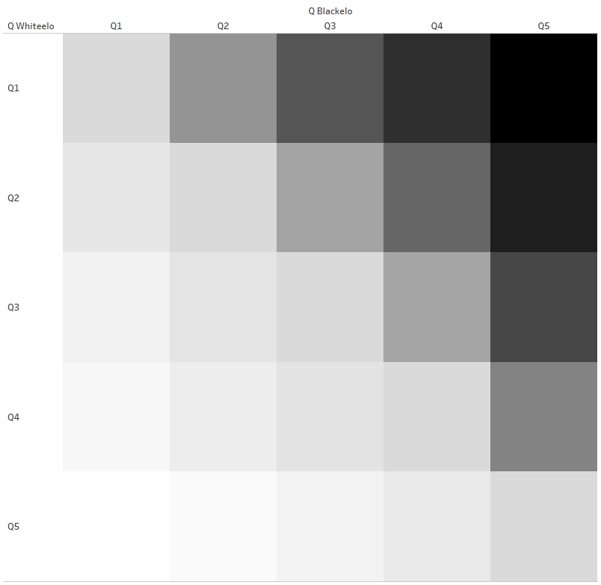
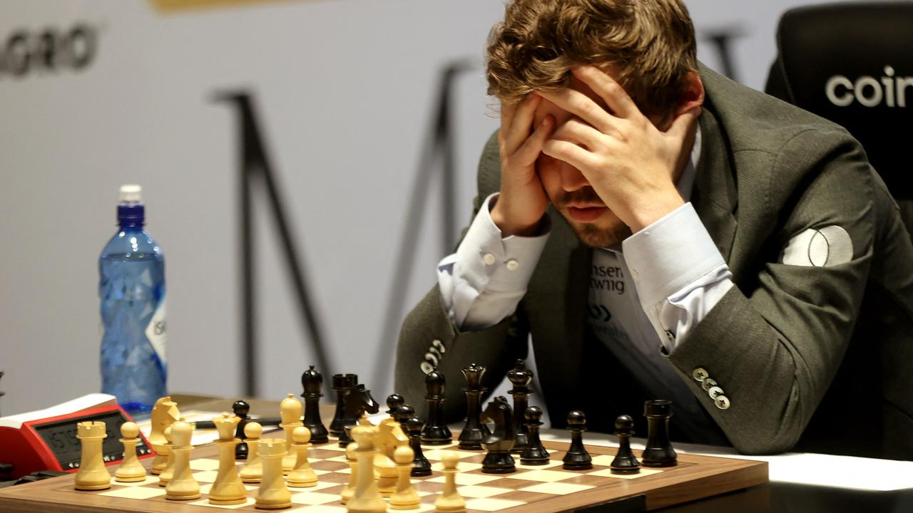
But How do i level up?
Notes:
But what if I want to push myself?
I already looked at equally “matched” games between players in the same rating quantile (along the blue line), so then I sought inspiration from “stretch” games where White played Black from the rating quantile above (along the red line)
I did the same grouping and analysis of the best openings, and it gave a different picture...
Quick BONUS for anyone who recognises that player – Magnus Carlsen GOAT

Slide 10
The magic formula
D31 Queen's Gambit (Declined)
Opening Moves (ECO) | Name
C46 | Three Knights’ game
C21 | Centre Game
D07 | Queen's Gambit (Declined) Chigorin
D31 | Queen's Gambit (Declined)
D11 | Queen's Gambit (Declined) Slav
D06 | Queen's Gambit I
The Queen's Gambit is indeed awesome!
Notes:
These are the “stretch” games’ top 6 opening sequences by average Result for White.
Can anyone spot a pattern here?
4 of 6 are ALL Queen's Gambits
It’s there in black and white – the Queen’s Gambit is indeed awesome!!!

Slide 11

THANK YOU
Notes:
Follow on projects would be to explore how Black can counter White openings by making a tracking function that picks the best next move for a given sequence

