Slide 1
Why the Queen's gambit is awesome
A. Gordon
Aug 2023

Slide 2

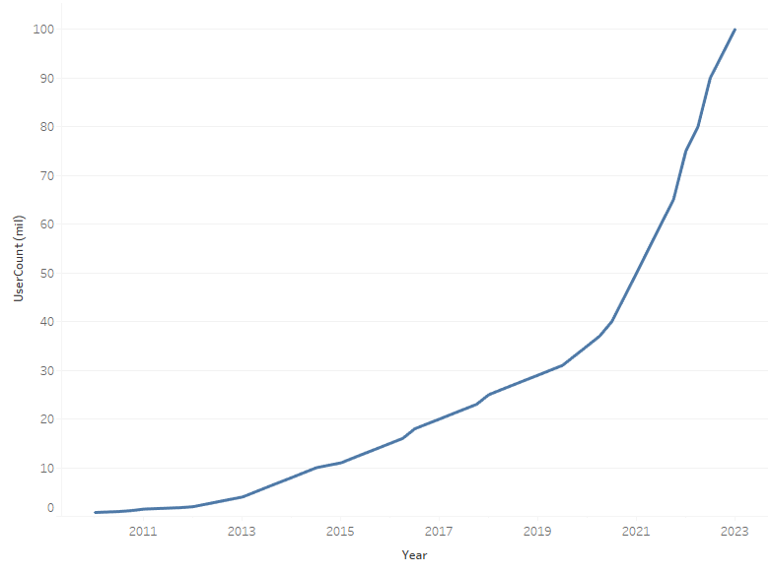
introduction
Notes:
First off, it's an awesome TV show on Netflix, well worth watching
Second, it inspired millions of people to take up chess
Or maybe it was me joining chess.com - if you squint you can see me in the data just before the elbow

Slide 3
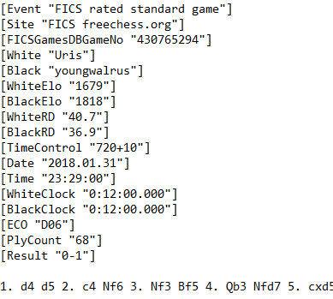
Chess data .pgn files
Format – Standard, Blitz, Lightning
Name of players
ELO (rating) of both players
Number of moves played
ECO (opening) code
Result – 1-0 White, ½-½, 0-1 Black
Movetext (sequence)
Notes:
All online chess games and uploaded tournament data are saved as .pgn files
These are standardised and contain useful info
ELO vs ECO is unnecessarily confusing, so I'll try to refer to them as "ratings" and "openings"

Slide 4
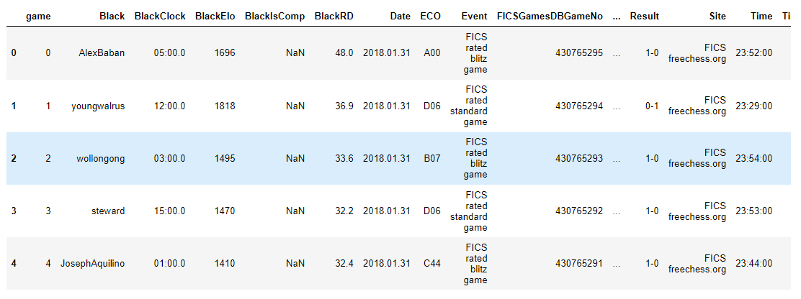
Our Best friend
Notes:
I wrote a function to convert the .pgn into our friend a Pandas Dataframe
This data was taken from Free Internet Chess Server (FICS) online portal
All games in Jan 2018
760,000 in total

Slide 5
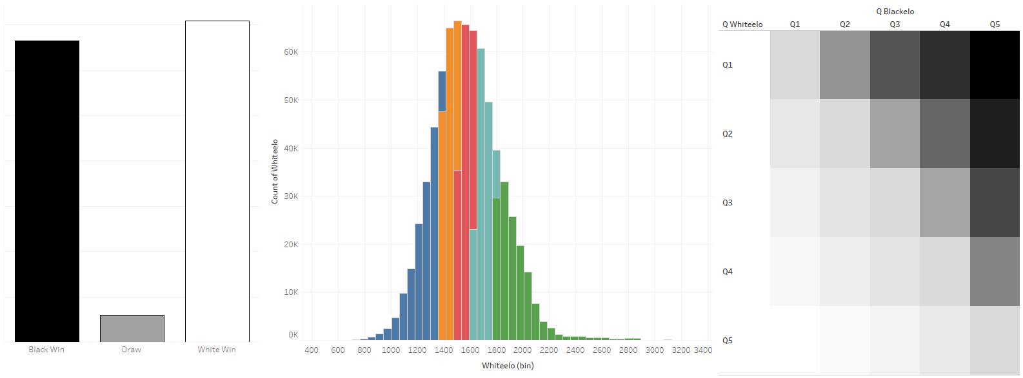
Wrangling 2 ½ days in...
Notes:
It took a while – after 2.5 days we found some basic insights!!!
White wins more than Black, and there are few Draws – this makes sense as White starts and is always one move ahead. At high levels, the expectation is you win your White games (like serving in tennis), then you try to hold your opponent to a draw when playing as Black or if you can, beat them!
There is a large spread of ratings for games played amongst the players - I split the ratings for both White and Black into five quantiles to better understand the data later on.
Reference, chess.com App starts new accounts at ELO=1200 (middle of blue players) then adjusts up or down based on performance. 2000 above (mid-green) are candidates for master titles, 2500 are Grandmasters (only around 2000 in world)
I'm at around 1400... (yellow)
It's also clear that higher quantile players win more often against lower players irrespective of colour

Slide 6
Where Next?
Classification models – White / Draw / Black – precision 0.63
Consider only "matched" games
Dependence of result on opening – Chi2
---> work on openings to improve my game
Notes:
Trying different classification models, and by oversampling Draws I managed to reach the heights of prediction_score = 0.63 - pretty rubbish, and clearly anyone could probably make a good guess by considering White and Black ELO, or just by flipping a coin
So I thought how could I get better at chess and improve my odds of winning
Chess.com pairs you with similar ranked opponents, so I looked at all games of players with the same ELO – fortunately, this was over half the dataset – chess-players are obviously fair players
I checked for this dataset whether openings had any bearing on the result. Null hypothesis was that opening types were independent from result – but p was low, the H0 had to go
So in order to improve my odds of winning, I should work on my chess openings.

Slide 7
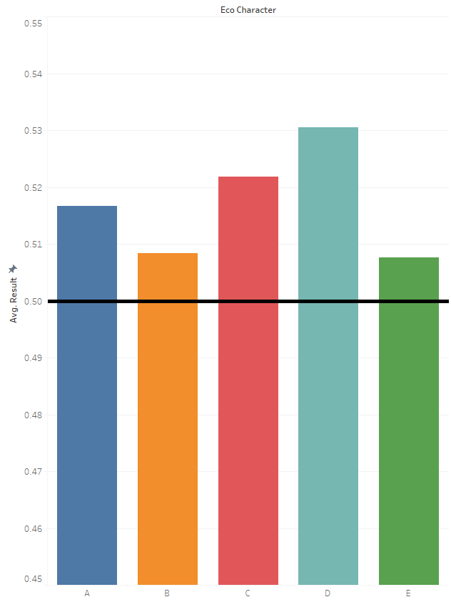
Optimal openings
ECO | Name | Average result 1 – White Win ½ – Draw 0 – Black Win
A30 | English Opening | 0.59
B90 | Sicilian, Najdor | 0.56
C21 | Centre Game | 0.56
D20 | Queen's Gambit Accepted | 0.58
E90 | King's Indian | 0.54
Notes:
ECO (openings) are grouped into five broad families A - E with many variations within each
Results varied by opening family at different ELO-quantiles (rating levels)
So I picked out the most commonly played, optimised openings for each of the families in matched games
At my level, A and C families tend to be best, so I will focus my efforts on learning and mastering the English Opening and the Centre Game

Slide 8
Openings for me to master
A30 English Opening
C21 Centre Game

Slide 9
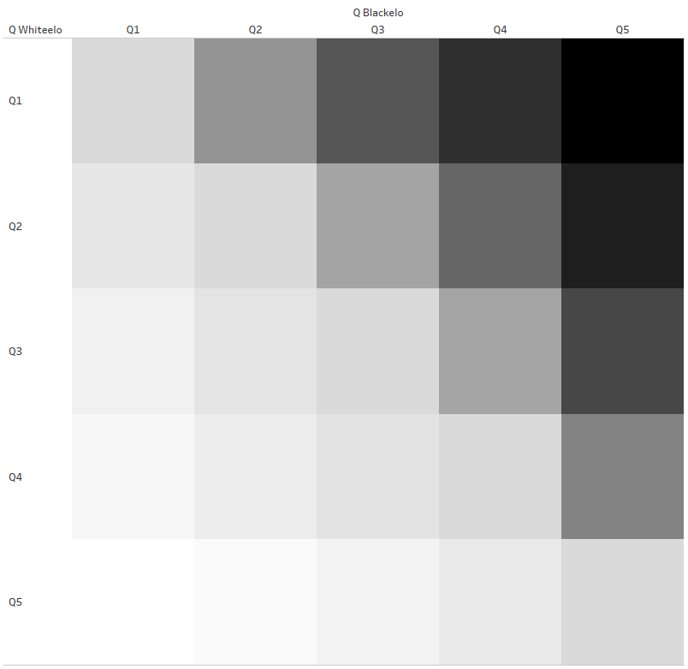
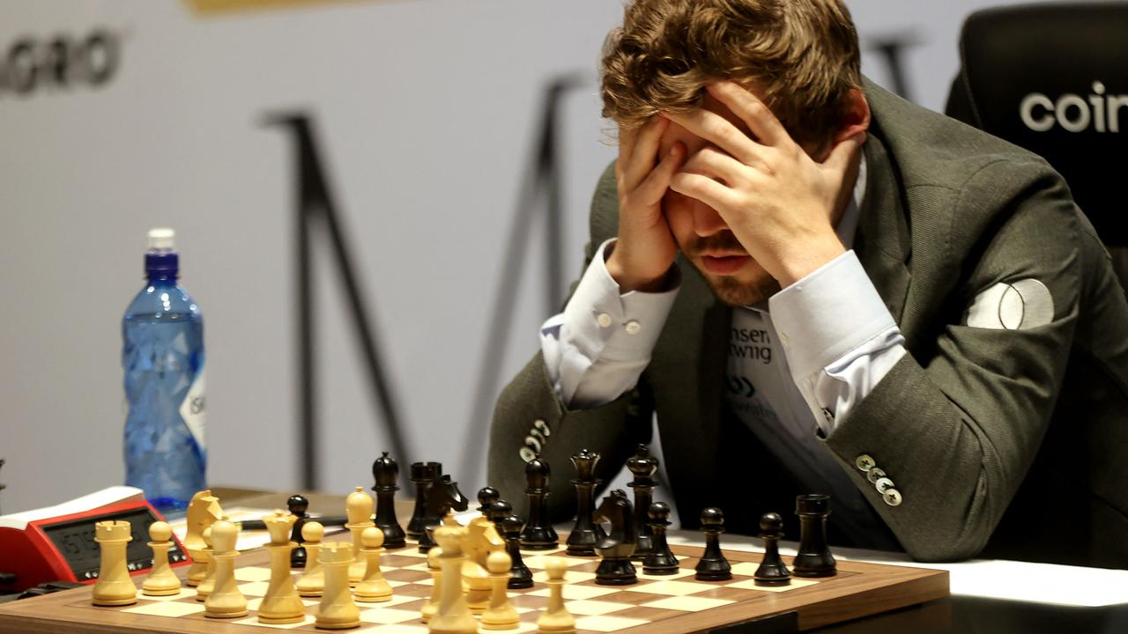
levelling up
Notes:
But what if I want to level up? I should no longer consider “matched” games against the same level, but instead “stretch” games against players at the quantile above.
I did the same grouping and analysis of optimised openings, and it gave a different picture...
In this stretched dataset I pitched White with lower ELO against Black with higher ELO as White would still largely determine the opening.
BONUS points for anyone who recognises that player

Slide 10
HOw to beat better players
D31 Queen's Gambit (Declined)
ECO | Name
C46 | Three knights game
C21 | Centre game
D07 | Queen's Gambit Declined, Chigorin
D31 | Queen's Gambit Declined
D11 | Queen's Gambit Declined Slav
D06 | Queen's Gambit I
The Queen's Gambit is indeed awesome!
Notes:
I cannot stress this enough, be prepared to lose. Even the best openings yielded average results between 0.4 and 0.45.
Can anyone spot a pattern there? Eagle eyed will notice that we see the Centre Game again, which is good as we would have learnt that already...
4 of the top 6 openings by average result for white are ALL Queen's Gambits variations
Proving that it is indeed awesome!!!

Slide 11

THANK YOU
Notes:
Follow on projects would be to explore how Black can counter White openings by making a tracking function that picks the best next move for a given sequence

