Slide 1
Jenkins-X
Exercise
NTT Data, 2019

Slide 2
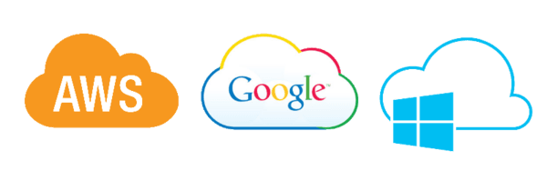
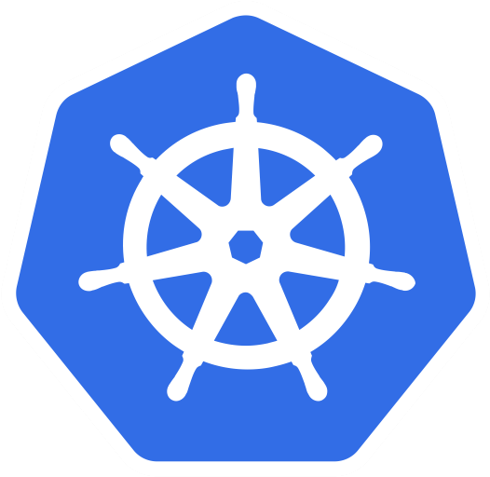

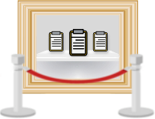
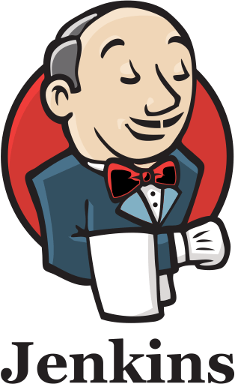


Infrastructure
NS
Kubernetes
Jenkins X
platform
Nexus
Docker
Registry
Chart
Museum
NS
NS
staging env
production env
app: 0.0.1
Notes:
Kubernetes Cluster running on AWS
Having Jenkins x installed
Part of the installation are two environments
Staging (auto deploy)
Production (manual deploy)
Accessible in the internet using the url http://jenkins.jx.cloud-poc-station.com/login (Try it yourself)

Slide 3
Give it a try
http://jenkins.jx.cloud-poc-station.com/login
Notes:
Access Jenkins

Slide 4
Github (everything as code )
https://github.com/cicdday
Notes:
The Jenkins x installation is connected to github account cicdday
Since it is everything as code there are three repositories in place
Micro the application
environment-cicd-hack-day-staging the staging environment
environment-cicd-hack-day-production the production environment

Slide 5

The Application
Payara-full JEE application having an index.html and a REST resource (Ping service)
Hello from Enso …
http://micro.jx-staging.cloud-poc-station.com/micro-sample/
http://micro.jx-staging.cloud-poc-station.com/micro-sample/rs/monitoring/ping
Alive1573067335560

Slide 6
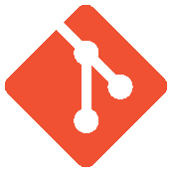


Jenkins-X – Dev Flow
Kubernetes cluster
NS
NS
NS
preview env
staging env
production env
app: 0.0.1
app: 0.0.1
app: 0.0.1
auto promotion
git create pull request
git create branch
merge
jx promote prod
repo
Pull Request build
Master build
Notes:
Create new Spring Boot projects, new quickstarts or import existing source code quickly into Jenkins X via the jx command line tool and:
get a Pipeline automatically setup for you that implements best practice CI/CD features:
creates a Jenkinsfile for defining the CI/CD pipelines through declarative pipeline-as-code
creates a Dockerfile for packaging the application up as an immutable container image (for applications which generate images)
creates a Helm chart for deploying and running your application on Kubernetes
ensures your code is in a git repository (e.g. GitHub) with the necessary webhooks to trigger the Jenkins CI/CD pipelines on push events
triggers the first release pipeline to promote your application to your teams Staging Environment
Then on each Pull Request:
a CI pipeline is triggered to build your application and run all the tests ensuring you keep the master branch in a ready to release state
your Pull Request is deployed to a Preview Environment (more on this later)
When a Pull Request is merged to the master branch the Release pipeline is triggered to create a new release:
a new semantic version number is generated
the source code is modified for the new version (e.g. pom.xml files get their <version> elements modified) and then tagged in git
new versioned artifacts are published including:
docker image, helm chart and any language specific artifacts (e.g. pom.xml and jar files for Java, npm packages for node or binaries for go etc)
the new version is promoted to Environments (more on this later)
Environment Promotion via GitOps

