Slide 1
CICD-DAY
Dockerized Pipeline

Slide 2
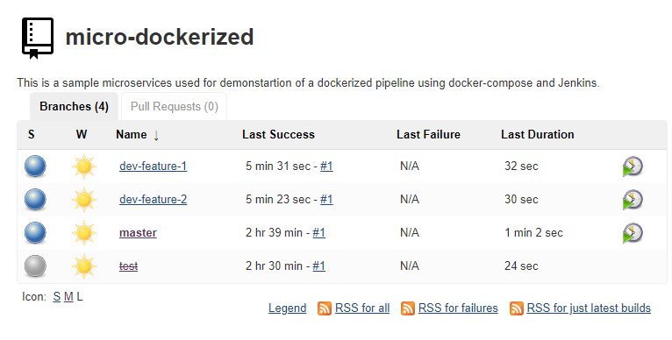
Dockerized Pipeline
Development takes place in feature branch and supports the agile development process
Fast feedback for developer about the feature
Feedback includes results of integration tests not just unit tests
Deployment on real application server possible with docker
More complex setup necessary to support multiple parallel build pipeline
Jenkins slave or master need more power

Slide 3
Code Structure
GIT_REPO:
cicdday/micro-dockerized
docker-compose.yaml
Orchestration for docker container
Jenkinsfile
Declaration of steps in build pipeline
Makefile
Support for command line
application
dockerfile
Docker definition for application
addressbook
src
Source code of application
pom.xml
Maven project definition
database
dockerfile
Docker definition for database

Slide 4
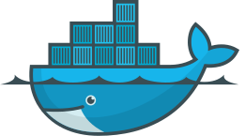
Docker Structure
192.99.1.x
Docker Network
Each set of docker container runs in a separate network with a special ip range
Network can be accessed via the docker bridge mode
Not necessary to reserve Ports when starting docker on jenkins
192.99.2.x
Docker Network
Payara Micro
Postgres 9.6
192.99.3.x
Docker Network
Adressbook
Adressbook Database
8080
5432

Slide 5
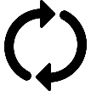

Jenkinsfile - Multibranch Pipeline
Agile development usually takes place on (feature) branches
Only when the feature is finished it will be integrated into the master (or develop) branch
For these branches you also want to have feedback for the developer
A new pipeline is created for each found branch
For deleted branches the pipeline is marked as deleted.
GIT
mp-config
master
master
mp-config
mp-jwt
mp-jwt

