Slide 1
AI Crop Yield Prediction
ENG346
Present by Alp Gövem

Slide 2
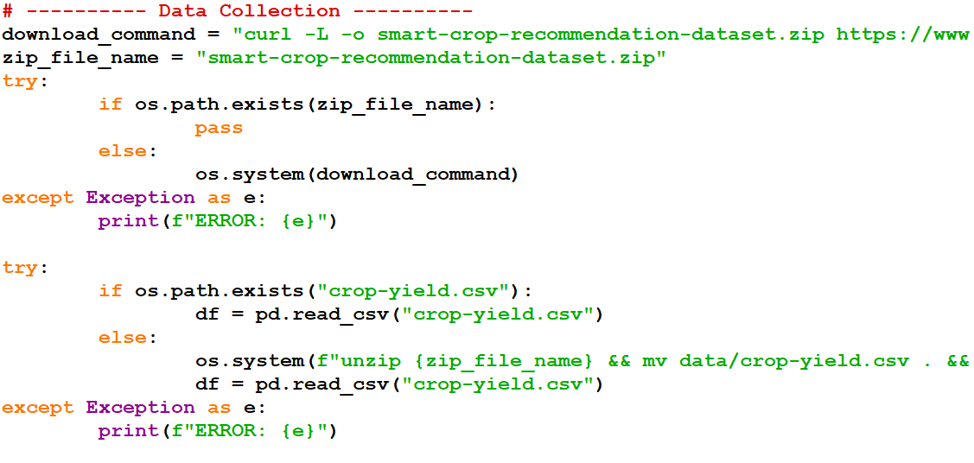
Dataset
Kaggle Smart Crop Recommendation Dataset
Main Features: N,P,K,pH,Moisture,Temp,Humidity,Rainfall etc.

Slide 3
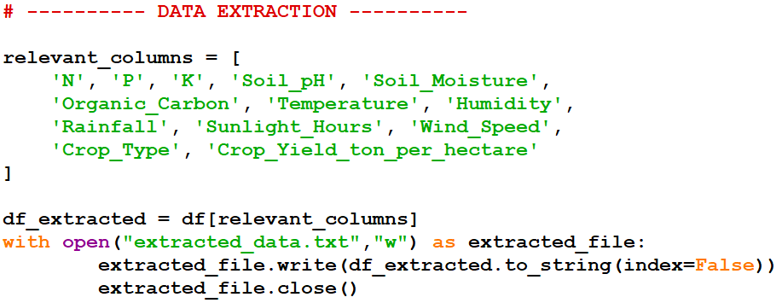
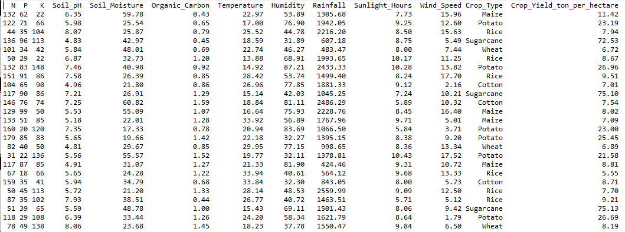

Slide 4
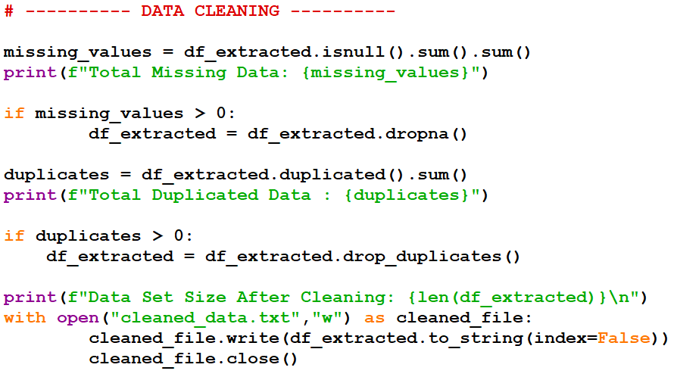
Data Cleaning
Missing values removed
Duplicates removed

Slide 5
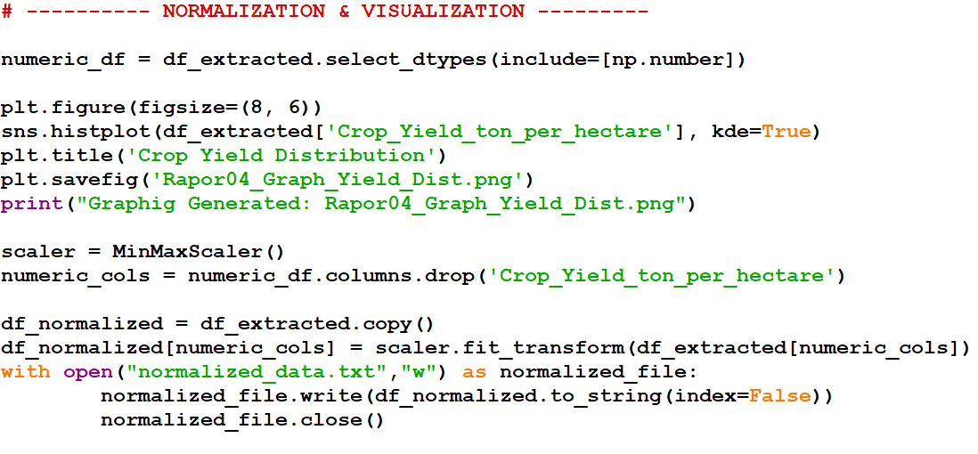
Normalization
MinMaxScaler applied to numeric features

Slide 6
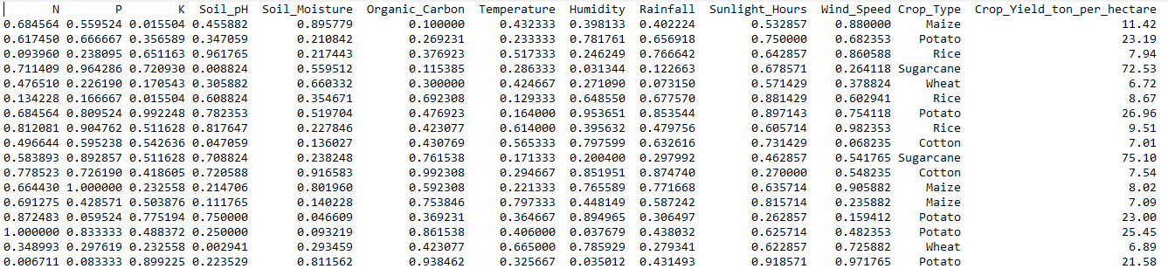

Slide 7
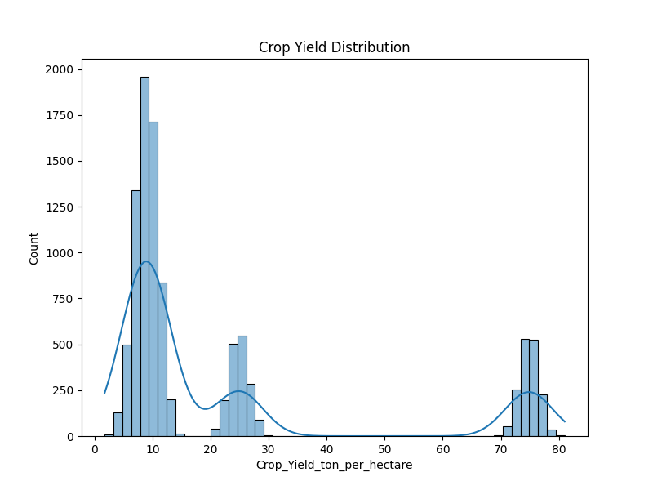
Visualization
Histogram of Crop Yield distribution

Slide 8
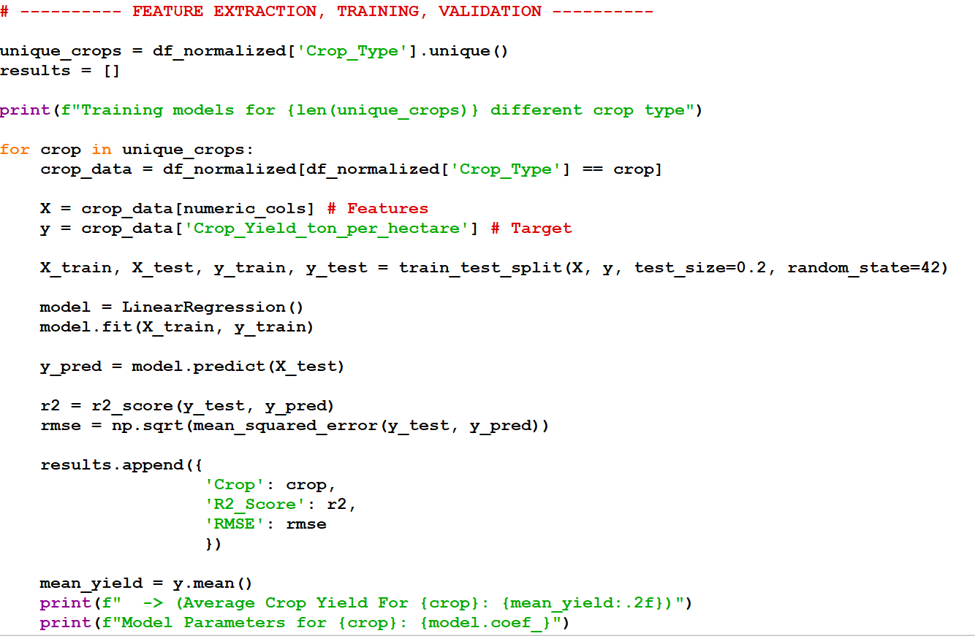
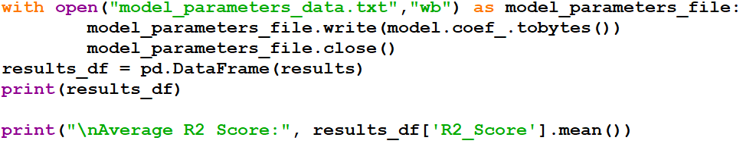
Model Training
Separate Linear Regression for each Crop Type

Slide 9
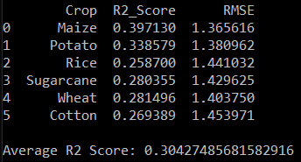
Evaluation
Metrics: R2 Score and RMSE

Slide 10
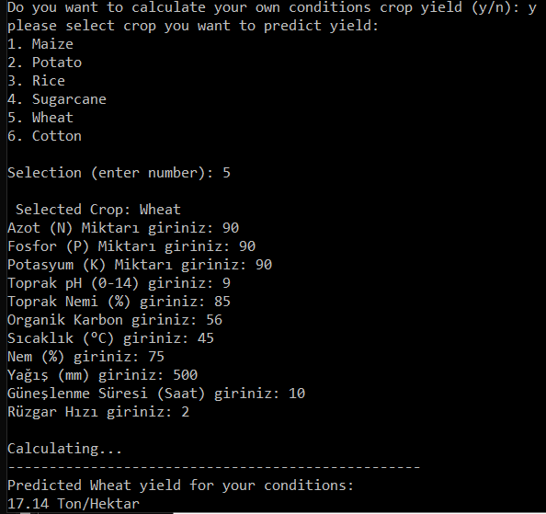
Prediction
User inputs conditions
Model predicts yield (ton/hectare)

Slide 11
Conclusion
Simple & effective ML pipeline

