Slide 1
Digital Image Processing
Colour Image Processing

Slide 2
Introduction
Today we’ll look at colour image processing, covering:
Colour fundamentals
Colour models

Slide 3
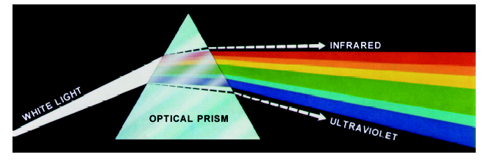
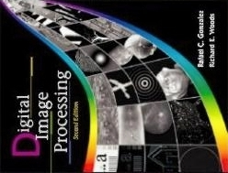
Colour Fundamentals
In 1666 Sir Isaac Newton discovered that when a beam of sunlight passes through a glass prism, the emerging beam is split into a spectrum of colours
Images taken from Gonzalez & Woods, Digital Image Processing (2002)

Slide 4
Colour Fundamentals (cont…)
The colours that humans and most animals perceive in an object are determined by the nature of the light reflected from the object
For example, green objects reflect light with wave lengths primarily in the range of 500 – 570 nm while absorbing most of the energy at other wavelengths
White Light
Colours Absorbed
Green Light

Slide 5
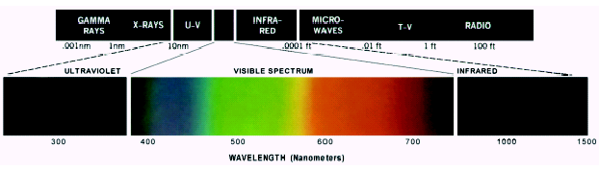
Colour Fundamentals (cont…)
Chromatic light spans the electromagnetic spectrum from approximately 400 to 700 nm
As we mentioned before human colour vision is achieved through 6 to 7 million cones in each eye
Images taken from Gonzalez & Woods, Digital Image Processing (2002)

Slide 6
Colour Fundamentals (cont…)
Approximately 66% of these cones are sensitive to red light, 33% to green light and 6% to blue light
Absorption curves for the different cones have been determined experimentally
Strangely these do not match the CIE standards for red (700nm), green (546.1nm) and blue (435.8nm) light as the standards were developed before the experiments!

Slide 7
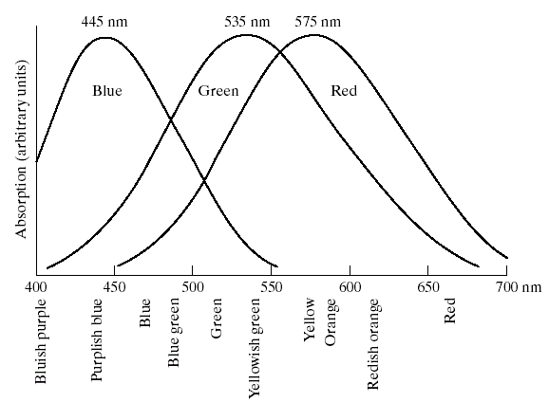
Colour Fundamentals (cont…)
Images taken from Gonzalez & Woods, Digital Image Processing (2002)

Slide 8
Colour Fundamentals (cont…)
3 basic qualities are used to describe the quality of a chromatic light source:
Radiance: the total amount of energy that flows from the light source (measured in watts)
Luminance: the amount of energy an observer perceives from the light source (measured in lumens)
Note we can have high radiance, but low luminance
Brightness: a subjective (practically unmeasurable) notion that embodies the intensity of light
We’ll return to these later on

Slide 9
CIE Chromacity Diagram
Specifying colours systematically can be achieved using the CIE chromacity diagram
On this diagram the x-axis represents the proportion of red and the y-axis represents the proportion of red used
The proportion of blue used in a colour is calculated as:
z = 1 – (x + y)

Slide 10
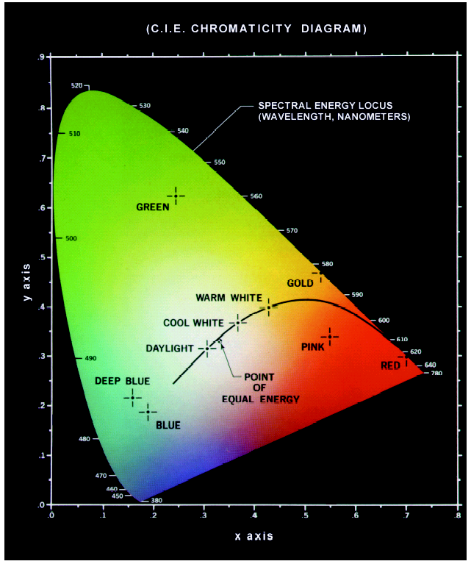
CIE Chromacity Diagram (cont…)
Green: 62% green, 25% red and 13% blue
Red: 32% green, 67% red and 1% blue
Images taken from Gonzalez & Woods, Digital Image Processing (2002)

Slide 11
CIE Chromacity Diagram (cont…)
Any colour located on the boundary of the chromacity chart is fully saturated
The point of equal energy has equal amounts of each colour and is the CIE standard for pure white
Any straight line joining two points in the diagram defines all of the different colours that can be obtained by combining these two colours additively
This can be easily extended to three points

Slide 12
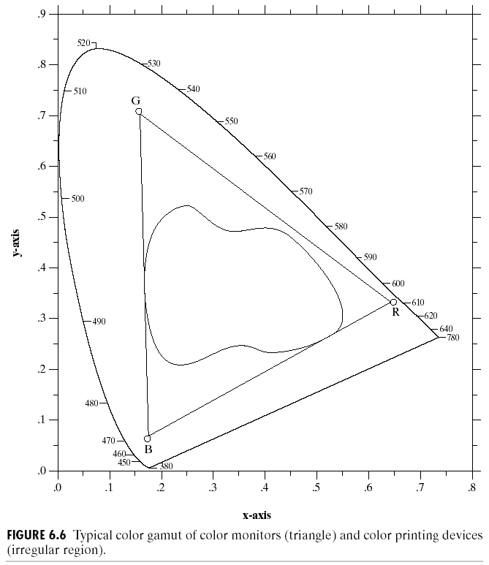
CIE Chromacity Diagram (cont…)
This means the entire colour range cannot be displayed based on any three colours
The triangle shows the typical colour gamut produced by RGB monitors
The strange shape is the gamut achieved by high quality colour printers
Images taken from Gonzalez & Woods, Digital Image Processing (2002)

Slide 13
Colour Models
From the previous discussion it should be obvious that there are different ways to model colour
We will consider two very popular models used in colour image processing:
RGB (Red Green Blue)
HIS (Hue Saturation Intensity)

Slide 14
RGB
In the RGB model each colour appears in its primary spectral components of red, green and blue
The model is based on a Cartesian coordinate system
RGB values are at 3 corners
Cyan magenta and yellow are at three other corners
Black is at the origin
White is the corner furthest from the origin
Different colours are points on or inside the cube represented by RGB vectors

Slide 15
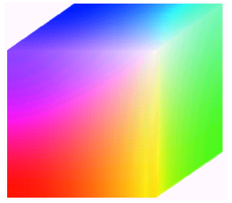
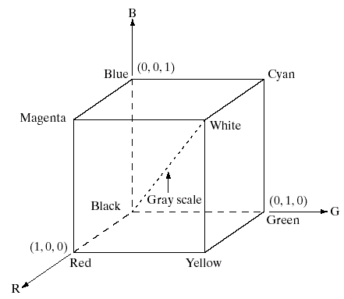
RGB (cont…)
Images taken from Gonzalez & Woods, Digital Image Processing (2002)

Slide 16
RGB (cont…)
Images represented in the RGB colour model consist of three component images – one for each primary colour
When fed into a monitor these images are combined to create a composite colour image
The number of bits used to represent each pixel is referred to as the colour depth
A 24-bit image is often referred to as a full-colour image as it allows = 16,777,216 colours

Slide 17
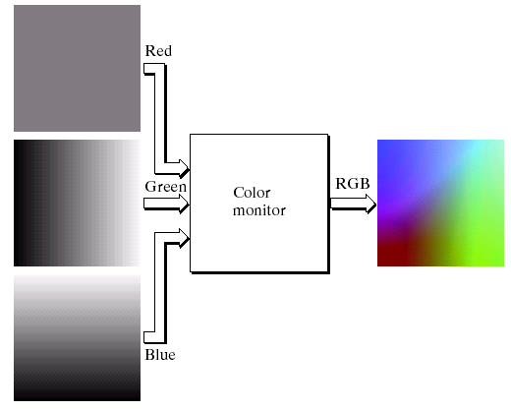
RGB (cont…)
Images taken from Gonzalez & Woods, Digital Image Processing (2002)

Slide 18
The HSI Colour Model
RGB is useful for hardware implementations and is serendipitously related to the way in which the human visual system works
However, RGB is not a particularly intuitive way in which to describe colours
Rather when people describe colours they tend to use hue, saturation and brightness
RGB is great for colour generation, but HSI is great for colour description

Slide 19
The HSI Colour Model (cont…)
The HSI model uses three measures to describe colours:
Hue: A colour attribute that describes a pure colour (pure yellow, orange or red)
Saturation: Gives a measure of how much a pure colour is diluted with white light
Intensity: Brightness is nearly impossible to measure because it is so subjective. Instead we use intensity. Intensity is the same achromatic notion that we have seen in grey level images

Slide 20
HSI, Intensity & RGB
Intensity can be extracted from RGB images – which is not surprising if we stop to think about it
Remember the diagonal on the RGB colour cube that we saw previously ran from black to white
Now consider if we stand this cube on the black vertex and position the white vertex directly above it

Slide 21
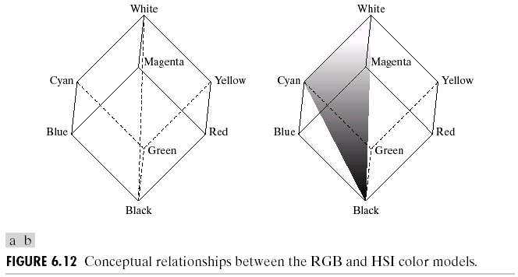
HSI, Intensity & RGB (cont…)
Now the intensity component of any colour can be determined by passing a plane perpendicular to the intenisty axis and containing the colour point
The intersection of the plane with the intensity axis gives us the intensity component of the colour
Images taken from Gonzalez & Woods, Digital Image Processing (2002)

Slide 22
HSI, Hue & RGB
In a similar way we can extract the hue from the RGB colour cube
Consider a plane defined by the three points cyan, black and white
All points contained in this plane must have the same hue (cyan) as black and white cannot contribute hue information to a colour
Images taken from Gonzalez & Woods, Digital Image Processing (2002)

Slide 23
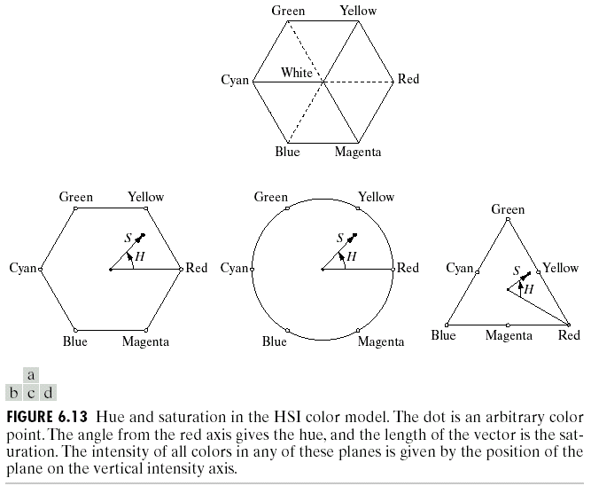
The HSI Colour Model
Consider if we look straight down at the RGB cube as it was arranged previously
We would see a hexagonal shape with each primary colour separated by 120° and secondary colors at 60°
from the primaries. So the
HSI model is composed of a
vertical intensity axis and the locus
of colour points that lie on planes
perpendicular to that axis
Images taken from Gonzalez & Woods, Digital Image Processing (2002)

Slide 24
The HSI Colour Model (cont…)
To the right we see a hexagonal shape and an arbitrary colour point
The hue is determined by an angle from a reference point, usually red
The saturation is the distance from the origin to the point
The intensity is determined by how far up the vertical intenisty axis this hexagonal plane sits (not apparent from this diagram
Images taken from Gonzalez & Woods, Digital Image Processing (2002)

Slide 25
The HSI Colour Model (cont…)
Because the only important things are the angle and the length of the saturation vector this plane is also often represented as a circle or a triangle
Images taken from Gonzalez & Woods, Digital Image Processing (2002)

Slide 26
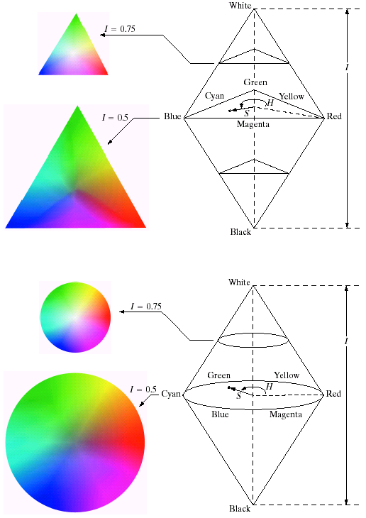
HSI Model Examples
Images taken from Gonzalez & Woods, Digital Image Processing (2002)

Slide 27
HSI Model Examples
Images taken from Gonzalez & Woods, Digital Image Processing (2002)

Slide 28
Converting From RGB To HSI
Given a colour as R, G, and B its H, S, and I values are calculated as follows:

Slide 29
Converting From HSI To RGB
Given a colour as H, S, and I it’s R, G, and B values are calculated as follows:
RG sector (0 <= H < 120°)
GB sector (120° <= H < 240°)

Slide 30
Converting From HSI To RGB (cont…)
BR sector (240° <= H <= 360°)

Slide 31
Manipulating Images In The HSI Model
In order to manipulate an image under the HIS model we:
First convert it from RGB to HIS
Perform our manipulations under HSI
Finally convert the image back from HSI to RGB
RGB Image
HSI Image
RGB Image
Manipulations

Slide 32
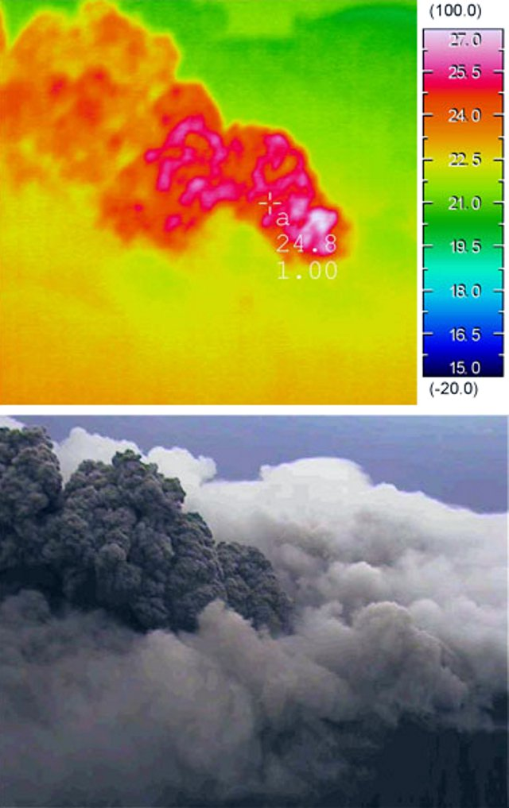

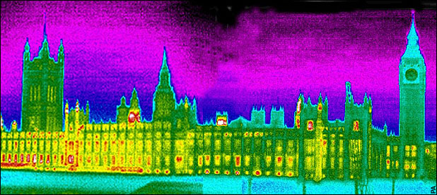
Pseudocolour Image Processing
Pseudocolour (also called false colour) image processing consists of assigning colours to grey values based on a specific criterion
The principle use of pseudocolour image processing is for human visualisation
Humans can discern between thousands of colour shades and intensities, compared to only about two dozen or so shades of grey

