Slide 1
Chapter two

Slide 2
Basic Relationships Between Pixels
Neighborhood
Adjacency
Connectivity
Paths
Regions and boundaries

Slide 3
Basic Relationships Between Pixels
Neighbors of a pixel p at coordinates (x,y)
4-neighbors of p, denoted by N₄(p):
(x-1, y), (x+1, y), (x,y-1), and (x, y+1).
4 diagonal neighbors of p, denoted by N_{D}(p):
(x-1, y-1), (x+1, y+1), (x+1,y-1), and (x-1, y+1).
8 neighbors of p, denoted N₈(p)
N₈(p) = N₄(p) U N_{D}(p)

Slide 4
Adjacency
Let V be the set of intensity values
m-adjacency: Two pixels p and q with values from V are m-adjacent if
(i) q is in the set N₄(p), or
(ii) q is in the set N_{D}(p) and the set N₄(p) ∩ N₄(q) has no pixels whose values are from V.

Slide 5
Path
(digital) path (or curve) from pixel p with coordinates (x₀, y₀) to pixel q with coordinates (x_{n}, y_{n}) is a sequence of distinct pixels with coordinates A
(x₀, y₀), (x₁, y₁), …, (x_{n}, y_{n})
Where (x_{i}, y_{i}) and (x_{i-1}, y_{i-1}) are adjacent for 1 ≤ i ≤ n.
Here n is the length of the path.
If (x₀, y₀) = (x_{n}, y_{n}), the path is closed path.
We can define 4-, 8-, and m-paths based on the type of adjacency used.

Slide 6
Examples: Adjacency and Path
V = {1, 2}
0 1 1 0 1 1 0 1 1
0 2 0 0 2 0 0 2 0
0 0 1 0 0 1 0 0 1

Slide 7
Examples: Adjacency and Path
V = {1, 2}
0 1 1 0 1 1 0 1 1
0 2 0 0 2 0 0 2 0
0 0 1 0 0 1 0 0 1
8-adjacent

Slide 8
Examples: Adjacency and Path
V = {1, 2}
0 1 1 0 1 1 0 1 1
0 2 0 0 2 0 0 2 0
0 0 1 0 0 1 0 0 1
8-adjacent
m-adjacent

Slide 9
Examples: Adjacency and Path
V = {1, 2}
01,1 11,2 11,3 0 1 1 0 1 1
02,1 22,2 02,3 0 2 0 0 2 0
03,1 03,2 13,3 0 0 1 0 0 1
8-adjacent
m-adjacent
The 8-path from (1,3) to (3,3):
(1,3), (1,2), (2,2), (3,3)
(1,3), (2,2), (3,3)
The m-path from (1,3) to (3,3):
(1,3), (1,2), (2,2), (3,3)

Slide 10
Basic Relationships Between Pixels
Connected in S
Let S represent a subset of pixels in an image. Two pixels p with coordinates (x₀, y₀) and q with coordinates (x_{n}, y_{n}) are said to be connected in S if there exists a path
(x₀, y₀), (x₁, y₁), …, (x_{n}, y_{n})
Where

Slide 11
Basic Relationships Between Pixels
Let S represent a subset of pixels in an image
For every pixel p in S, the set of pixels in S that are connected to p is called a connected component of S.
If S has only one connected component, then S is called Connected Set.
We call R a region of the image if R is a connected set
Two regions, R_{i} and R_{j} are said to be adjacent if their union forms a connected set.
Regions that are not to be adjacent are said to be disjoint.

Slide 12
Basic Relationships Between Pixels
Boundary (or border)
The boundary of the region R is the set of pixels in the region that have one or more neighbors that are not in R.
If R happens to be an entire image, then its boundary is defined as the set of pixels in the first and last rows and columns of the image.
Foreground and background
An image contains K disjoint regions, R_{k}, k = 1, 2, …, K. Let R_{u} denote the union of all the K regions, and let (R_{u})^{c} denote its complement.
All the points in R_{u} is called foreground;
All the points in (R_{u})^{c} is called background.

Slide 13
Question 1
In the following arrangement of pixels, are the two regions (of 1s) adjacent? (if 8-adjacency is used)
1 1 1
1 0 1
0 1 0
0 0 1
1 1 1
1 1 1
Region 1
Region 2

Slide 14
Question 2
In the following arrangement of pixels, are the two parts (of 1s) adjacent? (if 4-adjacency is used)
1 1 1
1 0 1
0 1 0
0 0 1
1 1 1
1 1 1
Part 1
Part 2

Slide 15
In the following arrangement of pixels, the two regions (of 1s) are disjoint (if 4-adjacency is used)
1 1 1
1 0 1
0 1 0
0 0 1
1 1 1
1 1 1
Region 1
Region 2

Slide 16
In the following arrangement of pixels, the two regions (of 1s) are disjoint (if 4-adjacency is used)
1 1 1
1 0 1
0 1 0
0 0 1
1 1 1
1 1 1
foreground
background

Slide 17
Question 3
In the following arrangement of pixels, the circled point is part of the boundary of the 1-valued pixels if 8-adjacency is used, true or false?
0 0 0 0 0
0 1 1 0 0
0 1 1 0 0
0 1 1 1 0
0 1 1 1 0
0 0 0 0 0

Slide 18
Question 4
In the following arrangement of pixels, the circled point is part of the boundary of the 1-valued pixels if 4-adjacency is used, true or false?
0 0 0 0 0
0 1 1 0 0
0 1 1 0 0
0 1 1 1 0
0 1 1 1 0
0 0 0 0 0

Slide 19
Distance Measures
Given pixels p, q and z with coordinates (x, y), (s, t), (u, v) respectively, the distance function D has following properties:
D(p, q) ≥ 0 [D(p, q) = 0, iff p = q]
D(p, q) = D(q, p)
D(p, z) ≤ D(p, q) + D(q, z)

Slide 20
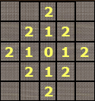
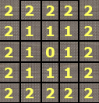
Distance Measures
The following are the different Distance measures:
a. Euclidean Distance :
D_{e}(p, q) = [(x-s)² + (y-t)²]^{1/2}
b. City Block Distance:
D₄(p, q) = |x-s| + |y-t|
c. Chess Board Distance:
D₈(p, q) = max(|x-s|, |y-t|)

Slide 21
Question 5
In the following arrangement of pixels, what’s the value of the chessboard distance between the circled two points?
0 0 0 0 0
0 0 1 1 0
0 1 1 0 0
0 1 0 0 0
0 0 0 0 0
0 0 0 0 0

Slide 22
Question 6
In the following arrangement of pixels, what’s the value of the city-block distance between the circled two points?
0 0 0 0 0
0 0 1 1 0
0 1 1 0 0
0 1 0 0 0
0 0 0 0 0
0 0 0 0 0

Slide 23
Question 7
In the following arrangement of pixels, what’s the value of the length of the m-path between the circled two points?
0 0 0 0 0
0 0 1 1 0
0 1 1 0 0
0 1 0 0 0
0 0 0 0 0
0 0 0 0 0

Slide 24
Question 8
In the following arrangement of pixels, what’s the value of the length of the m-path between the circled two points?
0 0 0 0 0
0 0 1 1 0
0 0 1 0 0
0 1 0 0 0
0 0 0 0 0
0 0 0 0 0

Slide 25
Introduction to Mathematical Operations in DIP
Array vs. Matrix Operation
Array product
operator
Array product
Matrix product
operator
Matrix product

Slide 26
Introduction to Mathematical Operations in DIP
Linear vs. Nonlinear Operation
H is said to be a linear operator;
H is said to be a nonlinear operator if it does not meet the above qualification.
Additivity
Homogeneity

Slide 27
Arithmetic Operations
Arithmetic operations between images are array operations. The four arithmetic operations are denoted as
s(x,y) = f(x,y) + g(x,y)
d(x,y) = f(x,y) – g(x,y)
p(x,y) = f(x,y) × g(x,y)
v(x,y) = f(x,y) ÷ g(x,y)

Slide 28
Example: Addition of Noisy Images for Noise Reduction
Noiseless image: f(x,y)
Noise: n(x,y) (at every pair of coordinates (x,y), the noise is uncorrelated and has zero average value)
Corrupted image: g(x,y)
g(x,y) = f(x,y) + n(x,y)
Reducing the noise by adding a set of noisy images, {g_{i}(x,y)}

Slide 29
Example: Addition of Noisy Images for Noise Reduction

Slide 30
Example: Addition of Noisy Images for Noise Reduction
In astronomy, imaging under very low light levels frequently causes sensor noise to render single images virtually useless for analysis.
In astronomical observations, similar sensors for noise reduction by observing the same scene over long periods of time. Image averaging is then used to reduce the noise.

Slide 31
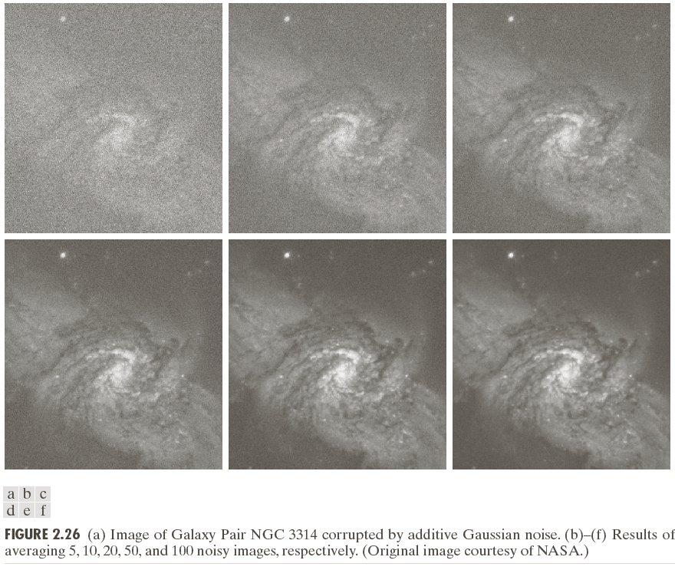

Slide 32
An Example of Image Subtraction: Mask Mode Radiography
Mask h(x,y): an X-ray image of a region of a patient’s body
Live images f(x,y): X-ray images captured at TV rates after injection of the contrast medium
Enhanced detail g(x,y)
g(x,y) = f(x,y) - h(x,y)
The procedure gives a movie showing how the contrast medium propagates through the various arteries in the area being observed.

Slide 33
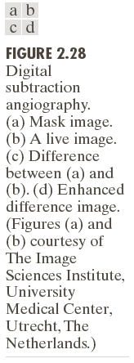

Slide 34
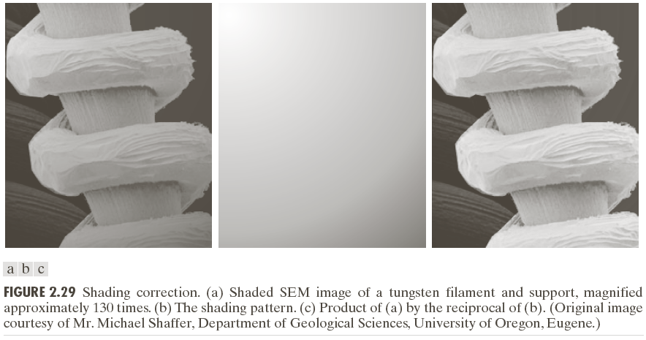
An Example of Image Multiplication

Slide 35
Set and Logical Operations

Slide 36
Set and Logical Operations
Let A be the elements of a gray-scale image
The elements of A are triplets of the form (x, y, z), where x and y are spatial coordinates and z denotes the intensity at the point (x, y).
The complement of A is denoted A^{c}

Slide 37
Set and Logical Operations
The union of two gray-scale images (sets) A and B is defined as the set

Slide 38
Set and Logical Operations

