Slide 1

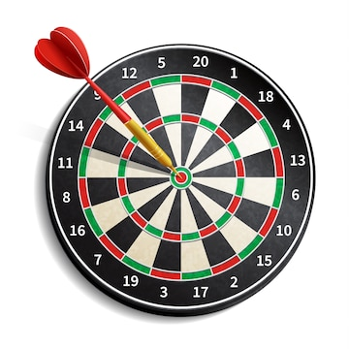
Dart

Slide 2
Getting Started
Dart is easy to learn if you know any of Java, C++, JavaScript, etc.
The simplest "Hello World" program gives the idea of the basic syntax of the programming language. It is the way of testing the system and working environment.
There are several ways to run the first program, which is given below:
  Using Command Line
  Running on Browser
  Using IDE

Slide 3
Hello World
void main() { print("Hello World!");
}

Slide 4
Identifiers
Identifiers are the name which is used to define variables, methods, class, and function, etc.
An Identifier is a sequence of the letters([A to Z],[a to z]), digits([0-9]) and underscore(_), but remember that the first character should not be a numeric.

Slide 5
Identifiers
•
•
The first character should not be a digit.
Special characters are not allowed except underscore (_) or a dollar sign ($).
Two successive underscores ( ) are not allowed.
The first character must be alphabet(uppercase or lowercase) or underscore.
Identifiers must be unique and cannot contain whitespace.
They are case sensitive. The variable name Hasan and hasan will be treated differently.
•
•
•
•

Slide 6
Printing and String Interpolation
The print() function is used to print output on the console, and $expression is used for the string interpolation. Below is an example.
void main()
{
var name = "Hasan"; var marks = 78.56;
print("My name is ${name} My marks are ${marks}");
}

Slide 7
Semicolon
The semicolon is used to terminate the statement that means, it indicates the statement is ended here. It is mandatory that each statement should be terminated with a semicolon(;).
We can write multiple statements in a single line by using a semicolon as a delimiter. The compiler will generate an error if it is not use properly.
Example -
var msg1 = "Hello World!"; var msg2 = "How are you?"
•
•

Slide 8
Whitespace and Line Breaks
The Dart compiler ignores whitespaces. It is used to specify space, tabs, and newline characters in our program.
It separates one part of any statement from another part of the statement.
We can also use space and tabs in our program to define indentation and provide the proper format for the program.
It makes code easy to understand and readable.
•
•
•

Slide 9
Block
The block is the collection of the statement enclosed in the curly braces. In Dart, we use curly braces to group all of the statements in the block.
Consider the following syntax. Syntax:
{ //start of the block
//block of statement(s)
}// end of the block
•
•

Slide 10
Comments
Comments are the set of statements that are ignored by the Dart compiler during the program execution. It is used to enhance the readability of the source code.
Generally, comments give a brief idea of code that what is happening in the code.
We can describe the working of variables, functions, classes, or any statement that exists in the code.
Programmers should use the comment for better practice.
•
•
•

Slide 11
Comments
Dart provides three kinds of comments
  Single-line Comments
  Multi-line Comments
  Documentation Comments

Slide 12
Single-line Comment
We can apply comments on a single line by using the // (double-slash). The single-line comments can be applied until a line break.
Example - void main(){
// This will print the given statement on screen
print("Welcome to MITU Skillologies");
}
•

Slide 13
Multi-line Comment
Sometimes we need to apply comments on multiple lines; then, it can be done by using /*…..*/. The compiler ignores anything that written inside the /*…*/, but it cannot be nested with the multi-line comments. Let's see the following example.
Example - void main(){
/* This is the example of multi-line comment
This will print the given statement on screen */ print("Welcome to Dart");
}
•

Slide 14
Documentation Comment
The document comments are used to generate documentation or reference for a project/software package. It can be a single-line or multi-line comment that starts with /// or /*. We can use /// on consecutive lines, which is the same as the multiline comment.
These lines ignore by the Dart compiler expect those which are written inside the curly brackets. We can define classes, functions, parameters, and variables. Consider the following example.
Syntax
///This
///is
///a example of
/// multiline comment

Slide 15
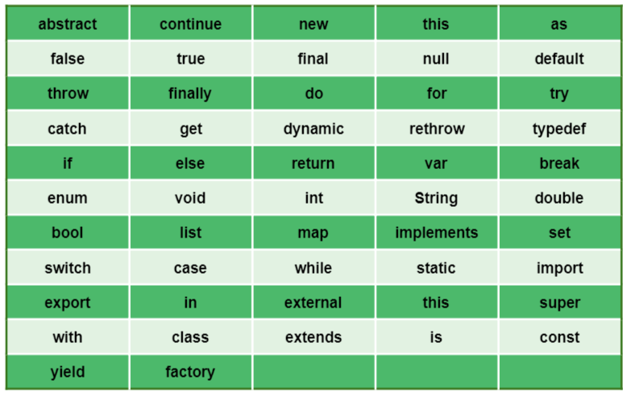
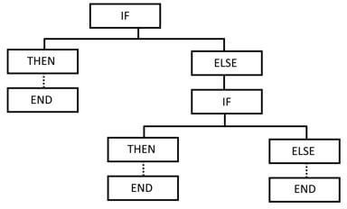

Keywords

Slide 16
Data Types
The data types are the most important fundamental features of programming language.
In Dart, the data type of the variable is defined by its value.
The variables are used to store values and reserve the memory location.
The data-type specifies what type of value will be stored by the variable. Each variable has its data-type.
The Dart is a static type of language, which means that the variables cannot modify.

Slide 17
Data Types
Dart supports the following built-in Data types.
  Number
  Strings
  Boolean
  Lists
  Maps
  Runes

Slide 18
Numbers
The Darts Number is used to store the numeric values. The number can be two types - integer and double.
Integer - Integer values represent the whole number or non-fractional values. An integer data type represents the 64-bit non-decimal numbers between -2⁶³ to 2⁶³. A variable can store an unsigned or signed integer value. Ex.
int marks = 80;
Double - Double value represents the 64-bit of information (double-precision) for floating number or number with the large decimal points. The double keyword is used to declare the double type variable.
double pi = 3.14;

Slide 19
Strings
A string is the sequence of the character. If we store the data like - name, address, special character, etc.
It is signified by using either single quotes or double quotes. A Dart string is a sequence of UTF-16 code units.
var msg = "Welcome to Dart"; print("বাংলাদেশ");

Slide 20
Boolean
The Boolean type represents the two values - true and false.
The bool keyword uses to denote Boolean Type.
The numeric values 1 and 0 cannot be used to represent the true or false value.
bool isValid = true;

Slide 21
List
The list is a collection of the ordered objects (value).
The concept of list is similar to an array. An array is defined as a collection of the multiple elements in a single variable.
The elements in the list are separated by the comma enclosed in the square bracket[].
The sample list is given below. var list = [1,2,3]

Slide 22
Map
The maps type is used to store values in key-value pairs. Each key is associated with its value.
The key and value can be any type. In Map, the key must be unique, but a value can occur multiple times.
The Map is defined by using curly braces ({}), and comma separates each pair.
var student = {'name': 'Rajesh', 'age':22, 'Branch': 'Statistics'}
•
•

Slide 23
Runes
As we know that, the strings are the sequence of Unicode UTF-16 code units. Unicode is a technique which is used to describe a unique numeric value for each digit, letter, and symbol.
Since Dart Runes are the special string of Unicode UTF-32 units. It is used to represent the special syntax.
For example - The special emoji Tears of Joy (😂) is equivalent to Unicode code \u2665, where \u means Unicode, and the numbers are hexadecimal integer.
If the hex value is less or greater than 4 digits, it places in a curly bracket ({}). For example – An emoji can be represented as \u{1f600}.

Slide 24
Example
void main( ){
var laugh_tear_symbol = '\u2665';
var laugh_symbol = '\u{1f600}';
print(laugh_tear_symbol); print(laugh_symbol);
}

Slide 25
Dynamic Type
•
•
Dart is an optionally typed language.
If the variable type is not specified explicitly, then the variable type is dynamic. The dynamic keyword is used for type annotation explicitly.

Slide 26
Variable Default Value
While declaring the variable without initializing the value then the Dart compiler provides default value (Null) to the variable.
Even the numeric type variables are initially assigned with the null value.
Let's consider the following example. int count;

Slide 27
Final and const
When we do not want to change a variable in the future then we use final and const. It can be used in place of var or in addition to a type.
A final variable can be set only one time where the variable is a compile-time constant. The example of creating a final variable is given below.
Example -
final name = ‘Howell';
// final variable without type annotation. final String msg = 'Hi?';
// final variable with type annotation.

Slide 28
Final and const
The const is used to create compile-time constants. We can declare a value to compile-time constant such as number, string literal, a const variable, etc.
const a = 1000;
The const keyword is also used to create a constant value that cannot be changed after its creation.
var f = const[];
If we try to change it, then it will throw an error.
f = [12]; //Error, The const variable cannot be change

Slide 29
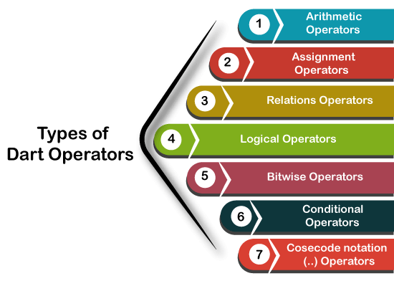
Operators

Slide 30
Arithmetic Operators
+
-
*
/
%

Slide 31
Arithmetic Operators
void main(){
print("Example of Assignment operators"); var n1 = 10;
var n2 = 5;
print("n1+n2 = ${n1+n2}"); print("n1-n2 = ${n1-n2}"); print("n1*n2 = ${n1*n2}"); print("n1/n2 = ${n1/n2}"); print("n1%n2 = ${n1%n2}");
}

Slide 32
Increment and Decrement
• ++ and -- operators are known as increment and decrement operators and also known as unary operators, respectively.
Unary operators, operate on single operand where ++ adds 1 to operands and -- subtract 1 to operand respectively.
The unary operators can be used in two ways - postfix and prefix.
If ++ is used as a postfix(like x++), it returns the value of operand first then increments the value of x. If -- is used as a prefix(like ++x), it increases the value of x.

Slide 33
Assignment Operators
• =
• +=
-=
*=
~/=
%=

Slide 34
Relational Operators
• ==
!=
<
>
<=
>=

Slide 35
Bitwise Operators
AND &
OR |
EX-OR ^
>>
<<
~

Slide 36
Type Test Operators
as
  It is used for typecast.
is
  It returns TRUE if the object has specified type.
is!
  It returns TRUE if the object has not specified type.

Slide 37
Type Test Operators
void main()
{
var num = 10;
var name = "Dart"; print(num is int); print(name is! String );
}

Slide 38
Logical Operators
&&
||
!

Slide 39
Conditional Operators
The Conditional Operator is same as if-else statement and provides similar functionality as conditional statement.
It is the second form of if-else statement. It is also identified as "Ternary Operator". The syntax is given below.
Syntax 1 -
condition ? exp1 : exp2
If the given condition is TRUE then it returns exp1 otherwise exp2.

Slide 40
Conditional Operators
Syntax 2 - exp1 ?? expr2
If the exp1 is not-null, returns its value, otherwise returns the exp2's value.

Slide 41
Conditional Operators
void main() { var x = null; var y = 20;
var val = x ?? y; print(val);
}

Slide 42
Conditional Operators
void main() { var a = 30;
var output = a > 38 ? "value greater than 10":"value lesser than equal to 30";
print(output);
}

Slide 43
The parse()
The parse() function converts the numeric string to the number. Consider the following example -
void main(){
var a = num.parse("20.56"); var b = num.parse("15.63");
var c = a+b;
print("The sum is = ${c}");
}

Slide 44
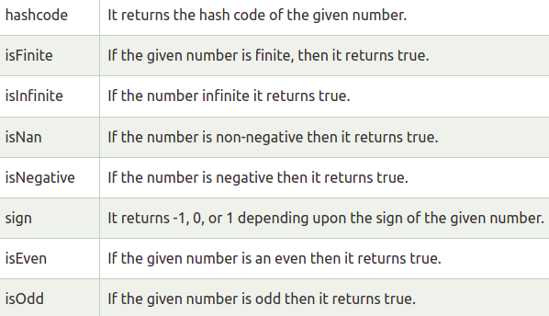
The number properties

Slide 45
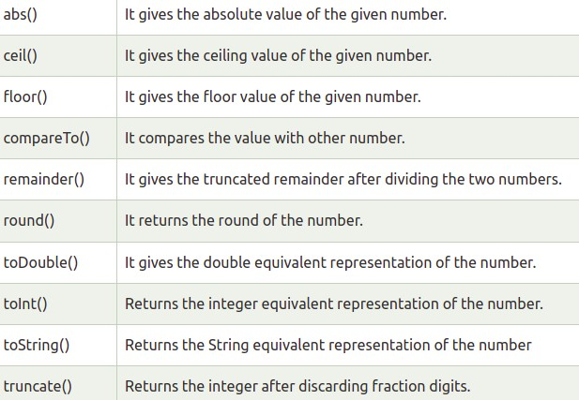
The number methods

Slide 46
Strings
Strings is a sequence of the character or UTF-16 code units. It is used to store the text value. The string can be created using single quotes or double-quotes.
The multiline string can be created using the triple- quotes. Strings are immutable; it means you cannot modify it after creation.
In Dart, the String keyword can be used to declare the string.
•
•

Slide 47
Strings
String msg = 'Welcome to Dart'; or
String msg1 = "This is double-quoted string example."; or
String msg2 = ''' line1 line2
line3'''
•
•

Slide 48
Strings
•
•
The + or += operator is used to merge the two string. String Interpolation
The string interpolation is a technique to manipulate the string and create the new string by adding another value.
It can be used to evaluate the string including placeholders, variables, and interpolated expression.
The ${expression} is used for string interpolation. The expressions are replaced with their corresponding values.

Slide 49
References
•
•
•
•
•
•
•
•
•
www.pythonprogramminglanguage.com www.scikit-learn.org www.towardsdatascience.com www.medium.com
www.mitu.co.in
www.analyticsvidhya.com www.kaggle.com
www.stephacking.com www.github.com

