Slide 1



Dart – Data Structures
Tushar B. Kute,
http://tusharkute.com

Slide 2
List
Dart List is similar to an array, which is the ordered collection of the objects.
The array is the most popular and commonly used collection in any other programming language. The Dart list looks like the JavaScript array literals.
The syntax of declaring the list is given below. var list1 = [10, 15, 20,25,25]
The Dart list is defined by storing all elements inside the square bracket ([]) and separated by commas (,).

Slide 3
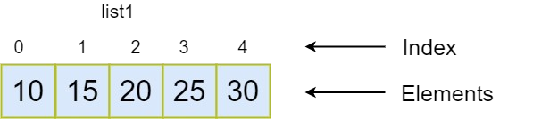
List

Slide 4
Fixed Length List
The fixed-length lists are defined with the specified length. We cannot change the size at runtime. The syntax is given below.
Syntax - Create the list of fixed-size var list_name = new List(size)
– The above syntax is used to create the list of the fixed size. We cannot add or delete an element at runtime. It will throw an exception if any try to modify its size.
•
•

Slide 5
Fixed Length List
Syntax - Initialize the fixed size list element list_name[index] = value;
Let's understand the following example.
Example - void main() {
var list1 = new List(5); list1[0] = 10;
list1[1] = 11;
list1[2] = 12;
list1[3] = 13;
list1[4] = 14; print(list1);
}

Slide 6
Growable List
The list is declared without specifying size is known as a Growable list. The size of the Growable list can be modified at the runtime.
The syntax of the declaring Growable list is given below.
Syntax - Declaring a List
// creates a list with values
var list_name = [val1, val2, val3] Or
// creates a list of the size zero var list_name = new List()

Slide 7
Growable List
Syntax - Initializing a List list_name[index] = value;
Consider the following example -
Example - 1 void main() {
var list1 = [10,11,12,13,14,15];
print(list1);
}

Slide 8
Growable List
In the following example, we are creating a list using the empty list or List() constructor. The add() method is used to add element dynamically in the given list.
Example void main() {
var list1 = new List(); list1.add(10); list1.add(11); list1.add(12); list1.add(13); print(list1);
}

Slide 9
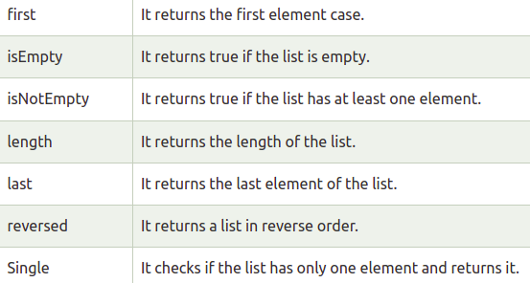
List Properties

Slide 10
Inserting Element into List
Dart provides four methods which are used to insert the elements into the lists. These methods are given below.
  add()
  addAll()
  insert()
  insertAll()

Slide 11
Removing Element from List
The Dart provides following functions to remove the list elements.
  remove()
  removeAt()
  removeLast()
  removeRange()

Slide 12
Set
Set is the unordered collection of the different values of the same type. It has much functionality, which is the same as an array, but it is unordered.
Set doesn't allow storing the duplicate values. The set must contain unique values.
It plays an essential role when we want to store the distinct data of the same type into the single variable.
Once we declare the type of the Set, then we can have an only value of the same type. The set cannot keep the order of the elements.
•
•
•

Slide 13
Set
Dart provides the two methods to declare/initialize an empty set.
The set can be declared by using the {} curly braces proceeded by a type argument, or declare the variable type Set with curly braces {}. The syntax of declaring set is given below.
Syntax -
var setName = <type>{}; Or
Set<type> setname = {};
•
•

Slide 14
Set
void main(){ print("Initializing the Set");
var names = <String>{"Rima","Mohan","Babu","Ram"}; print(names);
}

Slide 15
Set - Add Elements
Set_name.add(<value>);
Or Set_name.addAll(val1,val2....valN)

Slide 16
Set - Add Elements
// Declaring empty set var emp = <String>{}; emp.add("Jay"); print(emp);
// Adding multiple elements emp.addAll(names); print(emp);

Slide 17
Accessing Elements
Dart provides the elementAt() method, which is used to access the item by passing its specified index position.
The set indexing starts from the 0 and goes up to size - 1, where size is the number of the element exist in the Set.
It will throw an error if we enter the bigger index number than its size. The syntax is given below.
Syntax:
– Set_name.elementAt(index)
•
•
•

Slide 18
Other methods
•
•
•
set_name.contains(value); set_name.remove(value); set_name.clear();
•
•
•
x.union(y) x.intersection(y) y.difference(z)

Slide 19
Map
Map is an object that stores data in the form of a key- value pair. Each value is associated with its key, and it is used to access its corresponding value. Both keys and values can be any type.
In Dart Map, each key must be unique, but the same value can occur multiple times. The Map representation is quite similar to Python Dictionary.
The Map can be declared by using curly braces {} ,and each key-value pair is separated by the commas(,).
The value of the key can be accessed by using a square bracket([]).
•
•
•

Slide 20
Map
void main() {
var student = {'name':'Raju','age':'21'}; print(student);
}
•
student['course'] = 'B.tech';

Slide 21
Map
void main() {
var student = new Map(); student['name'] = 'Raju';
student['age'] = 21; student['course'] = 'B.tech';
student['Branch'] = 'Computer Science';
print(student);
}

Slide 22
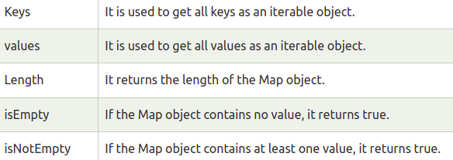
Map - Properties

Slide 23
Map - Methods
•
•
•
student.addAll({'dept':'Civil','email':'raj@abc.in'}); student.clear();
student.remove('age');

Slide 24
Symbol
Symbol object is used to specify an operator or identifier declared in a Dart programming language.
Generally, we do not need to use symbols while Dart programming, but they are helpful for APIs. It usually refers to identifiers by name, because identifier names can vary but not identifier symbols.
Dart symbols are dynamic string name that is used to derive the metadata from a library.
It mainly accumulates the connection between human- readable strings that are enhanced to be used by computers.
•
•
•

Slide 25
Symbol
Symbols have a term which is called Reflection; it is a technique that used to the metadata of at run- time, for example - the number of methods used in class, a number of constructors in a class, or numbers of arguments in a function.
The dart:mirrors library has all of the reflection related classes. It can be used with the command- line applications as well as web applications.
•

Slide 26






Thank you
This presentation is created using LibreOffice Impress 5.1.6.2, can be used freely as per GNU General Public License
/mITuSkillologies
@mitu_group
/company/mitu- MITUSkillologies
skillologies
Web Resources https://mitu.co.in http://tusharkute.com
contact@mitu.co.in tushar@tusharkute.com

