Slide 1



Dart – Control Statements
Tushar B. Kute,
http://tusharkute.com

Slide 2
Control flow statement
Control flow statement can be categorized mainly in three following ways.
  Decision-making statements
  Looping statements
  Jump statements

Slide 3
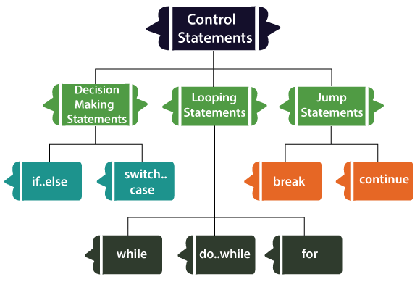
Control flow statement

Slide 4
If statement
if (condition) {
//statement(s)
}

Slide 5
If – else statement
if(condition) {
// statement(s);
} else {
// statement(s);
}

Slide 6
If – else – if statement
if (condition1) {
// statement(s)
}
else if(condition2) {
// statement(s)
}
else if (conditionN) {
// statement(s)
}
.
.
else {
// statement(s)
}

Slide 7
Nested if statement
It is possible to write an if in another if statement also.

Slide 8
Swith Statement
switch( expression )
{
case value-1:{
//statement(s) Block-1;
}
break;
case value-2:{
//statement(s)
Block-2;
}
break;
case value-N:{
//statement(s)
Block-N;
}
break;
default: {
//statement(s);
}
}

Slide 9
While Loop
while(condition) {
// loop body
}

Slide 10
for Loop
for(Initialization; condition; incr/decr) {
// loop body
}

Slide 11
for Loop
for (var i in expression) {
//statement(s)
}

Slide 12
do-while Loop
do {
// loop body
} while(condition);

Slide 13






Thank you
This presentation is created using LibreOffice Impress 5.1.6.2, can be used freely as per GNU General Public License
/mITuSkillologies
@mitu_group
/company/mitu- MITUSkillologies
skillologies
Web Resources https://mitu.co.in http://tusharkute.com
contact@mitu.co.in tushar@tusharkute.com

