Slide 1
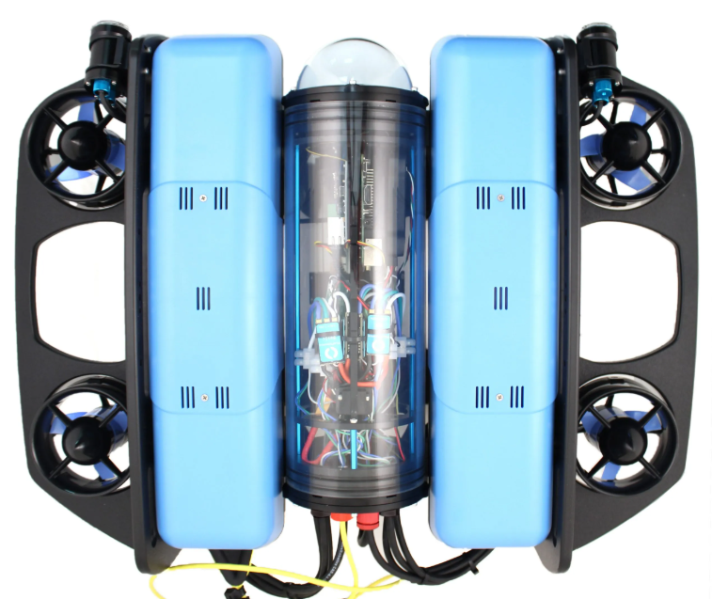














$$t_{1}$$
$$t_{1}$$
$$t_{1}$$
1
2
3
$$t_{2}$$
$$t_{2}$$
$P_{tether}(t)$
$$t_{2}$$
collision
$$t_{1}$$
$$t_{1}$$
$$t_{1}$$
$$t_{2}$$
4
5
$$t_{2}$$
6
$$t_{2}$$
$P_{tether}(t+1)$
collision

