Slide 1
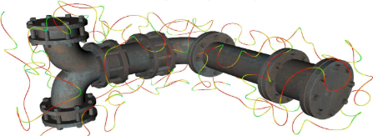

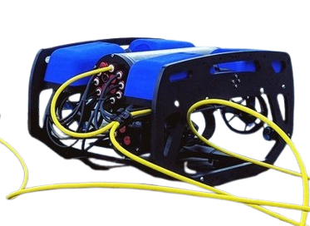




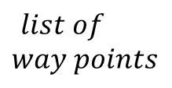


Coverage
Path Planner
Collision Map
Generation
$$list of$$
$$way points$$
$sdf Map$
$$Online$$
$$p^{rov}\left(t\right)$$
Online
Entanglement-Aware Path Planner
$$P^{tether}\left(t\right)$$
Tether Model
$$p^{target}$$
$$u(t)$$
$$x(t)$$
MPC

Slide 2









$$P_{2}^{T}(t)$$
$P_{3}^{T}\left(t\right)=$ $p_{rov}(t)$
$$P_{2}^{T}(t+1)$$
$$P_{3}^{T}\left(t+1\right)=p_{rov}(t+1)$$
$$∆$$
$$P_{1}^{T}(t)$$
$$P_{1}^{T}(t+1)$$
$$P_{0}^{T}\left(t\right)$$
$$P_{0}^{T}(t+1)$$

