Slide 1
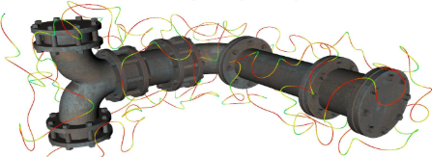

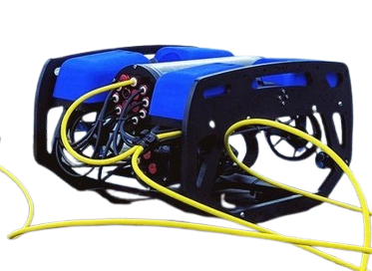








$$Offline$$
Coverage
Path Planner
Collision Map
Generation
$$list of$$
$$way points$$
$sdf map$
$$Online$$
Real-Time Entanglement
Aware Path Planner
$$P^{tether}\left(t\right)$$
Tether Model
$$p^{target}$$
$$x(t)$$
$$u(t)$$
MPC

