Slide 1
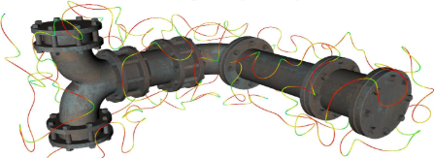

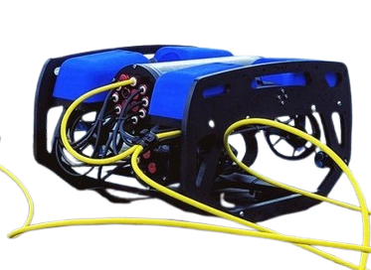








$$Offline$$
Coverage
path planner
Collision map
generation
$$list of$$
$$way points$$
$sdf map$
$$Online$$
$$P_{tether}(t)$$
Entanglement
aware path planner
Tether model
$$p_{target}(t)$$
$$x(t)$$
$$u(t)$$
MPC

