Slide 1


RAJIV GANDHI COLLEGE OF ENGINEERING
Suicide Mitigation System Integrated with a Talking Face Avatar, Utilizing an Ensemble of an LSTM Seq2Seq Model and a Fine-Tuned Pre-Trained Model
A H Brijesh (211921104003)
R Vigneswaran (211921104313)
N Poovarasi (211921104308)

Slide 2
Contents
Abstract
Objective
Technology Used
Architecture
Finetuning Process
Ensembling Process
Emotion and Lip-sync handling

Slide 3
Abstract
Suicide has become a critical issue, often perceived as an escape from overwhelming problems. However, individuals facing such distress may not realize that ending their lives is not the solution. Instead, seeking support and expressing their emotions can help them navigate difficult situations.
This system provides a virtual user interface where individuals can openly talk about their struggles. Using advanced AI and a talking face avatar, the system engages in meaningful conversations, offering emotional support and guidance to help users cope with their challenges and find alternative solutions

Slide 4
Objective
Training the LSTM Seq2Seq Model
An LSTM-based Seq2Seq model is first trained on a dataset collected from 69K Facebook conversations to learn contextual responses.
Fine-Tuning GPT-2
A pre-trained GPT-2 model is fine-tuned using the same dataset to enhance its ability to generate more empathetic and context-aware responses.
Ensembling for Hybrid Responses
The Seq2Seq model and fine-tuned GPT-2 are ensembled to create hybrid responses, improving the chatbot’s ability to generate both structured and emotionally intelligent replies.
Talking Face Avatar for Engagement
The generated responses are delivered through a talking face avatar, providing users with a more comfortable and human-like conversational experience.

Slide 5
Technology Used
Algorithms Used
Seq2Seq
LSTM (Long Short-Term Memory)
Python Frameworks
TensorFlow
Keras
Py-Torch
Pandas
NumPy
Bert-Tokenizer
React
Dailo-Gpt

Slide 6
Architecture
Inputs
LTSM Encoder
LTSM Encoder
LTSM Encoder
LTSM Encoder
ES
LTSM Decoder
LTSM Decoder
LTSM Decoder
LTSM Decoder
Outputs

Slide 7
Finetuning Process
P
R
E
D
E
C
T
E
D
D
A
T
A
T
R
A
I
N
I
N
G
D
A
T
A

Slide 8
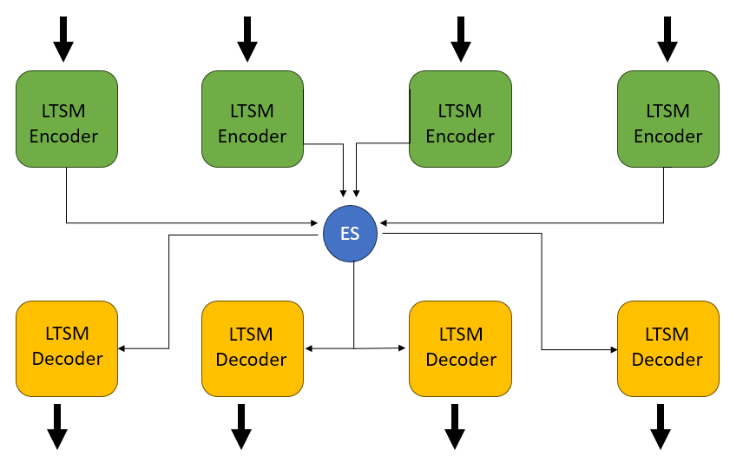
Ensembling Process
INPUT
₊
OUPUT

Slide 9
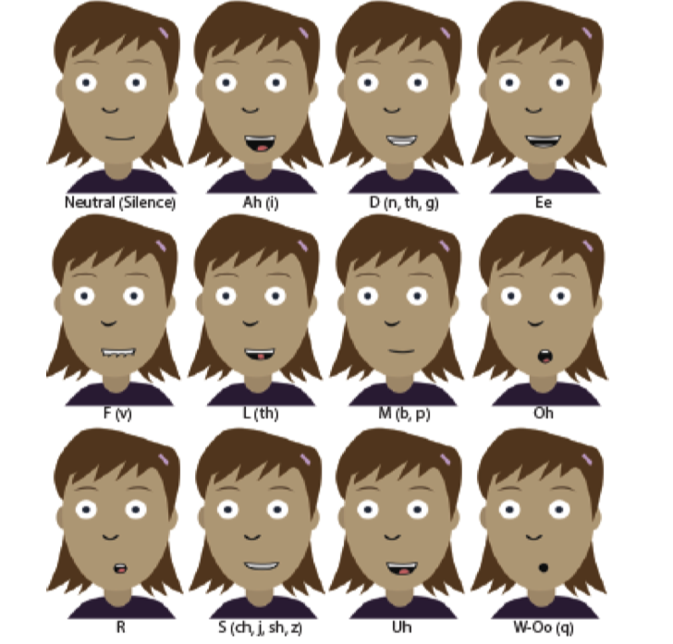
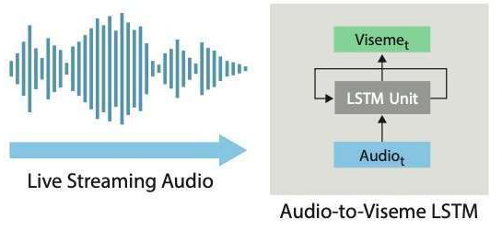
Emotion and Lip-sync handling
OUTPUT DATA to Live Streaming Audio by using pyttsx3

Slide 10
Advantage
24/7 Support – Always available for conversations.
AI-Powered Chatbot – Understands emotions & provides personalized responses.
Talking Avatar – Human-like engagement with lip sync & expressions.
Confidential & Judgment-Free – Safe space for users to share struggles.
Guidance & Resources – Directs users to professional help when needed.

Slide 11
PROCEED TO CODE

Slide 12
THANKYOU

