Slide 1
Bronco Startup Presentation Template

Slide 2
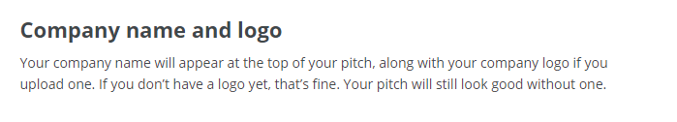
Headline

Slide 3
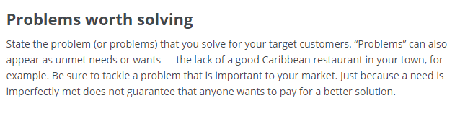
Problem Worth Solving
Or

Slide 4
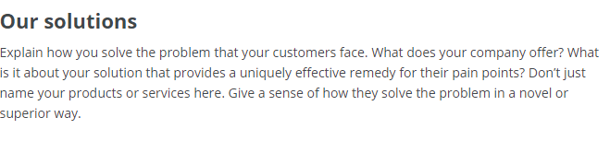
Our Solution
Or

Slide 5
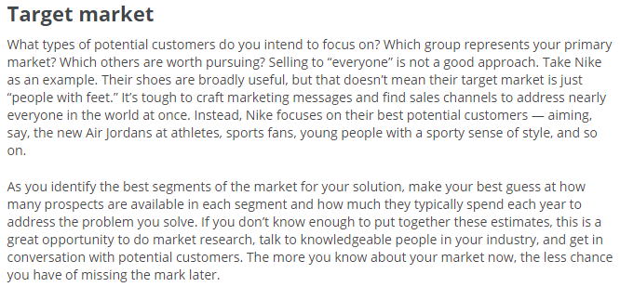
Target Market

Slide 6
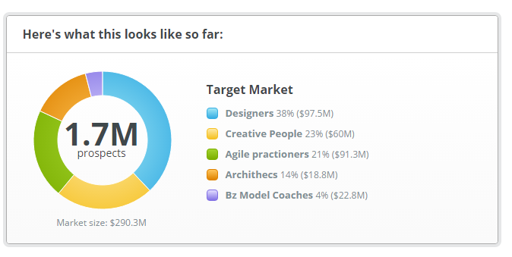
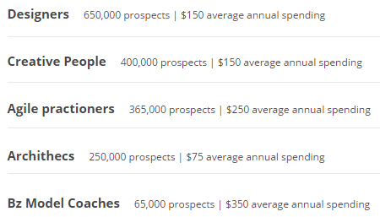
Target Market

Slide 7
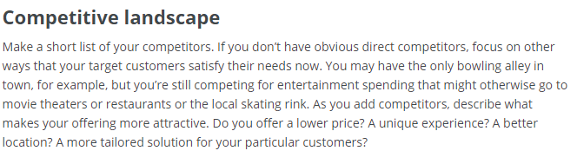
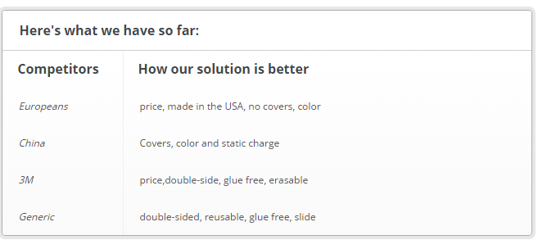
Competitive Landscape

Slide 8
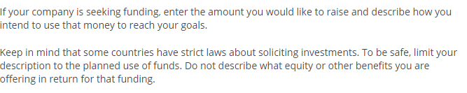
Funding Needs

Slide 9


Sales Channel
Or

Slide 10

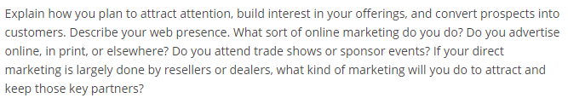
Marketing Activities
Or

Slide 11

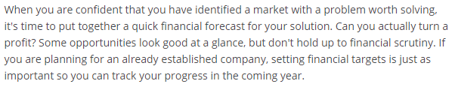
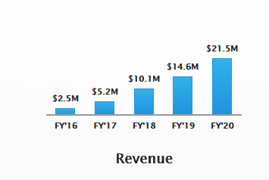
Forecast

Slide 12
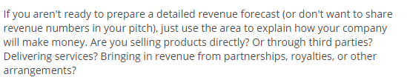
Forecast
Or

Slide 13


Forecast
Or

Slide 14

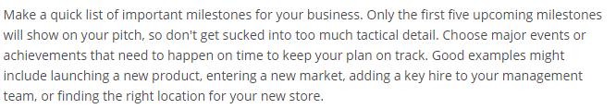
Milestones

Slide 15

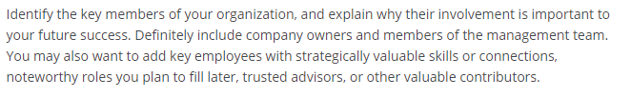
Team and Key Roles

Slide 16

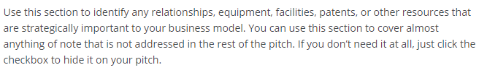
Partners and Resources

Slide 17
Why You?
Why are you the right (team)person for making this product into a reality?

Slide 18
If you are submitting again
What difference have you made/ what have you done differently to compete again in 2017?

