Slide 1
Research Paper
Answer Bot
Attention Is All You Need
1
p. 5 · rerank 0.96
2
LoRA: Low-Rank Adaptation
p. 4 · rerank 0.85
Grounded answers from 11 seminal GenAI papers, each with the three passages it was written from
3
QLoRA: Efficient Finetuning
p. 1 · rerank 0.91
[Your name] · GenAI Pinnacle Plus capstone · October 2026
Notes:
Research Paper Answer Bot: a retrieval-augmented question answering system over 11 seminal GenAI papers. Every answer is written only from the papers and shows the three passages it used, by paper title and page. It runs entirely on a laptop: llama3.1 8B through Ollama, bge-m3 embeddings, ChromaDB.

Slide 2
Answers from the papers, or no answer at all
1
Context
Students and researchers work from long, dense papers. A general chatbot answers fluently, but it cannot show where a claim comes from, and it invents details.
11
seminal papers, 2017-2023: Transformer to Llama 2
2
Objective
411
Answer questions only from 11 seminal GenAI papers, cite the three supporting passages by title and page, and say “I don’t know based on the provided papers.” when they do not cover it.
pages, cleaned page by page
3
Use case
766
Ask “How are the LoRA matrices A and B initialised?” and check the answer against page 4 of the LoRA paper in one click, without leaving the page.
chunks of up to 512 tokens
Notes:
The problem: LLMs answer confidently but cannot point to evidence. The objective is grounded answers with citations a reader can verify, and an explicit refusal when the papers do not answer the question. The corpus: Attention, BERT, GPT-3, InstructGPT, Llama 2, LoRA, QLoRA, DPR, RAG, chain-of-thought and ReAct.

Slide 3
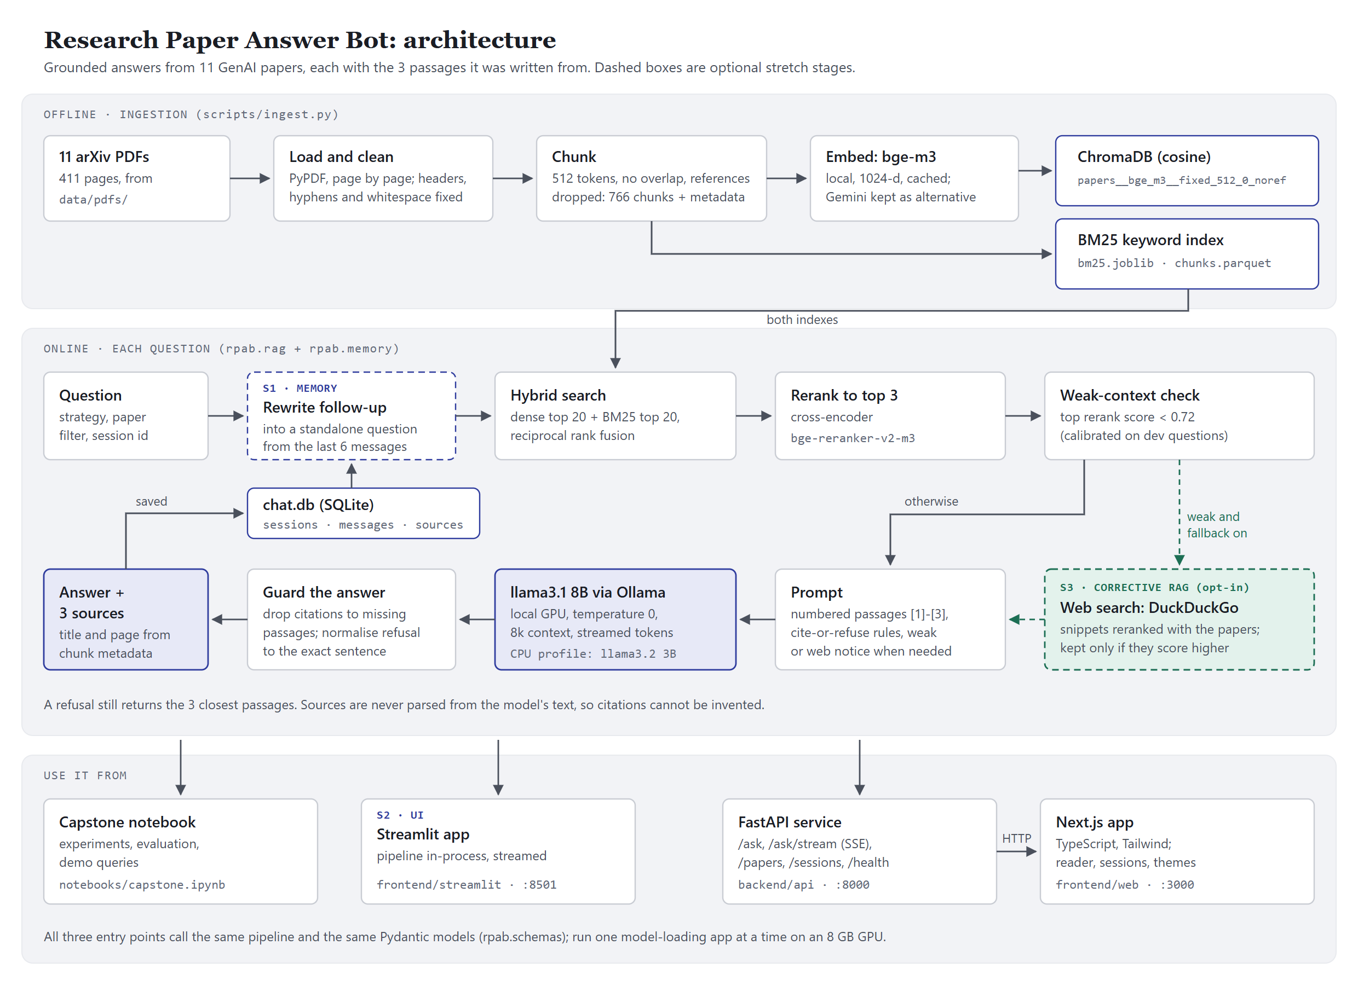
One pipeline from PDF to cited answer
1
Offline
Load, clean and chunk 11 PDFs; embed with bge-m3 into ChromaDB; build a BM25 index.
2
Each question
Hybrid search, rerank 20 to 3, check for weak context, answer from the 3 numbered passages.
3
Guarantees
Sources come from chunk metadata, never from the model’s text; wrong citation numbers are removed.
4
Entry points
Notebook, Streamlit, and a FastAPI service with a Next.js app: one rpab package.
Notes:
Offline, ingestion turns the PDFs into a vector index and a keyword index. For each question, hybrid search merges dense and BM25 results, a cross-encoder reranks 20 candidates to 3, and llama3.1 answers only from those three numbered passages. Sources are built from metadata, so a citation can never point to a page that was not retrieved. Dashed boxes are the optional stretch stages: follow-up rewriting (S1) and the web fallback (S3).

Slide 4
11 papers, read and cleaned page by page
Paper | Year | Pages | Chunks
Attention Is All You Need | 2017 | 15 | 21
BERT | 2018 | 16 | 32
Dense Passage Retrieval | 2020 | 13 | 30
GPT-3: Few-Shot Learners | 2020 | 75 | 145
Retrieval-Augmented Generation | 2020 | 19 | 32
LoRA | 2021 | 26 | 48
Chain-of-Thought Prompting | 2022 | 43 | 77
InstructGPT | 2022 | 68 | 109
ReAct | 2022 | 33 | 69
Llama 2 | 2023 | 77 | 156
QLoRA | 2023 | 26 | 47
1
PyPDF over pdfplumber
Compared on all 11 papers: faster and more text, and its defects can be repaired.
2
Six cleaning rules
Ligatures, a shifted font encoding (ReAct), arXiv stamps, repeated headers and footers, hyphenation, whitespace.
3
No OCR needed
No empty pages; the quality report would flag a scanned PDF added later.
4
Evaluation set
29 questions: 12 dev + 12 held-out answerable, 5 out of scope; gold pages audited.
Notes:
The dataset is the 11 papers from arXiv. Pages are loaded one by one so every chunk keeps its page number for citations. PyPDF beat pdfplumber on speed and coverage. Six cleaning rules fix extraction defects, including a shifted font encoding in ReAct's figures. The evaluation set has 29 questions: 12 dev and 12 held-out answerable ones, plus 5 out-of-scope questions that the bot should refuse; held-out questions were never used for tuning.

Slide 5
512-token chunks, without reference lists
16
chunking settings compared: fixed tokens, recursive characters, semantic; with and without reference lists
Chosen: fixed 512 tokens, no overlap, references dropped
hit@3 1.000 and MRR 0.917 on dev, with the fewest chunks (766) of the best group.
Why not the top MRR? fixed 512/50 ranks one more question first; reranking closes that gap. No chunk exceeds 513 tokens, so three passages (about 1,200 tokens) fit the 8k context.
Notes:
Sixteen chunking settings were scored on the dev questions with dense retrieval. Hit@3 is 1.0 for most of them, so MRR separates them. The chosen setting, 512-token chunks without overlap and without bibliography chunks, ties for the best hit@3 with the smallest index. fixed_512_50 has a higher MRR by one question ranked second instead of first; section 6 showed that reranking puts a gold page first for every dev question, so it was not worth rebuilding every index.

Slide 6
bge-m3 matches Gemini, and runs on the laptop
Measure | bge-m3 (open, local) | gemini-embedding-001 (API) | Note
Dense, dev: hit@3 / MRR | 1.000 / 0.917 | 1.000 / 0.889 | level on recall
Hybrid + rerank, held-out: hit@3 / MRR | 1.000 / 0.847 | 1.000 / 0.889 | same top passages on dev
Query embedding time | 27 ms | 474 ms | network round trip
Building the index (766 chunks) | 11 s | 882 s | free-tier rate limit
Cost | $0 | $0.046 | free tier: 1,000 requests a day
Works offline, data stays local | yes | no
✓
Decision: bge-m3. After reranking, both models return the same top passages for every dev question. That leaves latency, privacy and the API quota, which ran out during the strategy sweeps, and all three favour the local model. Gemini stays indexed and selectable.
Notes:
One open-source and one commercial embedding model, each in its own Chroma collection. On dense retrieval they are level; with reranking they return the same top passages on dev. On held-out questions Gemini's MRR is slightly higher, 0.889 against 0.847, which is one question ranked second; recall is identical. bge-m3 wins on everything practical: 27 ms per query against about half a second, an index built in 11 seconds instead of 15 minutes, no cost, and no quota. The Gemini free tier was exhausted during the experiments, which made the dependency risk concrete.

Slide 7
Hybrid search plus a reranker finds every gold page
1
ChromaDB, cosine
One persistent collection per embedding model and chunking, so vectors never mix.
2
Hybrid: dense + BM25
Fused by reciprocal rank fusion (weight 0.5). Dense, MMR, BM25 and multi-query also compared.
3
Rerank 20 to 3
bge-reranker-v2-m3 adds 0.4 s. Multi-query matched it on dev but took 5 s per question.
4
Weak-context score
Top rerank score below 0.72 means the papers probably lack the answer: it split dev perfectly.
Notes:
Strategies were tuned on the dev questions only, then the finalists were scored once on the held-out set. Hybrid search with the cross-encoder reranker puts a gold page in the top 3 for every held-out answerable question, against 0.833 for dense search, in about 0.56 seconds. Without a GPU the reranker is switched off and the bot uses plain hybrid search, which is weaker and documented as reduced quality. The reranker's top score doubles as the weak-context signal used for refusals and for the web fallback.

Slide 8
A cite-or-refuse chain in LangChain LCEL
1
Retrieve
System prompt rules (excerpt)
The chosen strategy with an optional paper filter; 3 passages with title, page and scores.
1. Answer ONLY using the numbered context passages.
2. If they do not contain enough information, reply exactly: “I don’t know based on the provided papers.”
3. Cite sources inline as [1], [2], [3]. Every sentence that states a fact ends with its citation.
4. Do not use outside knowledge. Do not invent paper titles, page numbers or results.
5. Be concise and precise.
2
Prompt
Numbered passages [1]-[3] with title and page, the rules, two few-shot turns from a made-up paper, and a notice when the context is weak.
3
Generate
llama3.1 8B through Ollama: temperature 0, 8k context, streamed token by token.
4
Guard
The weak-context notice raised refusals of out-of-scope questions from 2 of 5 to 5 of 5, with no answerable question refused.
Citation numbers outside 1-3 removed even mid-stream; refusals normalised to the exact sentence; sources from metadata.
Notes:
The chain is plain LCEL: retrieve, build a numbered context, prompt, generate, parse. The prompt asks for inline citations and an exact refusal sentence. Two guards do not depend on the model behaving: citation markers that point to no passage are removed while the answer streams, and anything that reads as a refusal is replaced by the exact sentence, with the closest passages still shown. When the top passage scores below the calibrated threshold, a notice in the prompt makes refusing the expected default; that took out-of-scope refusals from 2 of 5 to 5 of 5.

Slide 9
Grounded answers, and refusals when it counts
4.93
4.36
4.64
2 / 14
relevance
accuracy
groundedness
answers with an unsupported claim
Manual scores, 1 to 5, on the 14 held-out questions (12 answerable, 2 out of scope), llama3.1 8B
Refusals
Both held-out out-of-scope questions refused with the exact sentence (5 of 5 overall), and no answerable question refused. The closest passages are still shown.
Typical error
A neighbouring number from the right passage (5 answers), e.g. DPR’s WebQuestions accuracy given as its Natural Questions result. One retrieval miss: Llama 2’s 2T tokens.
LLM judge (qwen2.5:7b)
Agrees on accuracy within one point for 97% of answers (kappa 0.76), but finds only 1 of 4 hallucinations, so manual scores stay the reference.
Notes:
Every answer was scored by hand on relevance, accuracy and groundedness, plus a hallucination flag, then checked against an LLM judge. On held-out questions the answers are relevant and grounded; accuracy is lower because of one recurring error: the model picks a neighbouring number from the right passage. The judge is useful for accuracy but misses most hallucinations, because a wrong number that appears somewhere in the passages looks supported. Latency on the RTX 4060: first word after about 2 seconds, full answer in about 5.

Slide 10
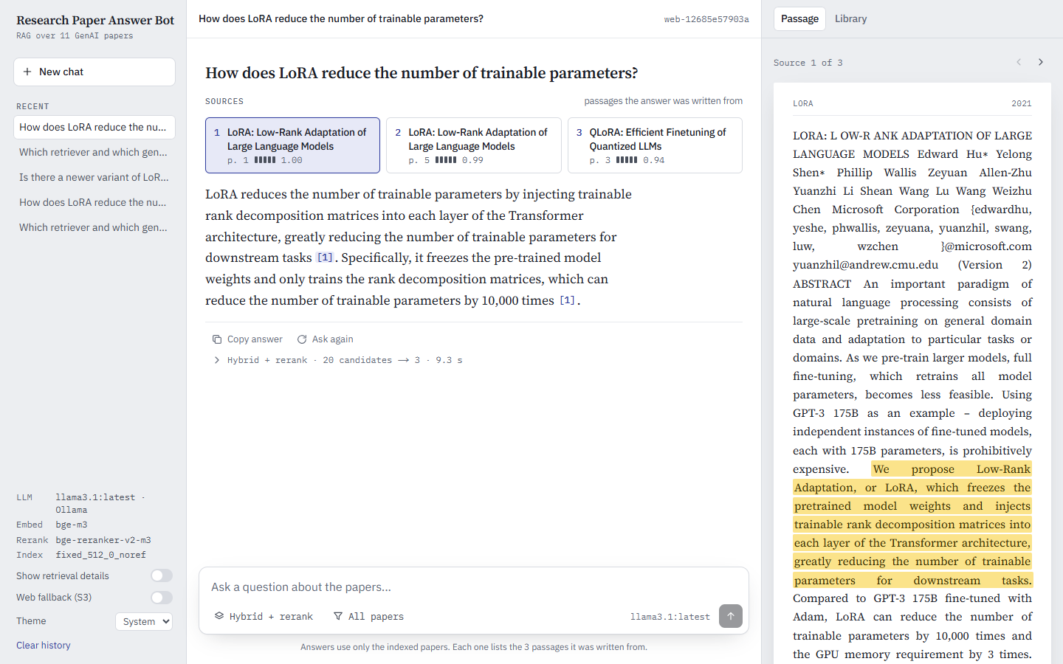
A sample answer, with its passages
Q How are the LoRA matrices A and B initialised, and why?
A A gets a random Gaussian initialization and B is zero [1], so ΔW = BA is zero at the beginning of training.
1
LoRA, p. 4 · rerank 0.85
2
LoRA, p. 2 · rerank 0.51
3
LoRA, p. 18 · rerank 0.36
Live demo: lookup, method detail, comparison, follow-up, out of scope (refused), web fallback.
The Next.js app: three source cards, citation chips, and the cited page with the sentence the answer drew on highlighted.
Notes:
This is the answer the notebook's final demo produces for the method-detail question: the claim matches page 4 of the LoRA paper, and the reader highlights that sentence. The live demo follows the script in the README: a factual lookup, this method detail, a cross-paper comparison, a follow-up that needs the conversation, an out-of-scope question that is refused, and optionally the web fallback. Ask the follow-up straight after the comparison. Fallback screenshots for every step are in slides/screenshots.

Slide 11
All three stretch goals, on the same pipeline
S1
S2
S3
Conversational memory
Two apps
Corrective RAG
Chats saved in SQLite. A follow-up is rewritten into a standalone question from the last 6 messages before retrieval: “What data type does it use for the frozen weights?” is searched as a QLoRA question.
Streamlit in-process, and Next.js over a FastAPI service that streams Server-Sent Events. Both follow the design mockup: sessions, paper filter, a reader that opens the cited page, light and dark.
Opt-in. When the best passage scores below 0.72, DuckDuckGo results are reranked with the papers and kept only if they score higher, marked WEB with their address.
Users can talk to the papers instead of repeating context.
Every claim is one click from its page.
Covers questions beyond the papers, labelled as such.
Notes:
S1: the rewriter turns follow-ups into standalone questions; retrieval only ever sees the rewrite, and both apps show it as 'Searched as'. S2: two front ends over the same package, checked in a real browser in every state. S3: the web fallback is off by default because it also answers out-of-scope questions, which the evaluation counts as refusals; when it is on, web sources are clearly labelled and the question leaves the machine, which the apps say next to the switch.

Slide 12
What went wrong, and what fixed it
1
Gemini quota ran out mid-sweep
2
Gold labels missed appendix pages
Local bge-m3 became the primary model; Gemini results are cached and it stays selectable.
An audit added the missing pages; strategies were re-scored before the final choice.
3
Out-of-scope answers slipped through
4
The LLM judge missed hallucinations
A weak-context notice in the prompt: refusals 2 of 5 → 5 of 5, none wrongly refused.
It found 1 of 4, so manual scores are the reference and the judge only ranks variants.
5
Follow-ups drifted to older topics
6
8 GB GPU for three models
The rewriter sees earlier questions only, plus the latest exchange: right topic 2 of 4 → 5 of 5 runs.
One model-loading app at a time; a CPU profile with llama3.2 3B, labelled reduced quality.
Notes:
Six problems that changed the design. The Gemini free tier ran out during the retrieval sweeps, which pushed the decision to the local model. A gold-page audit found answers on appendix pages the labels missed, so retrieval was re-scored. Out-of-scope questions were sometimes answered from loosely related passages until the weak-context notice. The judge could not be trusted for hallucinations. The follow-up rewriter was pulled towards the first topic of a conversation until it stopped seeing earlier answers. And everything had to share one 8 GB GPU.

Slide 13
Grounded, local, and honest about its limits
Next
1
A larger evaluation set and a second annotator
2
A sentence-level entailment check against neighbouring-number errors
Every answer cites its three passages by title and page, refuses when the papers are silent, and runs on one laptop GPU with no paid API.
3
Skip the rewrite for questions that are already standalone
4
Layout-aware parsing for tables and equations
5
A larger local model when the hardware allows
Code, notebook and README: Research-Paper-Answer-Bot repository
Notes:
To sum up: retrieval quality came from hybrid search with a reranker, and trust came from building citations out of metadata and refusing when the context is weak. The main limits are the size of the evaluation and the 8B model's neighbouring-number errors. Next steps target exactly those.

