Slide 1


Design of a 32-bit
RISC-V Processor
Arvin Delavari – Summer 2023
Supervisor: Professor Mirzakuchaki PhD.
Electronics Research Center
Iran University of Science and Technology

Slide 2

Contents :
Error Configurable Approximate Multiplier Design
Image Processing using Approximate Multiplier
32-bit RISC-V Processor Design
Processor Physical Layout and Verification
Assistant Software for Code Execution
References
I U S T

Slide 3
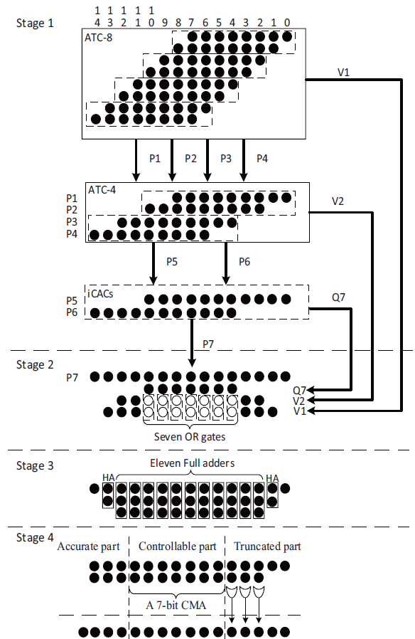
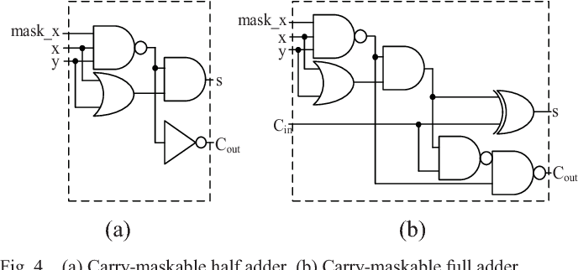
Error Configurable Approximate Multiplier Design
A Low-Power High-Speed Accuracy-Controllable
Approximate Multiplier Design [1]
Carry Maskable Adder (CMA)
Proposal of a new approximate multiplier architecture
Error Configurable
Multiplier
I U S T

Slide 4
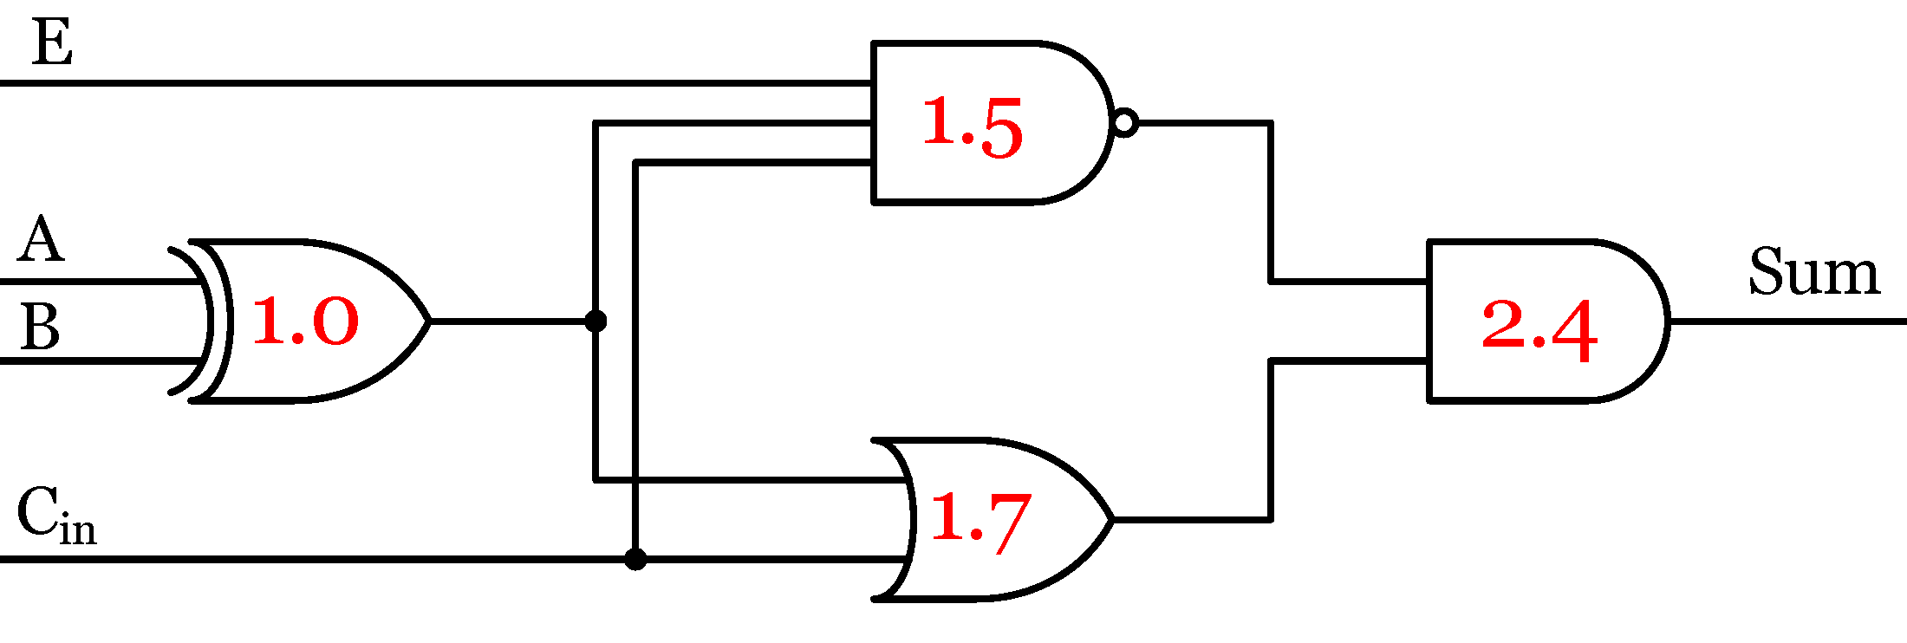
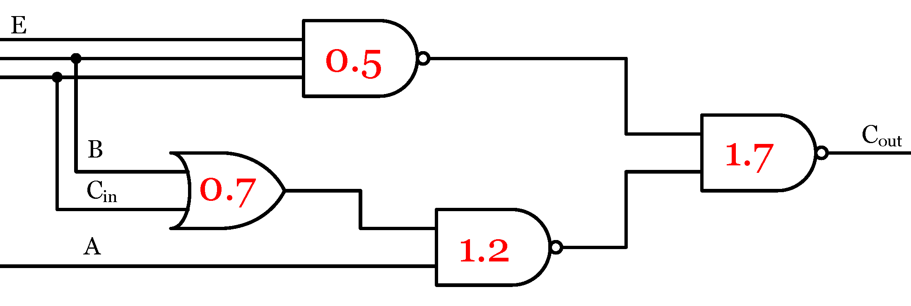
Error Configurable Approximate Multiplier Design
Proposal of a new Error Configurable Adder:
 |  |  | Er = 0 |  | Er = 1
A | B | Cin | Cout | Sum | Cout | Sum
0 | 0 | 0 | 0 | 0 | 0 | 0
0 | 0 | 1 | 0 | 1 | 0 | 1
0 | 1 | 0 | 0 | 1 | 0 | 1
0 | 1 | 1 | 0 | 1 | 1 | 0 | 1 ← 2
1 | 0 | 0 | 0 | 1 | 0 | 1
1 | 0 | 1 | 1 | 1 | 1 | 0 | 3 ← 2
1 | 1 | 0 | 1 | 0 | 1 | 0
1 | 1 | 1 | 1 | 1 | 1 | 1
* Normalized gate delay models to analyze circuit performance mentioned in [2]
I U S T

Slide 5
Error Configurable Approximate Multiplier Design
 | NMED | MRED | ER |  |  | NMED | MRED | ER
m_7b | 0.25 | 0.85 | 36.16 |  | ecm_7b | 0.25 | 0.85 | 36.16
m_6b | 0.26 | 0.99 | 43.46 |  | ecm_6b | 0.25 | 0.85 | 36.16
m_5b | 0.29 | 1.31 | 52.07 |  | ecm_5b | 0.26 | 0.97 | 39.73
m_4b | 0.35 | 1.93 | 61.05 |  | ecm_4b | 0.28 | 1.33 | 44.33
m_3b | 0.49 | 3.05 | 69.61 |  | ecm_3b | 0.34 | 2.11 | 50.33
m_2b | 0.71 | 4.57 | 74.93 |  | ecm_2b | 0.48 | 3.59 | 57.02
m_1b | 1.05 | 6.5 | 78.1 |  | ecm_1b | 0.76 | 5.89 | 61.8
m_0b | 1.64 | 9.02 | 80.02 |  | ecm_0b | 1.25 | 8.94 | 65.07
I U S T

Slide 6
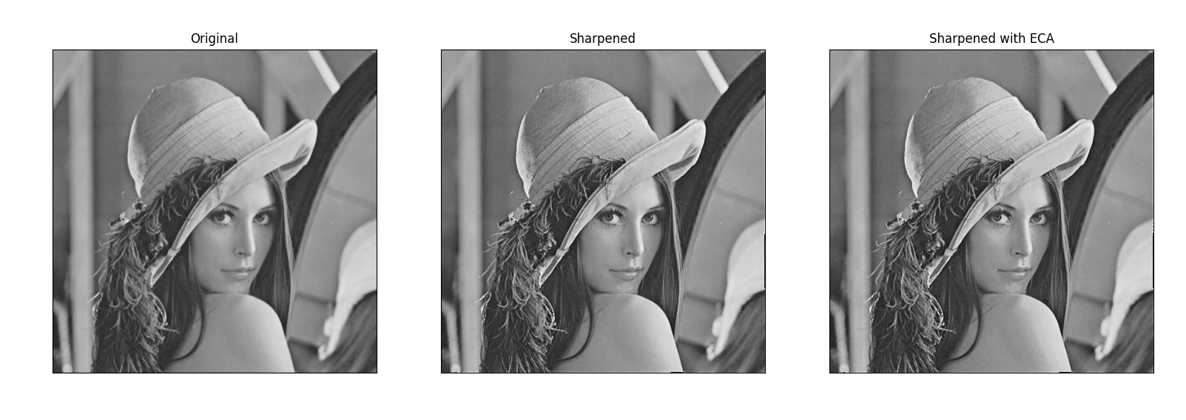
Image Processing using Approximate Multiplier
PSNR for image sharpening algorithm on Lenna image
 | M_7b | M_6b | M_5b | M_4b | M_3b | M_2b | M_1b | M_0b
CMA | 46.32 | 44.78 | 42.94 | 38.93 | 33.63 | 28.15 | 24.81 | 15.90
ECA | 46.32 | 46.32 | 43.99 | 41.78 | 37.51 | 31.27 | 26.52 | 21.82
I U S T

Slide 7
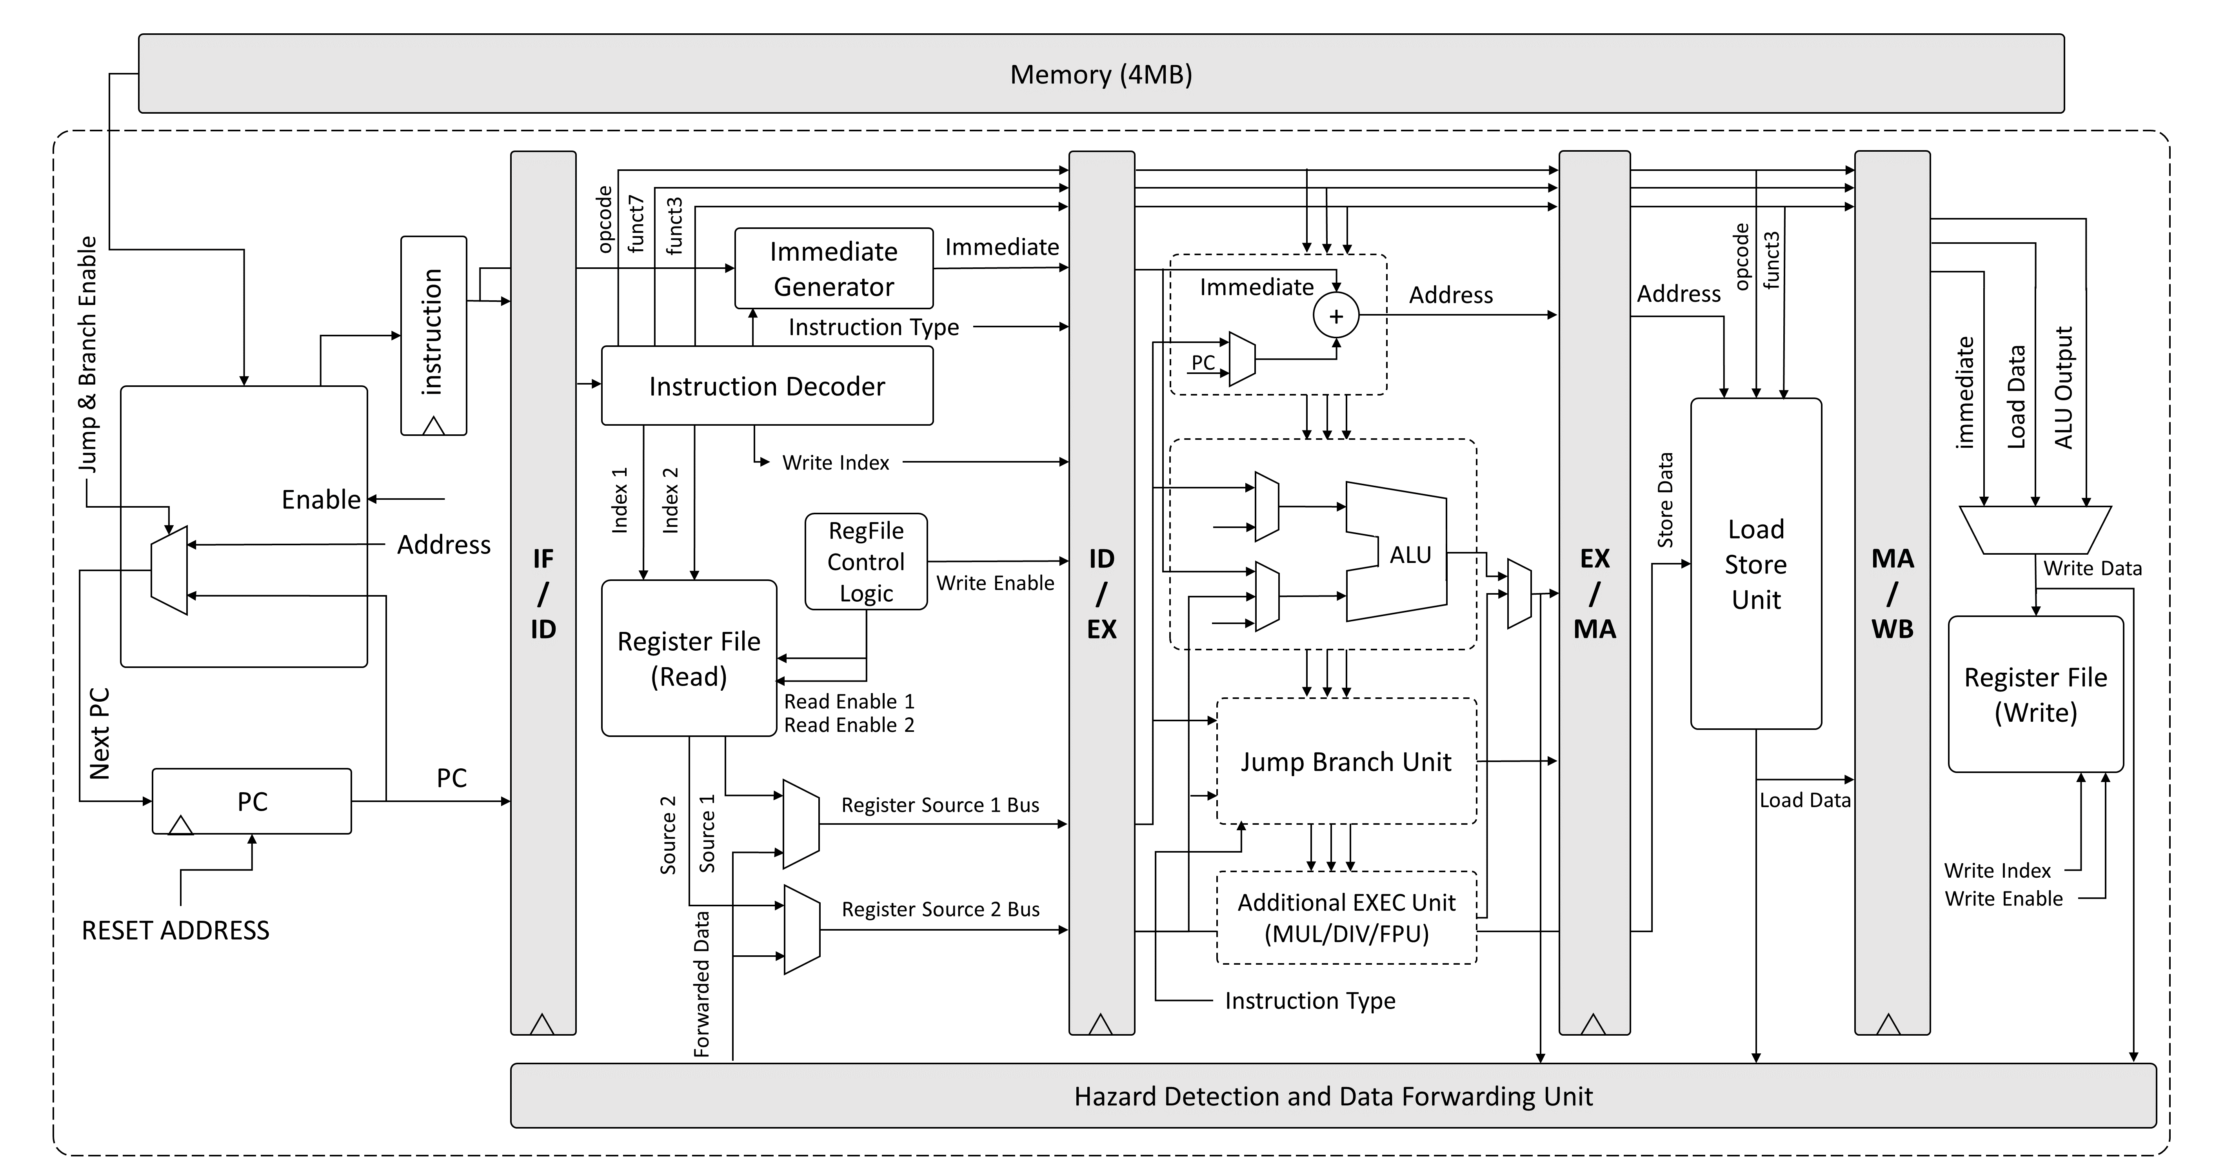
32-bit RISC-V Processor Design
Modular and Extensive Design
Distributed Control Logic
5 stage pipeline
Compatible with GCC compiler [3] (C and Assembly)
I-Extension of RISC-V ISA [4]
Synthesizable and implementable on FPGA (Ultrascale)
I U S T

Slide 8
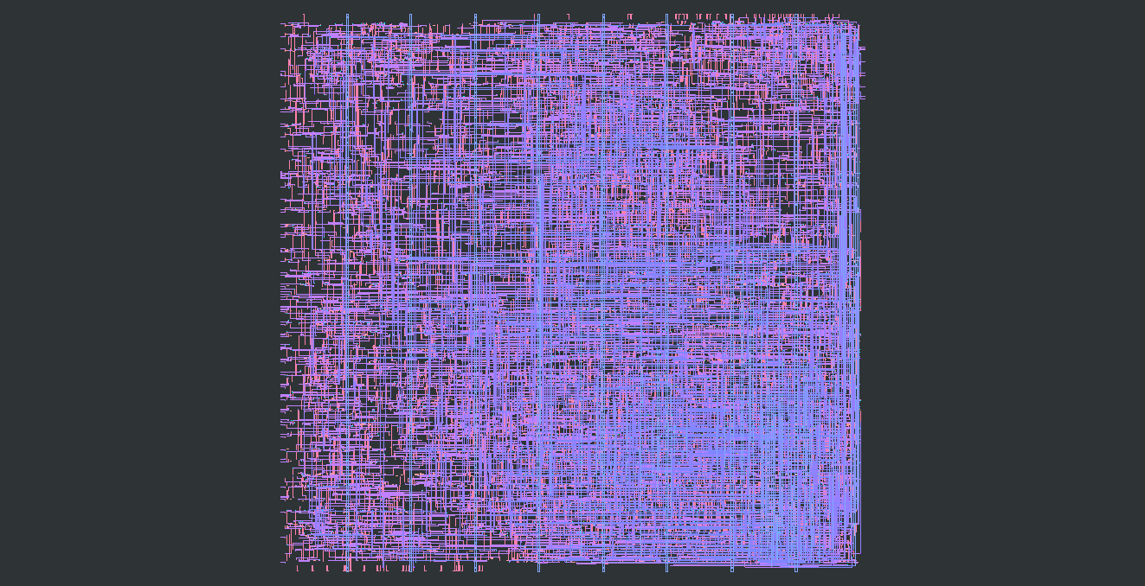

Processor Physical Layout and Verification
Core specifications
Clock Cycle Time | 4 ns
CPI (R,I-TYPE) | 1.13
Frequency | 250MHz
Module | Max Delay (ps)
Address Generator | 3844.84
Arithmetic Logic Unit | 3099.01
Control Status Registers | 747.689
Hazard Forward Unit | 1131.73
Immediate Generator | 1016.44
Instruction Decoder | 716.437
Jump Branch Unit | 243.115
Register File | 695.34
Normalized Memory Access Time | 10000 - 40000
Fetch Unit | 308.907
Load Store Unit | 569.903
Processed with TSMC 180nm technology [5]
Synthesis tool: Yosys [6]
Layout: Magic VLSI [7]
I U S T

Slide 9



Assistant Software for Code Execution
Windows:
Venus Simulator (Assembly code) “Visual Studio Code” extension
Test flow:
Assembly output (.txt) → Python Script → instruction memory HEX file → Testbench
Linux:
RISC-V GCC compiler toolchain (C and Assembly code)
Test flow:
C code → makefile → GCC compiler toolchain → instruction memory HEX file → Testbench
0 1 0
1 0 1
0 0 1
C
HEX
(instruction memory)
ASM
testbench
I U S T

Slide 10
References
[1] T. Yang, T. Ukezono, and T. Sato, "A Low-Power High-Speed Accuracy-Controllable Approximate Multiplier Design", 2018 23rd Asia and South Pacific Design Automation Conference (ASP-DAC), Jeju, Korea (south), 2018, pp.605-610
[2] Wen-Chang Yeh and Chein-Wei Jen, "High-speed Booth encoded parallel multiplier design,“
in IEEE Transactions on Computers, vol. 49, no. 7, pp. 692-701, July 2000
[3] https://github.com/riscv-collab/riscv-gnu-toolchain
[4] https://riscv.org/technical/specifications/
[5] https://www.tsmc.com/english/dedicatedFoundry/technology/logic/l_018micron
[6] https://www.yosyshq.com/open-source
[7] http://opencircuitdesign.com/magic/
[8] D. A. Patterson and J. L. Hennessy, "Computer Organization and Design: The Hardware/Software Interface," 5th ed., Morgan Kaufmann, 2013.
[9] J. L. Hennessy and D. A. Patterson, "Computer Organization and Design: A Quantitative Approach," 6th ed., Morgan Kaufmann, 2017.
I U S T

