Slide 1

Blockchain and Cryptocurrency

Slide 2
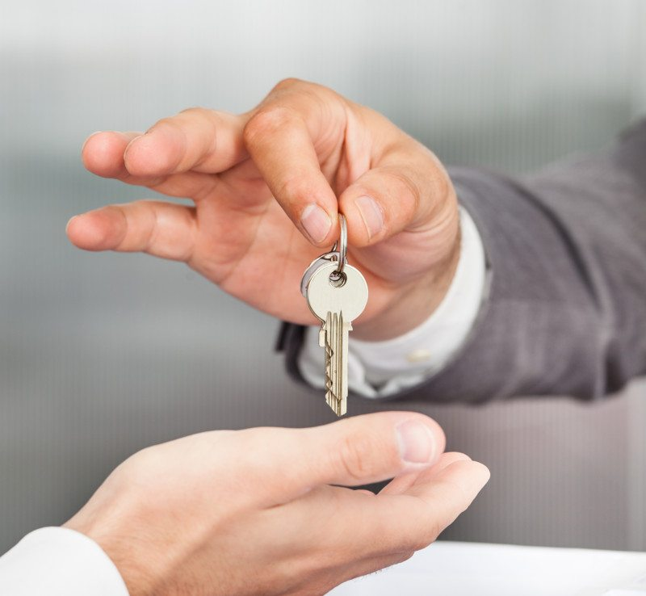
Blockchain manages ownership
The goal of blockchain is create a superior way of managing ownership
Ownership can be everything from money to cars to guns to property to even services

Slide 3

Trading currency
Normally when buying something, you use physical currency authorized by a central bank.
Your transaction is legitimate because the central bank determines your dollars to be real

Slide 4
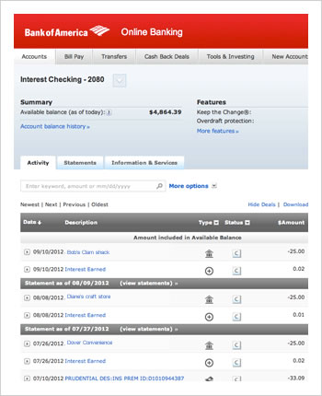
Digital Payment
When we trade and buy online, our banks track our balance on an online ledger
They don't actually hold the money we deposit, just track the amount that belongs to us

Slide 5
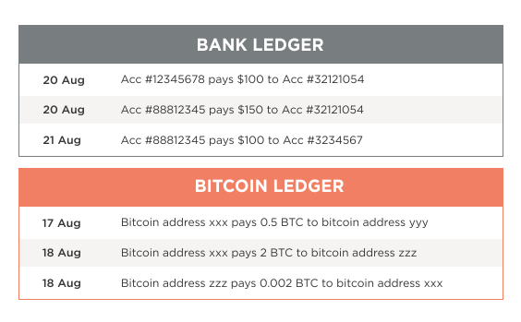
The Blockchain is a ledger
Bitcoin, cryptocurrency, or any blockchain is the same
All a cryptocurrency is is your current balance on a shared ledger
All users of a certain blockchain, cryptocurrency or otherwise, have access to this ledger

Slide 6
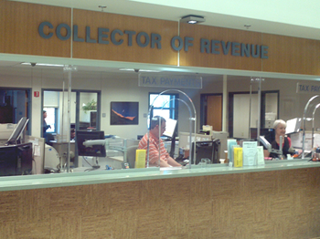
This isn't enough
We've established that what underlines Cryptocurrency is a ledger we called a “blockchain”, but what makes this ledger different from your bank or a ledger kept by a government?

Slide 7
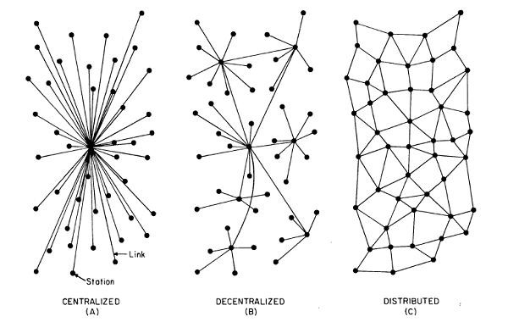
Centralized vs Distributed Systems

Slide 8
Centralized Systems
The components are located around and connected with one central components
Advantages – High Trust, Simplicity
Disadvantages – Single point of failure, bottleneck

Slide 9
Distributed Systems
Components of distributed systems form a network of connected components without having any central element of coordination or control
Advantages – Cost reduction, high reliability, ability to grow naturally
Disadvantages – Coordination overhead, dependency on networks, lack of trust

Slide 10
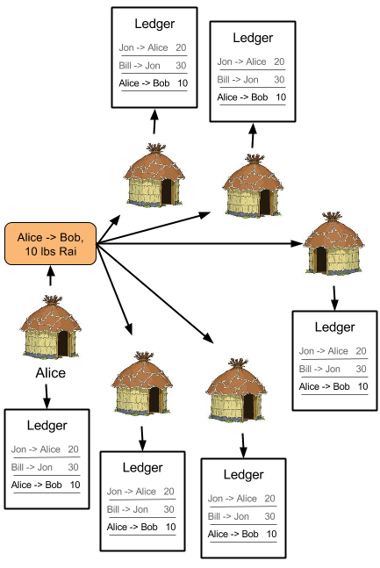
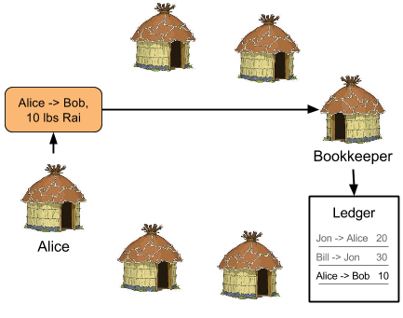
Centralized vs Decentralized Ledger

Slide 11
Challenges for a decentralized distributed ledger
1: Identity users on the ledger network
2: Protect identity such that only payments can be added to the ledger by the user authorized to make that payment
3: Organize transactions on the ledger in a trustworthy way
4: Agree on a method for determining the true ledger when all users are equally untrustworthy

Slide 12
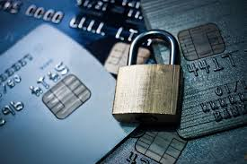
Step 1 and 2: Identity ledger users and secure those identities

Slide 13
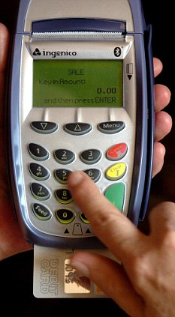
Issue
With a traditional system, a central authority, like a bank, confirms your identity (with a PIN for example, before you make a transaction
For cryptocurrency or blockchains, we need to confirm an identity without a third party authority

Slide 14

A detour into cryptography
Hashing – A method of creating a unique digital “fingerprint” of data
Encryption – A method for securely exchanging information between persons

Slide 15
Hashing
Hashing is a mathematical formula that takes some data, such as a word, sentence, book, transaction, or ledger, and outputs a unique hexidecimal (0-F rather than 0-9) of a fixed length
There are many hashing algorithms, the most common today being SHA256
For example, the SHA256 hash of “Hello World!” is
03ba204e50d126e4674c005e04d82e84c21366780af1f43bd54a37816b6ab340
While the SHA256 hash of “Hello World?” is
Ec5791dc1923cb01cc2850c9bba651380e1899c747dead57164d32ad825070db
Hashing allows us to create a digital fingerprint of some data, and therefore watch for changes

Slide 16
Properties of a good hashing function
1: Pseudorandom – The hash has seemingly nothing to do with the input data, and changes unpredictably with changes in the input data (see the previous example)
2: One Way Function – It should be impossible to figure out what input gives a certain hash through any method better than “guess and check” (this is actually an unsolved problem in mathematics
eg. If I want the hash 000000e50d126e4674c005e04d82e84c21366780af1f43bd54a37816b6ab34I shouldn't be able to find it without trying a large variety of inputs. Finding a full 256bit hash by guessing random inputs would likely take the age of multiple universes (not exaggerating)
3: Collision Resistant – Obviously this hash isn't very long compared to the massively sized datasets we want to hash, so there will be repeat hashes (a provably infinite number), but we want it to be nearly impossible for two similarly typed datasets to have the same hash

Slide 17
Demonstration of Hashing
(hashexample.py)

Slide 18
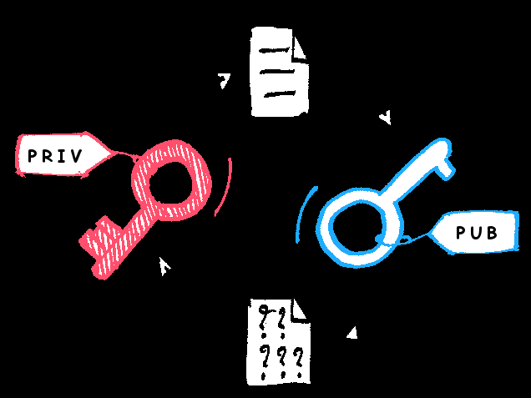
Public/Private Key Encryption
Similar to hashing, there are many encryption algorithms, with RSA being what we use for Bitcoin
Essentially, it is a mathematical formula that uses one “key” (usually a hexidecimal number as before), and turns data into garbage that can only be decrypted with a second key created at the same time

Slide 19
Explanation

Slide 20
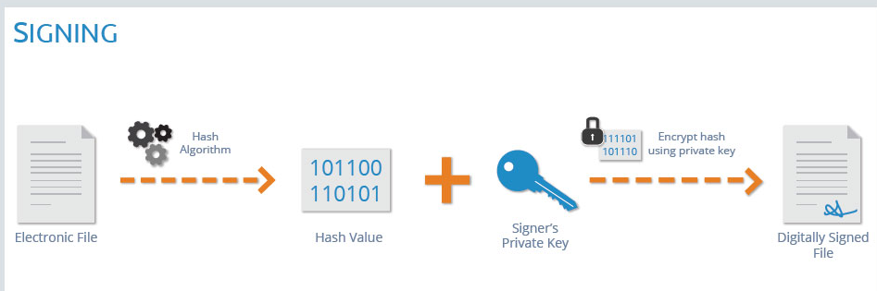
Digital Signatures
These two systems allow us to not only identity members of the shared ledger, but also allow them to “sign” transactions that they authorize
1: Users generate a public/private key pair (note, these can only be created at the same time and one cannot be found using the other)
2: Users set their public key to be their “identity “ on the ledger”
3: When somebody wants to send cryptocurrency/property/whatever to another user of the ledger, they start by hashing all the transaction info
4: They encrypt the hash with their private key and broadcast the transaction along with that encryption as its “signature”
5: Users looking to verify the signature simply decrypt it with the user's public key, then hash the transaction info and compare it with the signature

Slide 21
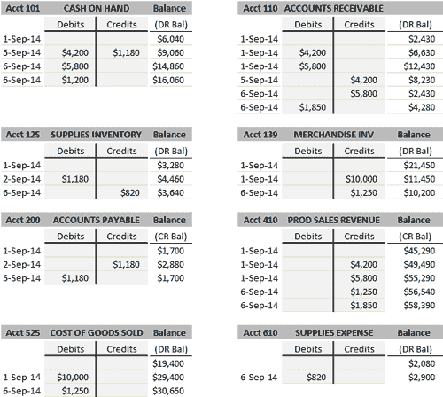
Step 2: Organize transactions in a trustworthy way

Slide 22
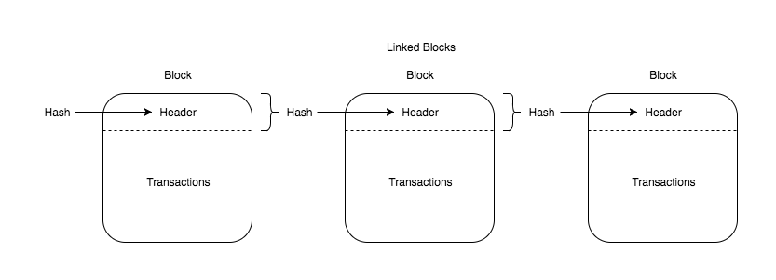
The blockchain data structure
We ensure the integrity of our ledger, we need to make sure that it cannot be changed after the fact
First, we organize sets of transactions into blocks. How this is done will be explained next
Then, we start each new block of transactions with the hash of the previous block
If any data is changed anywhere in the whole history of transactions will be changed in a snowball fashion

Slide 23
Demonstration of Blockchain
(blockchainexample.py)

Slide 24
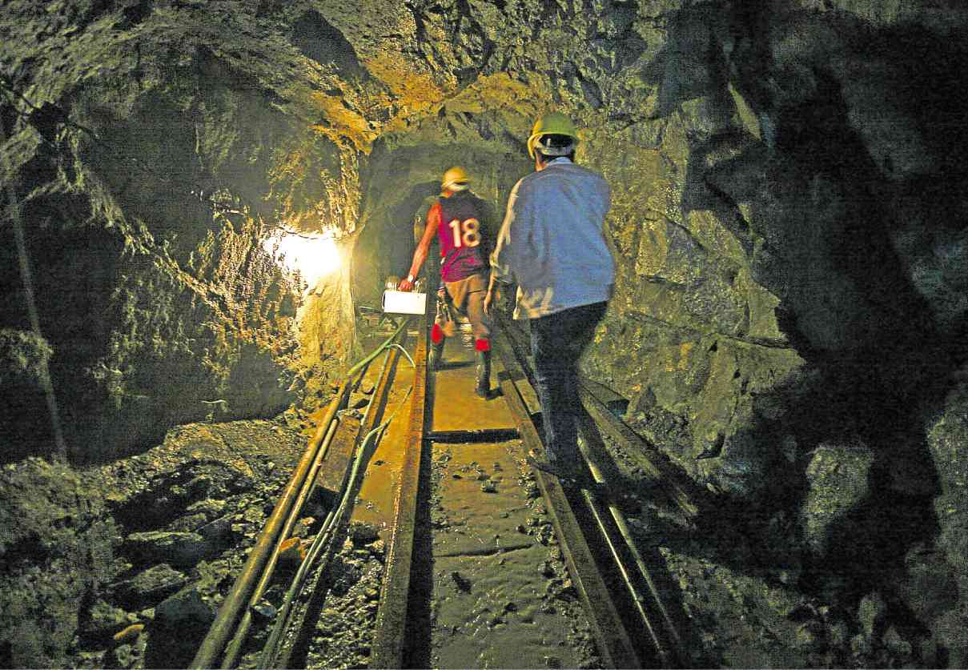
Step 4: Agree on a method for determining which ledger is true

Slide 25
The Challenge of Distributed Consensus
In the previous step, we have shown that it is impossible to hide changes to the ledger. So if someone changes the ledger, then we have conflicting versions of reality. Since the ledger is distributed and decentralized, and each user is equally untrustworthy, how do we decide on these versions of reality?
With no central authority, there needs to be a method of consensus
In addition, we want to make it costly and difficult to maintain a lie.
Without a central authority, how do we resolve disputes.....

Slide 26

Fight to the death

Slide 27
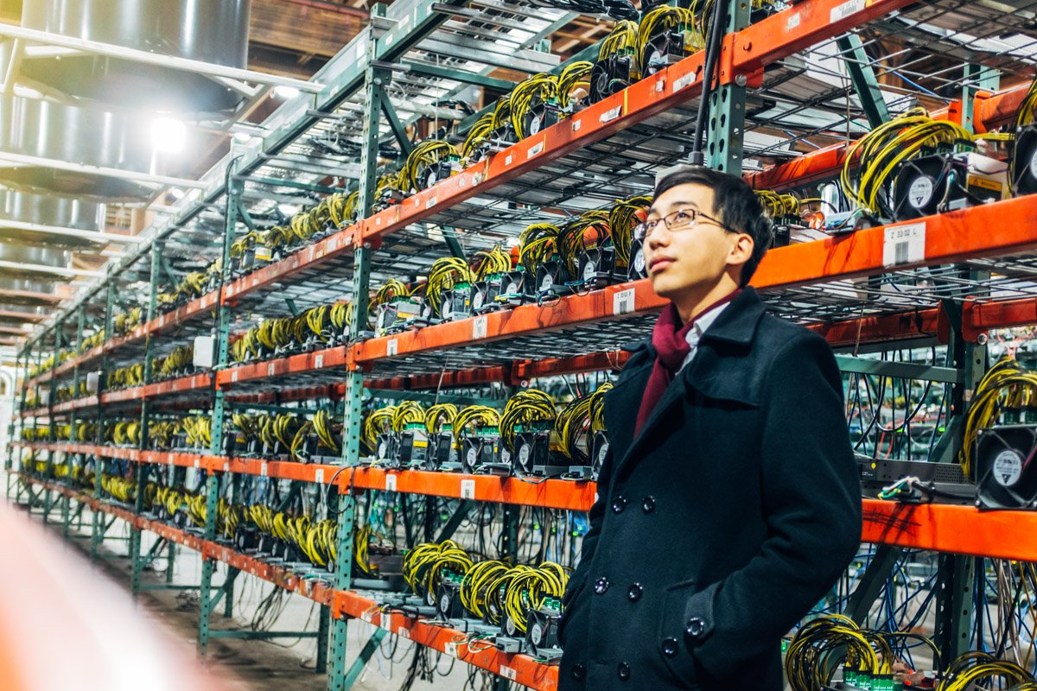
Introducing Mining
When users want transactions added to the ledger, they broadcast them out to the network, and those transactions are collected into a block by other users who chose to be “miners”
Miners then compete to solve a “computational puzzle”
Generally, the vast majority of miners are mining the same set of transactions, thus the “true” ledger generally wins out.

Slide 28
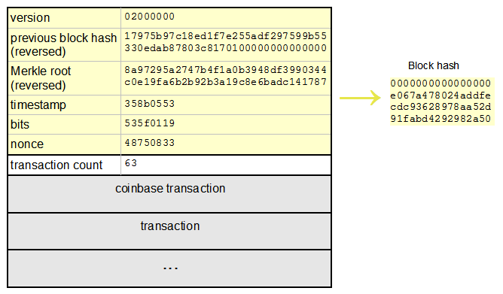
Hash Puzzles
By adding a number at the end of a set of transactions, called a “nonce” or “Proof of Work”, miners search for a hash that begins with a certain number of zeros
When that proof of work is found, the miner who found it adds it to the block, and is rewarded with additional cryptocurrency
This is the only way to create new cryptocurrency, and is designed to be harder the more people join the network

Slide 29
Hash puzzle demonstration
Mining.py

Slide 30
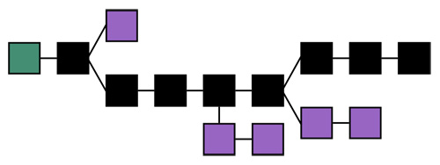
So what do we trust?
When the miners solve the hash puzzle for the current set of transactions, the proof of work that solved it is added to the block and appended to the blockchain
Since the blockchain is sensitive to change, changing any data in the ledger history results in a blockchain fork.
The users trust whichever chain is the longest

Slide 31
Why does this work?
Lets say that instead of mining, the network decided to simply vote on which ledger blockchain they agreed to be true, eg, one IP one vote. Then, users could use VPNs or other methods to stack the votes in their favor
Instead, the mining methods force users to spend CPU power by solving hash puzzles in order to build a blockchain, eg, one CPU one vote
If somebody decides to cheat by changing the history of the ledger in their favor, they would need to mine every single block AGAIN from the time of the change themselves, and mine faster than everyone else before the true blockchain becomes too long to overtake.
It is estimated that it would cost sombody $400,000,000 every 10 minutes in computer equipment and electricity in order to accomplish this on the bitcoin network
In otherwords, because the network votes with CPU power rather than IP addresses, it costs more to fake, hack, or attack the network than you can ever hope to gain doing it

Slide 32

In Summary
1: To initiate a transaction, a user first uses her private key to create a digital signature authorizing a transaction to be added to a shared, distributed ledger
2: These authorized transactions are broadcasted to everyone in the network
3: Users volunteering to be miners gather transactions made at similar times into a “block”
4: Those miners append the hash of the previous block in the chain to the top of this new block
5: Miners then compete to solve a hash puzzle by searching for a “Proof of Work” that results in a certain number of zeros when added to the hashed transaction
6: When a miner has found this proof of work, they are rewarded with cryptocurrency and their block, along with the proof of work, is added to the blockchain

