Slide 1
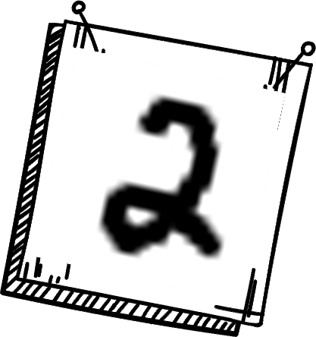

Handwritten digit Recognition
2023
Using Neural Networks

Slide 2
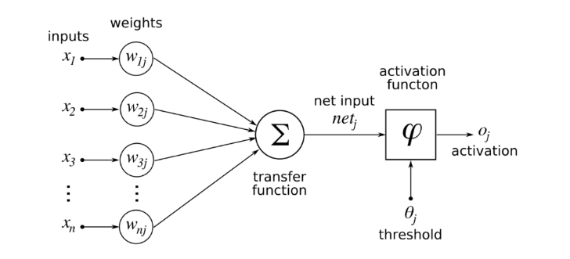
Basic elements of Neural Networks
Linear Regression!

Slide 3
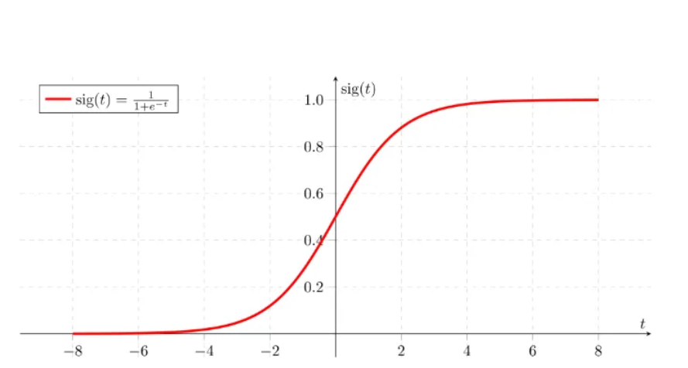
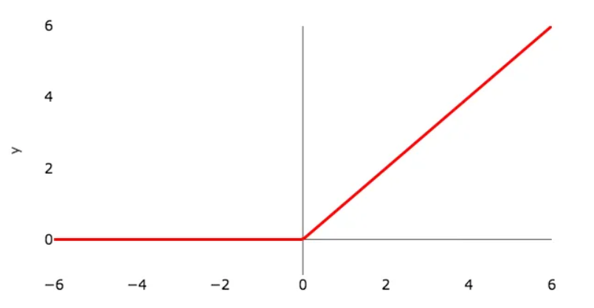
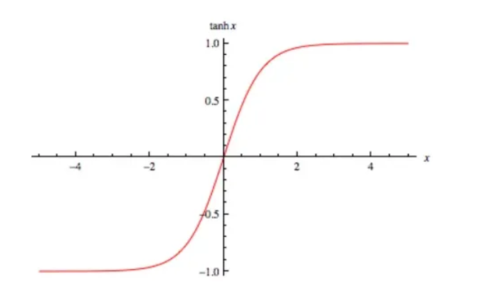



Activation Functions
Simply put, an activation function is a function that is added in order to help the network learn complex patterns in the data.
It takes in the output signal from the previous cell and converts it into some form that can be taken as input to the next cell.
ReLU (Rectified Linear Unit)
tanh
Sigmoid
Many more!!

Slide 4
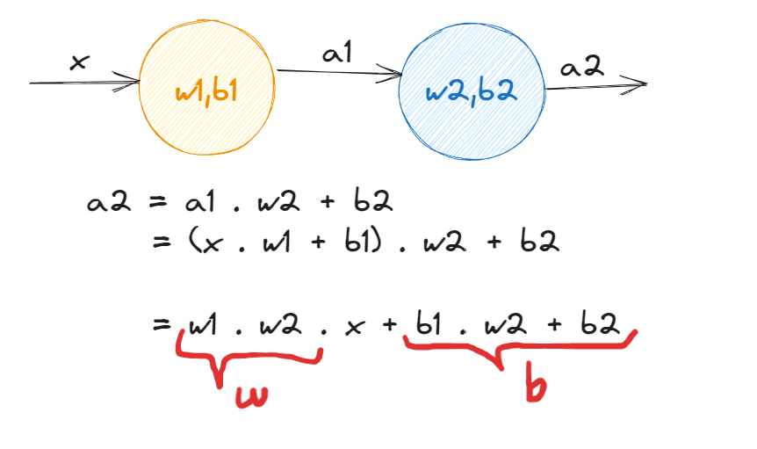
Do we really need activation functions?!!
Yes, activation functions are an essential component of neural networks.
Without activation functions, a neural network would simply be a linear regression model, and it would not be able to learn complex nonlinear patterns in the data.
Activation functions also help to ensure that the output of the neural network is within a certain range, which can be important for certain types of problems, such as classification problems

Slide 5
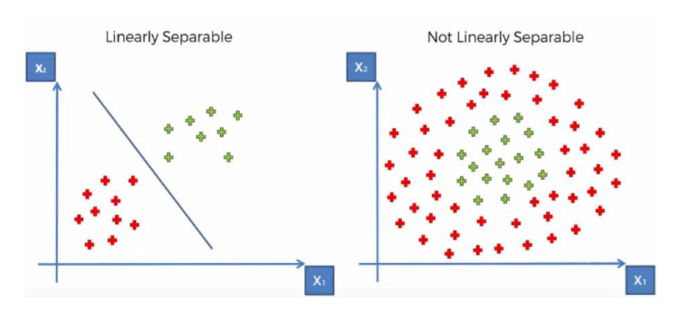
Why NOT using Single Layer Perceptron
Uses only Binary Activation function
Cannot solve Linear In-separable Problem
Single layer networks cannot solve complex problems

Slide 6
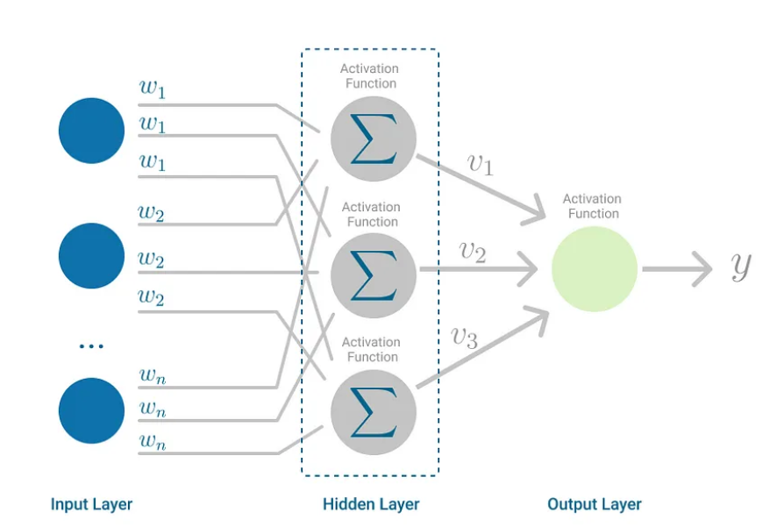
Multilayer Perceptron
There are many types of layers such as:
Dense Layer : each neuron in the layer is connected to every neuron
Flatten Layer : convert multi-dimensional input data into a one-dimensional array
Dropout Layer : a type of regularization technique (avoid overfitting) that randomly drops out (set to zero) some of the neurons in the layer during training
Hidden Layers!!

Slide 7
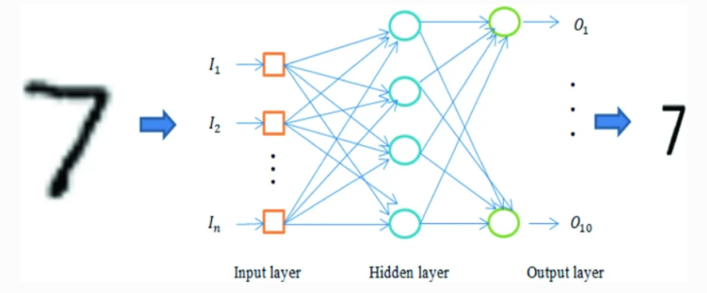
Multilayer Perceptron
Not just a neuron in the output layer – multiclass problem
Flatten Layer
Dense Layers
& dropout layer
Dense Layer

Slide 8
Back Propagation Network Algorithm
Step 1
Step 2
Step 3
Step 4
Initialization of Bias, Weights
Feedforward process
Back Propagation of Errors
Updating of weights & biases
01
02
03
04

Slide 9
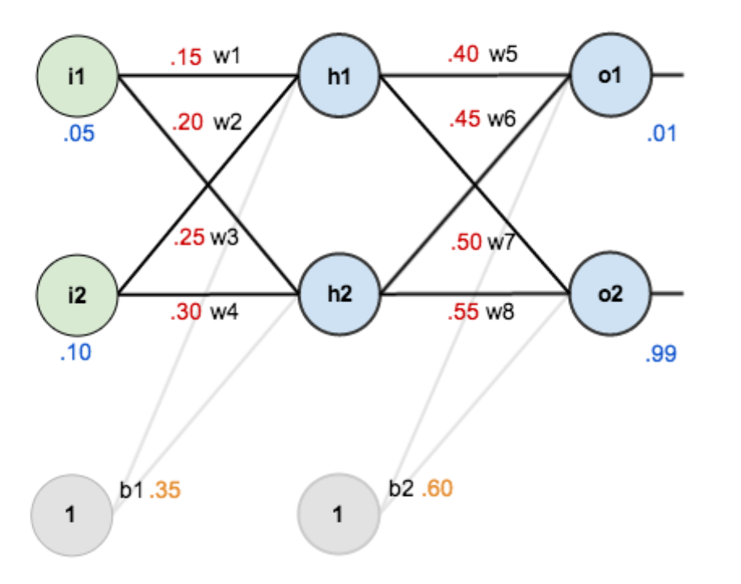
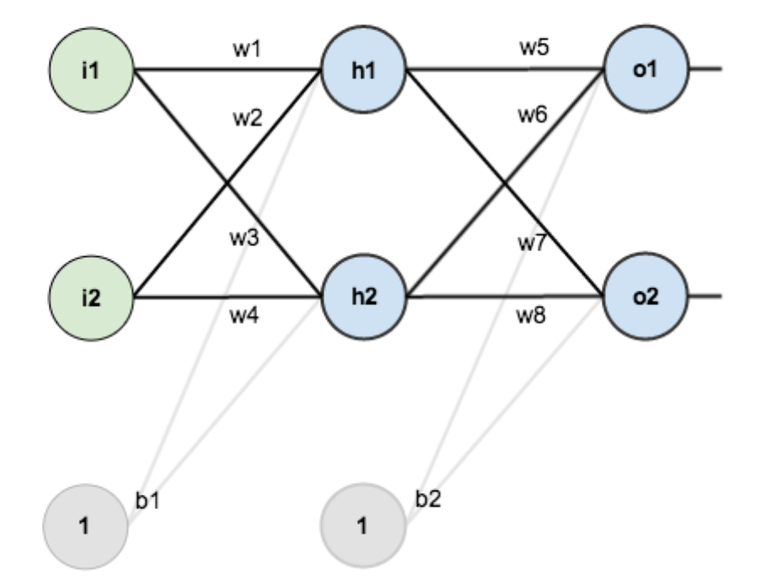
Initialization of Bias, Weights
Step 1

Slide 10

Feedforward process
z
z
Step 2
We figure out the total net input (z) to each hidden layer neuron.
squash the total net input using an activation function (f).
Then repeat the process with the output layer neurons.

Slide 11


Feedforward process
Step 2
Total error for the neural network
$Etotal =Eo1$ + $Eo2$
= $\frac{1}{2}$ (o1$target$ – o1$output$) ²+ $\frac{1}{2}$ (o2$target$ – o2$output$) ²

Slide 12

Back Propagation of Errors
Step 3
Our goal with backpropagation is to update each of the weights in the network, so that they cause the actual output to be closer the target output, thereby minimizing the error for each output neuron and the whole network.
What is the impact on the value of E_{total} if we changes w5 a little bit?

Slide 13
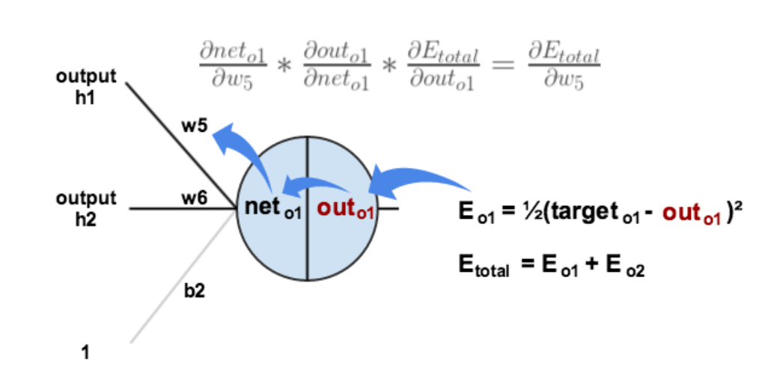
Back Propagation of Errors
Chain Rule
Step 3
E_{total}

Slide 14
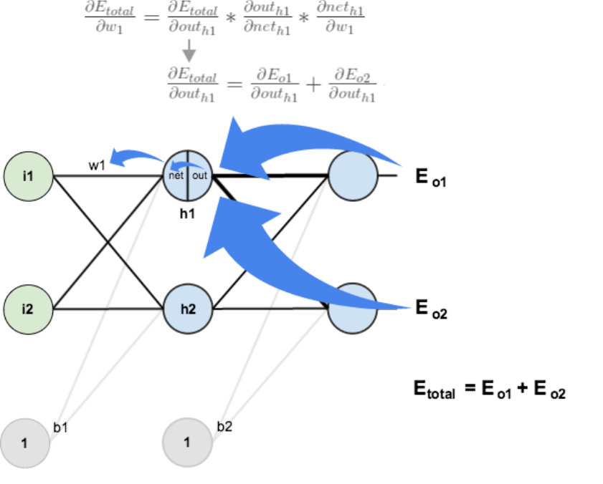
Back Propagation of Errors
Step 3

Slide 15




Back Propagation of Errors
Step 3
Ultimately, we determine how much each weight contributes to the overall error.
$$\frac{∂Etotal}{∂w5}$$
$$\frac{∂Etotal}{∂w6}$$
$$\frac{∂Etotal}{∂w4}$$
$$\frac{∂Etotal}{∂w3}$$

Slide 16

Updating of weights & biases
Step 4
Gradient Descent
For all wieght
i
i
i
b
For all bias
b
i
i
b
i

Slide 17
To better fit our problem, some modifications are required.
Activation function
softmax
Loss function
Sparse categorical crossentropy
Optimization algorithm
Adam algorithm

Slide 18
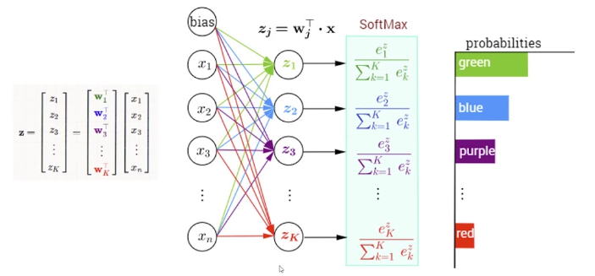
Softmax activation function
Sum of all p = 1
So, in this case the prediction of the number is 0 , the one of the higher probability!
0
1
2
9
Regression: Linear activation function.
Binary Classification: Sigmoid activation function
Multiclass Classification: Softmax activation function

Slide 19
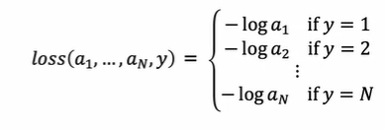
Sparse categorical cross entropy Loss function
0
1
For this some sample:
2
Prediction is ZERO
But the true value is ONE (y = 1)
Then loss = -log( )
9
Regression: Mean Squared Error (MSE)
Binary Classification: Binary Cross-Entropy
Multiclass Classification: Categorical Cross-Entropy

Slide 20
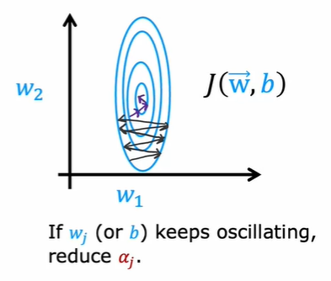
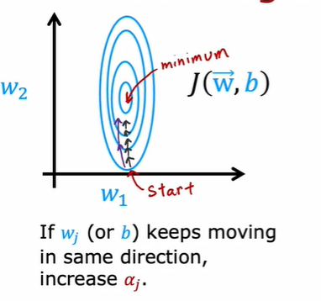
Adam Algorithm
97%
90%
Adam
Gradient Descent
Many adaptive learning rates!
FAST!

Slide 21
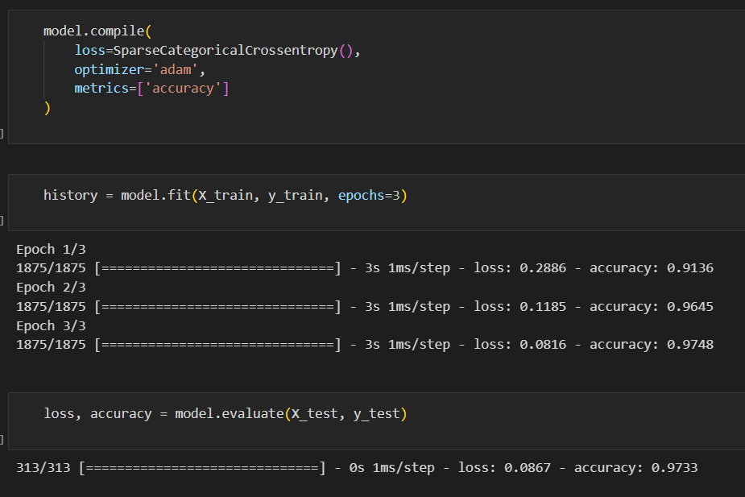
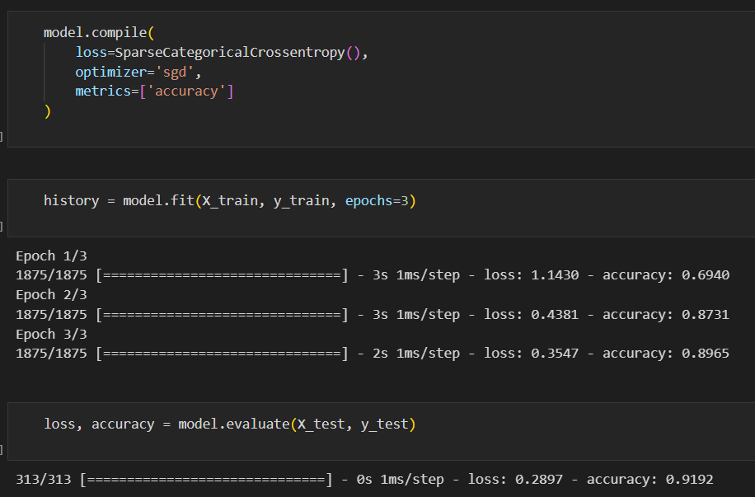
Adam Algorithm
97%
90%
Adam
Gradient Descent

Slide 22
Team 3
عبدالله سمير السيد الحداد
حازم احمد الشناوي ابو السعود
احمد اشرف عبد الحميد هجرس
ساره حمزه عبد الرازق سعدون
ساره صلاح الدين عبد المعطى عبد العال
شرين مصطفى ابراهيم محمد نصر
ايمان نصر إبراهيم خيال
سمر محمود طه البري

Slide 23
Thanks!

