Slide 1

Customer Shopping Behavior Analysis
Uncovering insights from 3,900 purchases to guide strategic business decisions.

Slide 2


Project Overview
1
2
3
Analyze Transactions
Uncover Insights
Guide Decisions
3,900 purchases across categories.
Spending patterns, segments, preferences.
Optimize strategy with data.

Slide 3
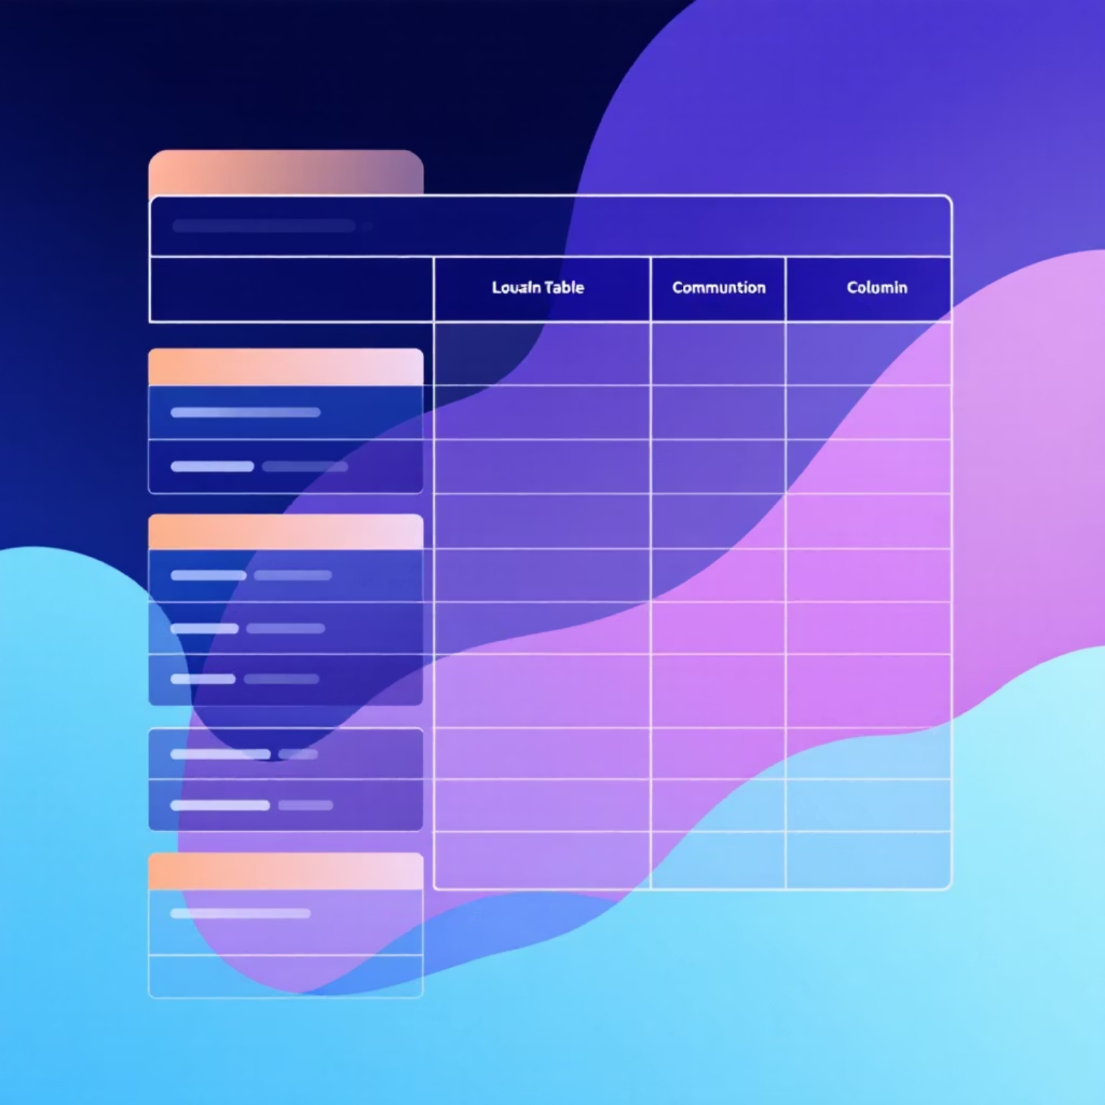
Dataset Summary
Rows: 3,900
Columns: 18
Customer demographics
Purchase details
Shopping behavior
Missing Data: 37 values in Review Rating.

Slide 4
Exploratory Data Analysis (Python)
01
02
03
Data Loading & Exploration
Missing Data Handling
Column Standardization
Imported with pandas, checked structure and statistics.
Imputed Review Rating using median by category.
Renamed to snake_case for readability.
04
05
Feature Engineering
Database Integration
Created age_group and purchase_frequency_days.
Loaded cleaned data to PostgreSQL for SQL analysis.

Slide 5

Data Analysis (SQL)
Revenue by Gender
1
Female: $75,191 | Male: $157,890
High-Spending Discount Users
2
839 customers spent above average with discounts.
Top 5 Products by Rating
3
Gloves (3.86), Sandals (3.84), Boots (3.82), Hat (3.80), Skirt (3.78).
Shipping Type Comparison
4
Standard: $58.46 | Express: $60.48

Slide 6
SQL Insights: Subscriptions & Discounts
Subscribers vs. Non-Subscribers
Discount-Dependent Products
Yes
1053
$59.49
$62,645
Hat
50.00%
No
2847
$59.87
$170,436
Sneakers
49.66%
Non-subscribers contribute more revenue.
Coat
49.07%
Sweater
48.17%
Pants
47.37%
Top 5 products with highest discounted purchases.

Slide 7
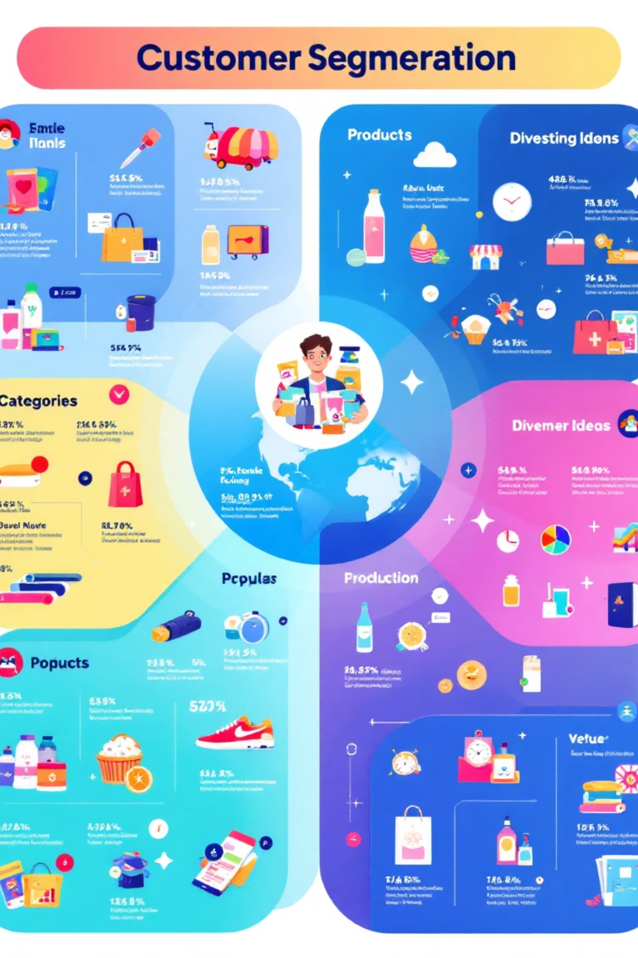
Customer Segmentation & Top Products
Customer Segments
Top Products per Category
Loyal
Accessories: Jewelry, Sunglasses, Belt
3116 Customers
Clothing: Blouse, Pants, Shirt
Footwear: Sandals, Shoes, Sneakers
Returning
701 Customers
Outerwear: Jacket, Coat
New
83 Customers

Slide 8
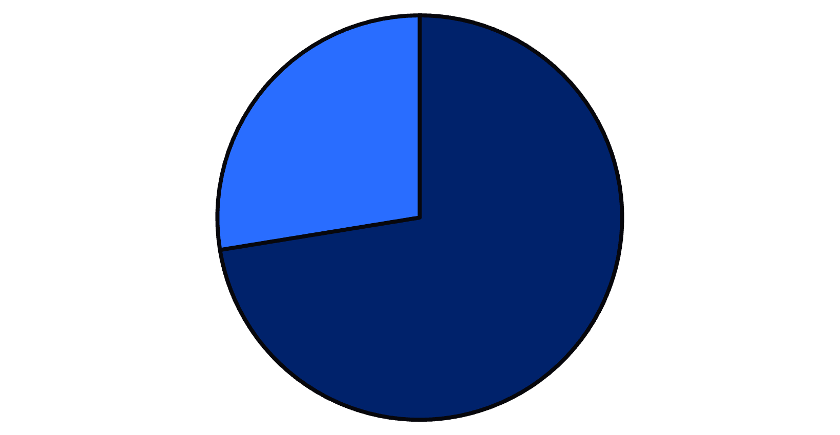
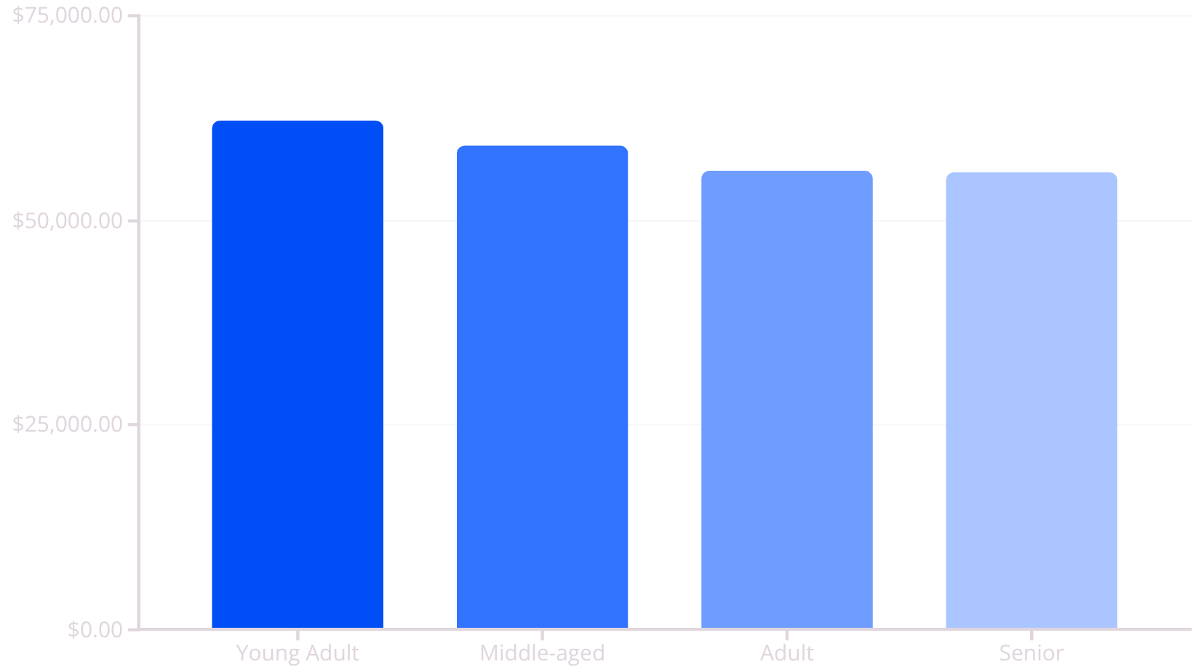
Repeat Buyers & Revenue by Age
Repeat Buyers & Subscriptions
Revenue by Age Group
No
Yes
Repeat buyers are less likely to subscribe.
Young Adults contribute the most revenue.

Slide 9
Power BI Dashboard: Visualizing Insights
Interactive dashboard for key metrics and visualizations.
Key Metrics
Visualizations
3.9K Customers, $59.76 Avg Purchase, 3.75 Avg Review.
Subscription status, revenue by category/age, sales by category/age.

Slide 10

Business Recommendations
Boost Subscriptions
Promote exclusive benefits.
Customer Loyalty Programs
Reward repeat buyers.
Review Discount Policy
Balance sales with margin control.
Product Positioning
Highlight top-rated and best-selling products.
Targeted Marketing
Focus on high-revenue age groups and express shipping users.

