Slide 1







Slide 2



PROJECT MEMBERS
  MOHAMMED OMAR HALAWANI
  MOHAMMED ALMANSOUR
  NAIF ALMASOUD
  AHMED AL-GHAMDI

Slide 3
Our project uses a Tello drone and a custom-trained object detection model to check if parking spaces are occupied or empty. We built the system by collecting our own images, labeling them, and training a model specifically for our parking lot. The drone captures live footage, and the model detects the status of each spot. This project demonstrates a simple but effective way to apply computer vision to real-world parking monitoring.​
Project Description

Slide 4
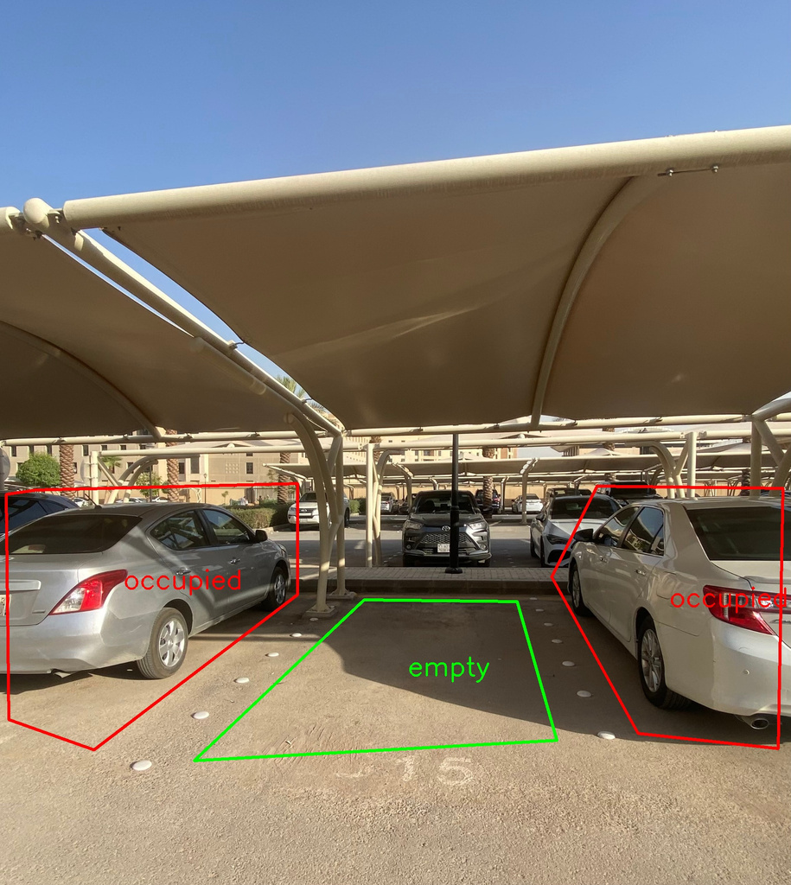
​
​
Data Collection
We built our dataset by capturing real images of a local parking lot using both smartphones and the Tello drone. Most of the photos were taken with our phones from different angles, distances, and lighting conditions to ensure variety.​
One unique aspect of our parking lot is that the spaces are marked with circular ground markings instead of traditional painted lines, which made standard datasets less effective for our use case. The drone was mainly used for overhead views during testing.​
After collecting the images, we manually annotated each one to label parking spots as either "occupied" or "empty." To expand the dataset and improve model performance, we applied data augmentation techniques like rotation, flipping, and brightness changes.​

Slide 5
Training Phase​
​
​
For the training phase, we used a YOLOv8s model with over images.​
All the data was collected manually using our smartphones, with different parking areas.
​
We labeled each image ourselves, classifying the parking spots as either empty or occupied.​
The annotation was done using Roboflow, and we trained the model on visual studio​
The whole training process took about 2.5 h​ours.

Slide 6
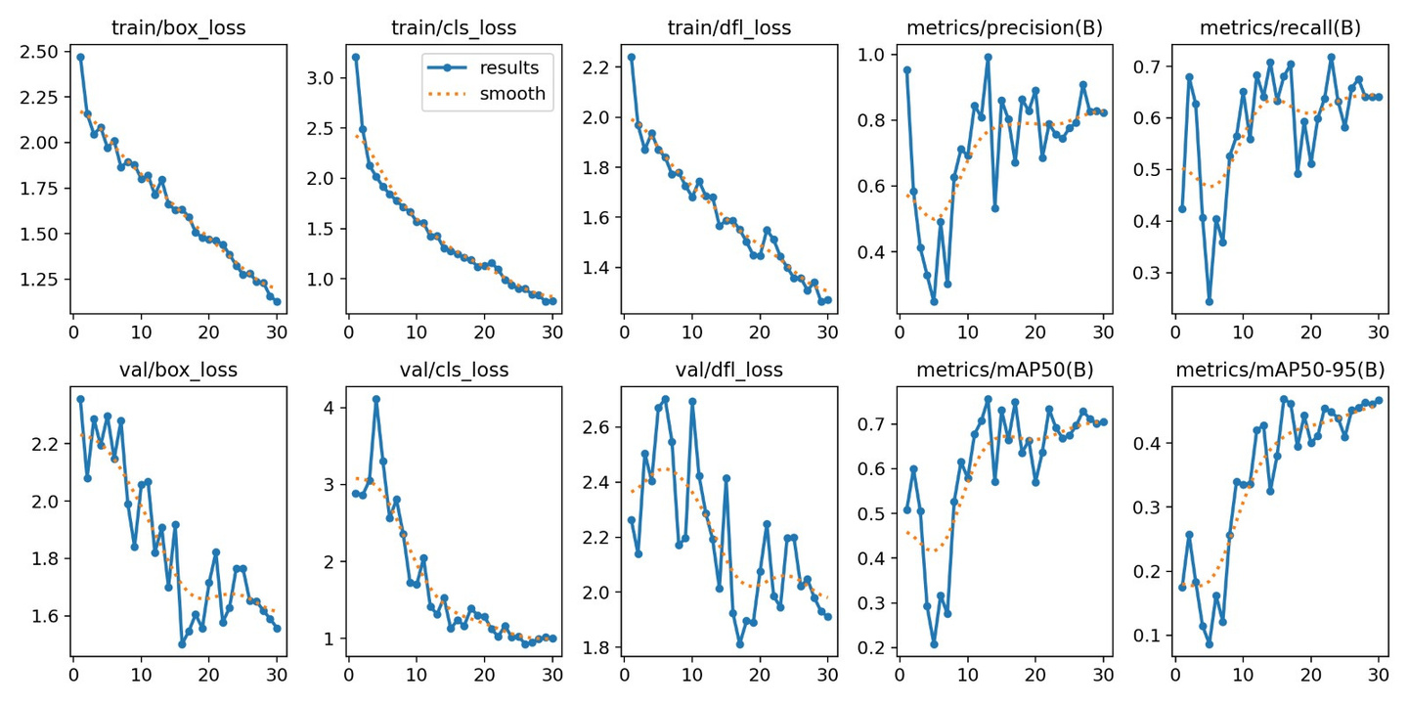
​
​
Training Phase(cont)​

Slide 7

​
​
Testing & Results​
​
​
After training, we tested the model on real image taken from real life.​
We also flew the Tello drone again to test the model in real-world​
scenarios.​
The model gave great potential results — with 99% precision, 64% recall,​
and a mean average precision of 75%.​
It successfully detected and classified parking spots in real-time during drone flights.​

Slide 8
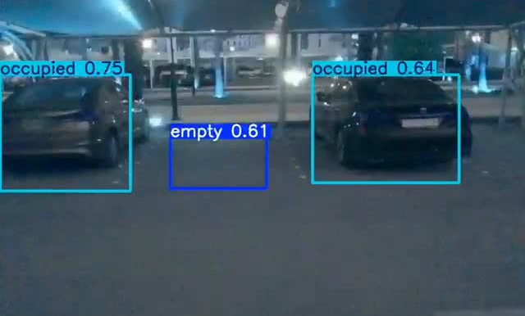
​
​
Testing & Results (cont)​

Slide 9
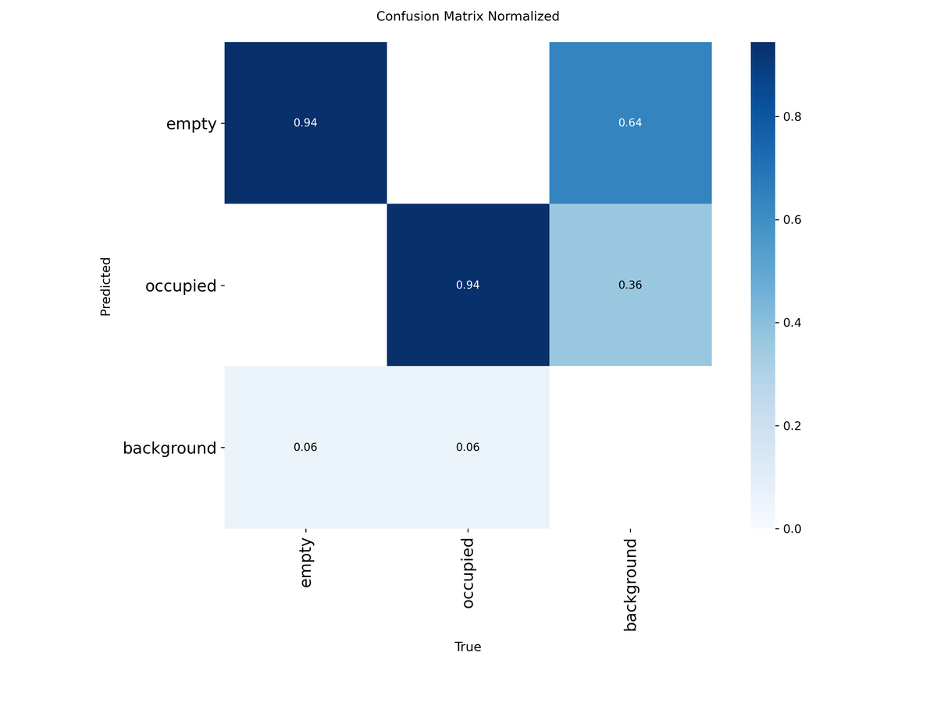
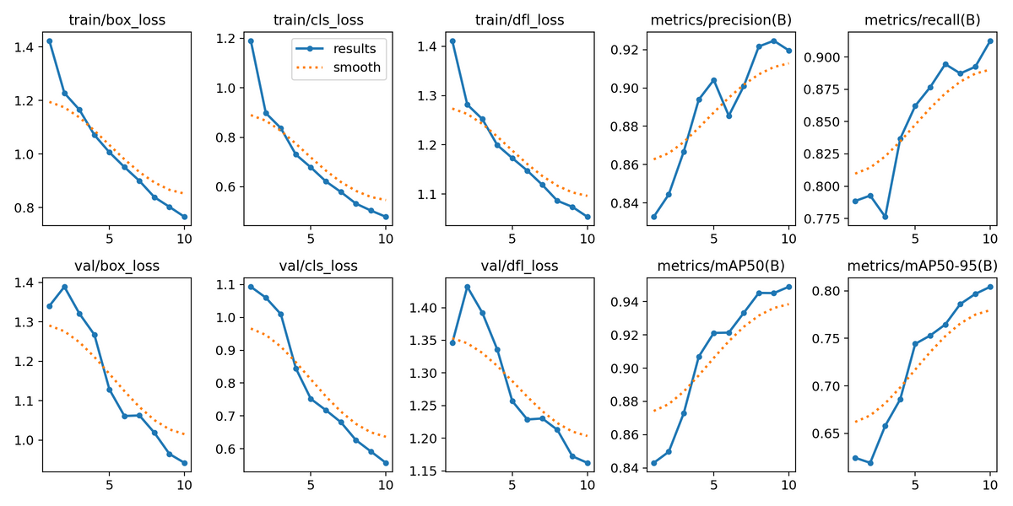
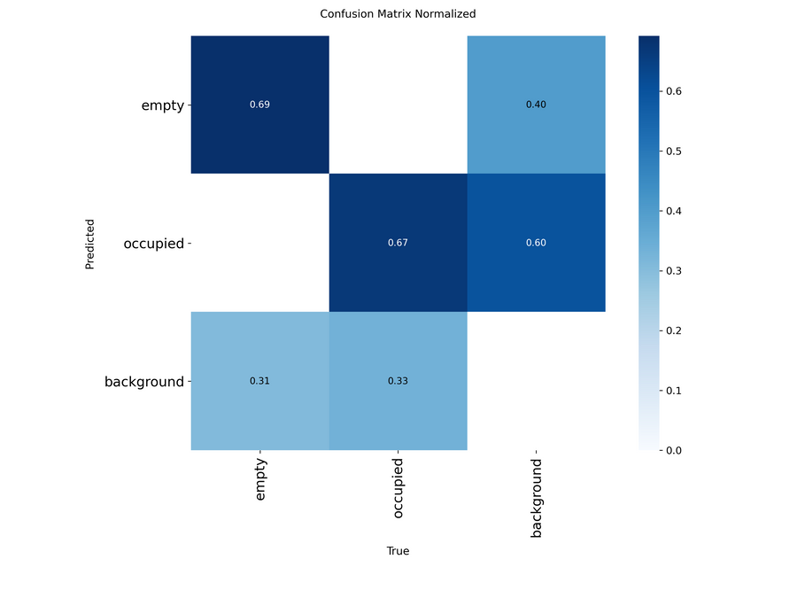

Comparing results

Slide 10
​
Challenges
During the development of our project, we encountered several key challenges
One of the major obstacles was: the poor accuracy of models trained on publicly available datasets. No matter how extensively we trained, the results were consistently suboptimal.
Custom Data Collection & Annotation: To overcome the dataset limitations, we had to collect our own drone footage and manually annotate the data to meet our project’s specific requirements. This process was time-consuming but essential.
Computational Power: Training deep learning models requires substantial computational resources. Running high-resolution object detection models with real-time performance posed hardware limitations during development.
Drone Reliability Issues: Operating the drone consistently was another challenge. It would often shut down unexpectedly due to overheating or other environmental conditions, which disrupted testing sessions.
Poor Camera Quality: The built-in drone camera had low resolution and poor stabilization, making it harder for the detection model to accurately identify vehicles and parking slots.

Slide 11
​
Future Improvements
We have identified several opportunities to enhance and expand the project in future iterations
Wrong Parking Detection: Extend the model’s capabilities to detect incorrect or illegal parking behavior, such as vehicles occupying two slots or blocking other cars.
Vehicle Type Classification: Train the model to classify vehicle types (e.g., cars, trucks, motorcycles) to enable better understanding of parking patterns.
Drone-Assisted Parking Guidance: Enable the drone to act as a smart assistant, guiding vehicles to available parking spots in real time using visual and spatial feedback.
Improved Accuracy and Dataset Expansion: Collect more diverse and high-quality data under various conditions to improve model robustness and overall detection accuracy.

Slide 12
The reasons behind our selection
• Real-Time Monitoring
The system provides instant updates on parking availability by analyzing live drone footage.
• Scalable and Easy to Deploy
Can be expanded to new locations by simply adjusting the drone’s flight path — no extra hardware needed.
• Ideal for Outdoor or Complex Areas
Works well in environments where traditional sensors are hard or costly to install.
• Insightful Data for Management
Offers analytics like peak usage times and occupancy trends to optimize parking space utilization.

Slide 13
Conclusion(what we’ve learned)
  Through our project that integrated AI with a drone, we learned how modern technologies can solve real-world problems like parking management.
  We used Object Detection and CNN techniques to accurately detect whether a parking spot is “Occupied” or “Empty”.
  We realized that smart selection of data is more important than quantity or diversity.
  More data doesn’t always mean better accuracy — sometimes, data collected from the actual target environment is the real key to a successful model.

Slide 14
Thank You For Listening!

