Slide 1
Discrete Structures
Spring 2026 – Week 4

Slide 2
Algorithms
Lecture 2

Slide 3
Problems and Algorithms
In many domains there are common problems where we are given some input and we must produce an output with certain properties.
First, we clearly define the problem by describing what the input is and what output we want.
Then, we solve the problem by writing clear, step-by-step instructions that take the input and give the correct output.
These step-by-step instructions are called an algorithm.

Slide 4

Algorithms
Definition: An algorithm is a finite set of precise instructions for performing a computation or for solving a problem.
Example: Describe an algorithm for finding the maximum value in a finite sequence of integers.
Abu Ja’far Mohammed Ibin Musa Al-Khowarizmi
(780-850)

Slide 5
Algorithms
Solution: Perform the following steps:
Set the temporary maximum equal to the first integer in the sequence.
Compare the next integer in the sequence to the temporary maximum.
If it is larger than the temporary maximum, set the temporary maximum equal to this integer.
Repeat the previous step if there are more integers. If not, stop.
When the algorithm terminates, the temporary maximum is the largest integer in the sequence.

Slide 6
Specifying Algorithms
Algorithms can be specified in different ways. Their steps can be described in English or in pseudocode.
Pseudocode is an intermediate step between an English language description of the steps and a coding of these steps using a programming language.
Programmers use pseudocode to later write the same steps in any programming language, like C, Java, or Python.
Pseudocode also helps us understand how much time an algorithm takes to solve a problem, without worrying about which programming language is used.

Slide 7
Properties of Algorithms
Input: An algorithm takes some input values to work on.
Output: After processing the input, the algorithm gives an output, which is the answer to the problem.
Correctness: An algorithm should produce the correct output values for each set of input values.
Finiteness: An algorithm should produce the output after a finite number of steps for any input.
Effectiveness: Each step of the algorithm should be simple and doable, and take a reasonable amount of time.
Generality: The algorithm should work for all similar problems, not just one specific case.

Slide 8
Finding the Maximum Element in a Finite Sequence
The algorithm in pseudocode:
Does this algorithm have all the properties listed on the previous slide?
procedure max(a₁, a₂, …., a_{n}: integers)
max := a₁
for i := 2 to n
if max < a_{i} then max := a_{i}
return max{max is the largest element}

Slide 9
Some Example Algorithm Problems
Classes of problems to be studied in this section.
Searching Problems: finding the position of a particular element in a list.
Sorting problems: putting the elements of a list into increasing order.

Slide 10
Searching Problems
You are given:
A list of different elements: a₁, a₂, …, aₙ
A value x that you want to find
The goal is:
To check whether x is in the list or not.
If x is found, the answer is the position (index) where x is located in the list.
If x is not found, the answer is 0, which means the value is not in the list.

Slide 11
Linear Search Algorithm
The linear search algorithm locates an item in a list by examining elements in the sequence one at a time, starting at the beginning.
First compare x with a₁. If they are equal, return the position 1.
If not, try a₂. If x = a₂, return the position 2.
Keep going, and if no match is found when the entire list is scanned, return 0.

Slide 12
Linear Search Algorithm
procedure linear search (x : integer, a₁, a₂, …,a_{n}: distinct integers)
i := 1
while (i ≤ n and x ≠ a_{i})
i := i + 1
if i ≤ n then location := i
else location := 0
return location{location is the subscript of the term that equals x, or is 0 if x is not found}

Slide 13
Binary Search Algorithm
The list must be already sorted.
Start by checking the middle element of the list.
If the middle element is the one you want, stop and return its position.
If the middle element is smaller than the required element, search in the right half of the list.
If the middle element is larger, search in the left half of the list.
Keep repeating these steps, each time cutting the list in half.
If the list becomes very small and the element is still not found, return 0.

Slide 14
Binary Search Algorithm
procedure binary search(x: integer, a₁,a₂,…, a_{n}: increasing integers)
i := 1 {i is the left endpoint of interval}
j := n {j is right endpoint of interval}
while i < j
m := ⌊(i + j)/2⌋
if x > a_{m} then i := m + 1
else j := m
if x = a_{i} then location := i
else location := 0
return location{location is the subscript i of the term a_{i} equal to x,
or 0 if x is not found}

Slide 15
Binary Search Algorithm
Example: The steps taken by a binary search for 19 in the list:
1 2 3 5 6 7 8 10 12 13 15 16 18 19 20 22
The list has 16 elements, so the midpoint is 8. The value in the 8th position is 10. Since 19 > 10, further search is restricted to positions 9 through 16.
1 2 3 5 6 7 8 10 12 13 15 16 18 19 20 22
The midpoint of the list (positions 9 through 16) is now the 12th position with a value of 16. Since 19 > 16, further search is restricted to the 13th position and above.
1 2 3 5 6 7 8 10 12 13 15 16 18 19 20 22

Slide 16
Binary Search Algorithm
The midpoint of the current list is now the 14th position with a value of 19. Since 19 ≯ 19, further search is restricted to the portion from the 13th through the 14th positions .
1 2 3 5 6 7 8 10 12 13 15 16 18 19 20 22
The midpoint of the current list is now the 13th position with a value of 18. Since 19> 18, search is restricted to the portion from the 14th position through the 14th.
1 2 3 5 6 7 8 10 12 13 15 16 18 19 20 22
Now the list has a single element and the loop ends. Since 19=19, the location 14 is returned.

Slide 17
Sorting Algorithms
Lecture 3

Slide 18
Sorting
Sorting means arranging the items in a list in a proper order, such as:
1. Numbers from small to large
2. Words in alphabetical order
Sorting is an important problem because:
Computers spend a lot of time and power sorting data.
Many real-life applications need data in a specific order, for example:
1. Customer names in alphabetical order
2. Product or part numbers in numeric order
3. Records in large databases arranged neatly

Slide 19
Bubble Sort
Bubble sort makes multiple passes through a list. Every pair of elements that are found to be out of order are interchanged.
procedure bubblesort(a₁,…,a_{n}: real numbers
with n ≥ 2)
for i := 1 to n− 1
for j := 1 to n − i
if a_{j} >a_{j+1} then interchange a_{j} and a_{j+1}
{a₁,…, a_{n} is now in increasing order}

Slide 20
Bubble Sort
Example: Show the steps of bubble sort with 3 2 4 1 5
In the first pass, the largest number moves to its correct place.
In the second pass, the second largest number moves to its correct place.
Each new pass puts one more number in the correct position.

Slide 21
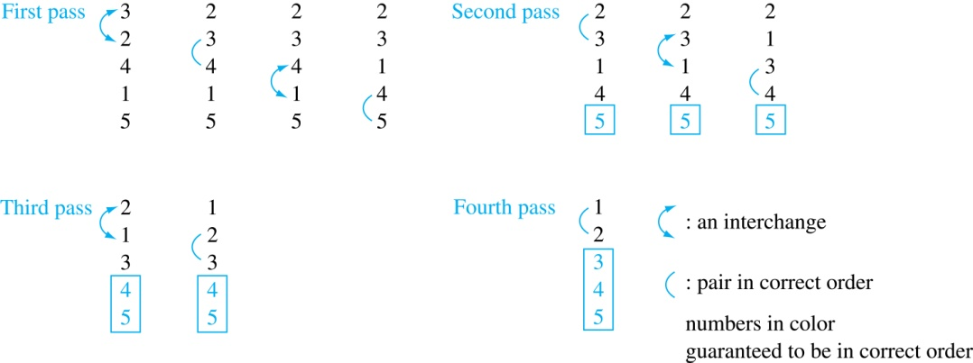
Bubble Sort

Slide 22
Bubble Sort – Illustration
https://en.wikipedia.org/wiki/Bubble_sort#/media/File:Bubble-sort-example-300px.gif

Slide 23
Insertion Sort
Insertion sort begins with the 2nd element. It compares the 2nd element with the 1st and puts it before the first if it is not larger.
Next the 3rd element is put into the correct position among the first 3 elements.
In each subsequent pass, the n+1st element is put into its correct position among the first n+1 elements.
Linear search is used to find the correct position.

Slide 24
Insertion Sort
Example: Show all the steps of insertion sort with the input:
3 2 4 1 5
2 3 4 1 5 (first two positions are interchanged)
2 3 4 1 5 (third element remains in its position)
1 2 3 4 5 (fourth is placed at beginning)
1 2 3 4 5 (fifth element remains in its position)
Continue on Next Slide …..

Slide 25
Insertion Sort (Further Explanation)
Step 3: Take the fourth element (1)
Compare 1 with 4 → 1 < 4, move 4 right
Compare 1 with 3 → 1 < 3, move 3 right
Compare 1 with 2 → 1 < 2, move 2 right
Place 1 at the beginning
List now: 1 2 3 4 5
Step 1: Start with the second element (2)
Compare 2 with the first element 3.
Since 2 < 3, swap them.
List now: 2 3 4 1 5
Step 2: Take the third element (4)
Compare 4 with elements before it: 3 and 2.
4 > 3 → it’s already in the right position.
List now: 2 3 4 1 5
Step 4: Take the fifth element (5)
Compare 5 with 4 → 5 > 4, so it stays in place
Final sorted list: 1 2 3 4 5

Slide 26
Insertion Sort – Illustration
https://en.wikipedia.org/wiki/Insertion_sort#/media/File:Insertion-sort-example-300px.gif

Slide 27
Insertion Sort
procedure insertion sort
(a₁,…,a_{n}:
real numbers with n ≥ 2)
for j := 2 to n
i := 1
while a_{j} > a_{i}
i := i + 1
m := a_{j}
for k := 0 to j − i − 1
a_{j-k} := a_{j-k-1}
a_{i} := m
{Now a₁,…,a_{n} is in increasing order}

Slide 28
Complexity of Algorithms
How can the efficiency of an algorithm be analyzed?
One measure of efficiency is the time used by a computer to solve a problem using the algorithm, when input values are of a specified size.
A second measure is the amount of computer memory required to implement the algorithm when input values are of a specified size.

Slide 29
Time Complexity
The time complexity of an algorithm can be expressed in terms of the number of operations used by the algorithm when the input has a particular size. The operations used to measure time complexity can be the comparison of integers, the addition of integers, the multiplication of integers, the division of integers, or any other basic operation.
Time complexity is described in terms of the number of operations required instead of actual computer time because of the difference in time needed for different computers to perform basic operations.
The fastest computers in existence can perform basic bit operations (for instance, adding, multiplying, comparing, or exchanging two bits) in 10−11 second (10 picoseconds), but personal computers may require 10−8 second (10 nanoseconds), which is 1000 times as long, to do the same operations.

Slide 30

Complexity of Algorithms
Describe the time complexity of Algorithm 1 for finding the maximum element in a finite set of integers.
The algorithm starts by taking the first element as the temporary maximum.
It then compares this maximum with each of the remaining elements, one by one.
If a larger element is found, the maximum is updated.
This process continues until all n elements have been checked.
Number of comparisons
The first element is taken without comparison.
Each of the remaining (n − 1) elements is compared once with the current maximum.
So, total comparisons ≈ n − 1.
Time complexity

Slide 31

Time Complexity of Linear Search Algorithm
Example: Describe the time complexity of the linear search algorithm.
Solution: The algorithm checks elements one by one starting from the first.
It stops when:
the element x is found, or
the end of the list is reached.
Number of comparisons:
At each step, two comparisons are made:
Check if we have reached the end of the list
Compare x with the current element
Case 1: When x is found
Suppose x is found at position i
Comparisons used ≈ 2i + 1
If x is found early → fewer comparisons
Case 2: Worst case (x is NOT in the list)
The algorithm checks all n elements
For each element → 2 comparisons → 2n
One comparison to exit the loop
One comparison outside the loop
Total comparisons = 2n + 2
Time complexity
Since the number of comparisons increases directly with n, the time complexity is:

Slide 32
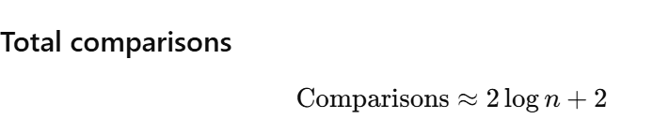

WORST-CASE COMPLEXITY
EXAMPLE 3 Describe the time complexity of the binary search algorithm in terms of the number of comparisons used (and ignoring the time required to compute m = (i +j)/2 in each iteration of the loop in the algorithm).
How binary search works (quick reminder)
Compare the search value x with the middle element of the list.
If x is smaller, search the left half.
If x is larger, search the right half.
Repeat this process until the element is found or only one element is left.
How many steps are needed?
Each step reduces the list size by half.
A list of size n can be halved log₂ n times.
So, total steps ≈ log₂ n.
Number of comparisons
At each step, the algorithm:
checks whether the search range is empty
compares x with the middle element
Time complexity
Since the number of comparisons grows with log n, the time complexity is:

Slide 33

AVERAGE-CASE COMPLEXITY
EXAMPLE 4 Describe the average-case performance of the linear search algorithm in terms of the average number of comparisons used, assuming that the integer x is in the list and it is equally likely that x is in any position
Step 1: Understanding comparisons
At each step of the loop, we check two things:
Is i ≤ n? (Have we reached the end of the list?)
Is x = ai? (Does the current element match x?)
After the loop finishes, there is one extra comparison to check i ≤ n again.
Step 2: Number of comparisons for each position
If x = a1 (first element):
1 comparison for i ≤ n
1 comparison for x = a1
1 comparison after loop Total = 3 comparisons
If x = a2 (second element):
Step 1: 2 comparisons (i ≤ n, x = a1)
Step 2: 2 comparisons (i ≤ n, x = a2)
After loop: 1 comparison Total = 5 comparisons
In general, if x = ai (ith element):

Slide 34
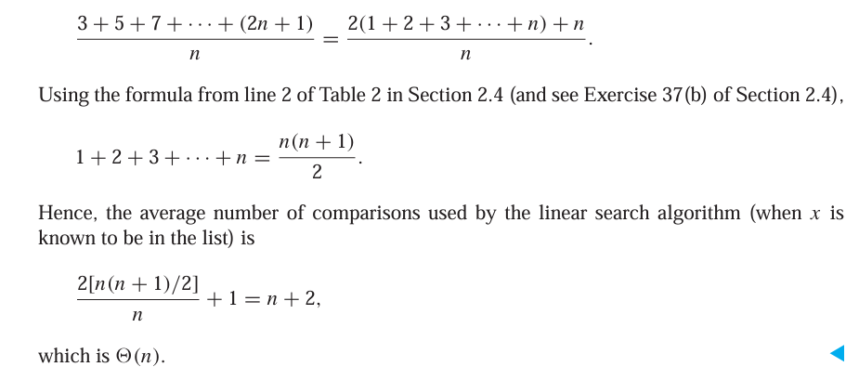
AVERAGE-CASE COMPLEXITY
Step 3: Average number of comparisons
If all elements are equally likely to be x, the average is:

Slide 35

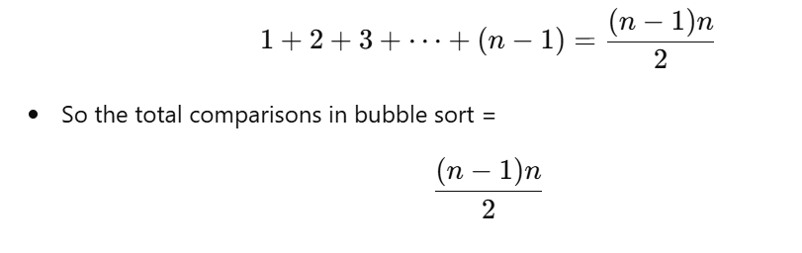
WORST-CASE COMPLEXITY OF TWO SORTING ALGORITHMS
EXAMPLE 5 What is the worst-case complexity of the bubble sort in terms of the number of comparisons made?
Step 1: Suppose the list has n elements.
On the first pass, we compare n − 1 pairs (because there are n − 1 adjacent pairs).
On the second pass, we compare n − 2 pairs.
On the third pass, we compare n − 3 pairs, and so on…
On the last pass, we compare 1 pair.
So, total comparisons =
Complexity
Bubble sort always does this many comparisons, even if the list gets sorted early.
Therefore, the worst-case complexity (and average too) is:
Step 2: Use formula for sum of numbers
The sum of numbers from 1 to (n−1) is:

Slide 36
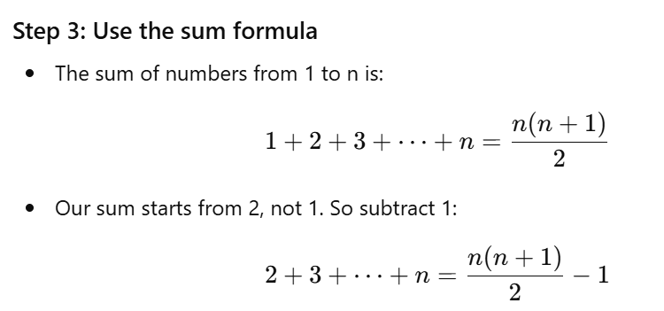


Insertion Sort
EXAMPLE 6 What is the worst-case complexity of the insertion sort in terms of the number of comparisons made?
Insertion sort builds a sorted list one element at a time.
At step j, it takes the jth element and inserts it into its correct position among the first j − 1 elements.
It does this by comparing the jth element with the elements before it until it finds where it belongs.
Step 2: Comparisons for each element
For the 2nd element, it may do 2 comparisons (worst case).
For the 3rd element, it may do 3 comparisons.
For the nth element, it may do n comparisons.
So total comparisons in worst case:
Step 4: Complexity
In the worst case, insertion sort does ~ n²/2 comparisons.
So the time complexity =

