Slide 1
Functions

Slide 2
Functions
Functions are an important part of discrete mathematics. A function assigns exactly one element of a set to each element of the other set.
Functions are sometimes called mappings or transformations.
A function , written f: A→B, is a mathematical relation where each element of a set A, called the domain, is associated with a unique element of another set B, called the codomain of the function.
For each element a ∈ A, we associate a unique element b ∈ B. The set of all such A→B, with (a,b) associations is called function f from A into B, denoted f: used to indicate the mapping f:a→b, or f(a)=b.

Slide 3
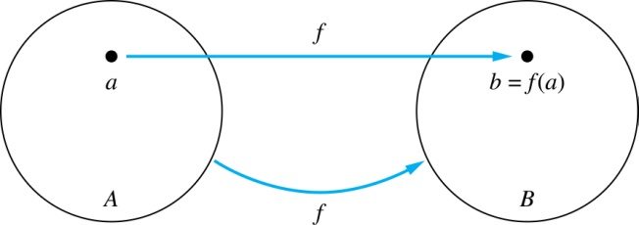
Functions
Given a function f: A → B:
We say f maps A to B or
f is a mapping from A to B.
A is called the domain of f.
B is called the codomain of f.
If f(a) = b,
then b is called the image of a under f.
a is called the preimage of b.
The range of f is the set of all images of points in A under f. We denote it by f(A).

Slide 4
Example:
Let:
A = {a,b,c}, B = {1,2}
Define function f : A→B as:
f (a) = 1
f (b) = 2
f (c) = 1
Here:
1 is the image of a
a is a preimage of 1

Slide 5
Questions
z
A
B
f(a) = ?
The image of d is ?
z
a
x
The domain of f is ?
A
b
y
The codomain of f is ?
B
c
d
z
The preimage of y is ?
b
f(A) = ?
{y,z}
The preimage(s) of z is (are) ?
{a,c,d}

Slide 6
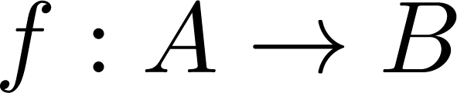
Question on Functions
If then
A
B
f {a,b,c,} is ?
{y,z}
a
x
f {c,d} is ?
b
{z}
y
c
d
z

Slide 7
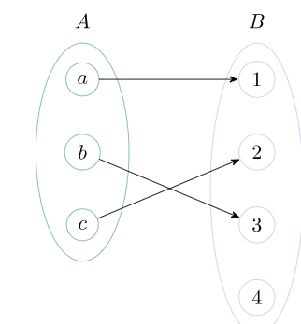
Injective Function
An injective (one-to-one) function is a function where each input has a unique output, so no two different inputs produce the same output.
Each input maps to a unique output.
Some elements of the codomain may not be mapped to at all.

Slide 8
Injective Function - Example
Example 1:
F : {1,2,3,4} → {2,4,6,8,10}
Solution:
f (1) = 2 f (2) = 4 f (3) = 6 f (4) = 8

Slide 9
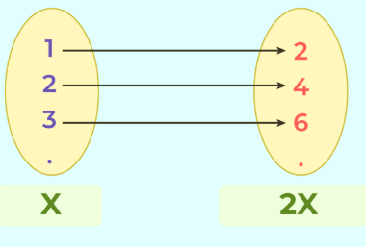
Injective Function - Example
Example 2: Let's take a function, f(x) = 2x. Is this function injective?
Solution: Yes, f(x) = 2x is indeed an injective function. For every distinct input, you will always get a distinct output.

Slide 10
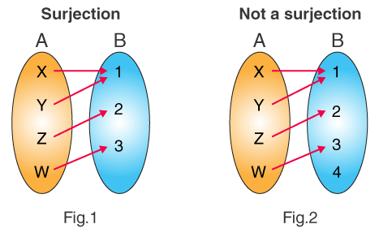
Surjective Function
A surjective (onto) function is a function where every element of the codomain is mapped to by at least one element of the domain—in other words, no element in the codomain is left unused.
Key point:
Multiple domain elements can map to the same codomain element.
The only requirement is that every codomain element has at least one assignment.

Slide 11
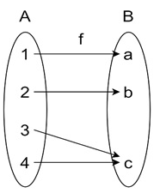
Surjective - Example
Example : Let us consider the function f : {1, 2, 3} → {a, b, c} defined by: f(1) = a, f(2) = b, f(3) = c
Solution:
Here, every element in the codomain {a, b, c} has been "hit" by some element from the domain {1, 2, 3}. This means f is a surjective function because there are no elements left out in the codomain.
The following mapping presents another example

Slide 12
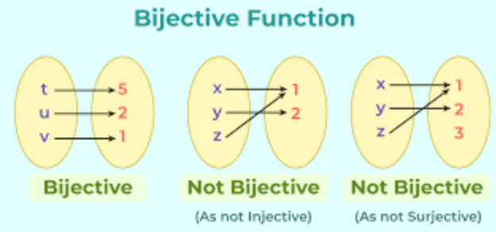
Bijective Functions
A bijective function is a function that is both injective (one-to-one) and surjective (onto). This means each element of the domain maps to a unique element of the codomain, and every element of the codomain is used exactly once.
No repeated outputs (injective)
No unused codomain elements (surjective)

Slide 13
Bijective - Example
Example 2: Matching Students and ID Numbers?
Suppose you have a set of students (Set A) and a set of student ID numbers (Set B). You want to create a bijective function to pair each student with a unique student ID number.
Set A (Students): {Alice, Bob, Carol, David} Set B (Student ID Numbers): {101, 102, 103, 104}
Solution:
You can define a bijective function f as follows:
f(Alice) = 101 f(Bob) = 102 f(Carol) = 103 f(David) = 104
In this example, each student in Set A is matched with a distinct student ID number in Set B, ensuring that no two students share the same ID number (injectivity). Also, every student ID number in Set B has a corresponding student in Set A, so no ID numbers are left unassigned (surjectivity).

Slide 14
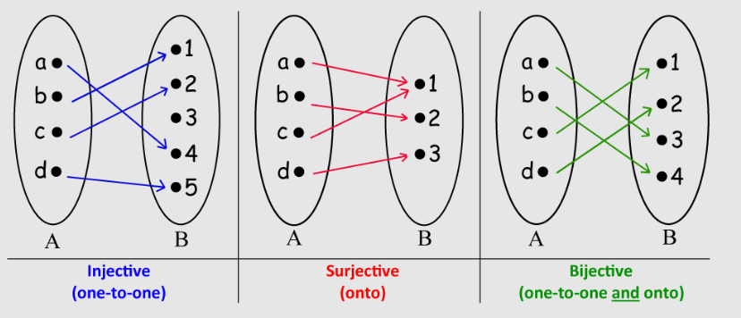

Slide 15
Sequences and Summations

Slide 16
Sequences
Sequences are ordered lists of elements.
1, 2, 3, 5, 8
1, 3, 9, 27, 81, …….
A sequence is a function whose domain is a subset of the integers, usually{0,1,2,3,…}or {1,2,3,..} and whose codomain is a set 𝑆.
The notation 𝑎𝑛 represents the value of the sequence at position 𝑛.
It is the same as writing 𝑓(𝑛), where 𝑓 is the function defining the sequence.
Each value 𝑎𝑛 is called a term of the sequence.

Slide 17
EXAMPLE
Let the Function be:
an=n^2
Then:
a1= 1^2 = 1
a2= 2^2= 4
a3=3^2 = 9
a4=4^2 = 16
So the sequence is:
1,4,9,16,…

Slide 18
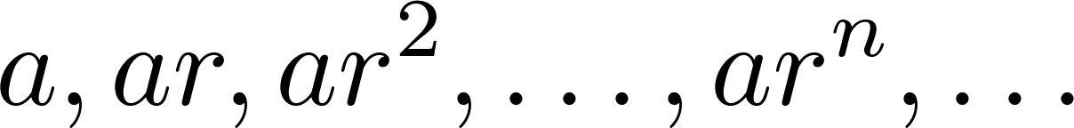
Geometric Progression
Definition: A geometric progression is a sequence of the form:
where the initial term a and the common ratio r are real numbers.
Real numbers Include:
Positive numbers (e.g., 2, 5, 3.7)
Negative numbers (e.g., −1,−4,−0.5)
Zero (0)
Whole numbers and fractions (1/2,−3/4​)
Irrational numbers (like √2,𝜋)

Slide 19
Geometric Progression
Examples:
Let a = 1 and r = −1. Then:
Let a = 2 and r = 5. Then:
Let a = 6 and r = 1/3. Then:

Slide 20
Arithmetic Progression
Definition: A arithmetic progression is a sequence of the form:
where the initial term a and the common difference d are real numbers.
Examples:
Let a = −1 and d = 4:
Let a = 7 and d = −3:
Let a = 1 and d = 2:

Slide 21
Strings
A string is a finite ordered sequence of characters taken from a fixed set called an alphabet.
Example strings: abcde, hello
The length of a string is the number of characters in it (e.g., abcde has length 5)
The empty string, written as λ, has no characters and length 0

Slide 22
Strings
A sequence is any ordered list of elements; a string is a sequence specifically made of characters or symbols.
Sequence: 2, 4, 6, 8 (numbers)
String: h, e, l, l, o → "hello"
Why strings matter in computer science?
Words, passwords, and text are strings
Programs work with strings all the time

Slide 23
Fibonacci Sequence
Definition: Fibonacci sequence, f₀ ,f₁ ,f₂,…, by:
Initial Conditions: f₀ = 0, f₁ = 1
Recurrence Relation: f_{n} = f_{n-1} + f_{n-2}
Example: Find f₂ ,f₃ ,f₄ , f₅ and f₆ .
Answer:
f₂ = f₁ + f₀ = 1 + 0 = 1,
f₃ = f₂ + f₁ = 1 + 1 = 2,
f₄ = f₃ + f₂ = 2 + 1 = 3,
f₅ = f₄ + f₃ = 3 + 2 = 5,
f₆ = f₅ + f₄ = 5 + 3 = 8.

Slide 24
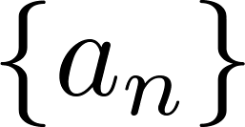
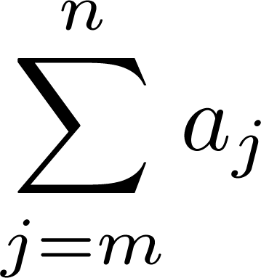
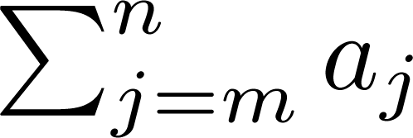
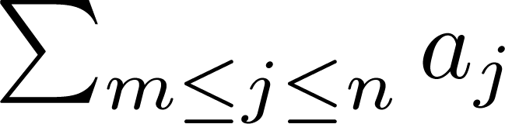
Summations
Sum of the terms
from the sequence
The notation:
(read as the sum from j = m to j = n of aj)
represents
The variable j is called the index of summation. It runs through all the integers starting with its lower limit m and ending with its upper limit n.

Slide 25


Summation EXAMPLE
Evaluate the summation:
Step 1: Write out the terms
This summation means: 1+2+3+4+5
Step 2: Add the terms
1+2=3
3+3=6
6+4=10
10+5=15
Final Answer

Slide 26
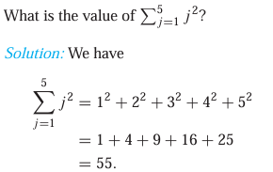
Summation EXAMPLE

Slide 27
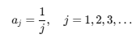
Summation EXAMPLE
Use summation notation to express the sum of the first 100 terms of the sequence {aj},
The sequence is:

Slide 28


Summations
SOLUTION:
First 100 terms means:
Start at j=1
End at j=100
So the terms are:

Slide 29
Product Notation
Product notation is used when we want to multiply many terms together, just like summation is used to add terms.
Summation ( Σ ) → addition
Product ( Π ) → multiplication/ say capital pi

Slide 30
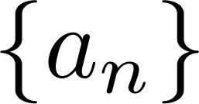
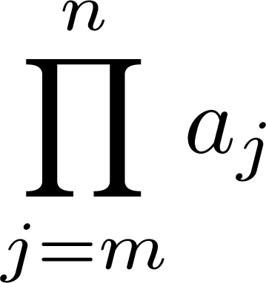
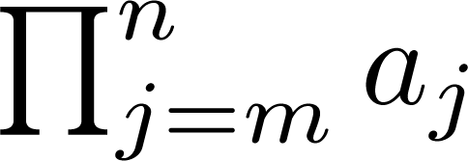
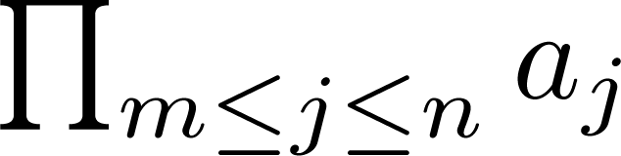
Product Notation
Product of the terms
from the sequence
The notation:
represents

Slide 31


Product Notation
Evaluate :
Step 1: Write out the terms
1×2×3×4
Step 2: Multiply
1×2=2
2×3=6
6×4=24
Final Answer

Slide 32
Recurrence Relations
A recurrence relation is a formula that defines each term of a sequence using previous terms.
Definition: A recurrence relation for the sequence {a_{n}} is an equation that expresses a_{n} in terms of one or more of the previous terms of the sequence, namely, a₀, a₁, …, a_{n-1}, for all integers n with n ≥ n₀, where n₀ is a nonnegative integer.
The initial conditions for a sequence specify the terms that precede the first term where the recurrence relation takes effect.

Slide 33
Recurrence Relations
Why n cannot be negative?
To calculate a2​, you need a1​ and a0 → OK
To calculate a1 you need a0 → OK
But if you tried a−1​, you would need a−2​ → doesn’t exist
So the sequence starts at a nonnegative index because you need actual previous terms to use the formula.

Slide 34
EXAMPLE: Recurrence Relations
Example 1: Let {a_{n}} be a sequence that satisfies the recurrence relation a_{n} = a_{n-1} + 3 for n = 1,2,3,4,…. and suppose that a₀ = 2. What are a₁ , a₂ and a₃?
[Here a₀ = 2 is the initial condition.]
Solution: We see from the recurrence relation that
a₁ = a₀ + 3 = 2 + 3 = 5
a₂ = 5 + 3 = 8
a₃ = 8 + 3 = 11

Slide 35
EXAMPLE 2: Recurrence Relations
Example 2: Let {a_{n}} be a sequence that satisfies the recurrence relation a_{n} = a_{n-1} – a_{n-2} for n = 2,3,4,…. and suppose that a₀ = 3 and a₁ = 5. What are a₂ and a₃?
[Here the initial conditions are a₀ = 3 and a₁ = 5. ]
Solution: We see from the recurrence relation that
a₂ = a₁ - a₀ = 5 – 3 = 2
a₃ = a₂ – a₁ = 2 – 5 = –3

Slide 36
Solving Recurrence Relations
Finding a formula for the nth term of the sequence generated by a recurrence relation is called solving the recurrence relation.
Such a formula is called a closed formula.
Various methods for solving recurrence relations will be covered in Chapter 8 where recurrence relations will be studied in greater depth.
Here we illustrate by example the method of iteration in which we need to guess the formula. The guess can be proved correct by the method of induction (Chapter 5).

Slide 37
Iterative Solution Example
Method 1: Working upward, forward substitution
Let {a_{n}} be a sequence that satisfies the recurrence relation a_{n} = a_{n-1} + 3 for n = 2,3,4,…. and suppose that a₁ = 2.
a₂ = 2 + 3
a₃ = (2 + 3) + 3 = 2 + 3 ∙ 2
a₄ = (2 + 2 ∙ 3) + 3 = 2 + 3 ∙ 3
.
.
.
a_{n} = a_{n-1} + 3 = (2 + 3 ∙ (n – 2)) + 3 = 2 + 3(n – 1)

Slide 38
Iterative Solution Example
Method 2: Working downward, backward substitution
Let {a_{n}} be a sequence that satisfies the recurrence relation a_{n} = a_{n-1} + 3 for n = 2,3,4,…. and suppose that a₁ = 2.
a_{n} = a_{n-1} + 3
= (a_{n-2} + 3) + 3 = a_{n-2} + 3 ∙ 2
= (a_{n-3} + 3 )+ 3 ∙ 2 = a_{n-3} + 3 ∙ 3
.
.
.
= a₂ + 3(n – 2) = (a₁ + 3) + 3(n – 2) = 2 + 3(n – 1)

Slide 39
Financial Application
Example: Suppose that a person deposits $10,000.00 in a savings account at a bank yielding 11% per year with interest compounded annually. How much will be in the account after 30 years?
Let P_{n} denote the amount in the account after 30 years. P_{n} satisfies the following recurrence relation:
P_{n} = P_{n-1} + 0.11P_{n-1} = (1.11) P_{n-1}
with the initial condition P₀ = 10,000
Continued on next slide →

Slide 40
Financial Application
P_{n} = P_{n-1} + 0.11P_{n-1} = (1.11) P_{n-1}
with the initial condition P₀ = 10,000
Solution: Forward Substitution
P₁ = (1.11)P₀
P₂ = (1.11)P₁ = (1.11)²P₀
P₃ = (1.11)P₂ = (1.11)³P₀
:
P_{n} = (1.11)P_{n-1} = (1.11)^{n}P₀ = (1.11)^{n} 10,000
P_{n} = (1.11)^{n} 10,000 (Can prove by induction, covered in Chapter 5)
P₃₀ = (1.11)³⁰ 10,000 = $228,992.97

