Slide 1
Set Operations

Slide 2

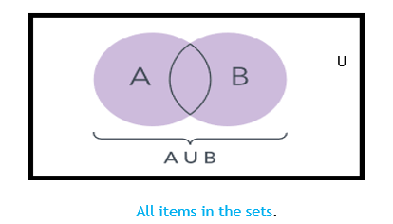
Union
Definition: Let A and B be sets. The union of the sets A and B, denoted by A ∪ B, is the set:
Example: What is {1,2,3} ∪ {3, 4, 5}?
Solution: {1,2,3,4,5}

Slide 3
UNION REMARK:
A ∪ B = B ∪ A that is union is commutative you can prove this very easily only by using definition.
A ⊆ A ∪ B and B ⊆ A ∪ B
The above remark of subset is easily seen by the definition of union.

Slide 4

Intersection
Definition: The intersection of sets A and B, denoted by A ∩ B, is
Note if the intersection is empty, then A and B are said to be disjoint.
Example: What is? {1,2,3} ∩ {3,4,5} ?
Solution: {3}
Example:What is?
{1,2,3} ∩ {4,5,6} ?
Solution: ∅
Venn Diagram for A ∩B
U
A
B

Slide 5
INTERSECTION REMARKS:
A ∩ B = B ∩ A
A ∩ B ⊆ A and A ∩ B ⊆ B
If A ∩ B = φ, then A & B are called disjoint sets.

Slide 6
Complement
Definition: If A is a set, then the complement of the A (with respect to U), denoted by Ā is the set U - A
Ā = {x ∈ U | x ∉ A}
(The complement of A is sometimes denoted by A^{c} .)
Example: If U is the positive integers less than 100, what is the complement of {x | x > 70}
Solution: {x | x ≤ 70}
Example 2:
U = {a, b, c, d, e, f, g],
A = {a, c, e, g}
Then A^{c} = {b, d, f}
Venn Diagram for Complement
U
Ā
A

Slide 7
COMPLEMENT REMARKS:
A^{c} = U – A
A ∩ A^{c} = φ
A ∪ A^{c} = U

Slide 8
Difference
Definition: Let A and B be sets. The difference of A and B, denoted by A – B, is the set containing the elements of A that are not in B. The difference of A and B is also called the complement of B with respect to A.
A – B = {x | x ∈ A ∧ x ∉ B} = A ∩‾B
Venn Diagram for A − B
EXAMPLE:
U = {a, b, c, d, e, f, g}
A = {a, c, e, g},
B = {d, e, f, g}
Then , A – B = {a, c}
U
A
B

Slide 9
DIFFERENCE REMARKS
A – B ≠ B – A that is set difference is not commutative.
A – B ⊆ A

Slide 10
Review Questions
Example: U = {0,1,2,3,4,5,6,7,8,9,10} A = {1,2,3,4,5}, B ={4,5,6,7,8}
A ∪ B
Solution: {1,2,3,4,5,6,7,8}
A ∩ B
Solution: {4,5}
Ā
Solution: {0,6,7,8,9,10}
Solution: {0,1,2,3,9,10}
A – B
Solution: {1,2,3}
B – A
Solution: {6,7,8}

Slide 11


Symmetric Difference (optional)
Definition: The symmetric difference of A and B, denoted by is the set
Example:
U = {0,1,2,3,4,5,6,7,8,9,10}
A = {1,2,3,4,5} B ={4,5,6,7,8}
What is :
Solution: {1,2,3,6,7,8}
U
A
B
Venn Diagram

Slide 12
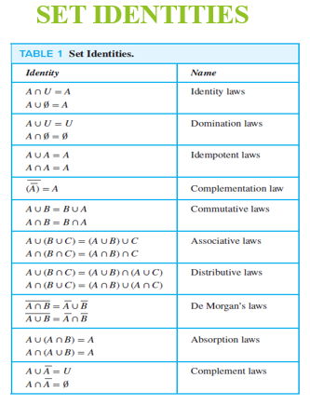

Slide 13
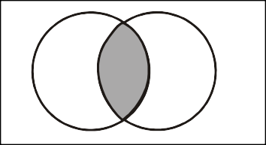
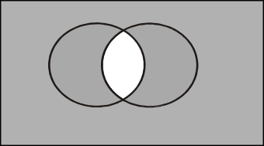
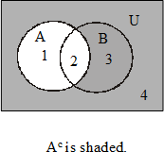
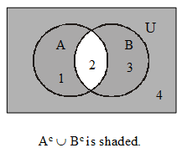
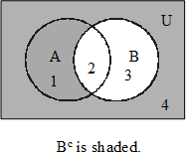
Proof De Morgan Law
Let A = {1,2} , B = {2,3} and U = {1,2,3,4}
Prove the following using Venn Diagrams:
(A ∩ B)^{c} = A^{c} ∪ B ^{c}
SOLUTION(Proof using Venn Diagram):
Taking the L.H.S
(a)
A 1
U
(b)
_{A} B
1 2 3
U
B 3
2
4
4
A ∩ B
Now taking the R.H.S
(A ∩ B)^{c}
L.H.S = R.H.S , Hence Proved

Slide 14

TASK A
A.
Let U = {1, 2, 3, …, 10},
Y = {y | y = 2 x, x ∈X},
X = {1, 2, 3, 4, 5}
Z = {z | z² – 9 z + 14 = 0}
Enumerate:
(1)X ∩ Y
(4)Y^{c}
(2) Y ∪ Z
(5) X^{c} – Z^{c}
(3) X – Z
(6) (X – Z) ^{c}

Slide 15
SOLUTION A
U = {1, 2, 3, …, 10},
X = {1, 2, 3, 4, 5}
Y = {y | y = 2 x, x ∈X} = {2, 4, 6, 8, 10}
Z = {z | z² – 9 z + 14 = 0} = {2, 7}
(1) | X ∩ Y = {1, 2, 3, 4, 5} ∩ {2, 4, 6, 8, 10} = {2, 4}
(2) | Y ∪ Z = {2, 4, 6, 8, 10} ∪ {2, 7}
 | = {2, 4, 6, 7, 8, 10}
(3) | X – Z = {1, 2, 3, 4, 5} – {2, 7}
(4) | = {1, 3, 4, 5} Y^{c} = U – Y = {1, 2, 3, …, 10} – {2, 4, 6, 8, 10}
(5) | = {1, 3, 5, 7, 9 X^{c} – Z^{c} = {6, 7, 8, 9, 10} – {1, 3, 4, 5, 6, 8, 9, 10}
(6) | = {7} (X – Z)^{c} = U – (X – Z)
 | = {1, 2, 3, …, 10} – {1, 3, 4, 5}
 | = {2, 6, 7, 8, 9, 10}
NOTE
(X – Z)^{c} ≠ X^{c} – Z^{c}

Slide 16
TASK B
2. Given the following universal set U and its two subsets P and Q,
where
U = {x | x ∈ Z, 0 ≤ x ≤ 10}
P = {x | x is a prime number}
Q = {x | x² < 70}
Draw a Venn diagram for the above and List the elements in P^{c} ∩ Q.

Slide 17
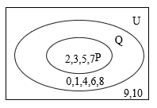
SOLUTION B
First we write the sets in Tabular form.
U = {x | x ∈Z, 0 ≤ x ≤ 10}
Since it is the set of integers that are greater then or equal 0 and less or equal to
10. So we have
U= {0, 1, 2, 3, …, 10}
P = {x | x is a prime number}
It is the set of prime numbers between 0 and 10. Remember Prime numbers are those numbers which have only two distinct divisors.
P = {2, 3, 5, 7}
Q = {x | x² < 70}
The set Q contains the elements between 0 and 10 which has their square less or equal to 70.
Q= {0, 1, 2, 3, 4, 5, 6, 7, 8}
Thus we write the sets in Tabular form.
VENN DIAGRAM:

Slide 18
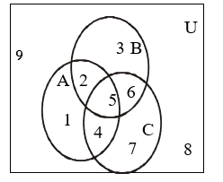
TASK C
▶ Use a Venn diagram to represent the following:
(A ∩ B) ∩ C^{c}
A^{c} ∪ (B ∪ C)
(A – B) ∩ C
(A ∩ B^{c}) ∪ C^{c}

Slide 19
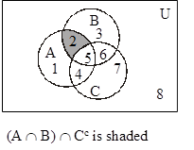
SOLUTION C
i.
(A ∩ B) ∩ C^{c}
Let us first construct the sets from the given venn diagram.
A = { 1,2,4,5} B = {2,3,5,6} C = {4,5,6,7} U = {1,2,3,4,5,6,7,8,9}
NOW,
A ∩ B = {2,5} and C^{c} = U- C = {1,2,8,9}
SO,
(A ∩ B) ∩ C^{c} = {2,5} ∩ {1,2,8,9} = {2}
9

