Slide 1
Relations
Chapter 9
Copyright © McGraw-Hill Education. All rights reserved. No reproduction or distribution without the prior written consent of McGraw-Hill Education.

Slide 2
Chapter Summary
Relations and Their Properties
n-ary Relations and Their Applications (not currently included in overheads)
Representing Relations
Closures of Relations (not currently included in overheads)
Equivalence Relations
Partial Orderings

Slide 3
Relations and Their Properties
Section 9.1

Slide 4
Section Summary
Relations and Functions
Properties of Relations
Reflexive Relations
Symmetric and Antisymmetric Relations
Transitive Relations
Combining Relations

Slide 5
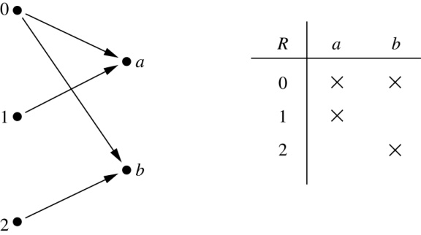
Binary Relations
Definition: A binary relation R from a set A to a set B is a subset R ⊆ A × B.
Example:
Let A = {0,1,2} and B = {a,b}
{(0, a), (0, b), (1,a) , (2, b)} is a relation from A to B.
We can represent relations from a set A to a set B graphically or using a table:
Relations are more general than functions. A function is a relation where exactly one element of B is related to each element of A.

Slide 6
Binary Relation on a Set
Definition: A binary relation R on a set A is a subset of A × A or a relation from A to A.
Example:
Suppose that A = {a,b,c}. Then R = {(a,a),(a,b), (a,c)} is a relation on A.
Let A = {1, 2, 3, 4}. The ordered pairs in the relation R = {(a,b) | a divides b} are
(1,1), (1, 2), (1,3), (1, 4), (2, 2), (2, 4), (3, 3), and (4, 4).

Slide 7
Binary Relation on a Set (cont.)
Question: How many relations are there on a set A?
Solution: Because a relation on A is the same thing as a subset of A ⨉ A, we count the subsets of A × A. Since A × A has n² elements when A has n elements, and a set with m elements has 2^{m} subsets, there are subsets of A × A. Therefore, there are relations on a set A.

Slide 8
Binary Relations on a Set (cont.)
Example: Consider these relations on the set of integers:
R₁ = {(a,b) | a ≤ b}, R₄ = {(a,b) | a = b},
First number is less than or equal to second Numbers are exactly the same
R₂ = {(a,b) | a > b}, R₅ = {(a,b) | a = b + 1},
First number is greater than second First number is one more than second
R₃ = {(a,b) | a = b or a = −b}, R₆ = {(a,b) | a + b ≤ 3}.
Numbers are same or opposites Sum of two numbers is 3 or less
Which of these relations contain each of the pairs
(1,1), (1, 2), (2, 1), (1, −1), and (2, 2)?
Solution: Checking the conditions that define each relation, we see that the pair (1,1) is in R₁, R₃, R₄ , and R₆: (1,2) is in R₁ and R₆: (2,1) is in R₂, R₅, and R₆: (1, −1) is in R₂, R₃, and R₆ : (2,2) is in R₁, R₃, and R₄.
Note that these relations are on an infinite set and each of these relations is an infinite set.

Slide 9
Reflexive Relations
Definition: A relation R on a set A is called reflexive if every element is related to itself.
R is reflexive if (a,a) ∊ R for every element a ∊ A. Written symbolically, R is reflexive if and only if
∀x[x∊U ⟶ (x,x) ∊ R]
“For every x in the set, the pair (x, x) must be in the relation.”
Example: The following relations on the integers are reflexive:
R₁ = {(a,b) | a ≤ b},
R₃ = {(a,b) | a = b or a = −b},
R₄ = {(a,b) | a = b}.
The following relations are not reflexive:
R₂ = {(a,b) | a > b} (note that 3 ≯ 3),
R₅ = {(a,b) | a = b + 1} (note that 3 ≠3 + 1),
R₆ = {(a,b) | a + b ≤ 3} (note that 4 + 4 ≰ 3).
If the set is: A={1,2,3}
Then for R to be reflexive, it must contain:
(1,1),(2,2),(3,3)
If even one of these is missing → ❌ not reflexive
If A = ∅ then the empty relation is reflexive vacuously. That is the empty relation on an empty set is reflexive!

Slide 10
Symmetric Relations
Definition: Whenever (a, b) is in the relation, (b, a) is also in the relation.
R is symmetric if (b,a) ∊ R whenever (a,b) ∊ R for all a,b ∊ A. Written symbolically, R is symmetric if and only if
∀x∀y [(x,y) ∊R ⟶ (y,x) ∊ R]
“For every pair in R, the reverse pair must also be in R.”
Example: The following relations on the integers are symmetric:
R₃ = {(a,b) | a = b or a = −b},
R₄ = {(a,b) | a = b},
R₆ = {(a,b) | a + b ≤ 3}.
The following are not symmetric:
R₁ = {(a,b) | a ≤ b} (note that 3 ≤ 4, but 4 ≰ 3),
R₂ = {(a,b) | a > b} (note that 4 > 3, but 3 ≯ 4),
R₅ = {(a,b) | a = b + 1} (note that 4 = 3 + 1, but 3 ≠4 + 1).

Slide 11
Antisymmetric Relations
Definition: The only time both (a, b) and (b, a) are in R is when a = b
A relation R on a set A such that for all a,b ∊ A if (a,b) ∊ R and (b,a) ∊ R, then a = b is called antisymmetric. Written symbolically, R is antisymmetric if and only if
∀x∀y [(x,y) ∊R ∧ (y,x) ∊ R ⟶ x = y]
“If a relates to b and b relates to a, then they must be the same element.”
Example: The following relations on the integers are antisymmetric:
R₁ = {(a,b) | a ≤ b},
R₂ = {(a,b) | a > b},
R₄ = {(a,b) | a = b},
R₅ = {(a,b) | a = b + 1}.
The following relations are not antisymmetric:
R₃ = {(a,b) | a = b or a = −b}
(note that both (1,−1) and (−1,1) belong to R₃),
R₆ = {(a,b) | a + b ≤ 3} (note that both (1,2) and (2,1) belong to R₆).
For any integer, if a a ≤ b and a ≤ b , then a = b.

Slide 12
Transitive Relations
Definition:
a is related to b and b is related to c then a must be related to c
A relation R on a set A is called transitive if whenever (a,b) ∊ R and (b,c) ∊ R, then (a,c) ∊ R, for all a,b,c ∊ A. Written symbolically, R is transitive if and only if
∀x∀y ∀z[(x,y) ∊R ∧ (y,z) ∊ R ⟶ (x,z) ∊ R ]
“Every two-step connection must also have a direct connection.”
Example: The following relations on the integers are transitive:
R₁ = {(a,b) | a ≤ b},
R₂ = {(a,b) | a > b},
R₃ = {(a,b) | a = b or a = −b},
R₄ = {(a,b) | a = b}.
The following are not transitive:
R₅ = {(a,b) | a = b + 1} (note that both (3,2) and (4,3) belong to R₅, but not (3,3)),
R₆ = {(a,b) | a + b ≤ 3} (note that both (2,1) and (1,2) belong to R₆, but not (2,2)).
For every integer, a ≤ b
and b ≤ c, then b ≤ c.

Slide 13
Combining Relations
Given two relations R₁ and R₂, we can combine them using basic set operations to form new relations such as R₁ ∪ R₂, R₁ ∩ R₂, R₁ − R₂, and R₂ − R₁.
Example: Let A = {1,2,3} and B = {1,2,3,4}. The relations R₁ = {(1,1),(2,2),(3,3)} and R₂ = {(1,1),(1,2),(1,3),(1,4)} can be combined using basic set operations to form new relations:
Take all pairs that are in R1 OR in R2
R₁ ∪ R₂ ={(1,1),(1,2),(1,3),(1,4),(2,2),(3,3)}
Take only pairs that are in BOTH R1 AND R2 R₁ ∩ R₂ ={(1,1)}
Take pairs that are in R1 but NOT in R2 R₁ − R₂ ={(2,2),(3,3)}
Take pairs that are in R2 but NOT in R1 R₂ − R₁ ={(1,2),(1,3),(1,4)}

Slide 14
Composition
Definition: Connect two relations by matching the middle element.
Suppose
R₁ is a relation from a set A to a set B.
R₂ is a relation from B to a set C.
Then the composition (or composite) of R₂ with R₁, is a relation from A to C where
if (x,y) is a member of R₁ and (y,z) is a member of R₂, then (x,z) is a member of R₂∘ R₁.

Slide 15
Representing the Composition of a Relation
R₁
R₂
w
m
a
x
n
b
y
o
c
p
z
R₁∘ R₂ = {(b,D),(b,B)}

Slide 16
Powers of a Relation
Definition: Powers of a relation mean applying the same relation again and again.
Let R be a binary relation on A. Then the powers R^{n} of the relation R can be defined inductively by:
Basis Step: R¹ = R (The first power is just the relation itself)
Inductive Step: R^{n+1} = R^{n} ∘ R (To get the next power:
Take the previous power
Compose it with R
This adds one more step)
(see the slides for Section 9.3 for further insights)
The powers of a transitive relation are subsets of the
relation. This is established by the following theorem:
Theorem 1: The relation R on a set A is transitive iff R^{n} ⊆ R for n = 1,2,3 ….
(see the text for a proof via mathematical induction)

Slide 17
Representing Relations
Section 9.3

Slide 18
Section Summary
Representing Relations using Matrices
Representing Relations using Digraphs

Slide 19
Representing Relations Using Matrices
A relation between finite sets can be represented using a zero-one matrix.
Step 1: Two Sets
Suppose we have:
A = {a₁, a₂, a₃} B = {b₁, b₂}
A relation R tells us which elements of A are related to elements of B.
Example: If (a₁, b₂) is in R, it means a₁ is related to b₂.
Step 2: Make a Table (Matrix)
We create a table like this:
Rows = elements of set A
Columns = elements of set B
Inside the table, we write:
1 → if aᵢ is related to bⱼ
0 → if aᵢ is NOT related to bⱼ

Slide 20
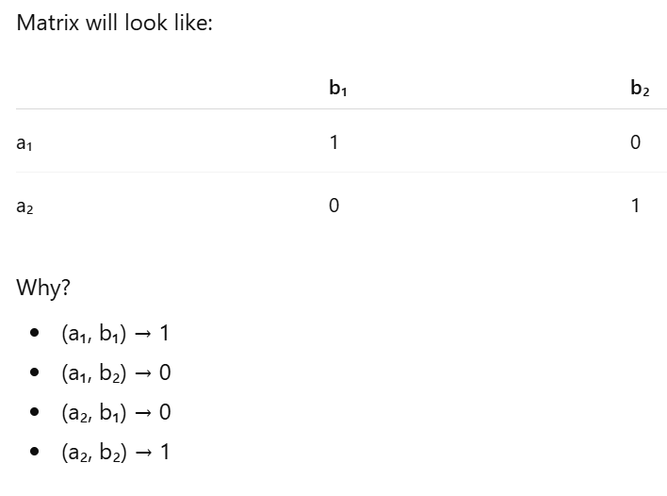
Representing Relations Using Matrices
Example
Let:
A = {a₁, a₂} B = {b₁, b₂}
Suppose relation R = {(a₁, b₁), (a₂, b₂)}
Matrix will look like:
Why?
(a₁, b₁) → 1
(a₁, b₂) → 0
(a₂, b₁) → 0
(a₂, b₂) → 1

Slide 21
Examples of Representing Relations Using Matrices
Example 2: Suppose that A = {1,2,3} and B = {1,2}. Let R be the relation from A to B containing (a,b) if a ∈ A, b ∈ B, and a > b. What is the matrix representing R (assuming the ordering of elements is the same as the increasing numerical order)?
Solution:
Step 1: Find all pairs where a > b
Check each value of A with each value of B.
For a = 1
(1,1) → 1 > 1 ❌
(1,2) → 1 > 2 ❌
For a = 2
(2,1) → 2 > 1 ✔
(2,2) → 2 > 2 ❌
For a = 3
(3,1) → 3 > 1 ✔
(3,2) → 3 > 2 ✔
So the relation is:
R = {(2,1), (3,1), (3,2)}

Slide 22
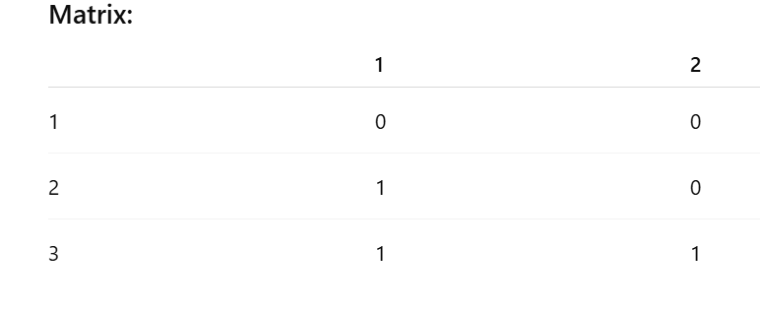
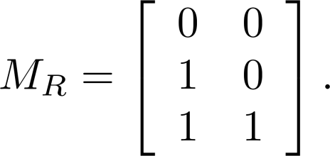
Examples of Representing Relations Using Matrices
Step 2: Make the Matrix
Rows = A = {1, 2, 3} Columns = B = {1, 2}
Put:
1 → if pair exists
0 → if pair does not exist
Final Answer:

Slide 23
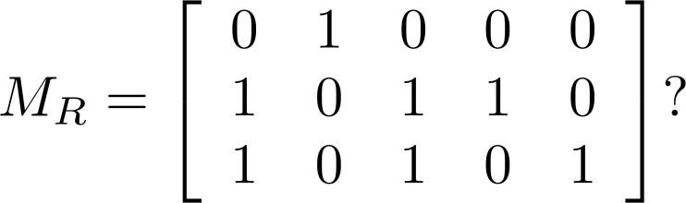
Examples of Representing Relations Using Matrices (cont.)
Example 3: Let A = {a₁,a₂, a₃} and B = {b₁,b₂, b₃,b₄, b₅}. Which ordered pairs are in the relation R represented by the matrix
Solution: Because R consists of those ordered pairs (a_{i},b_{j}) with m_{ij} = 1, it follows that:
R = {(a₁, b₂), (a₂, b₁),(a₂, b₃), (a₂, b₄),(a₃, b₁), {(a₃, b₃), (a₃, b₅)}.

Slide 24
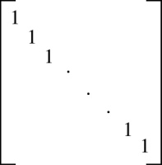
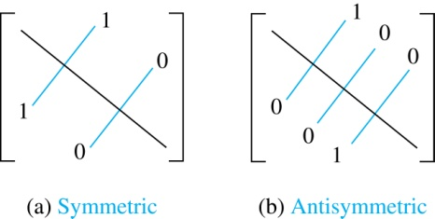
Matrices of Relations on Sets
If R is a reflexive relation, all the elements on the main diagonal of M_{R} are equal to 1.
R is a symmetric relation, if and only if m_{ij} = 1 whenever m_{ji} = 1. R is an antisymmetric relation, if and only if m_{ij} = 0 or m_{ji} = 0 when i≠ j.

Slide 25
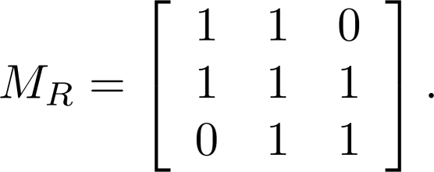
Example of a Relation on a Set
Example 3: Suppose that the relation R on a set is represented by the matrix
Is R reflexive, symmetric, and/or antisymmetric?
Solution: This matrix tells us which elements are related to each other.
1 means related
0 means not related
1. Is R Reflexive?
Rule: A relation is reflexive if all diagonal elements are 1.
Diagonal elements are:
First row, first column → 1
Second row, second column → 1
Third row, third column → 1
All are 1 ✔
So, R is reflexive.

Slide 26
Example of a Relation on a Set
3. Is R Antisymmetric?
Rule: A relation is antisymmetric if:
For different elements (i ≠ j), both mᵢⱼ and mⱼᵢ cannot be 1 at the same time.
But here:
m₁₂ = 1
m₂₁ = 1
Both are 1 and 1 ≠ 2 ❌
So this breaks the antisymmetric rule.
Therefore, R is NOT antisymmetric.
2. Is R Symmetric?
Rule: A relation is symmetric if:
If (i, j) = 1 then (j, i) must also be 1.
Check examples:
m₁₂ = 1 and m₂₁ = 1 ✔
m₂₃ = 1 and m₃₂ = 1 ✔
m₁₃ = 0 and m₃₁ = 0 ✔
The matrix looks the same on both sides of the diagonal (mirror image).
So, R is symmetric ✔

Slide 27
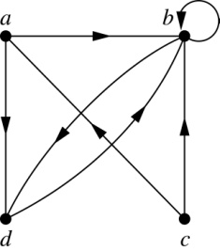
Representing Relations Using Digraphs
Definition: A directed graph is:
A set of points → called vertices (or nodes)
A set of arrows between points → called edges (or arcs)
The arrows have direction, That’s why the edges are written as ordered pairs like: (a,b)
This means the arrow starts from a
The arrow goes to b
Example 7: A drawing of the directed graph with vertices a, b, c, and d, and edges (a, b), (a, d), (b, b), (b, d), (c, a), (c, b), and (d, b) is shown here.
What is a Loop?
If an edge starts and ends at the same vertex, like: (a,a) It means the arrow goes from a vertex back to itself.
Edges:
(a, b) → arrow from a to b
(a, d) → arrow from a to d
(b, b) → loop at b
(b, d) → arrow from b to d
(c, a) → arrow from c to a
(c, b) → arrow from c to b
(d, b) → arrow from d to b

Slide 28
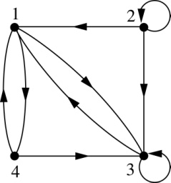
Examples of Digraphs Representing Relations
Example 8: What are the ordered pairs in the relation
represented by this directed graph?
Solution: The ordered pairs in the relation are
(1, 3), (1, 4), (2, 1), (2, 2), (2, 3), (3, 1), (3, 3), (4, 1), and (4, 3)

Slide 29
Determining which Properties a Relation has from its Digraph
1. Reflexive: Every vertex must have a loop.
That means:
For every element x
The pair (x, x) must exist
In the graph: Every vertex must have a small circle (loop) on itself.
If even one vertex does not have a loop, Then it is NOT reflexive.
2. Symmetric
If there is an arrow from x to y, there must also be an arrow from y to x.
So If (x, y) exists, then (y, x) must also exist.
In the graph: Every arrow must have a matching arrow going back.
Example: x → y y → x
If one direction is missing, Then it is NOT symmetric.
3. Antisymmetric
If x → y exists (and x ≠ y), then y → x must NOT exist.
So you cannot have arrows both ways
between two different vertices.
If you see: x → y and y → x
and x ≠ y, then it is NOT antisymmetric.
4. Transitive: This means:
If you can go from x → y and from y → z then you must also be able to go from x → z.
So if: x → y y → z
Then (x → z) must also be present.
If that direct arrow is missing Then it is NOT transitive.

Slide 30
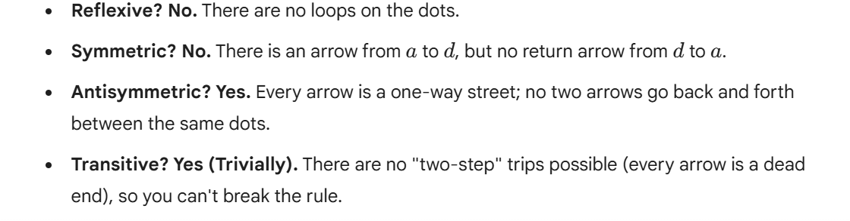
Determining which Properties a Relation has from its Digraph – Example 1
a
b
c
d

Slide 31
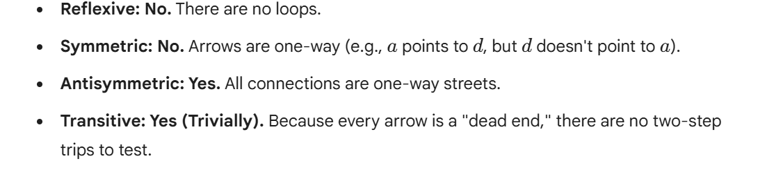
Determining which Properties a Relation has from its Digraph – Example 2
a
b
c
d

Slide 32
$a \to c$ would need a matching $c \to a$
Determining which Properties a Relation has from its Digraph – Example 3
a
b
c
d
Reflexive? No, there are no loops
Symmetric? No,
Antisymmetric? Yes, whenever there is an edge from one
vertex to another, there is not one going back
Transitive? Yes,

Slide 33
Determining which Properties a Relation has from its Digraph – Example 4
b
a
c
d
Reflexive? No, there are no loops
Symmetric? No, for example, there is no edge from d to a
Antisymmetric? Yes, whenever there is an edge from one vertex
to another, there is not one going back
Transitive? Yes (trivially), there are no two edges where the first
edge ends at the vertex where the second edge begins

Slide 34
Example of the Powers of a Relation
b
a
b
a
d
c
d
c
R
R²
a
b
a
b
d
c
d
c
R⁴
R³
The pair (x,y) is in R^{n} if there is a path of length n from x to y in R
(following the direction of the arrows).

Slide 35
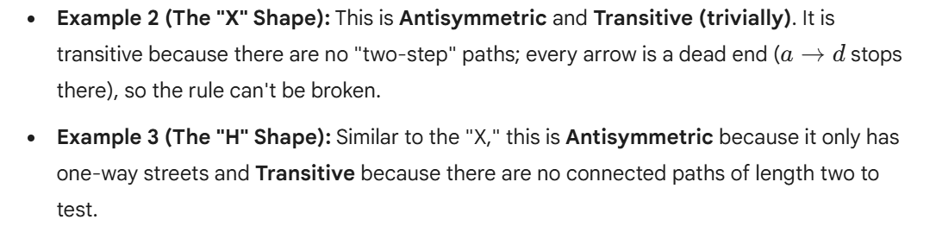
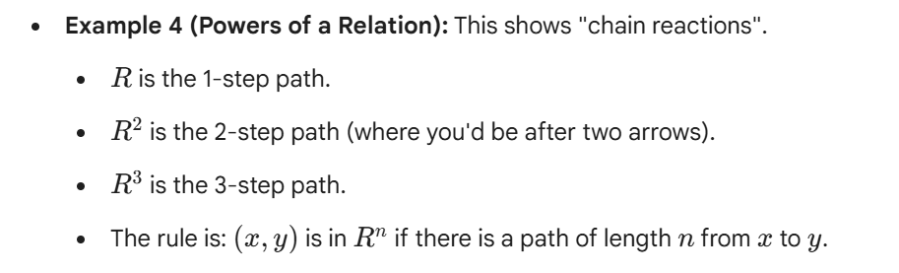
Example of the Powers of a Relation
Solution

Slide 36
Equivalence Relations
Section 9.5

Slide 37
Section Summary
Equivalence Relations
Equivalence Classes
Equivalence Classes and Partitions

Slide 38
Equivalence Relations
Definition 1: A relation on a set A is called an equivalence relation if it is reflexive, symmetric, and transitive.
Definition 2: Two elements a, and b that are related by an equivalence relation are called equivalent. The notation a ∼ b is often used to denote that a and b are equivalent elements with respect to a particular equivalence relation.

Slide 39
Strings
Example: Suppose that R is the relation on the set of strings of English letters such that aRb if and only if l(a) = l(b), where l(x) is the length of the string x. Is R an equivalence relation?
Solution: Show that all of the properties of an equivalence relation hold.
Reflexivity: Because l(a) = l(a), it follows that aRa for all strings a.
Symmetry: Suppose that aRb. Since l(a) = l(b), l(b) = l(a) also holds and bRa.
Transitivity: Suppose that aRb and bRc. Since l(a) = l(b),and l(b) = l(c), l(a) = l(a) also holds and aRc.

Slide 40
Congruence Modulo m
Example: Let m be an integer with m > 1. Show that the relation
R = {(a,b) | a ≡ b (mod m)}
is an equivalence relation on the set of integers.
Solution: Recall that a ≡ b (mod m) if and only if m divides a − b.
Reflexivity: a ≡ a (mod m) since a − a = 0 is divisible by m since 0 = 0 ∙ m.
Symmetry: Suppose that a ≡ b (mod m). Then a − b is divisible by m, and so a − b = km, where k is an integer. It follows that b − a = (− k) m, so b ≡ a (mod m).
Transitivity: Suppose that a ≡ b (mod m) and b ≡ c (mod m). Then m divides both a − b and b − c. Hence, there are integers k and l with a − b = km and b − c = lm. We obtain by adding the equations:
a − c = (a − b) + (b − c) = km + lm = (k + l) m.
Therefore, a ≡ c (mod m).

Slide 41
Divides
Example: Show that the “divides” relation on the set of positive integers is not an equivalence relation.
Solution: The properties of reflexivity, and transitivity do hold, but there relation is not transitive. Hence, “divides” is not an equivalence relation.
Reflexivity: a ∣ a for all a.
Not Symmetric: For example, 2 ∣ 4, but 4 ∤ 2. Hence, the relation is not symmetric.
Transitivity: Suppose that a divides b and b divides c. Then there are positive integers k and l such that b = ak and c = bl. Hence, c = a(kl), so a divides c. Therefore, the relation is transitive.

Slide 42
Equivalence Classes
Definition 3: Let R be an equivalence relation on a set A. The set of all elements that are related to an element a of A is called the equivalence class of a. The equivalence class of a with respect to R is denoted by [a]_{R}.
When only one relation is under consideration, we can write [a], without the subscript R, for this equivalence class.
Note that [a]_{R} = {s|(a,s) ∈ R}.
If b ∈ [a]_{R}, then b is called a representative of this equivalence class. Any element of a class can be used as a representative of the class.
The equivalence classes of the relation congruence modulo m are called the congruence classes modulo m. The congruence class of an integer a modulo m is denoted by [a]_{m}, so [a]_{m} = {…, a−2m, a−m, a+2m, a+2m, … }. For example,
[0]₄ = {…, −8, −4 , 0, 4 , 8 , …} [1]₄ = {…, −7, −3 , 1, 5 , 9 , …}
[2]₄ = {…, −6, −2 , 2, 6 , 10 , …} [3]₄ = {…, −5, −1 , 3, 7 , 11 , …}

Slide 43
Equivalence Classes and Partitions
Theorem 1: let R be an equivalence relation on a set A. These statements for elements a and b of A are equivalent:
(i) aRb → a is related to b
(ii) [a] = [b] → a and b belong to the same group
(iii) [a] ∩ [b] = ∅ → are not disjoint → they share elements
Proof: We show that (i) implies (ii). Assume that aRb. Now suppose that c ∈ [a]. Then aRc. Because aRb and R is symmetric, bRa. Because R is transitive and bRa and aRc, it follows that bRc. Hence, c ∈ [b]. Therefore, [a]⊆ [b]. A similar argument (omitted here) shows that [b]⊆ [a]. Since [a]⊆ [b] and [b]⊆ [a], we have shown that [a] = [b].
(see text for proof that (ii) implies (iii) and (iii) implies (i))

Slide 44
Partition of a Set
Definition:
A partition means:
Divide a set into smaller groups properly
You have a set S = {1,2,3,4,5,6}
A partition means: Split it into groups like:
{1,2}, {3,4}, {5,6}
2. No overlap (no repetition)
No element should appear in two groups
✔ {1,2}, {3,4} ❌ {1,2}, {2,3} (2 is repeated ❌)
3 Important Rules
3. Use all elements of S
Every element must be included somewhere
✔ {1,2}, {3,4}, {5,6} ❌ {1,2}, {3,4} (5 and 6 missing ❌)
1. No empty group
Every group must have at least one element
✔ {1,2}, {3} ❌ {1,2}, {} (not allowed)

Slide 45
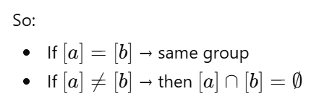
An Equivalence Relation Partitions a Set
If you have an equivalence relation R on a set A, then:
It automatically divides the set into groups (called equivalence classes)
These groups form a partition of A
1. Every element is in some group
For any element a in A:
it always belongs to its own group [a]
So, if you take all groups together, you get the whole set A
Nothing is left out
So what does this mean?
Now we have:
✔ Every element is in some group ✔ No group is empty ✔ Groups do not overlap
2. Groups are either same or completely separate
From the theorem 1, Two groups are either:
Exactly the same, or
Completely separate (no common elements)
No overlapping allowed

Slide 46
An Equivalence Relation Partitions a Set (continued)
Theorem 2: Let R be an equivalence relation on a set S. Then the equivalence classes of R form a partition of S. Conversely, given a partition {A_{i} | i ∈ I} of the set S, there is an equivalence relation R that has the sets A_{i}, i ∈ I, as its equivalence classes.
Proof: We have already shown the first part of the theorem.
For the second part, assume that {A_{i} | i ∈ I} is a partition of S. Let R be the relation on S consisting of the pairs (x, y) where x and y belong to the same subset A_{i} in the partition. We must show that R satisfies the properties of an equivalence relation.
Reflexivity: Every element is always in the same group as itself. So (a, a) is in R.
Symmetry: If (a,b) ∈ R, then b and a are in the same subset of the partition, so (b,a) ∈ R.
Transitivity: If (a,b) ∈ R and (b,c) ∈ R, then a and b are in the same subset of the partition, as are b and c. Since the subsets are disjoint and b belongs to both, the two subsets of the partition must be identical. Therefore, (a,c) ∈ R since a and c belong to the same subset of the partition.

Slide 47
Partial Orderings
Section 9.6

Slide 48
Section Summary
Partial Orderings and Partially-ordered Sets
Lexicographic Orderings
Hasse Diagrams
Lattices (not currently in overheads)
Topological Sorting (not currently in overheads)

Slide 49
Partial Orderings
Definition 1: A relation R on a set S is called a partial ordering, or partial order, if it is reflexive, antisymmetric, and transitive. A set together with a partial ordering R is called a partially ordered set, or poset, and is denoted by (S, R). Members of S are called elements of the poset.

Slide 50
Partial Orderings (continued)
Example 1: Show that the “greater than or equal” relation (≥) is a partial ordering on the set of integers.
Reflexivity: a ≥ a for every integer a.
Antisymmetry: If a ≥ b and b ≥ a , then a = b.
Transitivity: If a ≥ b and b ≥ c , then a ≥ c.
These properties all follow from the order axioms for the integers. (See Appendix 1).

Slide 51
Partial Orderings (continued)
Example 2: Show that the divisibility relation (∣) is a partial ordering on the set of integers.
Reflexivity: a ∣ a for all integers a. (see Example 9 in Section 9.1)
Antisymmetry: If a and b are positive integers with a | b and b | a, then a = b. (see Example 12 in Section 9.1)
Transitivity: Suppose that a divides b and b divides c. Then there are positive integers k and l such that b = ak and c = bl. Hence, c = a(kl), so a divides c. Therefore, the relation is transitive.
(Z⁺, ∣) is a poset.

Slide 52
Partial Orderings (continued)
Example 3: Show that the inclusion relation (⊆) is a partial ordering on the power set of a set S.
Reflexivity: A ⊆ A whenever A is a subset of S.
Every set is a subset of itself
Example:
{1,2} ⊆ {1,2}
Always true
Antisymmetry: If A and B are positive integers
with A ⊆ B and B ⊆ A, then A = B.
Example:
A = {1,2}, B = {1,2}
A ⊆ B and B ⊆ A ✔ So, A = B
Transitivity: If A ⊆ B and B ⊆ C,
then A ⊆ C.
Example:
A = {1}
B = {1,2}
C = {1,2,3}
A ⊆ B and B ⊆ C So, A ⊆ C

Slide 53
Comparability
Definition 2: The elements a and b of a poset (S,≼ ) are comparable if either a ≼ b or b ≼ a. When a and b are elements of S so that neither a ≼ b nor b ≼ a, then a and b are called incomparable.
Definition 3: If (S,≼ ) is a poset and every two elements of S are comparable, S is called a totally ordered or linearly ordered set, and ≼ is called a total order or a linear order. A totally ordered set is also called a chain.
Definition 4: (S,≼ ) is a well-ordered set if it is a poset such that ≼ is a total ordering and every nonempty subset of S has a least element.
The symbol ≼ is used to denote the relation in any poset.

Slide 54
Lexicographic Order
Definition: Given two posets (A₁,≼₁) and (A₂,≼₂), the lexicographic ordering on A₁ ⨉ A₂ is defined by specifying that (a₁, a₂) is less than (b₁,b₂), that is,
(a₁, a₂) ≺ (b₁,b₂),
either if a₁ ≺₁ b₁ or if a₁ = b₁ and a₂ ≺₂ b₂.
This definition can be easily extended to a lexicographic ordering on strings (see text).
Example: Consider strings of lowercase English letters. A lexicographic ordering can be defined using the ordering of the letters in the alphabet. This is the same ordering as that used in dictionaries.
discreet ≺ discrete, because these strings differ in the seventh position and e ≺ t.
discreet ≺ discreetness, because the first eight letters agree, but the second string is longer.

Slide 55
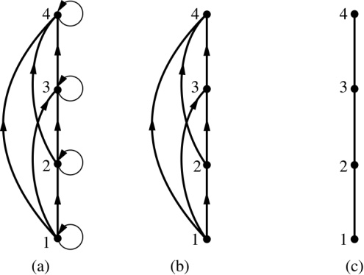
Hasse Diagrams
Definition: A Hasse diagram is a visual representation of a partial ordering that leaves out edges that must be present because of the reflexive and transitive properties.
A partial ordering is shown in (a) of the figure above. The loops due to the reflexive property are deleted in (b). The edges that must be present due to the transitive property are deleted in (c). The Hasse diagram for the partial ordering (a), is depicted in (c).

Slide 56
Procedure for Constructing a Hasse Diagram
To represent a finite poset (S,≼ ) using a Hasse diagram, start with the directed graph of the relation:
Remove the loops (a, a) present at every vertex due to the reflexive property.
Remove all edges (x, y) for which there is an element z ∈ S such that x ≺ z and z ≺ y. These are the edges that must be present due to the transitive property.
Arrange each edge so that its initial vertex is below the terminal vertex. Remove all the arrows, because all edges point upwards toward their terminal vertex.

