Slide 1
SPEC'26 • NEDUET
CCSDS TELEMETRY
FRAME SYNCHRONIZER
Finding frame boundaries in a noisy serial bit stream
CONTINUOUS STREAM
LEVELS 1–3 • MODEL + RTL + FPGA
Python model • Verilog RTL • FPGA synthesis
noise
ASM
frame
ASM
Detect → verify → recover
Team: The Vanguard
SPEC'26 • CCSDS Telemetry Frame Synchronizer • Levels 1–3
01
Notes:
LEAD (30 s). Assalam-o-Alaikum, respected judges. We are Team The Vanguard from NED University. A satellite sends a continuous stream of bits. Our job is to find where each message starts, even when noise flips bits and the stream begins at a random position. Today we will show a complete solution: a Python model, a hardware design in Verilog with a self-checking testbench, and FPGA synthesis results.

Slide 2
01 / PROBLEM
The receiver sees bits — not message boundaries
Noise can flip bits, and the stream may begin at any bit offset.
random prefix
ASM
32 bits
TM frame
512 bits
ASM
32 bits
next frame
Known marker
Scanning strategy
Acceptance rule
0x1ACFFC1D
32 bits • MSB first
Move a 32-bit window one bit at a time. Do not assume byte alignment.
Accept a candidate when at least 28 of 32 bits match.
Core challenge: detect the marker, avoid false alarms, and only trust data after frame checks.
SPEC'26 • CCSDS Telemetry Frame Synchronizer • Levels 1–3
02
Notes:
LEAD (45 s). Every frame starts with a known 32-bit marker, 0x1ACFFC1D. The receiver slides a 32-bit window one bit at a time, because we cannot assume byte alignment. If we demand all 32 bits match, one noisy bit makes us miss a frame. If we accept too many mismatches, random data looks like a marker: a false alarm. In Level 1 we accept a candidate when at least 28 of 32 bits match. The core challenge: detect the marker, avoid false alarms, and trust the data only after the frame checks pass.

Slide 3
02 / METHOD
A simple software receiver pipeline
This package demonstrates Level 1: a reproducible reference model, not hardware timing.
1
2
3
4
Generate frames
→
Simulate channel
→
Detect marker
→
Validate frame
ASM + 64-byte TM-style frame
Header • VCID • FECF CRC
BPSK: 0 → +1, 1 → −1
Add Gaussian noise (AWGN)
Hard decisions to bits
32-bit window • threshold 28/32
Check header and CRC/FECF
Only then decode telemetry
ASM: 0x1ACFFC1D
Frame: 64 bytes
Threshold: 28/32
73-bit random prefix
Teaching scope: uncoded BPSK/AWGN and an illustrative VCA payload. No RF modem, FEC decoder, or complete flight receiver is claimed.
SPEC'26 • CCSDS Telemetry Frame Synchronizer • Levels 1–3
03
Notes:
JUNIOR (45 s). Four steps. One: generate frames: 4-byte marker, then a 64-byte frame with a 6-byte header, 56-byte data field and 2-byte CRC. Two: simulate the channel with BPSK and Gaussian noise. Three: hard decisions, then search every bit position for 28 of 32 matches. Four: validate header and CRC, and only then decode telemetry. 73 random bits at the start prove we do not assume alignment. This is a software model: no RF modem, no error correction.

Slide 4
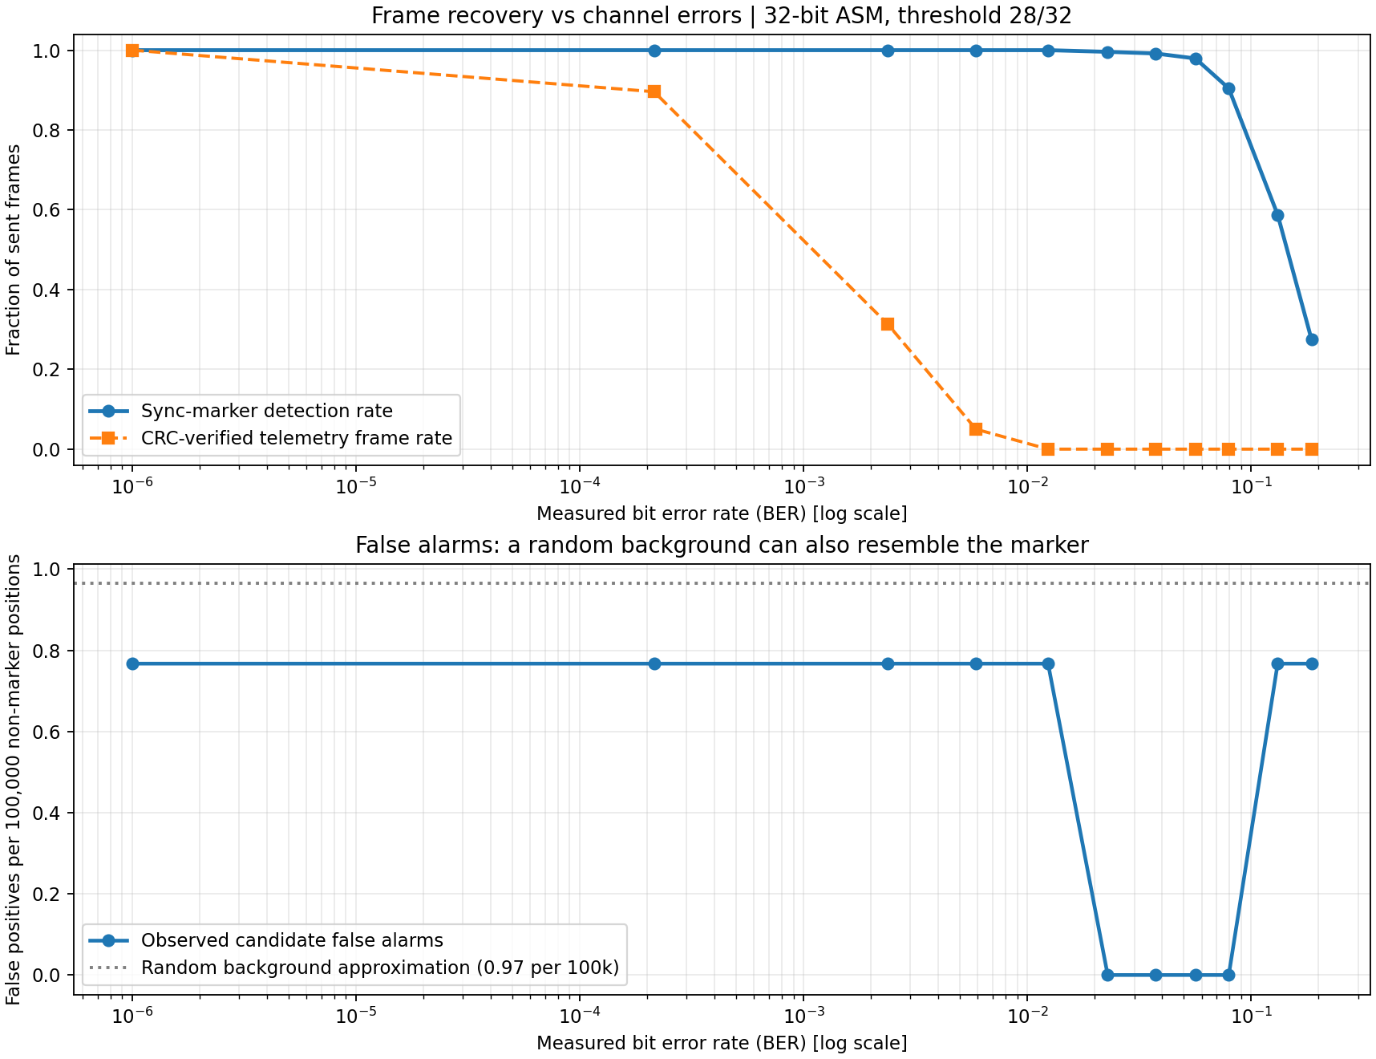
03 / RESULTS
What happened in the seeded 8 dB experiment?
The included simulation was rerun from the supplied code; seven automated unit tests passed.
DEFAULT RUN • SEED 2026
120 / 120
true sync markers found
1
false candidate position
110 / 120
CRC-verified frames
0.000168
measured bit error rate
Threshold: 28/32 matches
SPEC'26 • CCSDS Telemetry Frame Synchronizer • Levels 1–3
04
Notes:
JUNIOR (60 s). At 8 dB Eb/N0, seed 2026, the measured bit error rate was 0.000168, close to the theoretical 0.000191. We found 120 of 120 markers with one false candidate position. 110 of 120 frames passed the CRC. Why not 120? One wrong bit among 512 fails the CRC, while the marker only needs 28 of 32. Marker detection survives noise better than full frame recovery. Lower threshold: more markers but more false alarms. For 28 of 32 theory predicts about 9.7 false alarms per million positions.

Slide 5
04 / LIVE DEMO
Live demo: run it and reproduce the numbers
Interactive walkthrough first, then the Python simulation and its automated tests.
POWERSHELL / TERMINAL
EXAMPLE RECOVERED DATA
# Run tests
VC0
TEMP=22.6C; BAT=85%; MODE=OK
py -m unittest -v test_phase1.py
VC1
BUS=3.70V; SOLAR=13.0W
# Run simulation
py ccsds_phase1.py
VC2
PITCH=-0.6; ROLL=-0.2; YAW=87
Expected: 7 tests pass; reports/plots are written to results/.
Next: the same design in Verilog, a self-checking RTL regression, and FPGA results.
SPEC'26 • CCSDS Telemetry Frame Synchronizer • Levels 1–3
05
Notes:
JUNIOR (60 s). Open walkthrough.html first: change the noise, show the marker and the recovered telemetry. Then in the terminal: py -m unittest -v test_phase1.py (7 tests OK) and py ccsds_phase1.py (120/120, 1 false, 110/120). Say: here are the seven automated tests, and here is the simulation reproducing the numbers on the slide. Backup: screenshots in the repo.

Slide 6
05 / LEVEL 2 • RTL ARCHITECTURE
From Python to hardware: a clocked receiver
One bit per clock. Same algorithm as the Level 1 model, written as synthesizable Verilog.
Shift register
Distance to marker
State machine
Frame extractor
Virtual channels
32 bits, one new bit per clock
→
registered adder tree counts wrong bits
→
search • check • lock • flywheel
→
bytes, header, CRC-16
→
frame counters, VC 0 to 7
Different tolerance per state (wrong bits allowed out of 32)
SEARCH
CHECK
LOCK
FLYWHEEL
≤ 2
≤ 4
≤ 6
3 misses
Blind search: strict, so random data rarely locks
A second marker must appear one frame later
Position is known, so noise is tolerated
Keep frame timing; 3 in a row returns to SEARCH
Bit-slip window ±4
Polarity-safe
50 MHz, 1 bit per clock
A strong match near the expected position re-aligns the frame counter without a new search.
The inverted marker 0xE53003E2 is detected and the data flipped back (180° BPSK ambiguity).
Sustains 50 Mbit/s. Outputs bytes, decoded header, CRC check and per-VC frame counts.
SPEC'26 • CCSDS Telemetry Frame Synchronizer • Levels 1–3
06
Notes:
CLASSMATE (60 s). For Level 2 we wrote synthesizable Verilog. Each clock one bit enters a 32-bit shift register. A registered adder tree counts how many bits differ from the marker. The state machine uses different tolerances: strict while searching blindly (at most 2 wrong bits), 4 to verify, and 6 once locked at the known position. This keeps false locks rare but survives noise. It also detects the inverted marker 0xE53003E2 and corrects the data (180-degree ambiguity). A window of plus or minus 4 bits around the expected position re-aligns after a bit slip without searching again. It extracts frames, decodes the header, checks the CRC and counts frames per virtual channel. One bit per clock at 50 MHz is 50 megabits per second.

Slide 7
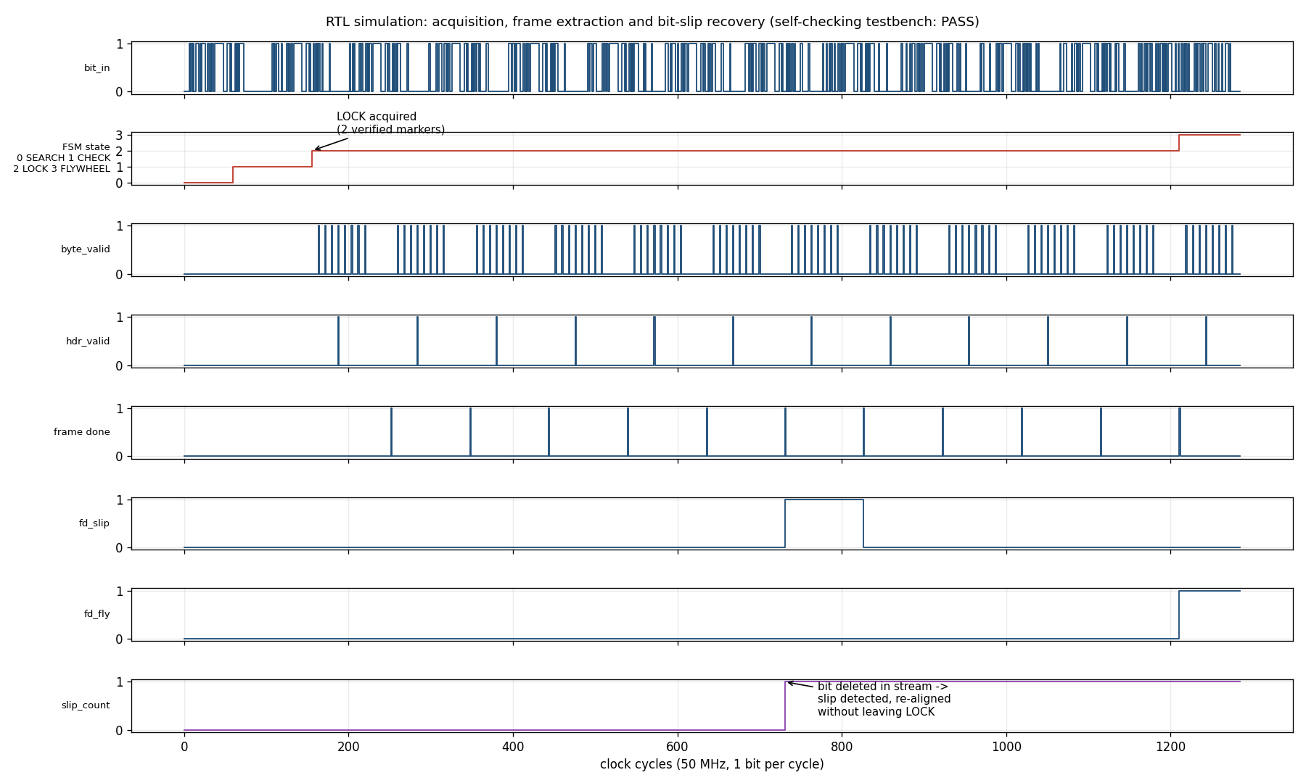
06 / LEVEL 2 • VERIFICATION
Verified against a bit-exact golden model
Errors up to 10 %, slips, inverted polarity, burst loss, clock gaps, real frame length, and our own Level 1 bit streams.
SELF-CHECKING TESTBENCH
16 / 16
scenarios pass, frame by frame against the Python model
4 / 4
deliberately injected RTL bugs were caught
≈ 1 vs ≈ 4.5
frames lost per bit slip: with vs without the slip window
Waveform: SEARCH → CHECK → LOCK, then a deleted bit is re-aligned and lock is kept.
SPEC'26 • CCSDS Telemetry Frame Synchronizer • Levels 1–3
07
Notes:
CLASSMATE (60 s). We verify the RTL against a bit-exact Python golden model. The testbench compares every output frame byte by byte, plus flags, virtual channel and counters. 16 scenarios, all passing: errors up to 10 percent, inserted and deleted bits, inverted polarity, a burst of garbage, random clock gaps, the real 1115-byte frame length, and the two bit streams from our own Level 1 model. We injected four deliberate bugs into the RTL and the testbench caught all four. In the waveform the state goes SEARCH, CHECK, LOCK; when a bit is deleted the slip counter increments and the receiver stays locked. One bit slip costs about 1 frame with the slip window versus about 4.5 frames and a full re-search without it.

Slide 8
07 / LEVEL 3 • FPGA RESULTS
Level 3: fits a low-cost FPGA and beats 50 MHz
Open-source flow (Yosys + nextpnr), Lattice iCE40 HX8K, real 1115-byte frame length. Vivado script included.
909
logic cells, 11 % of an iCE40 HX8K
≈ 750 LUTs • 357 FFs
Xilinx 7-series mapping estimate (Yosys, no timing)
69.9–80.2 MHz
post-route, 5 seeds: 50 MHz target met
Open-source flow results, not Vivado. A Vivado script is included in the repo.
SPEC'26 • CCSDS Telemetry Frame Synchronizer • Levels 1–3
08
Notes:
LEAD (45 s). For Level 3 we synthesized with the open-source Yosys and nextpnr flow for a low-cost Lattice iCE40 HX8K, using the real 1115-byte frame length. 909 logic cells, 11 percent of the device. Post-route maximum clock between 69.9 and 80.2 MHz across five placement seeds, so the 50 MHz requirement is met. A Xilinx 7-series mapping estimate is about 750 LUTs and 357 flip-flops. We also include a Vivado script. To be clear: these timing numbers come from the open-source flow, not from Vivado.

Slide 9
08 / ENGINEERING HONESTY
What is proven — and what remains future work
Everything on this slide can be reproduced from the repository.
IMPLEMENTED / VERIFIED IN THIS REPOSITORY
LIMITATIONS / NOT CLAIMED
Level 1: Python BPSK/AWGN model, 7 automated tests pass.
Hard-decision input only; frame length is fixed per build.
Level 2: Verilog RTL, 16 / 16 self-checking scenarios pass.
No physical board, RF front end, carrier recovery or FEC decoder.
Bit slips (±4 bits), inverted polarity, flywheel, VC extraction.
Timing is from the open-source flow, not from Vivado.
Level 3: iCE40 synthesis, 69.9–80.2 MHz post-route (target 50 MHz).
Tolerances come from our own simulation study, not the standard.
Golden model, ground-truth checks and a bug-injection test.
Next: soft-decision input and a Vivado timing report.
“We scan every bit, verify before we trust, survive slips, and prove it by simulation.”
References: CCSDS 131.0-B (TM Synchronization and Channel Coding); CCSDS 132.0-B-3 (TM Space Data Link Protocol). See technical report.
SPEC'26 • CCSDS Telemetry Frame Synchronizer • Levels 1–3
09
Notes:
LEAD (45 s). To be honest about scope: hard decisions only, fixed frame length per build, no physical board, RF front end or error-correction decoder. Tolerances were chosen by our own simulation study, not copied from the standard. In one line: we scan every bit, we verify before we trust, we survive bit slips, and we prove it with an automatic testbench. Thank you, we welcome your questions.

