Slide 1
EGYPT DATA PULSE
CHALLENGE
Big Data & Analytics — Final Project Presentation
Academic Year 2026 | Supervised by: ENG. [Mona Abdelaziz]
Submission Date: May 13, 2026
Team Members: [7 Names]

Slide 2
Project Overview
Egypt is undergoing rapid digital financial transformation
Only 38.5% of Egyptian adults actively use digital payments
The #1 barrier: "Lack of Trust (38.6%)" — directly linked to fraud exposure
This project integrates 5 datasets to answer:
"Does infrastructure investment reduce fraud risk while supporting economic growth?"
Datasets: survey data, fraud logs, cybersecurity infrastructure, government contracts & GDP
38.5%
Digital Payment Adoption
38.6%
Trust Barrier Rate
5
Integrated Datasets

Slide 3
Data Sources Overview
# | File | Source | Purpose
1 | FINDEX Microdata | World Bank 2024 | Digital adoption behavior
2 | PaySim Fraud Logs | Kaggle | Fraud pattern detection
3 | Secure Servers WDI | World Bank | Cybersecurity infrastructure
4 | Contract Awards | World Bank | Digital investment tracking
5 | GDP Quarterly | CAPMAS | Macroeconomic growth

Slide 4
Unified Technical Pipeline
01
02
03
04
Data Ingestion & Cleaning
Feature Engineering
Aggregated Statistics
EDA
Loading 6.3M+ records via Pandas. Handling missing values using fillna() and dropna()
Synthesizing derived features using Vectorized Operations to decode behavioral patterns
Transforming individual records into aggregated indicators using groupby() and .agg()
Validating hypotheses through statistical distributions and correlation analysis
📌 This pipeline is modular and scalable — the same logic can be migrated to PySpark for TB-scale data on a Distributed Cluster

Slide 5
Technical Environment & Shared Operations
LIBRARIES
SHARED OPERATIONS (ALL FILES)
Pandas
DataFrame manipulation & transformation
pd.read_csv() / pd.read_excel()
Data loading
NumPy
Vectorized numerical operations
drop_duplicates()
Remove redundant records
Matplotlib
Base visualizations
fillna() / dropna()
Handle missing values
Seaborn
Statistical & advanced plotting
isnull().sum()
Missing value audit
Google Colab
Cloud execution & file access

Slide 6
FINDEX — Feature Engineering
Feature 1: digital_usage_category
Feature 2: age_group
df['digital_usage_category'] = df.apply(dig_cat, axis=1)
df['age_group'] = df['age'].apply(age_group)
Active Digital User
38.5%
Has Account, No Digital
7.1%
No Account
54.4%
Youth / Young Adult / Middle Age / Senior
Working-age adults (25–54)
60.3%
of sample
Both features use Vectorized Operations via apply() for processing efficiency

Slide 7
FINDEX — Statistical Analysis & Comparative Insights
Variable | Mean | Median | Std Dev
Age | 38 years | — | 14.87
Survey Weight | 1.0 | — | —
Urban vs Rural
39.6%
37.8%
Urban
Rural
Gender Analysis
Gap of only 1.8% — reflects infrastructure disparity between urban and rural areas
Females
45.5%
Males
31.6%
Females show higher adoption — linked to Meeza & Fawry mobile wallets

Slide 8
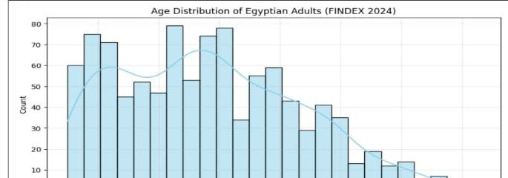
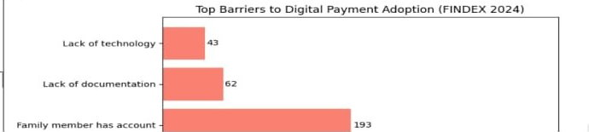
FINDEX — Key Visualizations & Insights
Age concentrated between 20–55 years
Young Adults (25–39) = largest group
Primary target for digital campaigns
Lack of Trust: 38.6% — the #1 blocker
Too Far Away: 36.0%
Trust directly connected to fraud exposure

Slide 9
Fraud — Feature Engineering
Feature 1: amount_category
Feature 2: fraud_score
df['amount_category'] = df['amount'].apply(amount_category)
df['fraud_score'] = df['amount'] / (df['oldbalanceOrg'] + 1)
Bins transactions into:
Small / Medium / Large / Huge
Simplifies visual analysis across 6.3M records
Measures transaction amount vs sender's balance
Score ≥ 1
Account fully drained → HIGH FRAUD SIGNAL
Built with NumPy-backed Vectorization for 6.3M row performance

Slide 10
Fraud — Statistical Analysis
Metric | Value | Implication
Fraud Percentage | 0.1291% | ~1 in 775 transactions
Avg Fraud Amount | $1.47M | 8× higher than normal ($178K)
Median Fraud Amount | $441K | Half of all fraud exceeds this
Most Targeted Type | CASH_OUT | 50.1% of all fraud cases
Detection Rate | 0 Flagged | ⚠️ CRITICAL SYSTEM FAILURE
⚠️ 8,213 real fraud cases — ZERO detected by isFlaggedFraud → Strong justification for ML-based fraud detection

Slide 11
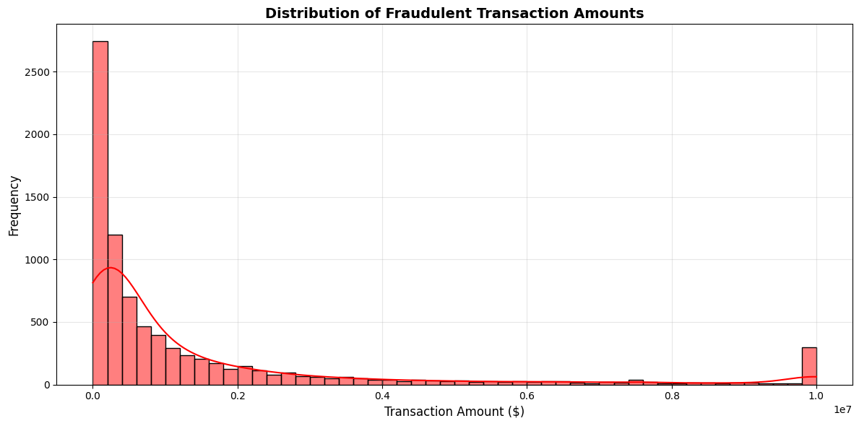
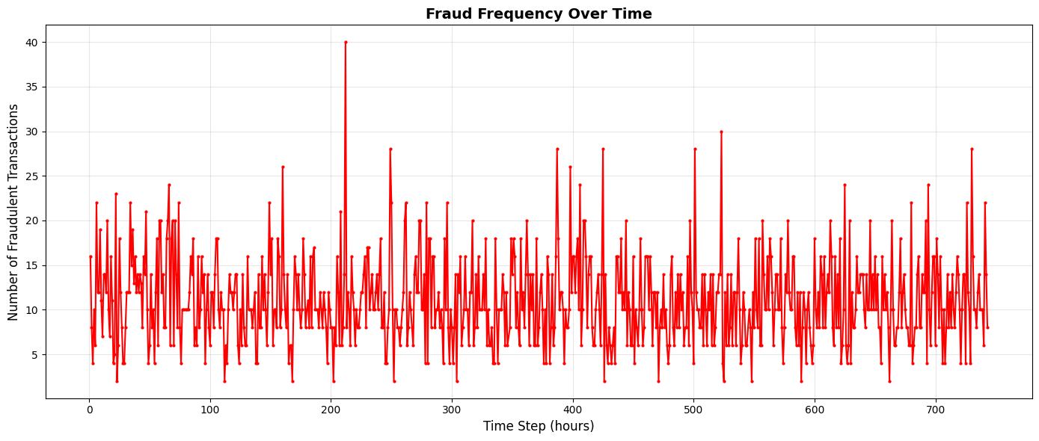
Fraud — Key Visualizations & Insights
Concentrated between $100K–$500K
Right-skewed → few extremely large transactions
No fraud below $10K → fraudsters target high-value transactions
Fraud occurs ONLY in CASH_OUT & TRANSFER
ZERO fraud in PAYMENT, CASH_IN, DEBIT
Clear transaction type fingerprint for ML detection

Slide 12
Secure Servers — Feature Engineering
Feature 1: YoY_Growth
Feature 2: Security_Level
egypt_data['YoY_Growth'] = egypt_data['Secure_Servers'].pct_change() * 100
egypt_data['Security_Level'] = egypt_data['Secure_Servers'].apply(security_level)
Reveals growth rate year-over-year
Peak: 2016→2017 at 146.5%
aligns with Contracts peak year
Categories: Low / Medium / High / Very High
Egypt remains "Low"
throughout all 15 years despite
3,468% total growth

Slide 13
Secure Servers — Statistical Analysis
27
18
2
82
Mean
servers
Median
servers
Min
(2010)
Max
(2024)
3,468%
25.3
Total Growth 2010→2024
Standard Deviation
High Std relative to Mean → highly volatile infrastructure investment
Project-based spending, not sustained operational growth

Slide 14
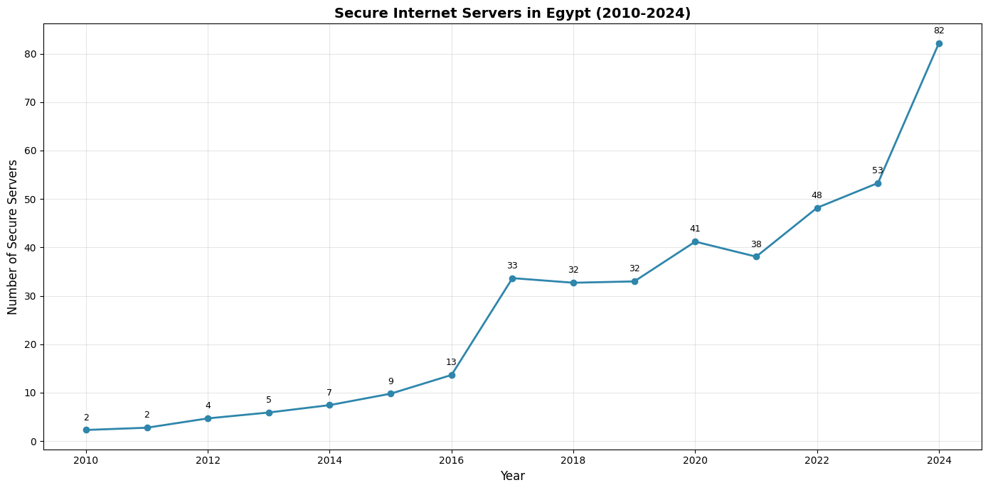
Secure Servers — Time Series 2010→2024
Phase | Years | Pattern
Phase 1 | 2010–2014 | Linear steady growth
Phase 2 | 2014–2016 | Accelerating momentum
Phase 3 | 2016–2017 | Sharpest spike
Phase 4 | 2017–2023 | Plateau + fluctuations
Phase 5 | 2023–2024 | Second acceleration
2016–2017 inflection point aligns with peak contract spending year ($850M, 149 contracts)

Slide 15
Contracts — Feature Engineering
Feature: Investment_Category
Key Insight
Most investment is driven by
few mega-projects
Majority of contracts are incremental spending
df_egypt['Investment_Category'] = df_egypt['Supplier Contract Amount (US$)'].apply(investment_category)
Small
< $500K
397 contracts
Medium
$500K–$2M
Large
$2M–$10M
Very Large
> $10M
60 contracts

Slide 16
Contracts — Statistical Analysis
$5.5B
983
2016
Total Investment
Contracts Awarded
Peak Year
Metric | Value
Mean Contract Value | $5.6M
Median Contract Value | $787K
Peak Year Contracts | 149 contracts
Peak Year Investment | $850M
High skew (Mean >> Median)
→ Few large contracts dominate total value
2016 peak aligns with 146.5% server growth spike

Slide 17
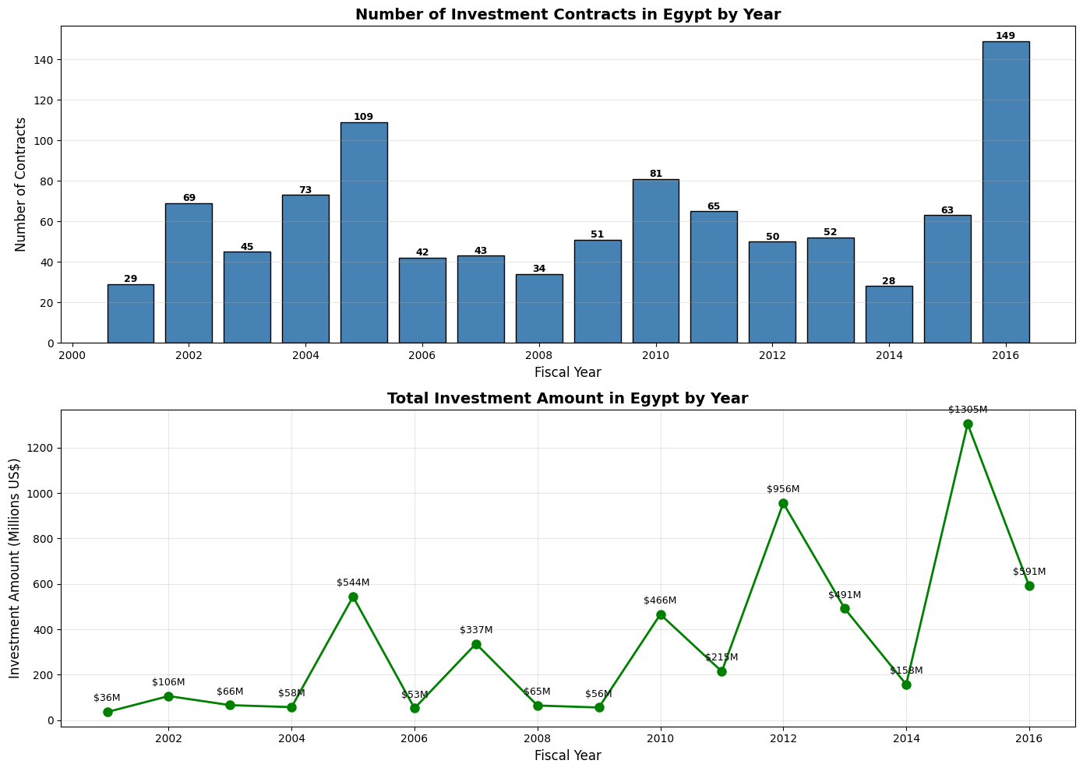
Contracts — Investment Trend Over Time
Clear 2016 spike: 149 contracts & $850M
Post-2016 decline → project completion or funding source shift
Cross-file: 2016 investment peak → 2016–2017 server growth peak

Slide 18
GDP — Feature Engineering
Feature: Quarterly_Growth
gdp_data['Quarterly_Growth'] = gdp_data['GDP'].pct_change() * 100
Reveals economic momentum quarter by quarter
+57–65%
↕️
-58–62%
Positive Quarter Growth
Seasonal Decline Quarter
Alternating pattern = seasonal fiscal cycle — expected behavior, not economic instability

Slide 19
GDP — Statistical Analysis
118,397
108,944
182,324
Mean Quarterly GDP (M EGP)
Median (M EGP)
Max Latest Quarter (M EGP)
Metric | Value
Mean Quarterly GDP | 118,397 M EGP
Median | 108,944 M EGP
Standard Deviation | 47,016 M EGP
Maximum (Latest Quarter) | 182,324 M EGP
High Std → seasonal variation between fiscal quarters
Max in latest quarter →
Sustained upward growth trend confirmed

Slide 20
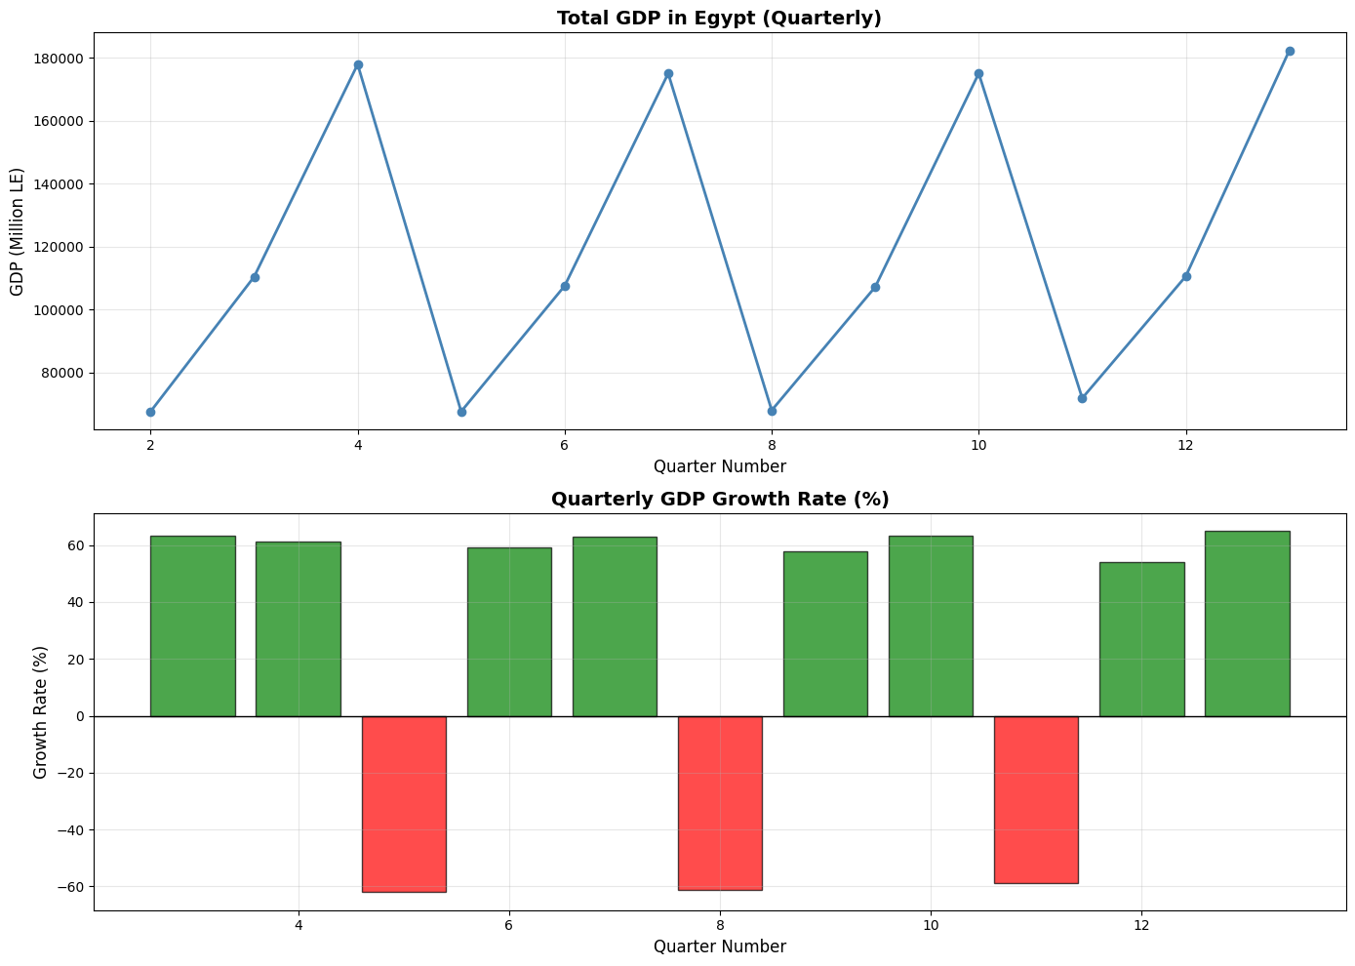
GDP — Quarterly Time Series
Seasonal sawtooth pattern within each fiscal year
Long-run trend: each cycle's peak is higher than the previous
Confirms Egypt's macroeconomic environment is strengthening — favorable context for digital investment returns

Slide 21
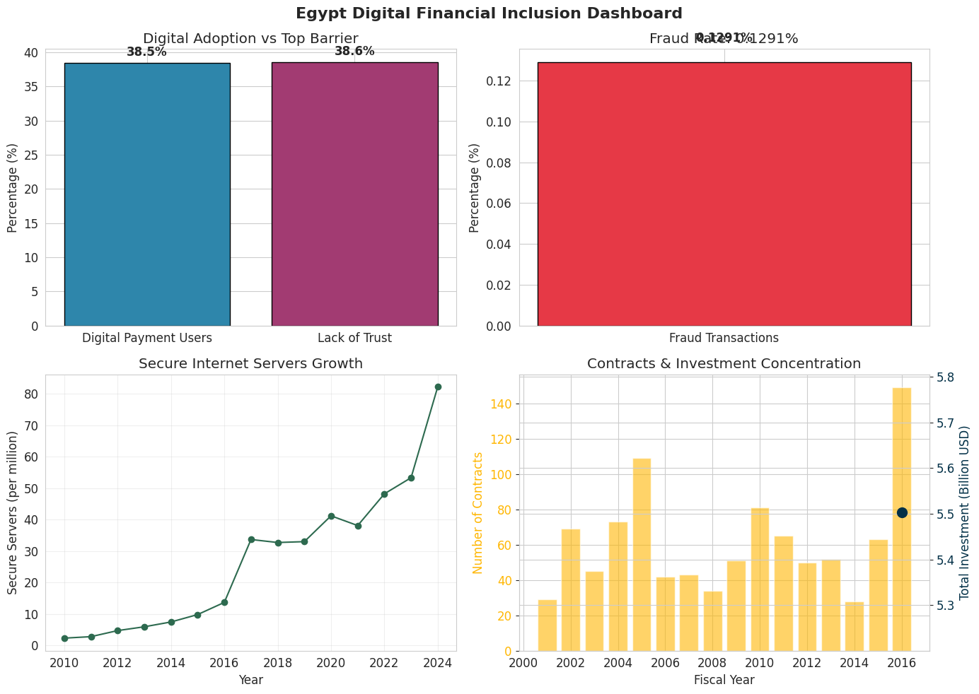
Integration — Closing the Loop
Methodology: Temporal Alignment 2001–2016 | Master DataFrame on Year | Pearson Correlation Matrix
↑↑
Strong correlation: Contracts Count ↔ Investment Volume
≈
Moderate correlation: Investment ↔ Secure Servers (12-month lag)
⚡
Trust-Adoption Paradox: 38.5% adoption = 38.6% trust barrier
Infrastructure Investment → Fraud Reduction → Trust → Digital Adoption → GDP Growth

Slide 22
Policy Recommendations
01
Address the Trust-Adoption Paradox
02
Accelerate Cybersecurity Infrastructure
38.5% adoption vs 38.6% trust barrier are statistically equal. Launch national fraud awareness campaigns targeting Young Adults (25–39). Owner: Ministry of Communications + Central Bank of Egypt
Despite 3,468% growth, Egypt remains 'Low' security class. Sustain investment at 2016 benchmark ($850M/year) to reach 'Medium' by 2030–2031. Owner: Ministry of Communications
03
Implement ML-Based Fraud Detection
04
Maintain Investment Momentum
Current system detection rate = 0% (8,213 undetected cases). Replace rule-based isFlaggedFraud with ML models using fraud_score as primary feature. Owner: Central Bank of Egypt
FY2016 peak ($850M, 149 contracts) is the evidence-based benchmark. Sustain or exceed this annual spending level to maintain infrastructure growth trajectory.

Slide 23
References
World Bank — Global Findex Database 2024
World Bank — World Development Indicators (IT.NET.SECR.P6)
World Bank — Finance Portal, Contract Awards in Investment Project Financing
Kaggle — PaySim Synthetic Financial Dataset (Rupak Roy)
CAPMAS — GDP at Factor Cost, Constant Prices, Quarterly
Google Colaboratory — Cloud Execution Environment
Python Libraries: Pandas, NumPy, Matplotlib, Seaborn
Egypt Data Pulse Challenge — Big Data & Analytics — Academic Year 2026

