Slide 1
MedKit
IUT_Berserk
Fardin Ahsan Sakib
A. H. M. Rezaul Karim
Ahmad Imam

Slide 2
4%
11%
30%
Deaths a year due to fake medicine
Of world population suffer from malnutrition
Of World Population are Obese or Overweight

Slide 3
The Problem

Slide 4


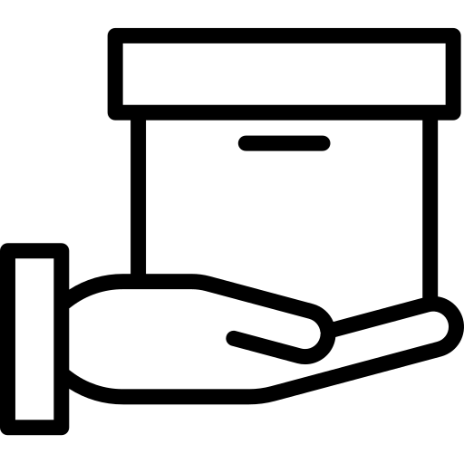
Not all medicines are available in local drug store
No database for patients
No reliable online medicine delivery source

Slide 5
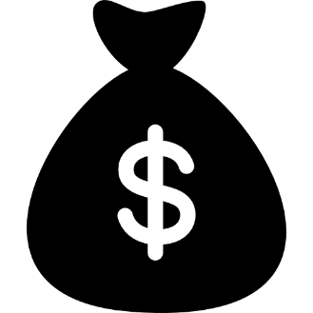


Nutritionists are expensive
Lack of timely reminders
No change in diet with changed health conditions

Slide 6
Objectives

Slide 7




Create a Unique Platform for Medicine Delivery
Proper Nutrition Chart
Help the user follow proper diet
Provide food and medication reminder

Slide 8
The Solution

Slide 9

MedKit

Slide 10
Features

Slide 11

Order Medicine
Attach Prescription for authentication
Select Medicine and Quantity
Confirm Purchase

Slide 12
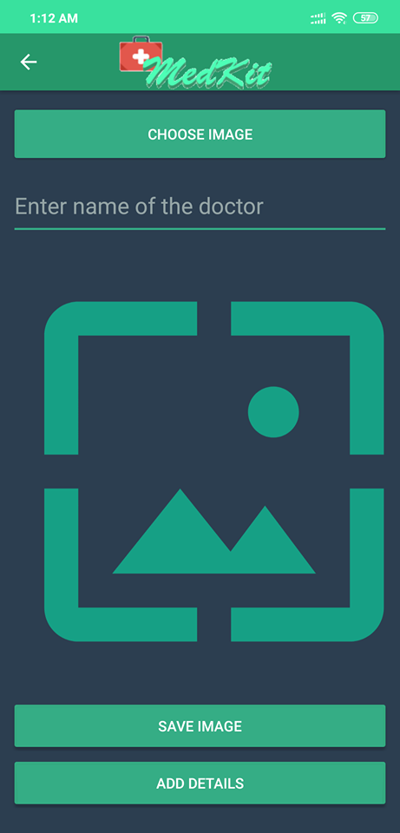
Order Medicine

Slide 13

Nutrition Plan
Calculate BMI
Update height and weight
Provide
proper
diet-plan

Slide 14
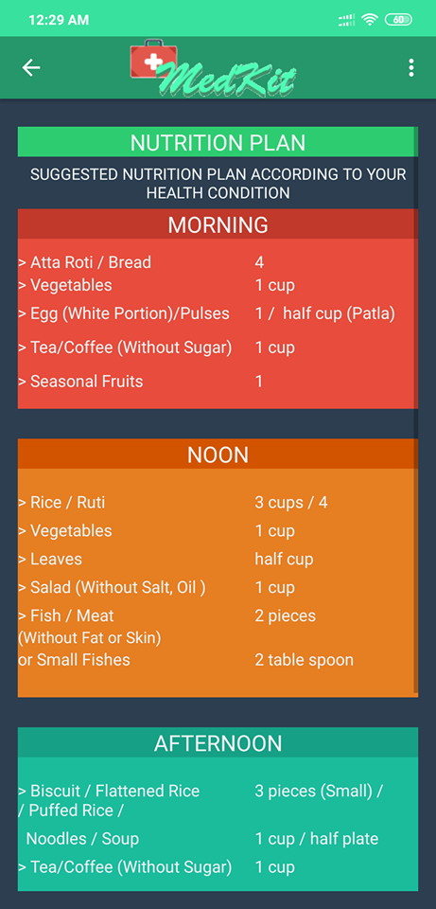
Nutrition Plan

Slide 15
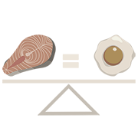
Food Exchange
Select Food
Category
Search Food Item
Choose Appropriate Alternative

Slide 16
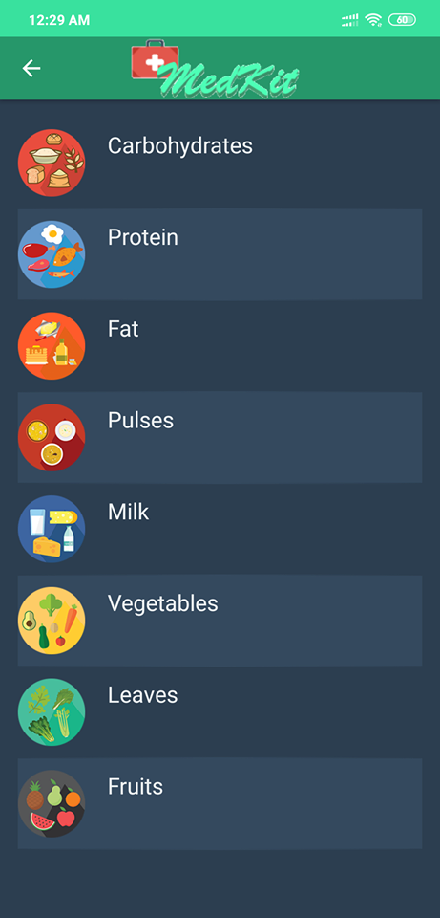
Food Exchange

Slide 17








Food
Reminder
Breakfast
Remind for breakfast within 6 am to 9 am
Lunch
Remind for lunch within 12 pm to 3 pm
Snacks
Remind for snacks within 4 pm to 6 pm
Dinner
Remind for dinner within 7 pm to 10.30 pm

Slide 18
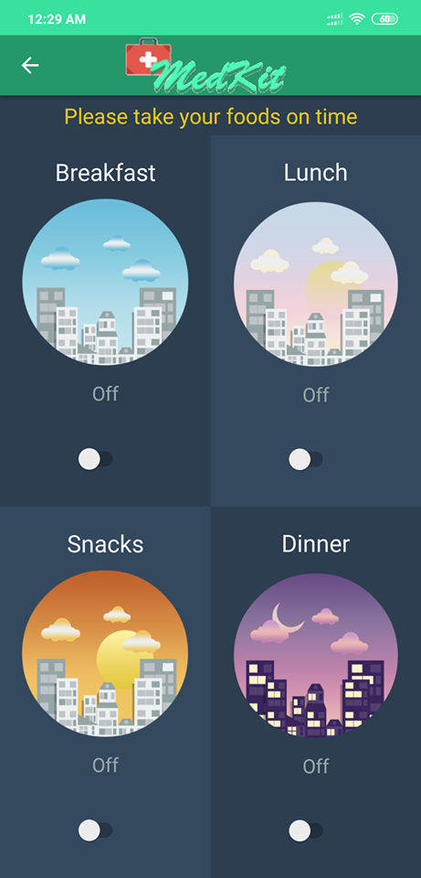
Food Reminder

Slide 19
Medicine Reminder
Set Reminder Title
Pick Date and Time
Choose what to remind
Choose when to remind
Get Notification
Get reminded

Slide 20
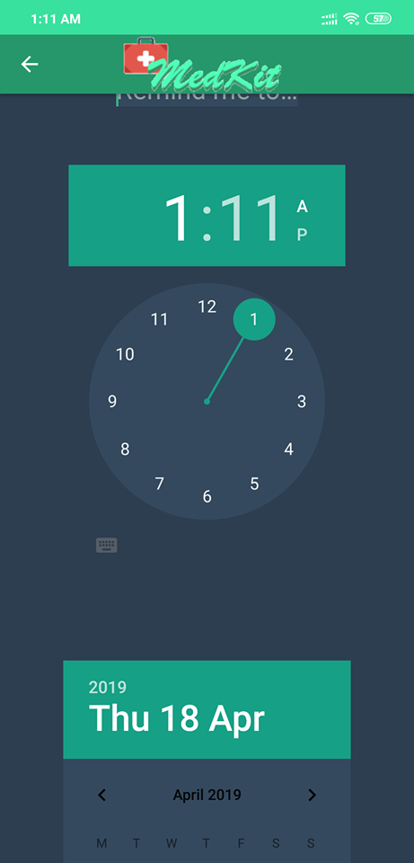
Medicine Reminder

Slide 21
Present Market Situation

Slide 22




Top Competitors

Slide 23
Brand Mapping
Premium
Comical
Emotional
Affordable

Slide 24


No specialized app that allows online medicine delivery
No app that provides proper diet plan for
Bangla cuisine

Slide 25
Why Us?

Slide 26

The Complete Package
Specialized app for reliable medicine delivery
Proper Diet plan according to BMI
Food Exchange
Food and Medicine Reminder

Slide 27
System Requirements

Slide 28

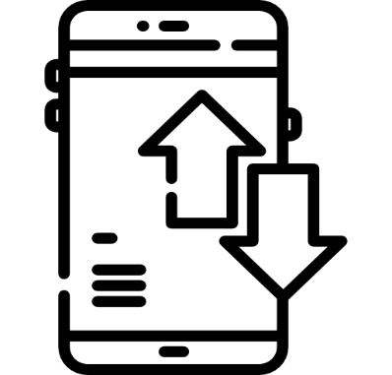
Android 4.4 – KitKat or above
Mobile Data or WIFI

Slide 29
Brand Strategies

Slide 30
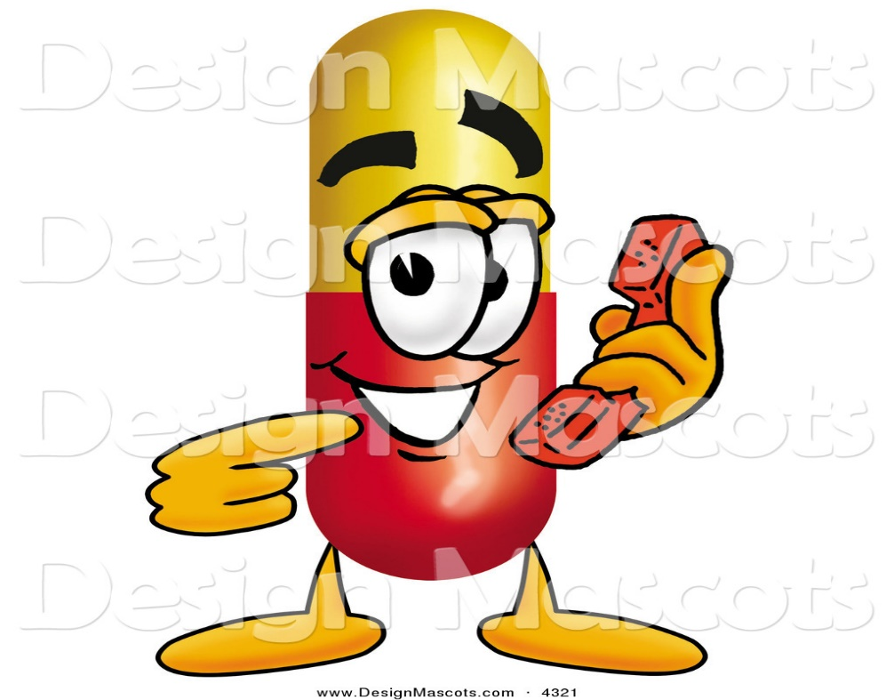
Mascot

Slide 31
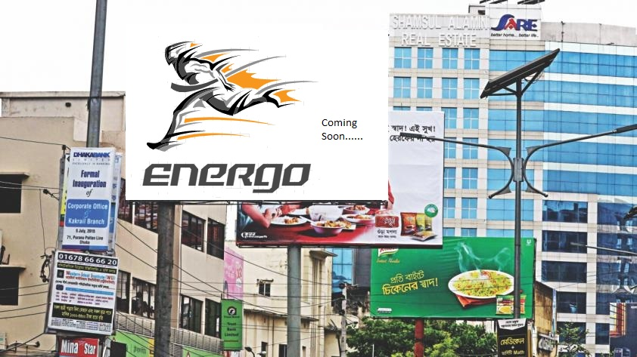
Bill Boards

Slide 32
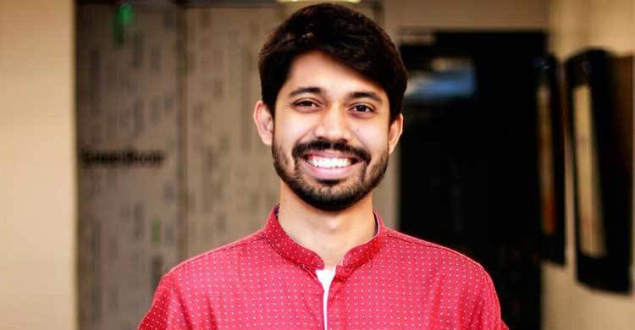
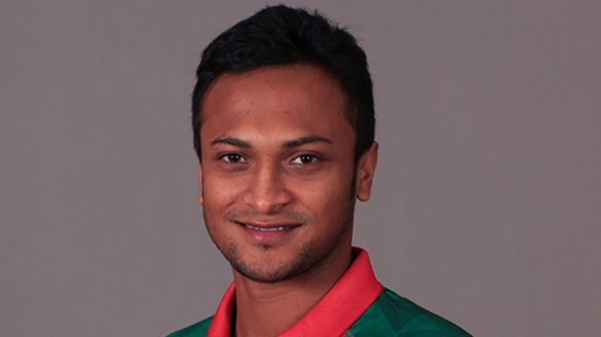
Brand Ambassadors

Slide 33
AIDA
Attention
1.Coming soon advertisement on billboard and print media
2.Campus Ambassadors
3.Social media campaign
Interest
1.TVC,print media
2.Campaigns at different Universities
3.Hosting Competitions.
Desire
1.Event Sponsorship
2.Brand Ambassador
Action
1.Regular updates
2.Opening different outlets across the city
3.Free delivery offers

Slide 34
Campaign timeline
Brand Ambassadors
7-12 months
Billboards
1-3 months
TVC
3-8 months
Campus Ambassadors
1-12 months
Sponsorships
4-8 months
Print media
1-12 months

Slide 35
Feasibility analysis

Slide 36
SWOT Analysis

Slide 37
Strength
S
Purchase Medicine
Nutrition Plan
Food Exchange
Food and Medicine Reminder
W
Weakness
Manual Price Calculation
Needs internet connectivity to operate.
Opportunity
No similar apps
Unique features.
O
T
Threat
Established pharmaceutical companies/drug stores might create similar app.

Slide 38
Future Vision

Slide 39
Include map that shows nearest hospitals and drug stores.
Include image processing to validate prescription authenticity.
Create database with medicine names and prices.

Slide 40
Thank you
We would love to answer your queries !

