Slide 1
Bayesian
Optimisation
Surrogate Models, Acquisition Functions & Sample-Efficient Search
Bayesian Optimization II — Building on the GP foundations from Lecture I

Slide 2
What We Know So Far
RECAP FROM LECTURE I
In the previous lecture we established that a Gaussian Process (GP) is a distribution over functions, fully specified by a mean function μ(x) and a kernel function k(x, x').
f(x) ~ GP(μ(x), k(x, x'))
Given observed data, the GP posterior gives us at every point:
• Mean prediction μ(x) — our best estimate of f(x)
• Predictive variance σ²(x) — our calibrated uncertainty
Today’s lecture takes these GP capabilities as given and asks: how do we use them to optimise an expensive function?

Slide 3
01
What is Bayesian Optimisation and why do we need it?

Slide 4
The Optimisation Problem
We seek the global optimum of an objective function:
x* = argmax f(x), x ∈ 𝒳
where f has properties that make classical methods impractical:
• Expensive to evaluate — each call may be a CFD simulation (hours), a physical experiment (days), or a neural-network training run
• Black-box — no closed-form expression is available; we only observe input-output pairs (xᵢ, yᵢ)
• No gradient information — derivatives of f are unavailable, so gradient-based optimisers cannot be used
• Possibly noisy — observations may be corrupted: y = f(x) + ε, where ε ~ N(0, σ²ₙ)

Slide 5
Why Not Brute Force?
When evaluations are cheap, we can afford exhaustive strategies. When they are expensive, we cannot:
Method | Strategy | Evaluations needed | Uses past data?
Grid search | Evaluate on a fixed grid | O(k^d) — exponential in d | No
Random search | Sample uniformly at random | Many, high variance | No
Gradient descent | Follow ∇f | Moderate | Requires gradients
Bayesian Optimisation | Model f, then decide | Very few (10–100) | Yes

Slide 6
The Two Ingredients of BO
Bayesian Optimisation combines two components in a sequential loop:
1. Surrogate Model — A cheap probabilistic approximation of f(x) that provides predictions with uncertainty.
Answers: "What do we think f looks like?"
2. Acquisition Function — A utility function α(x) that quantifies the value of evaluating f at a candidate point x.
Answers: "Where should we sample next?"
Together they form a sequential decision process: model → decide → evaluate → update → repeat.

Slide 7
02
The Surrogate Model

Slide 8
What is a Surrogate Model?
DEFINITION: A surrogate model (also: metamodel, emulator, response surface) is a statistical model that approximates an expensive function f(x) from a small set of observations Dₙ = {(xᵢ, yᵢ)}.
For BO, the surrogate must provide two outputs at every query point x:
• Predictive mean μ(x) = E[f(x) | Dₙ] — the best estimate
• Predictive uncertainty σ(x) = √Var[f(x) | Dₙ] — how confident the estimate is
The uncertainty is critical: it is what allows BO to distinguish "explored" regions from "unexplored" ones and to make principled decisions about where to sample next.

Slide 9
Why GPs Are the Default Surrogate
Many models can predict μ(x), but few give well-calibrated σ(x). GPs are the standard choice because:
• Closed-form posterior — predictions are exact, computed via the conditioning formulae from Lecture I
• Calibrated uncertainty — σ(x) is analytically derived, not heuristic; it shrinks at observed points and grows in unobserved regions
• Non-parametric — the model complexity grows with the data, not fixed in advance
• Data-efficient — perform well with very few observations (n < 50), exactly the BO regime
Other surrogates (Random Forests, Bayesian Neural Networks, etc.) can be used, but GPs remain the most common choice for low-dimensional BO.

Slide 10
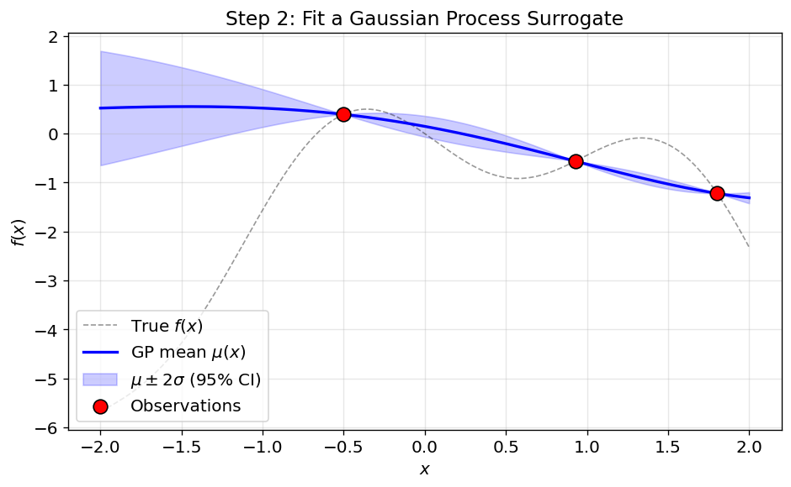
Surrogate Fitted to 3 Initial Samples
A GP surrogate trained on just 3 observations. Blue line: posterior mean μ(x). Shaded band: μ ± 2σ (95% CI). Dashed black: the true function (unseen by the model).
• Near observations (red dots): the confidence band is narrow — the model is certain
• Far from observations: the band is wide — the model honestly reports its ignorance

Slide 11
03
Acquisition Functions

Slide 12
What is an Acquisition Function?
DEFINITION: An acquisition function α(x) is a cheap-to-evaluate utility that scores every candidate point x based on how valuable it would be to evaluate f(x) there.
The next sample is chosen as: xₙ₊₁ = argmax α(x)
It uses the GP posterior (μ and σ) as input — it never calls the expensive f itself. Different acquisition functions encode different strategies:
In this lecture we cover three widely used acquisition functions:
• Expected Improvement (EI) — How much improvement can we expect?
• Probability of Improvement (PI) — How likely is any improvement?
• Upper Confidence Bound (UCB) — What is the optimistic upper bound on f?

Slide 13
The Exploration–Exploitation Trade-off
Before diving into the formulae, let us build intuition for the central tension:
EXPLOITATION: Sample where the predicted mean μ(x) is high — regions we already believe are good.
Risk: converging to a local optimum and missing the global one.
EXPLORATION: Sample where the uncertainty σ(x) is large — regions we haven’t explored.
Risk: wasting expensive evaluations in regions that turn out to be uninteresting.
A good acquisition function balances both signals. The three functions we cover next differ mainly in how they strike this balance.

Slide 14
Shared Notation
Before we define each function, let us establish the shared notation. All three build on the same GP posterior quantities:
Symbol | Meaning
μ(x) | GP posterior mean at x
σ(x) | GP posterior standard deviation at x
f* = max yᵢ | Best observed value so far (the "incumbent")
Φ(·) | Standard normal CDF — Φ(z) = P(Z ≤ z)
φ(·) | Standard normal PDF — φ(z) = (1/√2π) e^(-z²/2)
Z | Standardised improvement: Z = (μ(x) - f*) / σ(x)

Slide 15
Expected Improvement (EI)
DEFINITION: EI measures the expected amount by which a new evaluation will improve over the current best f*.
EI(x) = (μ(x) - f*) · Φ(Z) + σ(x) · φ(Z) if σ(x) > 0, 0 otherwise
where Z = (μ(x) - f*) / σ(x)
Interpreting the two terms:
• (μ(x) - f*)·Φ(Z) — EXPLOITATION: large when the mean is well above f* and improvement is likely
• σ(x)·φ(Z) — EXPLORATION: large when uncertainty is high, even if the mean is not promising

Slide 16
Where Does the EI Formula Come From?
Define the improvement random variable at point x as:
I(x) = max(f(x) - f*, 0)
EI is the expectation of I(x) under the GP posterior, where f(x) ~ N(μ(x), σ²(x)):
EI(x) = E[I(x)] = ∫ from f* to ∞ (f - f*) · N(f | μ(x), σ²(x)) df
Evaluating this integral analytically (by substituting z = (f - μ)/σ and integrating by parts) yields the closed-form expression on the previous slide.

Slide 17
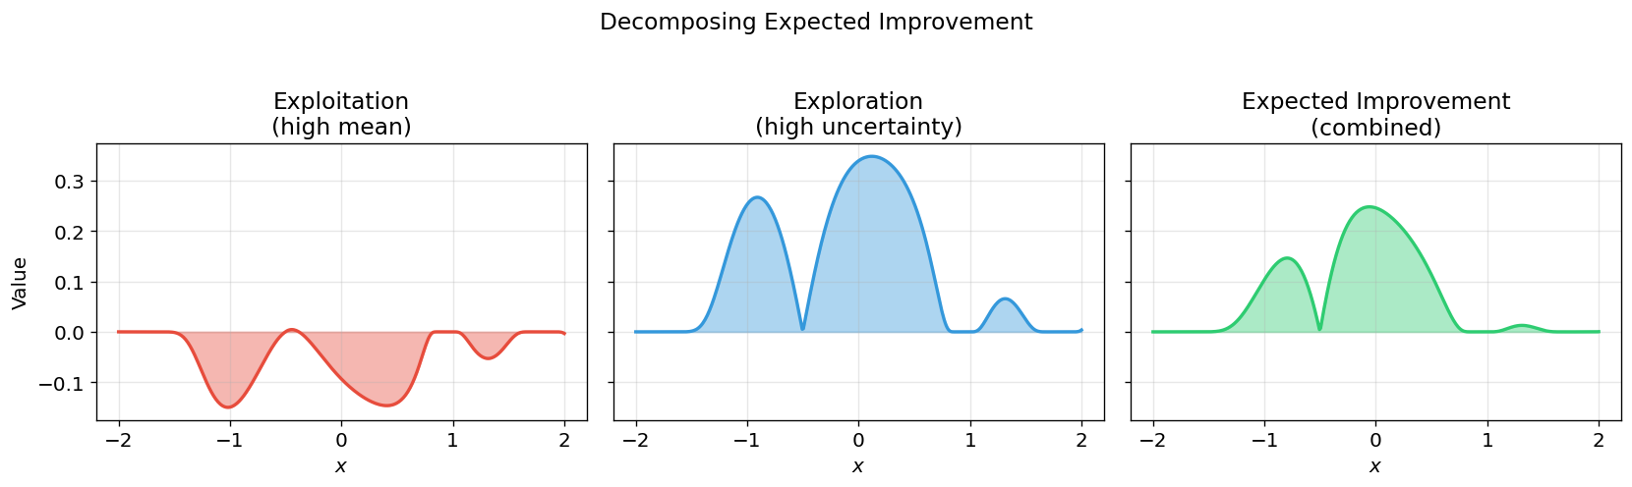
Visualising the Two Terms of EI
The figure decomposes EI into its constituent parts on a GP fitted to the initial observations:
• Left (red): exploitation term (μ - f*)Φ(Z) — peaks where the mean already exceeds f*
• Middle (blue): exploration term σ·φ(Z) — peaks in high-uncertainty regions
• Right (green): the full EI — the sum of both, selecting a point that balances the two signals

Slide 18
Probability of Improvement (PI)
Having seen how EI balances explore and exploit, let us now look at a simpler alternative:
DEFINITION: PI measures the probability that a new evaluation will exceed the current best by at least a margin ξ ≥ 0.
PI(x) = P(f(x) > f* + ξ) = Φ((μ(x) - f* - ξ) / σ(x))
• PI asks only whether improvement occurs, not how much — it ignores the magnitude
• With ξ = 0: very greedy — samples cluster near the current best, risking premature convergence
• Increasing ξ adds a margin that encourages more exploration, but the right value is problem-dependent
• PI was one of the earliest acquisition functions proposed (Kushner, 1964)

Slide 19
Upper Confidence Bound (UCB)
UCB takes an entirely different approach from EI and PI:
DEFINITION: UCB scores each point by its mean plus an exploration bonus proportional to the uncertainty.
UCB(x) = μ(x) + κ · σ(x)
• κ > 0 directly controls the balance: κ = 0 is pure exploitation; κ → ∞ is pure exploration
• Also called GP-UCB; has theoretical regret bounds: O(√(T·γ_T)) (Srinivas et al., 2010)
• Common practical choice: κ = 2 (roughly a 95% upper confidence bound)

Slide 20
Summary: Three Acquisition Functions at a Glance
Now that we have seen each function individually, the table below collects the key differences:
Property | EI | PI | UCB
Formula | (μ-f*)Φ(Z) + σφ(Z) | Φ((μ-f*-ξ)/σ) | μ + κσ
Measures | Expected magnitude | Probability of improvement | Optimistic upper bound
Free parameter | None | ξ (margin) | κ (exploration weight)
Character | Balanced (default) | Greedy / exploitative | Tuneable, principled
Regret bound | Empirically strong | No formal bound | O(√(Tγ_T))

Slide 21
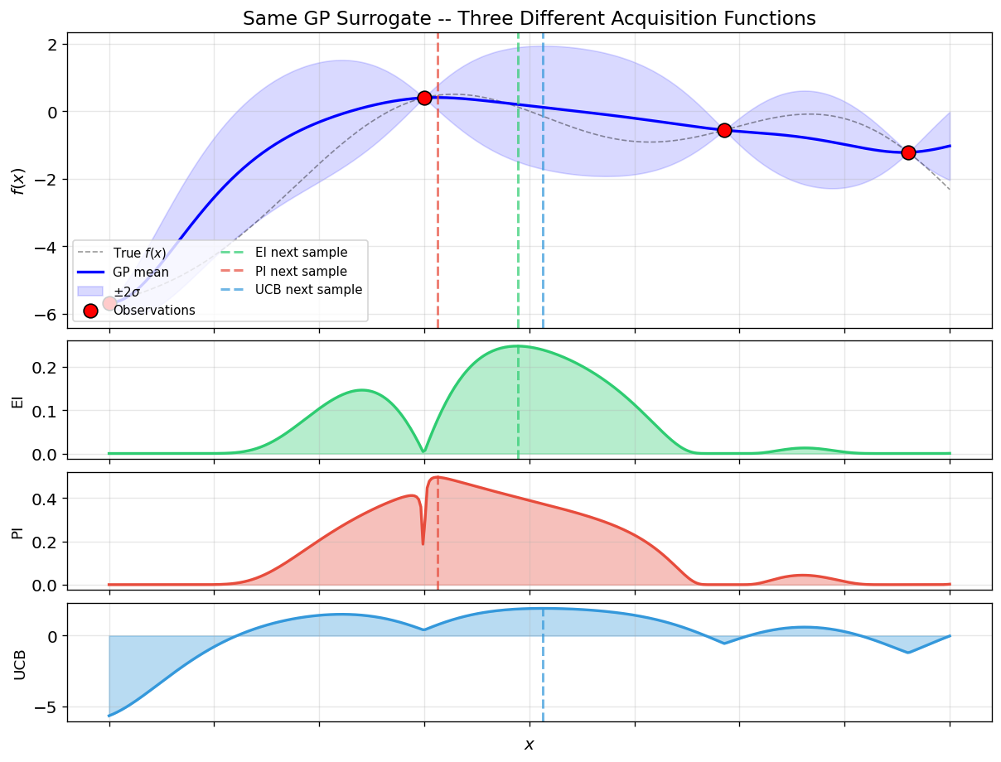
EI, PI, and UCB on the Same Surrogate
All three acquisition functions evaluated on the same GP posterior fitted to 4 observations. Dashed lines mark each function’s recommended next sample:
• PI (red) peaks closest to the current best observation — it is the most exploitative
• UCB (blue) peaks furthest into the uncertain region to the right — the most explorative
• EI (green) sits between the two, balancing mean and uncertainty

Slide 22
Practical Guidance: Choosing an Acquisition Function
There is no universally best acquisition function — the right choice depends on problem characteristics:
If you need… | Use | Why
A safe, general-purpose default | EI | Parameter-free, balances both signals
Fast convergence on simple landscape | PI (small ξ) | Aggressively exploits
Robustness to local optima | UCB (high κ) | Strong exploration prevents premature convergence
Theoretical guarantees | UCB | Formal regret bounds under mild assumptions

Slide 23
04
How It All Comes Together

Slide 24
From Components to Algorithm
We have now covered the two building blocks — the surrogate model and the acquisition function. Bayesian Optimization puts them together in a simple iterative loop:
• Step 1. Start with a small initial dataset (e.g. 3–5 random evaluations)
• Step 2. Fit the surrogate to all data collected so far → obtain $μ(x)$ and $σ(x)$
• Step 3. Maximize the acquisition function to choose the next evaluation point
• Step 4. Evaluate the expensive function at $xₙ₊₁$and add the result to the dataset
• Step 5. Go back to Step 2 until the evaluation budget is exhausted
Each iteration, the surrogate becomes more accurate and the acquisition function makes better-informed decisions.

Slide 25
The Bayesian Optimisation Algorithm
Input: search space $χ$, budget $T$, acquisition function $α$
1. Choose initial design $\{x_{1}, …, x_{ₙ₀}\}$ and evaluate $yᵢ = f(xᵢ)$
2. for $t = n₀ + 1$to $T$ do
a. Fit GP to data $𝒟_{t−1} = {\{(xᵢ, yᵢ)\}}_{i=1}^{t−1}$
b. Compute $α(x)$ using GP posterior $μ(x), σ(x)$
c. $xₜ = {\text{arg} \text{max}}_{x∈χ} α(x)$
d. $yₜ = f(xₜ) + ε$← the expensive evaluation
e. $Dₜ = Dₜ₋₁ ∪ \{(xₜ, yₜ)\}$
3. Return $x^{∗}={\text{arg} \text{max}}_{x_{i}x∈𝒟_{T}} y_{i}$

Slide 26
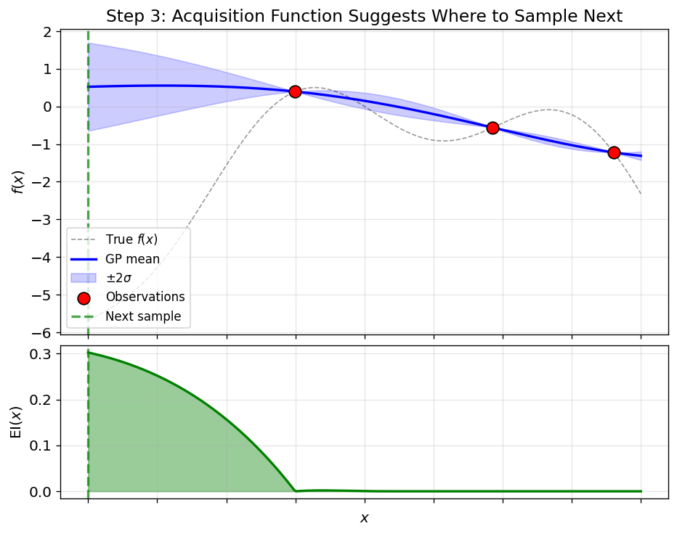
One BO Iteration Visualised
Top panel: GP surrogate (step 2a). Bottom panel: EI acquisition function (step 2b). Green dashed line:
$xₙ₊₁=\text{arg} \text{max} EI(x)$ (step 2c).
• EI is high where the mean is promising AND uncertainty remains moderate
• EI is near zero at observed points (no uncertainty = no expected improvement)

Slide 27
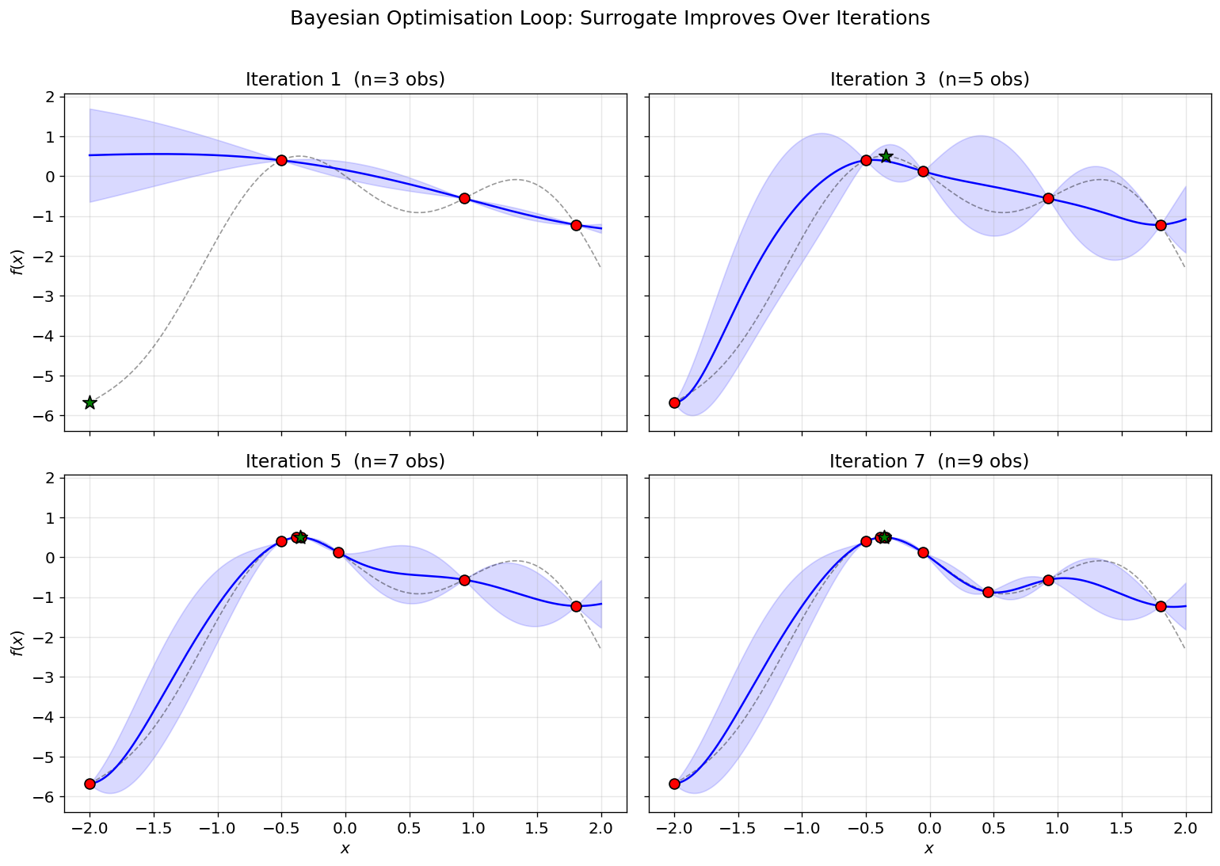
How the Surrogate Evolves Over Iterations
The grid below shows the GP surrogate at iterations 1, 3, 5, and 7. At each step a new observation is added and the surrogate is re-fitted:
• The uncertainty band shrinks progressively as data accumulates
• The GP mean converges toward the true function (dashed black line)
• New samples (green stars) migrate toward the optimum — the algorithm self-focuses

Slide 28
05
Code Example: BO on a 1-D Test Function

Slide 29
A Coded Example Case
The accompanying Jupyter notebook implements a full BO pipeline from scratch using numpy, scikit-learn, and scipy:
• Step 0: Define a 1-D test function as a stand-in for an expensive black-box
• Step 1: Draw 3 random initial samples
• Step 2: Fit a GP surrogate
• Step 3: Implement the EI acquisition function as a Python function
• Step 4: Run the BO loop for 7 iterations, plotting the surrogate at each step
• Step 5: Compare BO against random search, and compare EI vs. PI vs. UCB
The following slides show key code snippets alongside their output graphs.

Slide 30
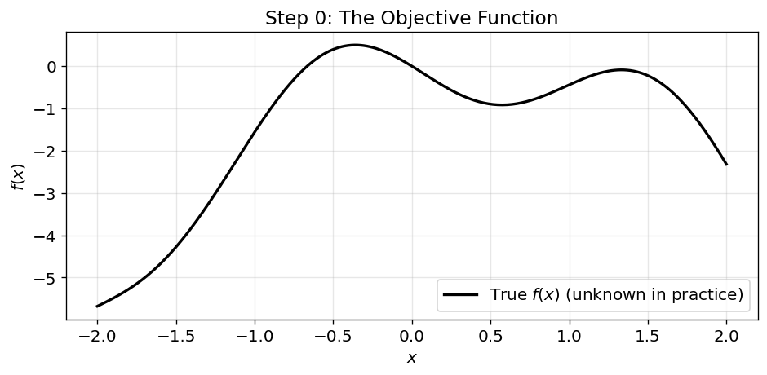
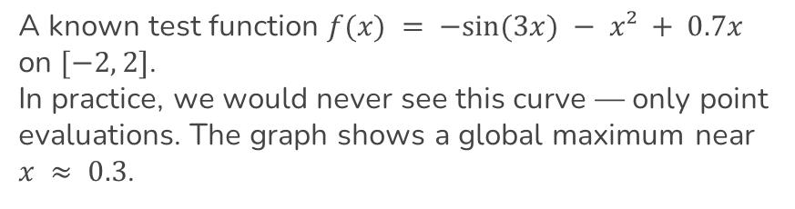
Step 0: The Objective Function
def objective(x): """Expensive in real life.""" return -np.sin(3*x) - x**2 + 0.7*x
A known test function $f(x) = −sin⁡(3x) − x² + 0.7x$ on $[−2, 2]$.
In practice, we would never see this curve — only point evaluations. The graph shows a global maximum near $x ≈ 0.3$.

Slide 31
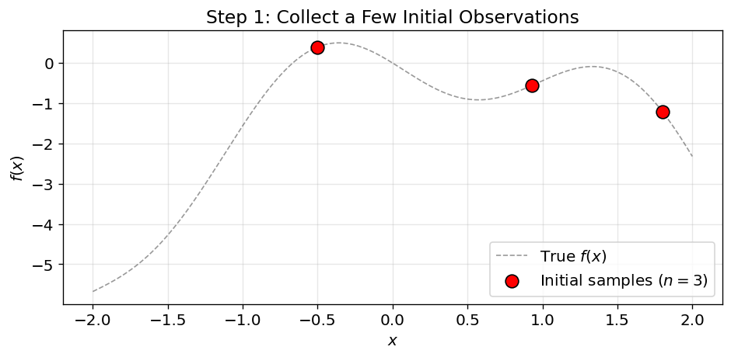
Step 1–2: Initial Samples & Surrogate Fit
# 3 random initial points X_init = rng.uniform(-2, 2, size=3) y_init = objective(X_init) # Fit GP surrogate gp = GaussianProcessRegressor( kernel=Matern(nu=2.5), alpha=1e-6) gp.fit(X_init, y_init)
Step 1: 3 random samples (red dots).
Step 2: GP surrogate fitted to those points. With so little data, the surrogate is highly uncertain.

Slide 32
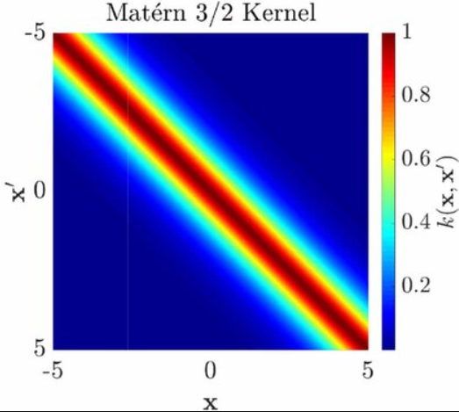
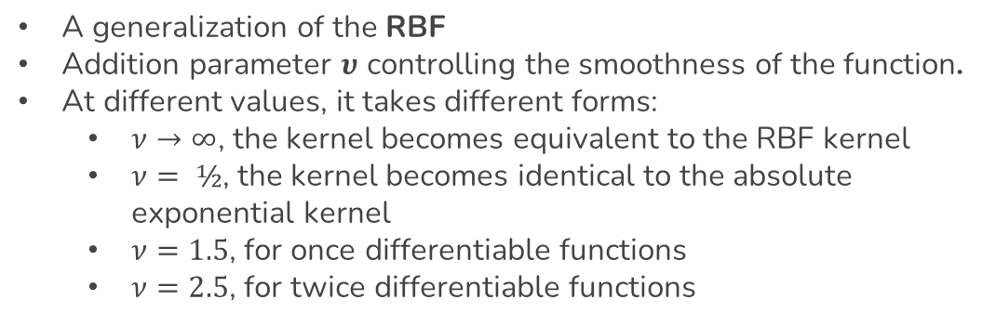
The Matern Kernel
$$k\left(x_{i},x_{j}\right)=\frac{1}{Γ\left(ν\right)2^{ν−1}}{\left(\frac{\sqrt{2ν}}{l}d\left(x_{i},x_{j}\right)\right)}^{ν}K_{ν}\left(\frac{\sqrt{2ν}}{l}d\left(x_{i},x_{j}\right)\right)$$
A generalization of the RBF
Addition parameter $υ$ controlling the smoothness of the function.
At different values, it takes different forms:
$ν→∞$, the kernel becomes equivalent to the RBF kernel
$ν= ½$, the kernel becomes identical to the absolute exponential kernel
$ν=1.5$, for once differentiable functions
$ν=2.5$, for twice differentiable functions

Slide 33
Step 3: Computing Expected Improvement
def expected_improvement(X, gp, f_best): mu, sigma = gp.predict(X, return_std=True) sigma = np.maximum(sigma, 1e-9) # avoid division by zero Z = (mu - f_best) / sigma ei = (mu - f_best) * norm.cdf(Z) + sigma * norm.pdf(Z) return ei
This is a direct translation of the closed-form EI formula into code:
• mu - f_best computes $μ(x) − f^{∗}$ — the predicted improvement in the mean
• Z = (mu - f_best) / sigma computes the standardized score $Z$ - the key to balancing explore and exploit
• norm.cdf(Z) and norm.pdf(Z) are Φ(Z) and φ(Z) from scipy.stats

Slide 34
Step 4: The Complete BO Loop
for i in range(n_iterations): gp = fit_gp(X_obs, y_obs) # step 2a: fit surrogate f_best = np.max(y_obs) # current incumbent ei = expected_improvement(X, gp, f_best) # step 2b: compute alpha x_new = X[np.argmax(ei)] # step 2c: argmax alpha y_new = objective(x_new) # step 2d: EXPENSIVE call X_obs = np.vstack([X_obs, x_new]) # step 2e: update data y_obs = np.vstack([y_obs, y_new])
Each iteration maps directly to steps 2a–2e of the pseudocode. The entire BO engine is under 10 lines of Python.
Result after 7 iterations (10 total evaluations): f(x*) = 0.5003 — matching the true optimum to 4 decimal places.

Slide 35
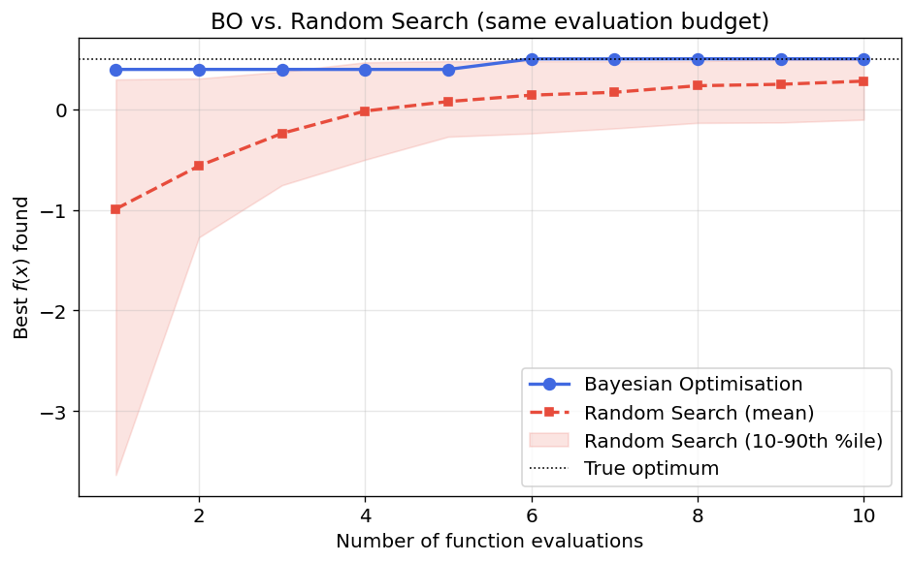
BO vs. Random Search
50 independent random-search trials with the same evaluation budget (10 calls) compared against BO:
• BO (blue) reaches the optimum in ~6 evaluations — deterministic given initial samples
• Random search (red band = 10th–90th percentile) has high variance and often fails within budget
• The gap widens dramatically on more expensive or higher-dimensional problems

Slide 36
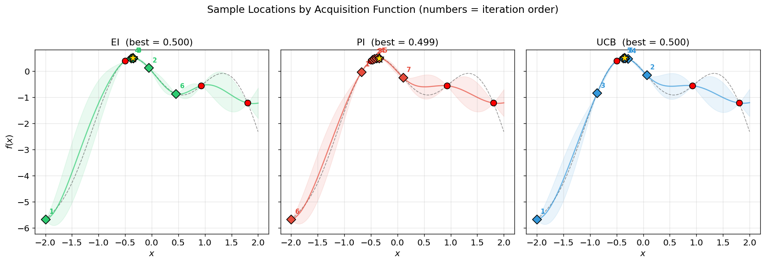
Where Did Each Acquisition Function Sample?
Full BO loop run independently with EI, PI, and UCB (same 3 initial points). Numbered diamonds show evaluation order:
• PI clusters tightly near the first promising region — pure exploitation, as predicted by theory
• UCB ($κ=2$) spreads broadly, probing uncertain regions even when the mean is low
• EI strikes a middle ground: it explores somewhat but converges toward the optimum

Slide 37
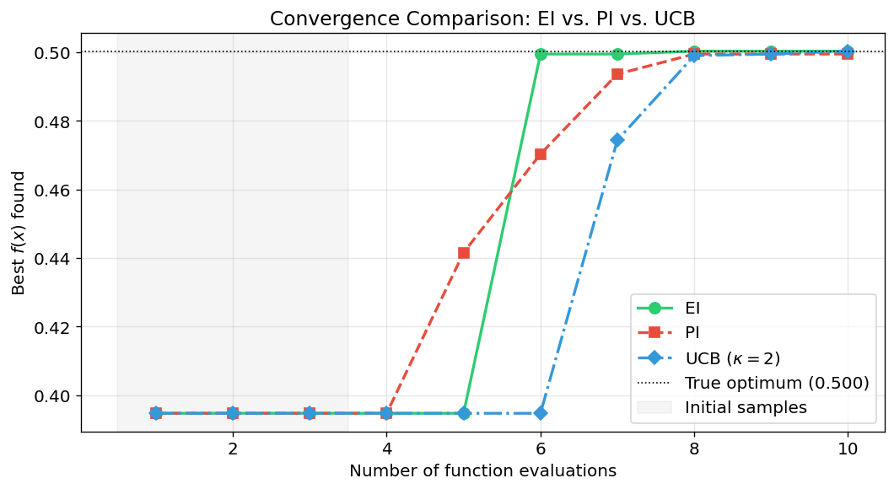
Convergence: EI vs. PI vs. UCB
• All three reach the optimum within budget on this simple 1-D problem
• EI and UCB converge smoothly; PI can plateau before catching up (stall around evaluation 5–6)
• The grey band marks the 3 initial samples — all methods start from the same baseline

Slide 38
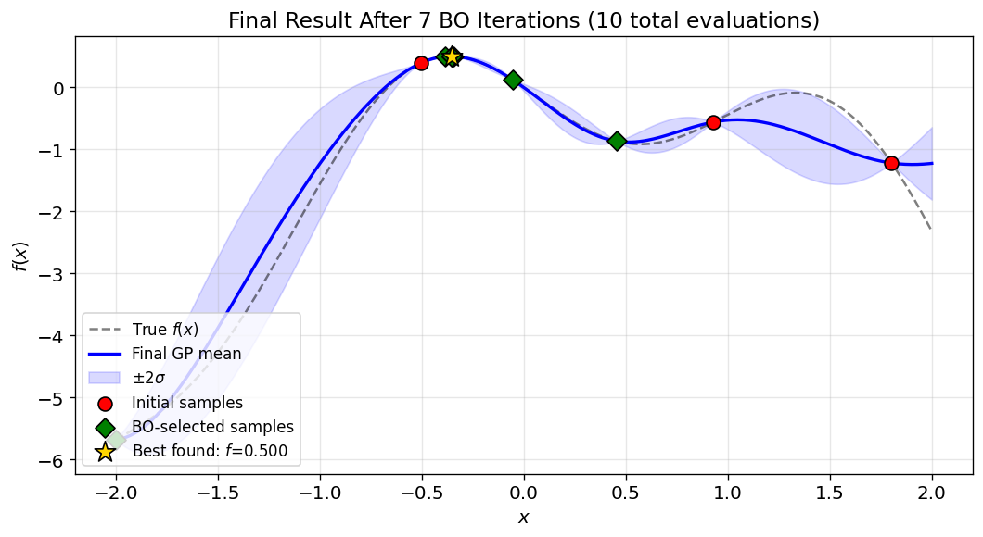
Final Result
The figure below shows the GP surrogate after all 7 BO iterations (10 total evaluations), using EI as the acquisition function. Red circles are the initial samples; green diamonds are the points selected by BO; the gold star is the best observation:
• The surrogate now closely tracks the true function across the entire domain
• The confidence band has collapsed nearly everywhere — very little uncertainty remains
• Best found value f(x*) = 0.5003 matches the true optimum to 4 decimal places

Slide 39
When to Use Bayesian Optimisation
Good fit
• Expensive evaluations (simulations, physical experiments)
• Low-dimensional input space (typically $d < 20$)
• Smooth, continuous objective
• Black-box: no gradients available
• Budget of 10–100 evaluations
Poor fit
• Cheap evaluations (can afford 10³+ calls)
• Very high-dimensional ($d>20$): GP cost is $O(n³)$
• Highly discrete or combinatorial problems
• Gradient information available (use gradient descent)
• Extremely noisy with no structure

Slide 40
Key Takeaways
• Bayesian Optimization is a sequential, model-based strategy for optimizing expensive black-box functions using as few evaluations as possible.
• The surrogate model (typically a GP) provides predictions with calibrated uncertainty, enabling intelligent sampling.
• Acquisition functions formalize the exploration–exploitation trade-off:
• EI: expected magnitude of improvement (balanced, parameter-free)
• PI: probability of improvement (greedy, tunable via $ξ$)
• UCB: optimistic bound on $f$ (principled, tunable via $κ$)
• The BO loop - fit, decide, evaluate, update - converges to the optimum in very few evaluations compared to uninformed methods.

Slide 41
References & Further Reading
• Kushner, H.J. (1964). A New Method of Locating the Maximum Point of an Arbitrary Multipeak Curve in the Presence of Noise. — introduced PI
• Mockus, J. (1975). On Bayesian Methods for Seeking the Extremum. — introduced EI
• Srinivas, N. et al. (2010). Gaussian Process Optimization in the Bandit Setting: No Regret and Experimental Design. ICML. — GP-UCB regret bounds
• Brochu, E., Cora, V.M. & de Freitas, N. (2010). A Tutorial on Bayesian Optimization.
• Shahriari, B. et al. (2016). Taking the Human Out of the Loop: A Review of Bayesian Optimization. Proc. IEEE.
• Frazier, P.I. (2018). A Tutorial on Bayesian Optimization. arXiv:1807.02811.

Slide 42
Thank You
Questions?

